Slide 1
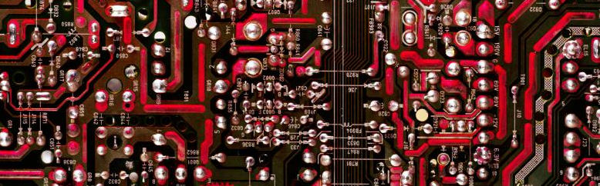
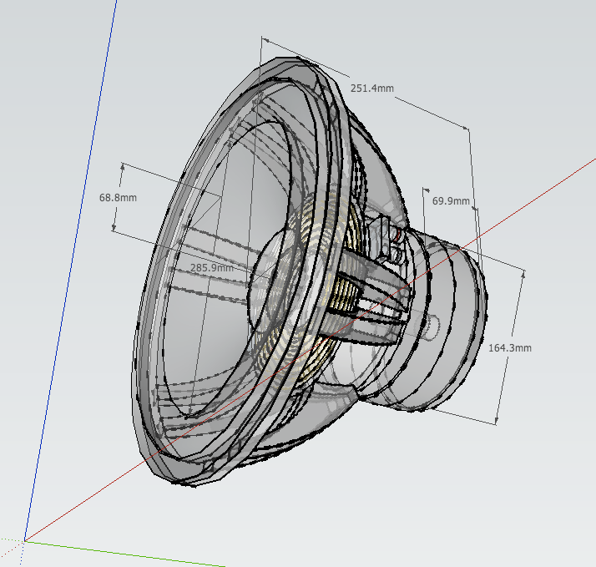
QJackCtl
Y. Collette (ycollette.nospam@free.fr)
https://audinux.github.io

Slide 2
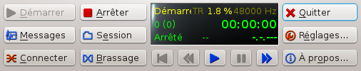
Main interface
Transport area
Software version information
Jack Information
Jack launch configuration
Close QJackCtl
Automatic application connection between them
Launch of an application group
Jack stop
Manual connection of applications between them
Message area concerning Jack
Jack start

Slide 3
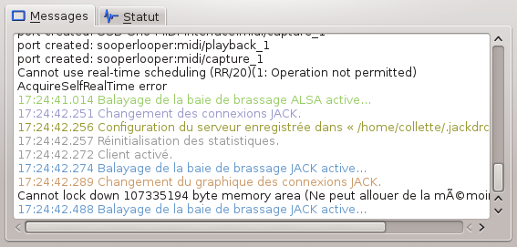
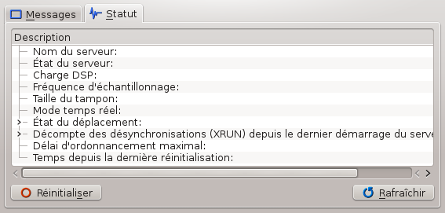
Jack messages area
This first window displays Jack Starting Messages
This second window displays the message relating to Jack's condition

Slide 4
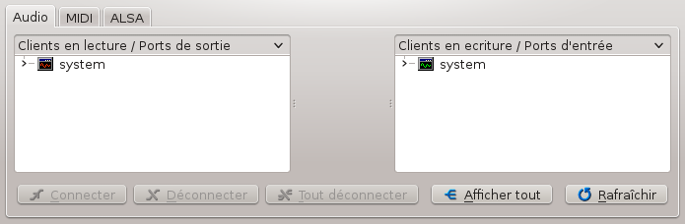
The connection window
1/6
Application input / output connections area.
The 'System' input corresponds to the microphone and / or the input of the sound card.
The 'System' output corresponds to the speaker and / or the line output.
Some sound cards can have several mono / stereo inputs and several mono / stereo outputs

Slide 5
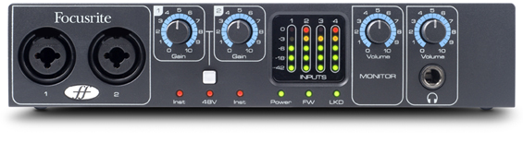
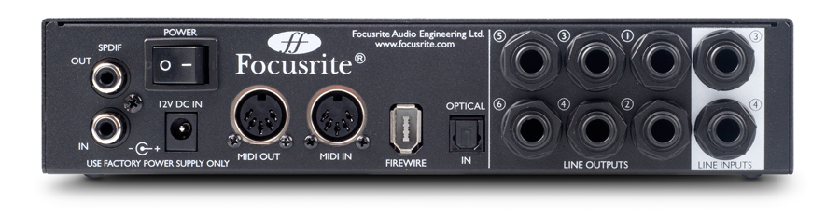
The connection window
2/6
Focusrite Saffire Pro24 (firewire)
Entrances
1/4 ”/XLR
Gain from
preamps
Volume of
exit
MIDI
Other entries
1/4 ”outputs

Slide 6
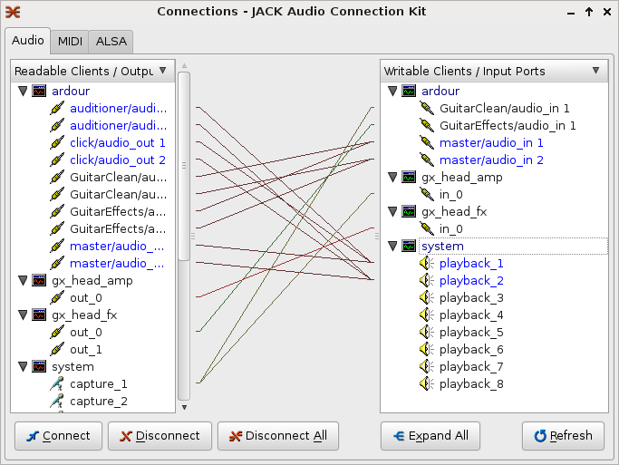
The connection window
3/6
An example of a connections window with several applications including, Guitarix, Ardour

Slide 7
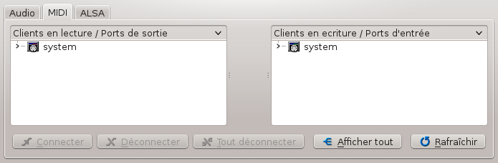
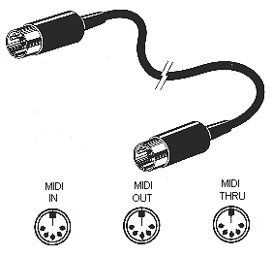
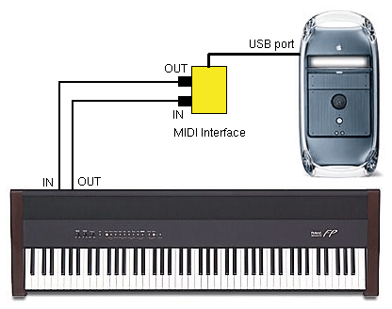
The connection window
4/6
Standard MIDI cable

Slide 8
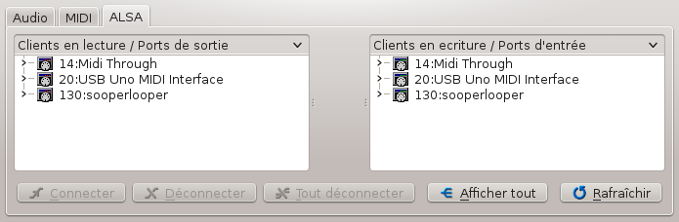
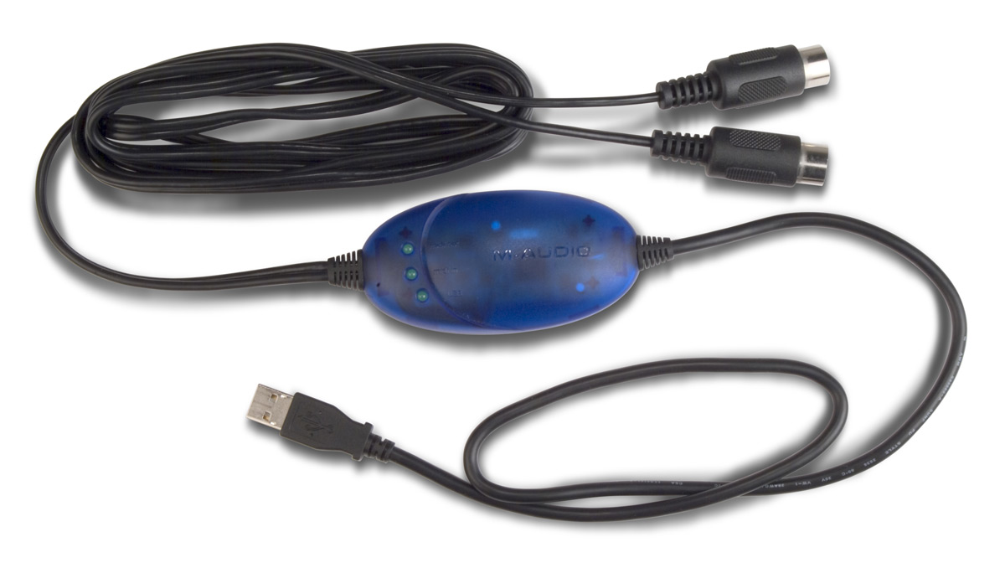
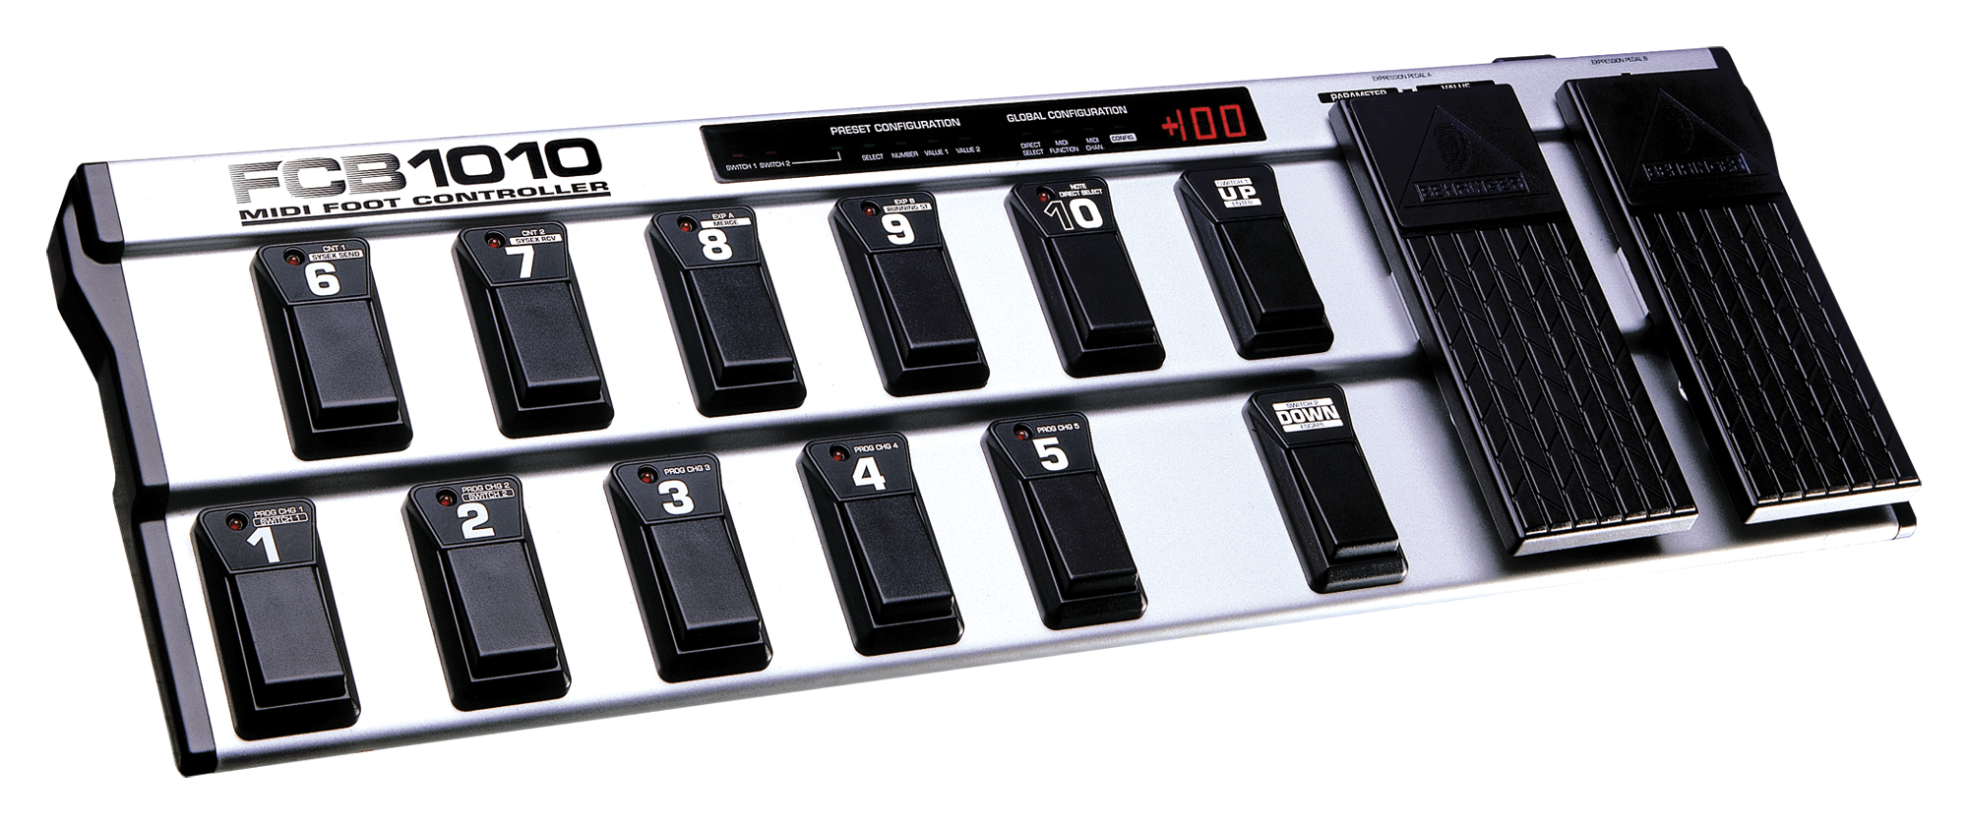
The connection window
5/6
M-AUDIO USB UNO 1X1 MIDI Interface connector
MIDI FCB 1010 crankset

Slide 9
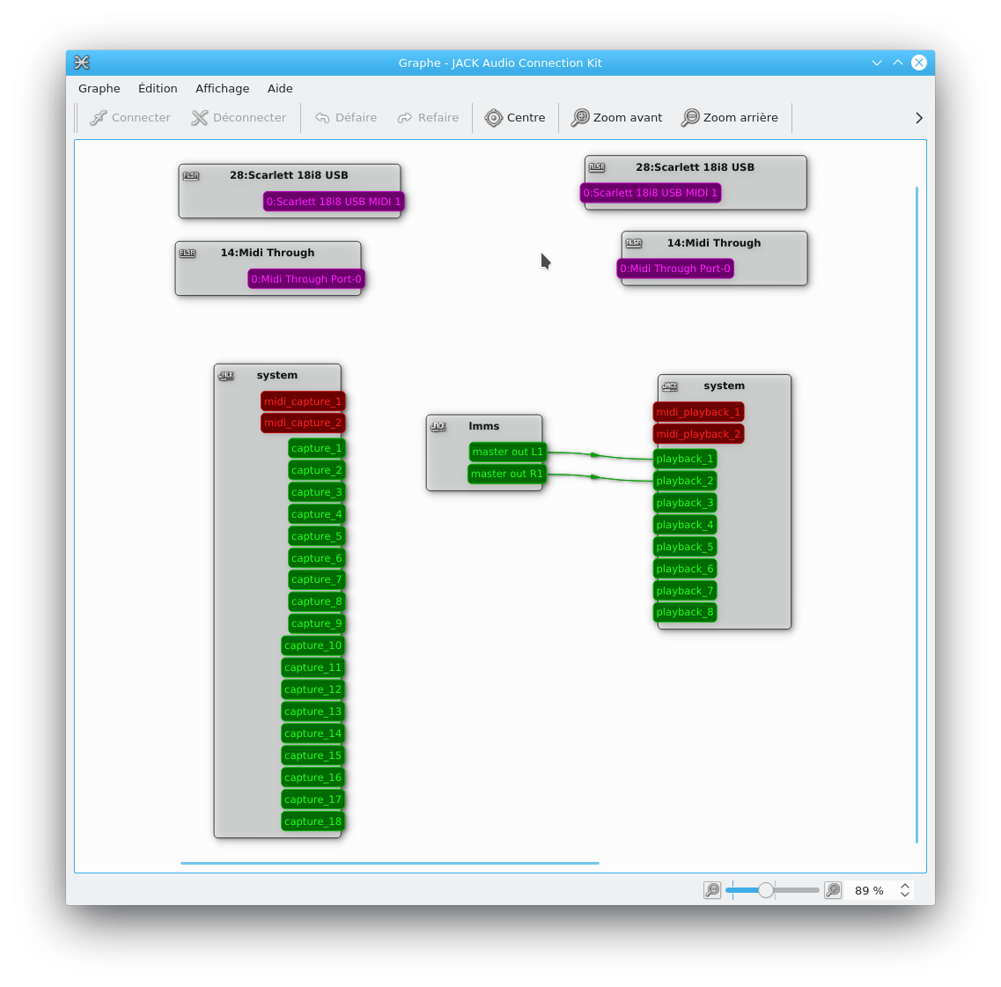
The connection window
6/6

Slide 10
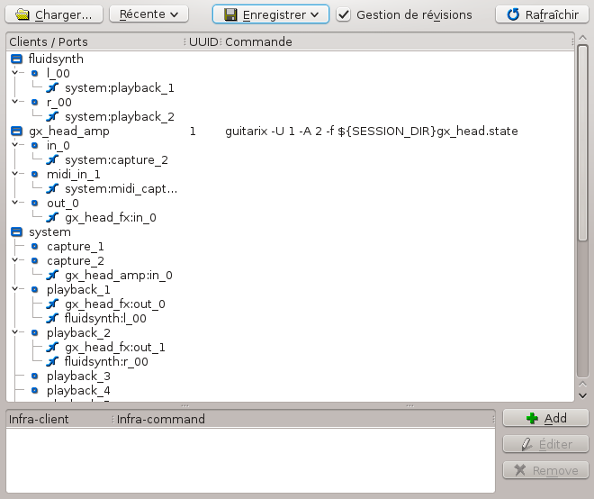
The 1/2 session window
To see this information, you must first select a backup directory via 'save → save'.
Then, we see all the applications which the state will be saved during Qjackctl exit.
During a future start, it will be enough to select the session directory to automatically reload all the applications and find them in the state where they had been left.

Slide 11
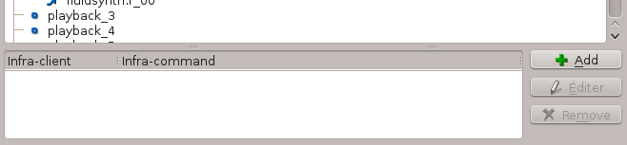
The 2/2 session window
In the bottom area, applications that do not manage session can be recorded.
These applications cannot be detected automatically by Jack.
To add one of these applications, you must identify the name of this application in the session.
For example, TuxGuitar will appear under the name "Fluidsynth":
We click on add;
We give the name that appears in the session in the infra-client column (fluidsynth in the case of TuxGuitar);
We give the access path to the application in the infra-command column (/usr/bin/txguitar in the case of TuxGuitar).

Slide 12
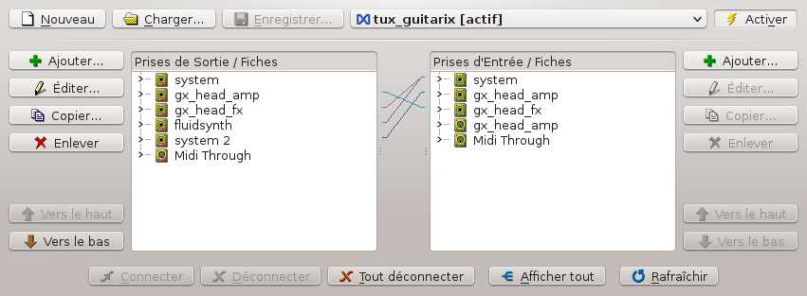
The connection window
The connection window automatically connects applications between them. Unlike the session window, this window does not manage the automatic launch of applications.

Slide 13
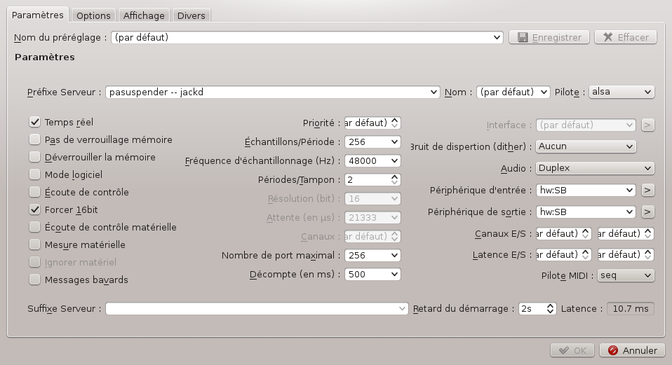
The configuration window
1/4
Under VirtualBox: 1024
Under Linux: 256 or less
Latency = (Frames / period) * (period / buffer) / sample rate

Slide 14
The configuration window
1/4 - Bis
Pasuspender - Jackd
Pulseaudio is not recommended:
- Too large latency
- consumes CPU resources
When you start Jack (Jackd), you stop Pulseaudio.
nouspender allows you to temporarily stop pulseaudio when Jack starts.
Pulseaudio will restart when Jack stop.
Under Fedora, at the outlet of Jackd, the pulse system can block. To remedy this problem, you can reset pulseaudio. It is necessary between the command line:
pulseaudio --kill; pulseaudio --clean
In the 'Options' tab of the adjustment window, in the 'execute a script after extinction':

Slide 15
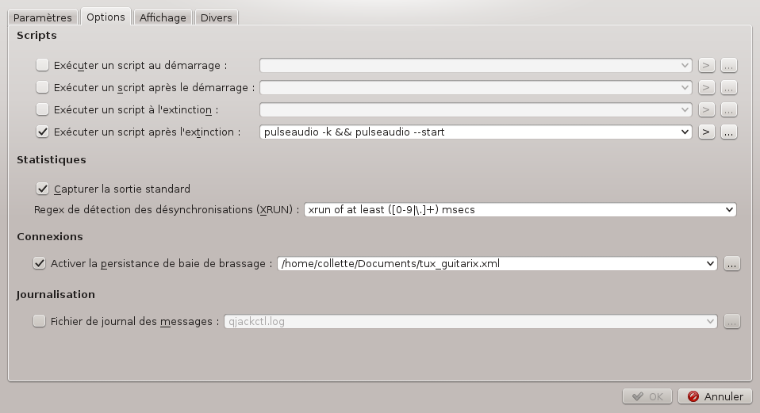
The configuration window
2/4

Slide 16
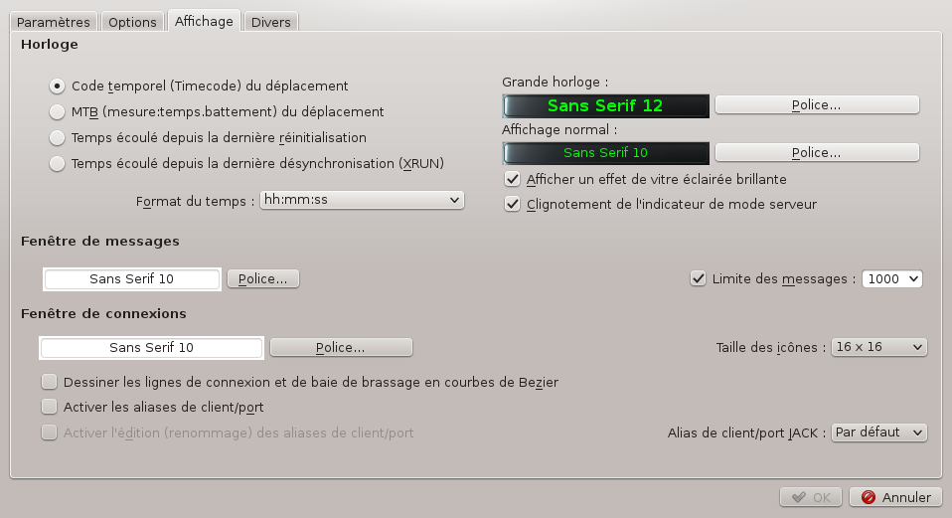
The configuration window
3/4

Slide 17
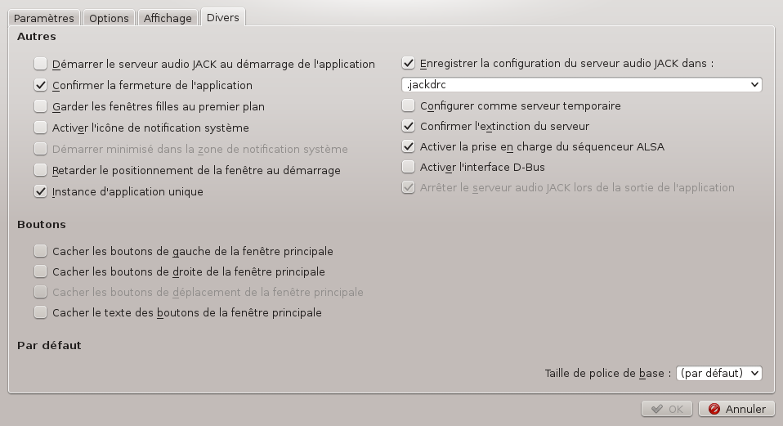
The configuration window
4/4

Slide 18
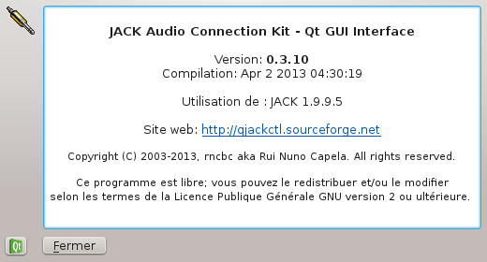
The information window
This window displays the version information of Jack (1.9.9.5) and Qjackctl (here version 0.3.10).
The Qjackctl site: https://qjackctl.sourceforge.io/
The Jack site: https://jackaudio.org/

Slide 19
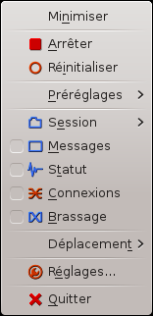

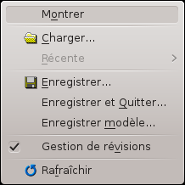

Context menu
This menu is accessible by a right click in any place in the graphical interface.
We find all the functions accessible by the other buttons.

Slide 20
Connect several cards
audio
To connect the output of another sound card:
$ alsa_out -d hw:1
We connect everything while using Qjackctl.
It is likely that we hear the reorganization if we use the default values.
By adjusting the 'Catch_Factor' between 10,000 and 100,000 you can get a better quality sound.
List of options :
-j <jack name> give a name to a connection
-d <alsa_device>
-c <channels>
-p <period_size>
-n <num_period>
-r <sample_rate>
-m <max_diff>
-t <target_delay>
-f <catch_factor>
$ alsa_out -d hw:1 -f 30000
And to connect an input:
$ alsa_in -d hw:1 -f 30000
It is convenient to connect an internal sound card of a PC together with a USB or Firewire sound card.

Slide 21
Alsa MIDI to Jack MIDI
For each Alsa-MIDI port you get the equivalent port in Jack-MIDI, to do this, it could not be simpler, we use the A2J_Control command.
To list all the options:
$ a2j_control
To start and stop:
$ a2j_control start
$ a2j_control ehw
$ a2j_control stop
exit - exit a2j bridge dbus service
start - start bridging
stop - stop brdiging
status - get bridging status
gjcn - get JACK client name
ma2jp <client_id> <port_id> - map ALSA to JACK playback port
ma2jc <client_id> <port_id> - map ALSA to JACK capture port
mj2a <jack_port_name> - map JACK port to ALSA port
ehw - enable export of hardware ports
dhw - disable export of hardware ports

Slide 22
Alsa MIDI to Jack MIDI
You can also use Zita-A2J to do the same thing, but better.
Zita-A2J is not supported by all distributions (no package under Fedora).
http://kokkinizita.linuxaudio.org/linuxaudio/index.html
Another advantage of Zita-A2J: these 2 tools advantageously replace Alsa_in and Alsa_out
$ modprobe snd-aloop # Loading the ALSA Aloop module
# For the creation of an interface
# of a Loopback interface
$ zita -a2j -l -d hw: loopback # in a first terminal
$ zita -j2a -l -d hw: loopback # in a second terminal

Slide 23
Jack Network
First approach
On the Master Machine:
We start Qjackctl normally.
We then start the connection with the slave n ° 1:
$ jack_netsource -h <ip of the slave machine> -p 3000
We check that the UDP 3000 port is open to the firewall
We connect the netjack input to the Jack output via Qjackctl.
On the slave machine:
We start Qjackctl with the Netone driver. That's it.
You just have to check that the UDP 3000 port is also open to the slave machine firewall.

Slide 24
Jack Network
Second approach
On the Master Machine:
We start Qjackctl normally.
We then start the NetManager driver:
$ jack_load netmanager -i '-a <ip du master> -p 3000'
We open the Port 3000 UDP on the Master Firewall.
On the slave machine:
We start Qjackctl with the net driver. That's it.
You can start it on the command line:
$ jackd -d net -a <IP Master> -P 3000 -C 2 -P 2 (with 2 input ports and 2 output ports).
We open the Port 3000 UDP on the slave firewall.
In both approaches, you have to pay attention to the version of Jack which turns on the slave and the master. A version difference can cause difficult to flush out bugs.

Slide 25
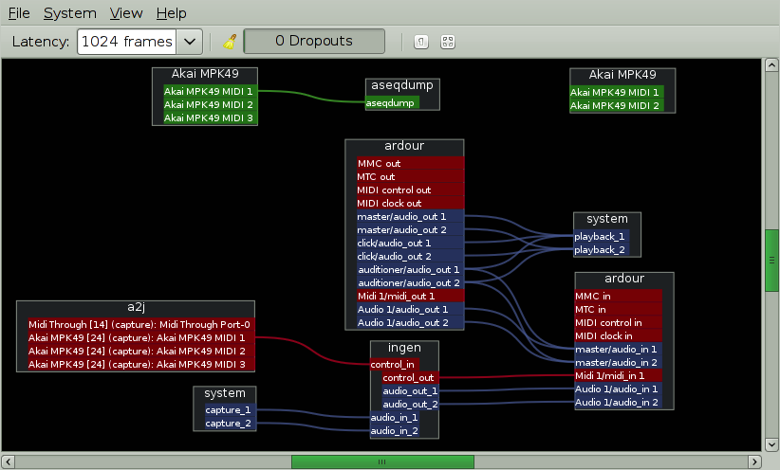
Alternative : Patchage
https://gitlab.com/drobilla/patchage

Slide 26
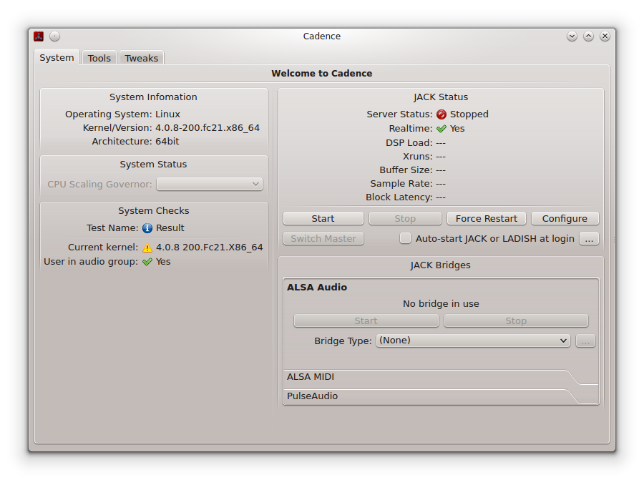
Cadence
'system' folder
OS information
Audio configuration information
Jack start
ALSA / Jack replication management of audio and MIDI connections
Cadence is a tool of the same kind as Qjackctl allowing to launch Jack ...

Slide 27
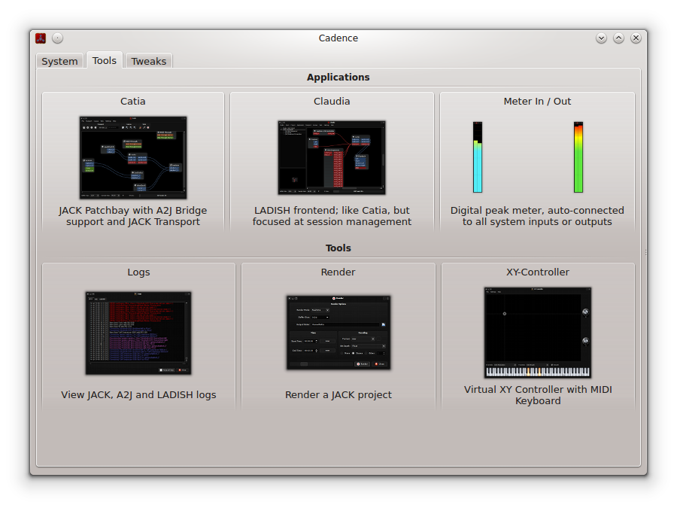
Cadence
'tools' folder
Catia : connexions jack (patchbay)
Claudia : connexions jack (session)
Meters: seen meter
Logs: display of operating information
Render: Audio export of a Jack project
X y controllers: MIDI keyboards + controllers x y

Slide 28
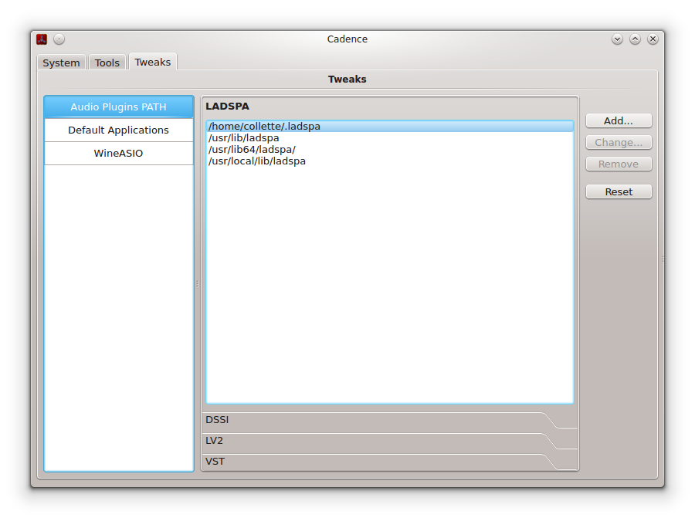
Cadence
'tweaks' folder
Path settings for LADSPA, LV2, DSSI and VST plugins.
Path settings to certain applications.
In some Linux distribution, it will be necessary to adjust the paths to the LV2, LADSPA, VST plugins.

Slide 29
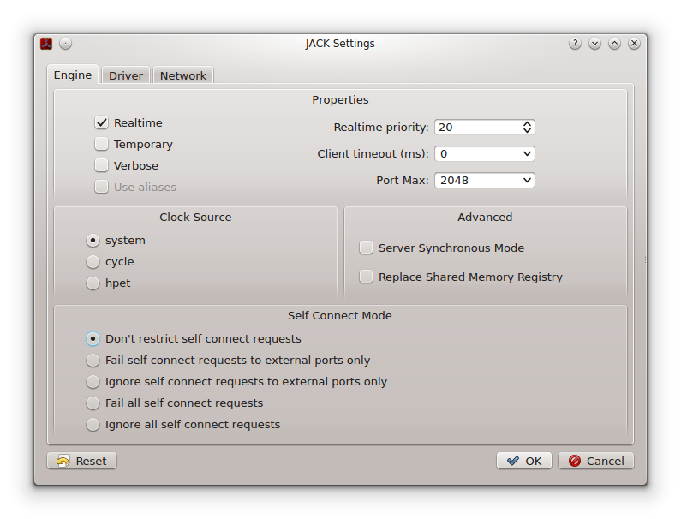
Cadence
Configuration

Slide 30
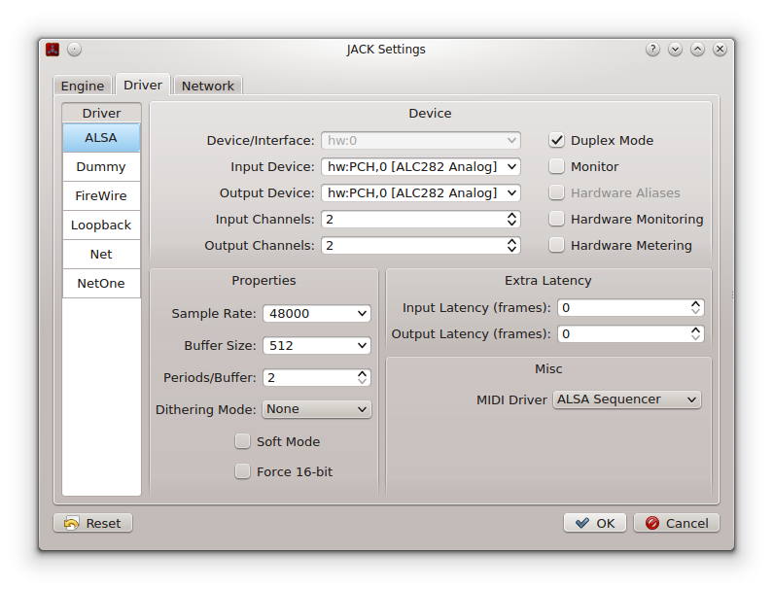
Cadence
Configuration
Audio driver selection
Audio driver settings
Jack settings
MIDI Driver selection

Slide 31
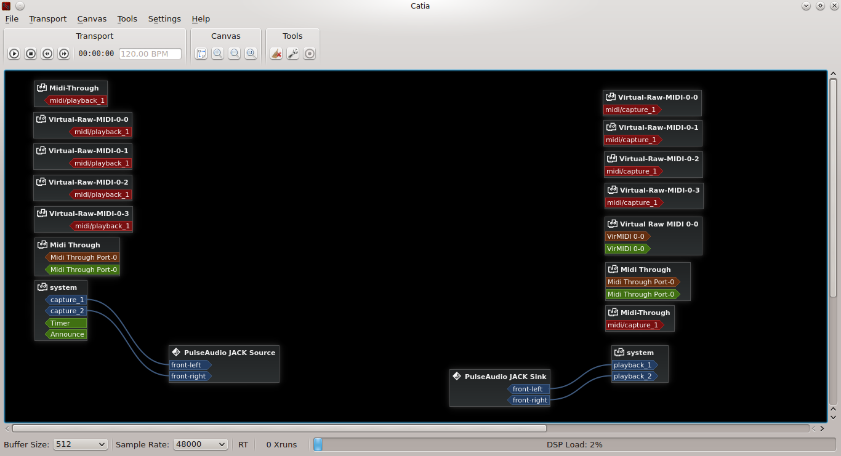
Cadence
Catia View
Blue : audio – Red : Jack MIDI – Brown : ALSA MIDI HW – Green : ALSA MIDI Soft

Slide 32
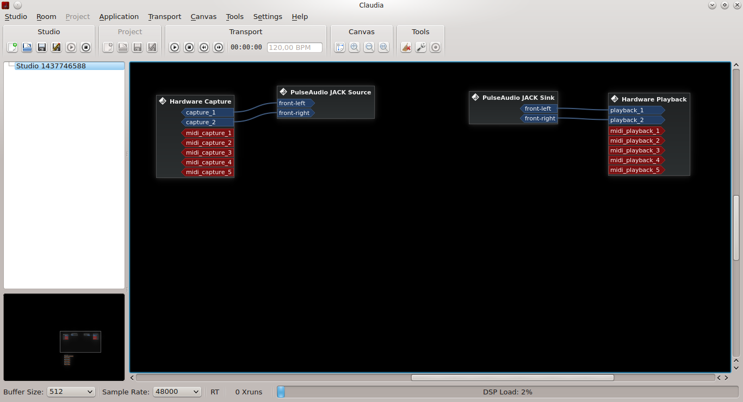
Cadence
Claudia view
View almost identical to that of Catia. Most Jack sessions management via Ladish. Please note: not all applications support Ladish.

Slide 33
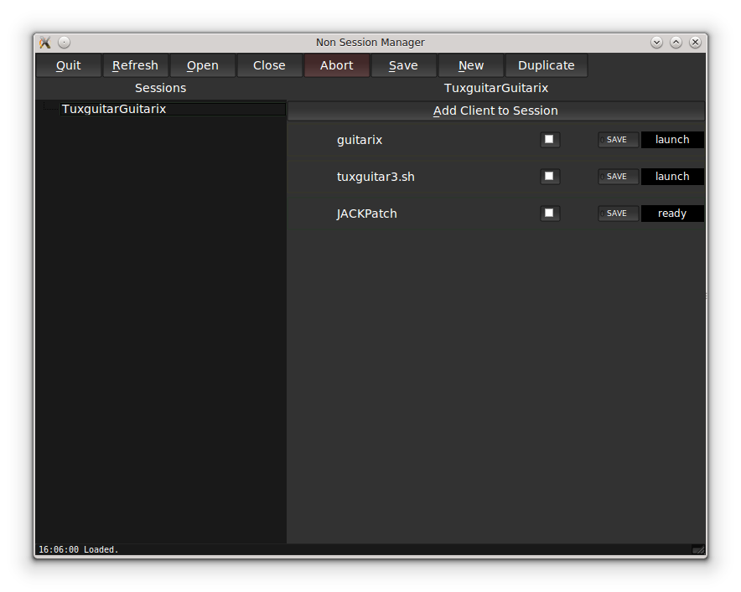
Non session manager
Session name
List of applications launched in the session
Tool to integrate to record Jack connections
No session manager allows you to launch several applications and reconnect them
Applications must be in the path ...

Slide 34
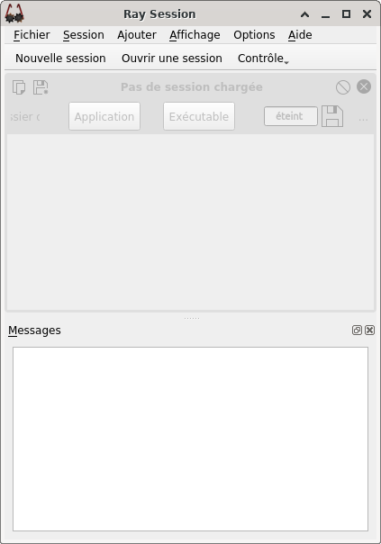
Ray Session
Like non-session-manager, Ray Session allows you to manage the launch and automatic connection of Jack audio application.
Unlike non-session-manager, this application is always actively developed.
Creation zone
/
Sessions management
Zone where the different tools and indication of the backups of states appear
http://linuxmao.org/Ray+Session
https://github.com/Houston4444/RaySession
Launch messages area

Slide 35
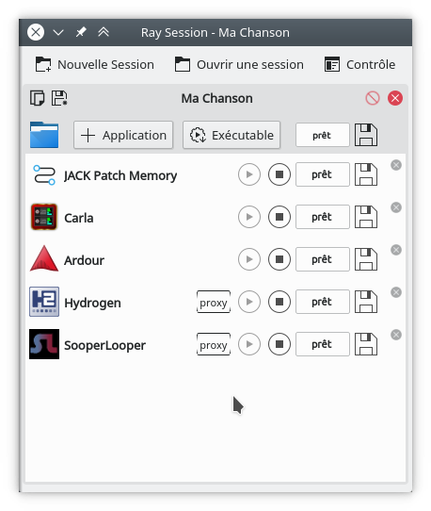
Ray Session
Example
Safeguard of the session
Adding applications
State backup button
Stop / start application

Slide 36
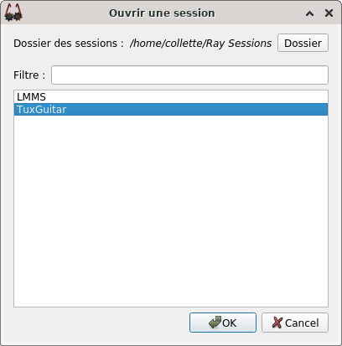
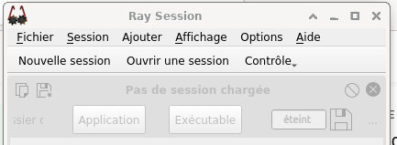
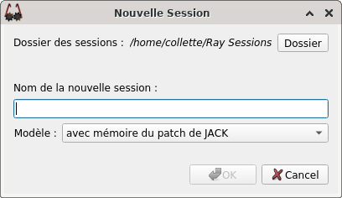
Ray Session
Session creation window

Slide 37
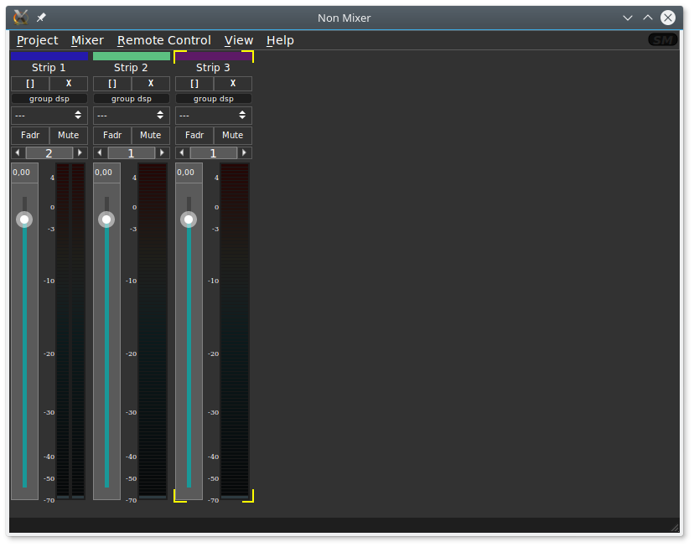
Non Mixer
A very practical tool for adjusting the levels of signals passing through Jack.
Mixing: to add mixing strips
Mixing: to add mixing strips
Remote Control: to learn OSC controls
The 'non-mixer-Oosc-Port <Portnum>' option allows you to adjust the Listening port.

Slide 38
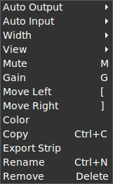

Non Mixer
Each band has a number of settings:
Right click on a bar
Color, for strip
The name, for the strip also
The number of voices:
- 1 → Mono
- 2 → Stereo

Slide 39
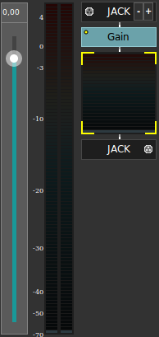
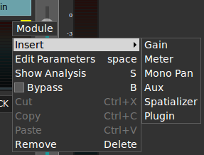

Non Mixer
Right click → View → Fader / Flow
Right click
Adding LADSPA plugins
Right click
Use JM2CV to control non -mix

Slide 40

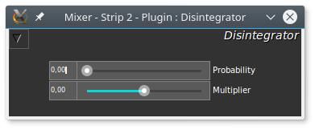
Non Mixer
To use CV (Control Voltage) to control non-mixer, it will be necessary to install JM2CV (Jack Midi to Control Voltage):
https://github.com/harryhaaren/jm2cv.git
$ dnf install non-mixer
$ dnf install non-mixer-xt
$ dnf install non-mixer-lv2

Slide 41
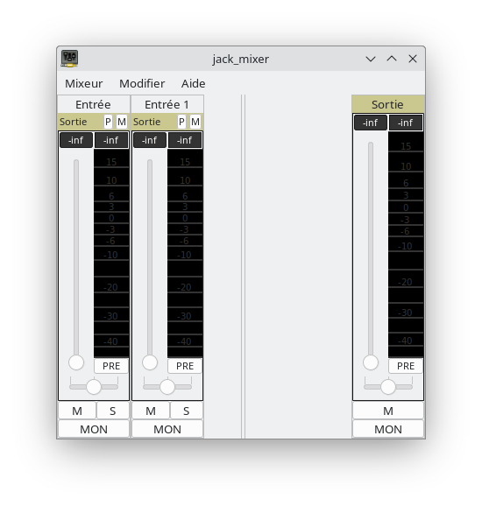
Jack_Mixer
$ dnf install jack_mixer

