Slide 1
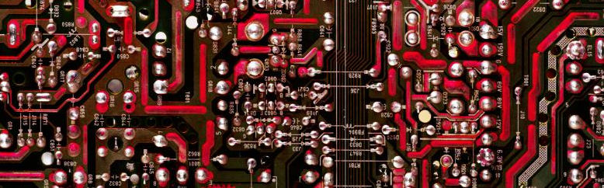

Hydrogen
https://www.hydrogen-music.org
Y. Collette (ycollette.nospam@free.fr)
https://audinux.github.io

Slide 2
Facility
Resources
$ dnf install hydrogen
3355606kit
AVL-BlackPearl-4A-1.1
AVL-BlackPearl-4B-1.1
AVL-BlackPearl-5-1.1
AVL-RedZep-4-1.0
AVL-RedZep-5-1.1
Ace-Tone_Rhythm_Ace
Ace-Tone_Rhythm_Plus
Akai_MPC-X
Akai_XE8
Akai_XR10
Akai_XR10_Latiny
Alesis_D4FX_full
Alesis_DM5_circle_full
Alesis_DM5_eclectic
Alesis_DM5_future_full
Alesis_DM5_ghazal_full
Alesis_DM5_space_full
Alesis_HR16_chaser
Alesis_HR16_power_full
Alesis_HR16_skins_full
Alesis_HR16_wimpy
Alesis_SR16
Altemark_gameboy-lsdj
BJAPacific
Bdu_Roland_TR606
Blackie666_8bit
Boss_DR-110
Boss_DR-660_taxman_full
Boss_DR-660_zapman_full
Boss_DR110_full
Boss_DR202_altaira_full
Boss_DR202_sainthood
Boss_DR202_zaphod_full
Boss_DR220C
Boss_DR550_cymbale
Boss_DR550_dj
Casio_MT500
Casio_MT800
Casio_PT30
Casio_PT80
Casio_RAP1
Casio_RZ3
Cheetah_MD16_full
Classic-626
Classic-808
ColomboAcousticDrumkit
DeathMetal
EKO_Rhythmbox
EasternHop-1
ElectricEmpireKit
Electro_Harmonix_Drm15-32
Emu_Drumulator
Emu_Drumulator-alt
EMU_E-DRUM
EMU_SP1
Ensoniq_Asrx_Acoustic_Full
Ensoniq_Asrx_Electro_Full
Ernyspercussion
Fairlight_cmi-IX_Full
Farfisa
Fortereo
Fricke_mfb5x2
Hamnd_Autovari2
Hamnd_DPM4
Hardelectro1
Hiphop-1
Hiphop-2
Ianhall_SamPlesseet
Jovica_Tonic_Full
K-27_Trash_kit
Kawaixd-5kit
Kawai_R1
Kawai_R50_Full
Kawai_xd5
Corg_DDD1
Corg_DDD5
Corg_DDM1
Corg_kpr7
Corg_kr5
Corg_m1
Korg_ms20+ems_vcs3
Korg_minipops35
Korg_minipops7
Korg_sr120
Korg_tx
Korg_wavestation
Korg_x5_full
Lightning1024
Linn_lm1
Linn_lm2
Linn_linn-9000
Linn_linndrum
Ltibbits_Rock
Lugenfalscher_beguinesandbeghards
Lugenfalscher_blitzbox
Lugenfalscher_sg1
Lugenfalscher_teatime
Mxr_m185
Matiasreccius_heavymetal
Mill-Dums_v.1
Millo_multilayered2
Millo_multilayered3
Moogish_full
Oberheim_dmx
Quasimidi_309
Rolandjd-990kit
Roland_cr-1000

Slide 3
Facility
Resources
$ dnf install hydrogen-drumkit-TD-7kit
Roland_CR79
Roland_D-10_withMOD_full
Roland_D-70
Roland_JD-990_full
Roland_JD800
Roland_MC303
Roland_TB909
Roland_Tr-808_full
SF3007-2011-Set-03
Serge_Modular
Suonho_deconstruction
Synthie-1
TD-7kit
TR808909
Techno-1
Thanvannispen_industrisplode
TicTacShutUp_studio_17-29
VariBreaks
YamahaRX15Kit
YamahaTG-55Kit
YamahaVintageKit
Yamaha_SY22_full
Yamaha_Sy35
Yamaha_TX16W
Yamaha_Tg33_full
Yoursck+Vitriolix_Texturizer

Slide 4
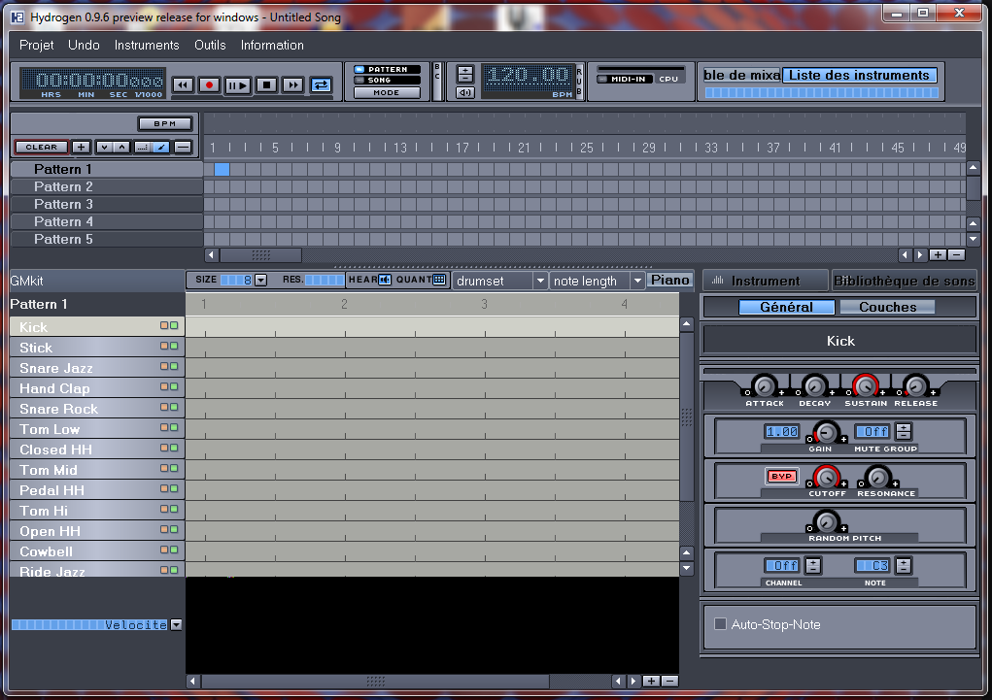
General appearance
Menus sweep
Patterns sequencer
Patterns
Sound settings

Slide 5
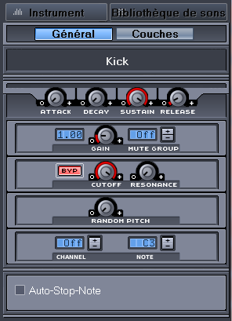
1/2 sound adjustment
ADSR filter associated with each drum sound
Attack: Attack
Decay: decrease
Sustain: Maintain
Release: relaxation
Various sound effects

Slide 6
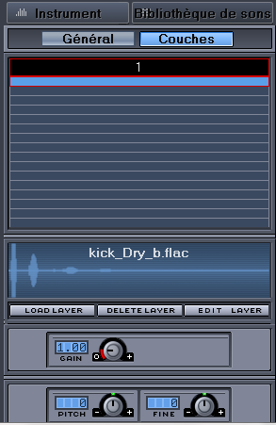
Sound adjustment 2/2
Each drum sound can be a superposition of different sounds.

Slide 7
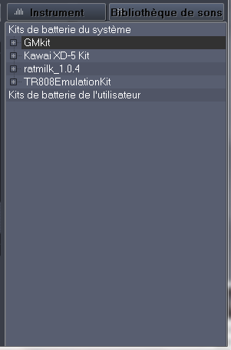
Library selection
Several drum sets exist. Some are downloadable from the site:
http://sourceforge.net/projects/hydrogen/files/sound%20libraries/
Version 0.9.7 allows you to download automatically and install new drum sounds.

Slide 8
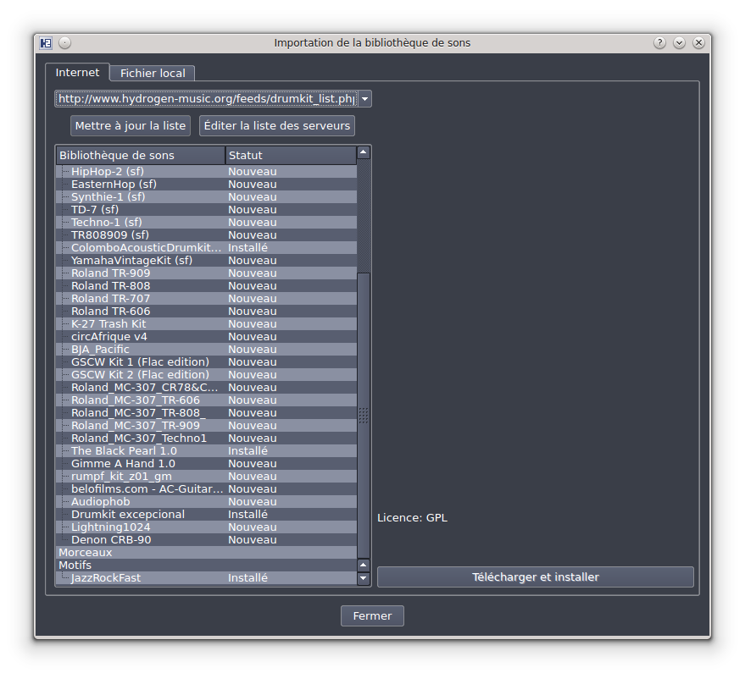
Import of libraries
To install a new library, the easiest way is to go through the instrument menu:
Instruments → Import Library
Click on 'Update List', then select the library you want to install and then click the 'Download and install' button.
Some other libraries are accessible here:
http://www.hydrogen-music.org/hcms/node/16

Slide 9
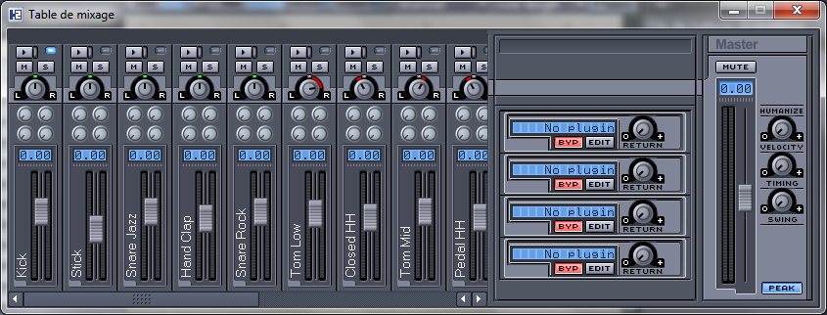
Mixer
Effect zone of effects plugins
General level
Mixing track for each sounds of the drum

Slide 10
Midi management
Version 0.9.5 manages the Midi Alsa (the Hydrogen input appears in the Alsa Midi section of Qjackctl.
Version 0.9.6 Beta manages the Midi Alsa and Jack (the Hydrogen input may appear to choose from in the Alsa or Jack of Qjackctl section.
$ git clone https://github.com/hydrogen-music/hydrogen.git
$ CD Hydrogen
$ mkdir build_tmp
$ cd build_tmp
$ cmake -dcmake_install_prefix =/opt/hydrogen -devel -dcmake_build_type = release ..
$ # Install the missing applications, then relaunch the command above
$ make
$ sudo make install

Slide 11
Connect an instrument
Hydrogen only uses part of the MIDI events to control sounds.
The events managed range from 36 to 59.
To find out that they are generating MIDI events, you have to connect its outing to KMIDIMON. This application makes it possible to display all the MIDI events that go through a given connection.
Then, the hydrogen instruments must be reordered according to the MIDI events of the instrument.
For example, if my instrument generates an event 36 and that we want to associate a snare, then it will be necessary to move the snare in position 1 (so that it is triggered by our MIDI 36 event) in the Drumkit loaded in Hydrogen.
The following table lists the instrument positions with associated MIDI events.

Slide 12
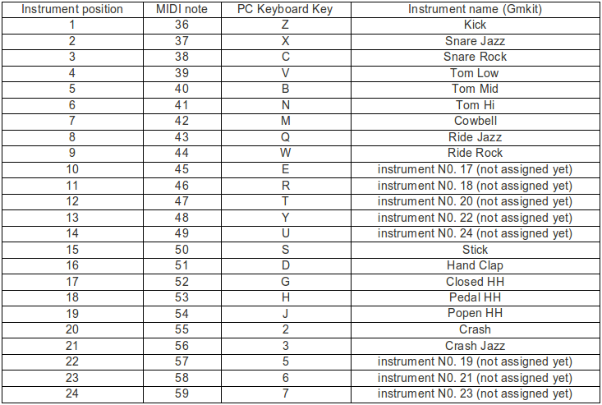
Connect an instrument

Slide 13
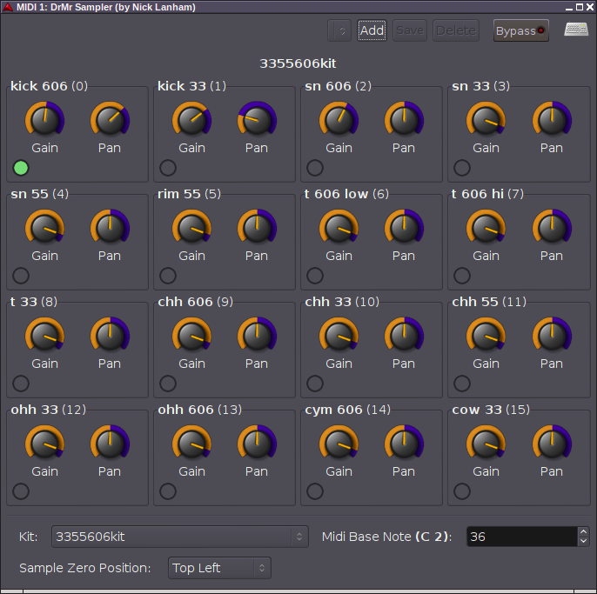
DrMr
LV2 Plugin LV2 for Hydrogen
DRMR is a LV2 plugin that allows you to read hydrogen files and generate a sound rendering via MIDI events
https://github.com/nicklan/drmr
Other puglins are available:
- Drumrox
- Drumlabooh

Slide 14

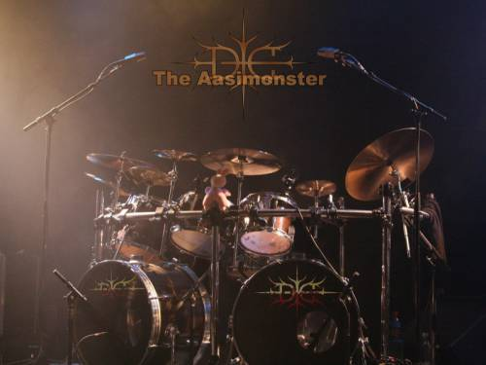
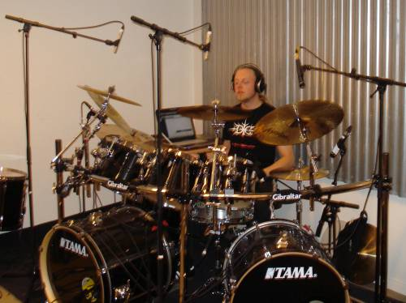
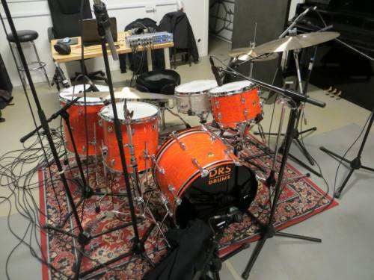
An alternative: Drumgizmo
A plugin / executable to simulate a drum.
The current drumkits are rather metal oriented:
- Drskit
- Muldjordkit
- Aasimonster
https://www.drumgizmo.org/wiki/doku.php?id=start

Slide 15
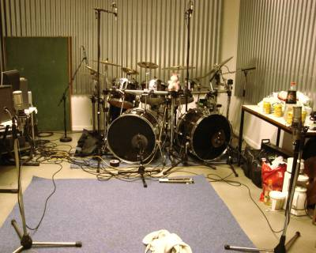
Drumkit
aasimonster
$ drumgizmo -i jackmidi -I midimap=midimap.xml -o jackaudio aasimonster.xml

Slide 16
Drumgizmo
Aasimonster - Micros
This drumkit was recorded using 14 microphones a trigger and the output from a trigger module:
Snare drum was close-mic recorded using two Shure SM57 micrphones. One at the top of the snare and one at the bottom. Furthermore the analog output of a DDrum trigger was recorded.
Each of the four toms were close-mic recorded using AKG C518M swaneneck microphones.
The kickdrums were recorded using AKG D112 microphones mounted in the hole. Furthermore the output of a Alesis DM5 drummodule were stored set up with the “Speed Metal” sample. The trigger module were activated using the Axis E-Kit trigger system.
The hihat and ride cymbal were close-mic recorded using cardioid condenser microphones.
The crash cymbals were recorded using RØDE NT5 over head microphones.
The ambiance of the entire kit were recorded using cardioid condenser microphones.

Slide 17
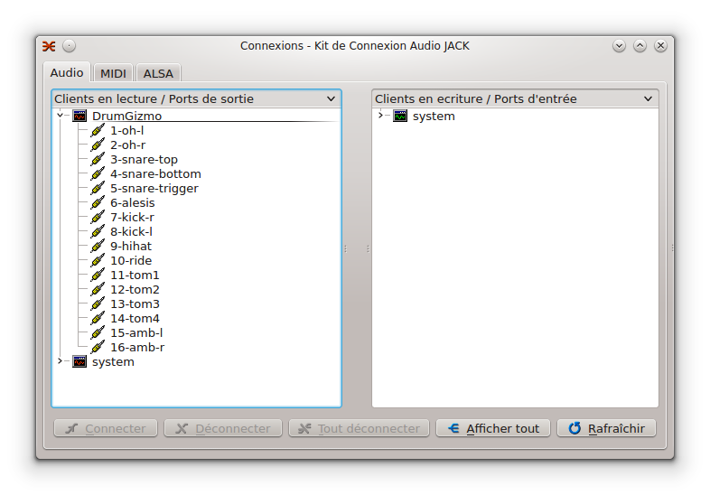
Drumgizmo
Aasimonster - Canals
Each of the microphones are mapped to an output channel when the plugin is assigned to the MIDI track. The tracks are as follows:
Midi Ch 1: Overhead left (RØDE-NT5)
Midi Ch 2: Overhead right (RØDE-NT5)
Midi Ch 3: Snare top (Shure SM57)
Midi Ch 4: Snare bottom (Shure SM57)
Midi Ch 5: Snare trigger (DDrum)
Midi Ch 6: Alesis DM5
Midi Ch 7: Kick right (AKG D112)
Midi Ch 8: Kick left (AKG D112)
Midi Ch 9: Hihat (Cardioid condenser)
Midi Ch 10: Rise cymbal (Cardioid condenser)
Midi Ch 11: Tom 1 (AKG C518M)
Midi Ch 12: Tom 2 (AKG C518M)
Midi Ch 13: Tom 3 (AKG C518M)
Midi Ch 14: Tom 4 / floor tom (AKG C518M)
Midi Ch 15: Ambience left (Cardioid condenser)
Midi Ch 16: Ambience right (Cardioid condenser)

Slide 18
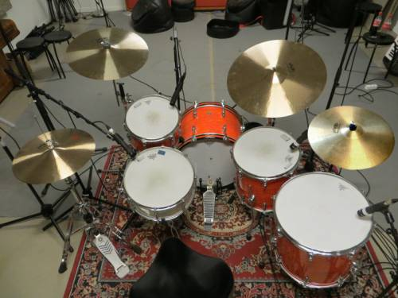
Drumkit
DRSKit
drumgizmo -i jackmidi -I midimap=Midimap_minimal.xml -o jackaudio DRSKit_minimal.xml

Slide 19
Drumgizmo
DRSKIT - Micros
Close mic: Snare top: Shure Sm57
Close mic: Snare bottom: Shure Sm57
Close mic: Tom1: Shure Sm57
Close mic: Tom2: Shure Sm57
Close mic: Tom3: Shure Sm57
Close mic: Kick drum back: AKG D112
Close mic: Kick drum front: Shure Sm57
Close mic: Ride cymbal: Beyerdynamic MCE 86 II
Close mic: Hihat: Beyerdynamic MCE 86 II
Overhead: Focusing on left crash and hihat: Røde Nt5
Overhead: Focusing on right crash and ride: Røde Nt5
Ambience: Focusing on entire kit placed further back in the room to the left: t.bone Rb500
Ambience: Focusing on entire kit placed further back in the room to the right: t.bone Rb500

Slide 20
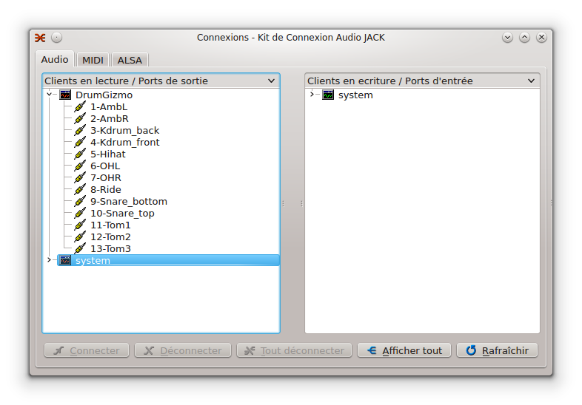
Drumgizmo
DRSKIT - Canals
All microphones are connected to its own channel when loading the kit in DrumGizmo. 13 channels total. Remember to pan the relevant channels to give you a better stereo effect.
Midi Ch 1: Ambience left
Midi Ch 2: Ambience right
Midi Ch 3: Kickdrum back
Midi Ch 4: Kickdrum front
Midi Ch 5: Hihat
Midi Ch 6: Overhead left
Midi Ch 7: Overhead right
Midi Ch 8: Ride cymbal
Midi Ch 9: Snaredrum bottom
Midi Ch 10: Snaredrum top
Midi Ch 11: Tom1
Midi Ch 12: Tom2 (Floor tom)
Midi Ch 13: Tom3 (Floor tom)

Slide 21
DrumKit
Muldjordkit
drumgizmo -i jackmidi -I midimap=Midimap.xml -o jackaudio MuldjordKit.xml

Slide 22
DrumGizmo
Muldjordkit - Micros
Close mic: Snare top: Shure Sm57
Close mic: Snare bottom: Shure Sm57
Close mic: Tom1: AKG C516 ML
Close mic: Tom2: AKG C516 ML
Close mic: Tom3: AKG C516 ML
Close mic: FTom4: AKG C516 ML
Close mic: Kick drum left inside barrel: AKG D112 + DDrum trigger
Close mic: Kick drum right inside barrel: AKG D112 + DDrum trigger
Close mic: Ride cymbal left: Shure Sm57
Close mic: Ride cymbal right: Shure Sm57
Close mic: Hihat: Shure Sm57
Overhead left: Røde Nt5
Overhead right: Røde Nt5
Ambience: Focusing on entire kit placed a little further back in the room to the left:
t.bone Rb500
Ambience: Focusing on entire kit placed a little further back in the room to the right:
t.bone Rb500
Also DDrum triggers on both kick drums mixed onto one mono channel

Slide 23
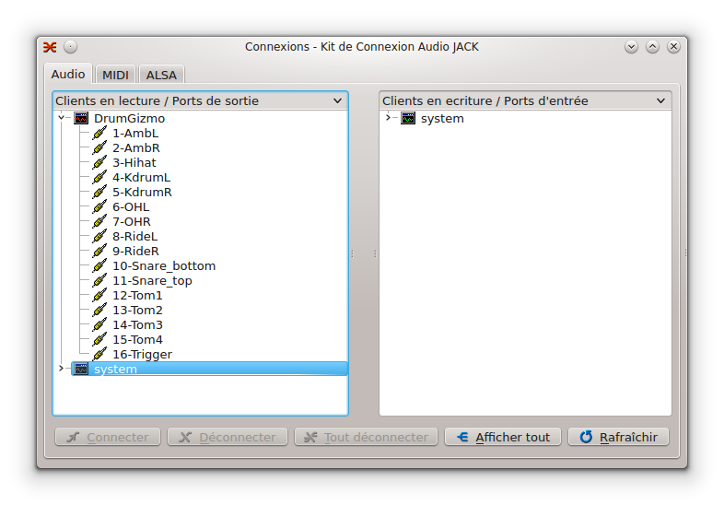
DrumGizmo
Muldjordkit - Canals
All microphones are connected to its own channel when loading the kit in DrumGizmo. 16 channels total. Remember to pan the relevant channels to give you a better stereo effect.
Midi Ch 1: Ambience left
Midi Ch 2: Ambience right
Midi Ch 3: Hihat
Midi Ch 4: Kickdrum left
Midi Ch 5: Kickdrum right
Midi Ch 6: Overhead left
Midi Ch 7: Overhead right
Midi Ch 8: Ride left
Midi Ch 9: Ride right
Midi Ch 10: Snare bottom
Midi Ch 11: Snare top
Midi Ch 12: Rack tom 1
Midi Ch 13: Rack tom 2
Midi Ch 14: Rack tom 3
Midi Ch 15: Floor tom
Midi Ch 16: Kick drum trigger signals

Slide 24
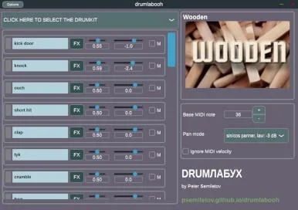
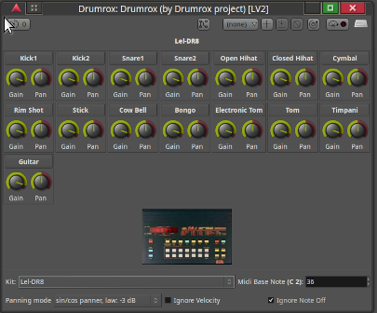
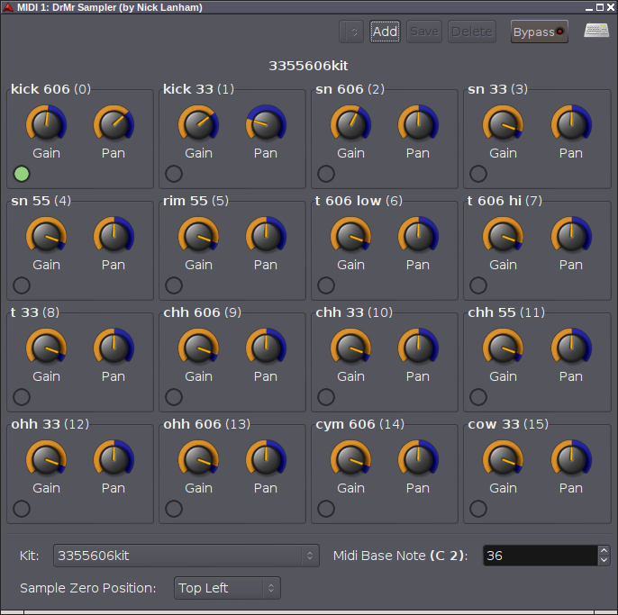
Hydrogen plugins
drmr
drumlabooh
drumrox

Slide 25
Other drum plugins
drumgizmo : Software Synthesizer
ChowKick : Kick synthesizer based on old-school drum machine circuits
boomer : A drum synth
geonkick : Drum Software Synthesizer
kickmess : A kick drum synthesizer plugin
lv2-fabla : An LV2 drum sequencer
onetrick-cryptid : An FM drum synth with the cold clanging heart of a DX7 in the fearsome frame of an 808.
onetrick-urchin : A hybrid drum synth that models the gritty lo-fi sound of beats from vintage records without sampling.
sickbeatbetty : An open source MIDI drum machine / generator VST and standalone application
AVLDrumkits-BlackPearl-H2-repack : Hydrogen drumkit
AVLDrumkits-BlondeBop-HotRod.h2d : Hydrogen drumkit
AVLDrumkits-BlondeBop.h2d : Hydrogen drumkit
AVLDrumkits-BuskmansHoliday : Hydrogen drumkit
AVLDrumkits-RedZeppelin-H2-repack.h2d : Hydrogen drumkit
bandshed-drumkits : Bandshed DrumKits for Hydrogen
drumkv1 : An old-school drum-kit sampler
lv2-avldrums-x42-plugin : Simple Drum Sample Player LV2 Plugin

Slide 26
Other drum plugins
drumelidrum : drum machine VST3 plugin
drumgroovepro : A free open-source MIDI drum groove sequencer
drumlabooh : A drum machine that can use Hydrogen / SFZ an other drumkits
drumrox : A hydrogen compatible drum LV2 plugin
drummock : A simple drum sampler
drumcracker : A drum sampler compatible with drumgizmo drumkits
jdrummer : An open source drum plugin that acts as an alternative to EZDrummer3

