Slide 1
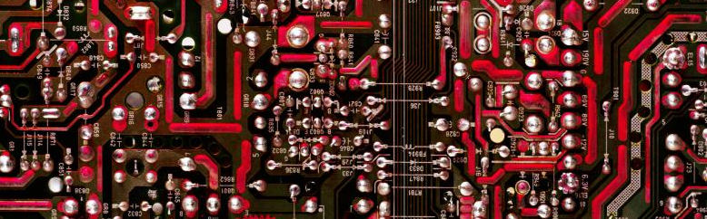
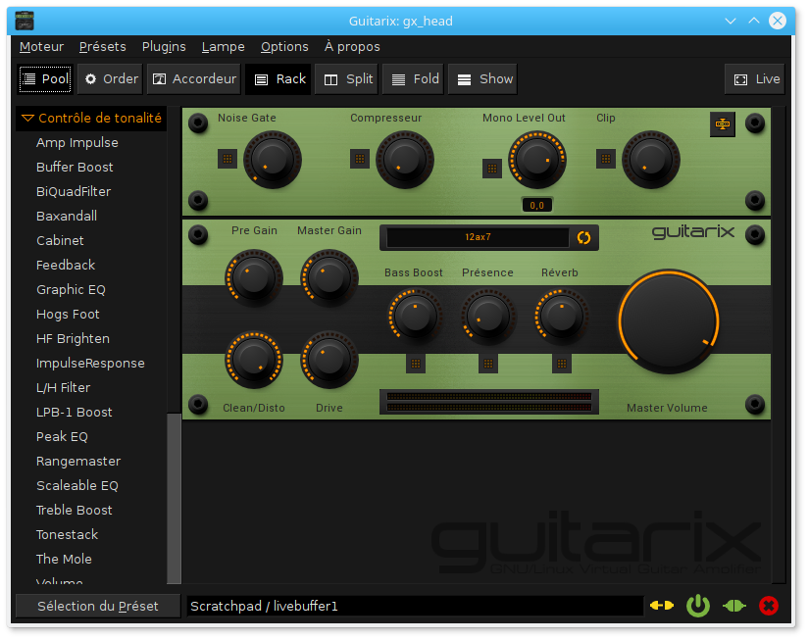
Guitarix
Y. Collette (ycollette.nospam@free.fr)
https://audinux.github.io

Slide 2
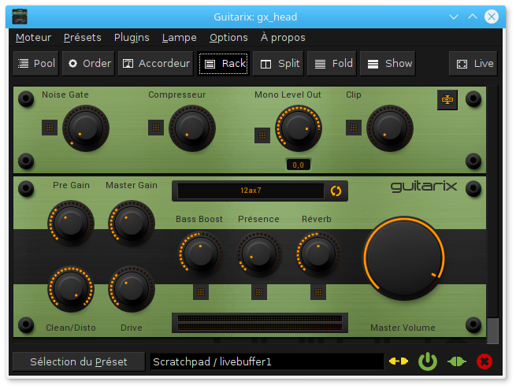
Guitarix
https://guitarix.org/

Slide 3
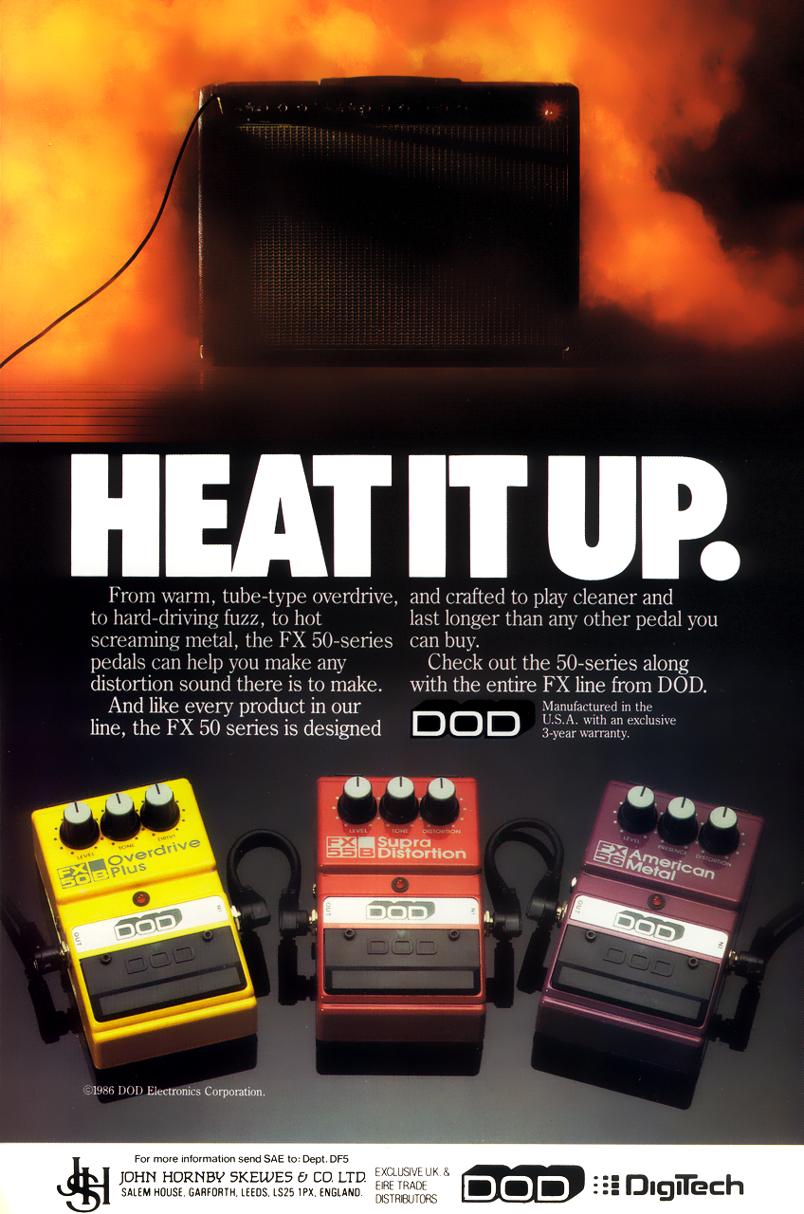
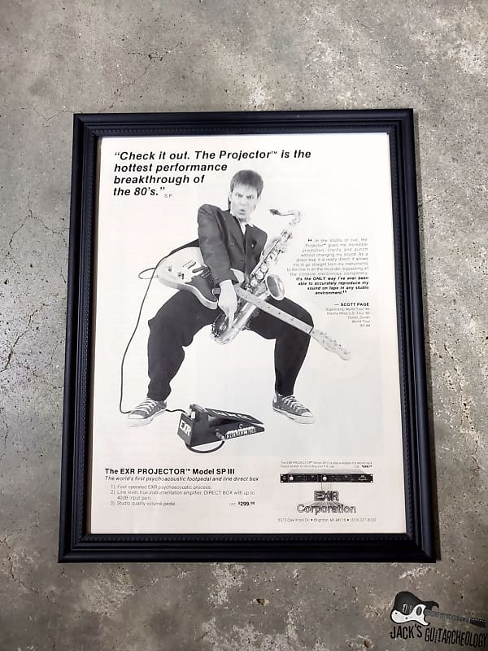
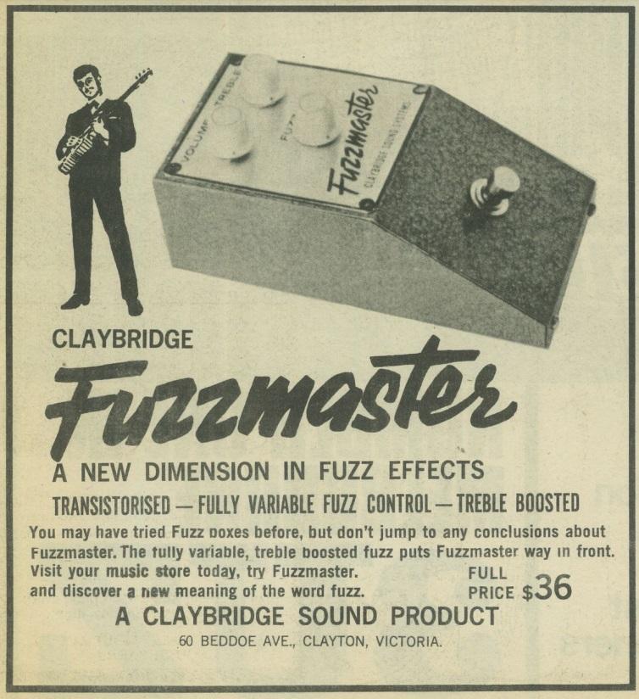
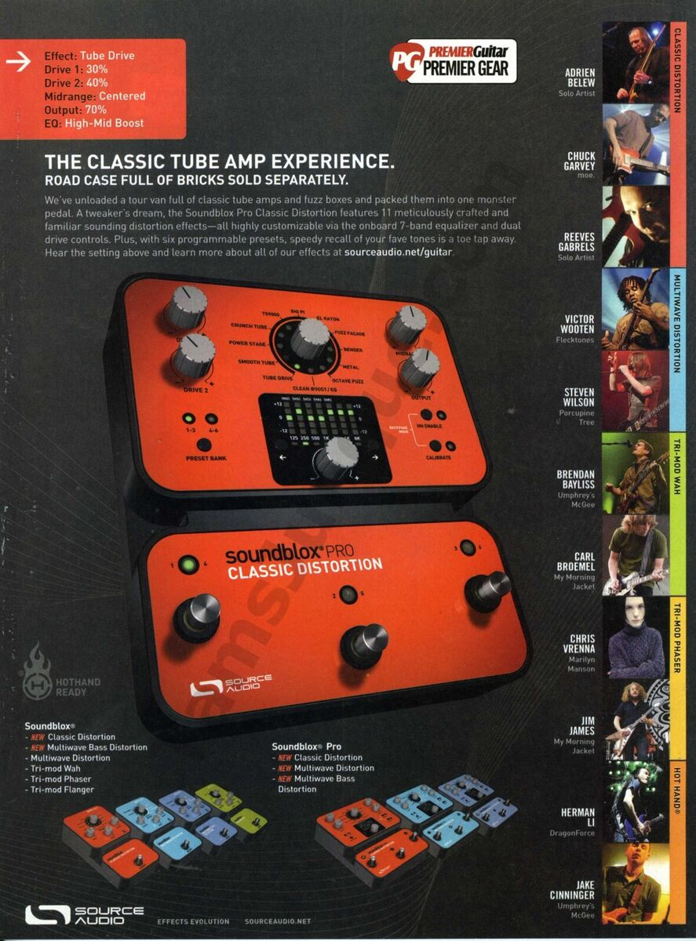
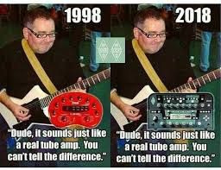
Some old ads

Slide 4
Some old promises
In the 1980s, the "death of tubes" was heralded with transistor distortions, the Rockman, and later the SansAmp—a promised revolution, but tube amps never disappeared.
In the 2000s and 2010s, Line 6 PODs, then Kemper/Axe-FX, were heralded as "the death of the amp and pedalboard"—again, they mostly added a new palette of tools.
Today, with NAM, AIDA-X, Neural DSP, etc., the narrative is back: "plugins/AI replace everything"... but amps, pedals, and open-source solutions like Guitarix + IR + LADSPA/LV2 under Linux continue to offer excellent sounds.
“For 40 years, every new technology has promised to kill tubes and pedals… Yet, the good sounds were already there. What’s really changing is the accessibility and diversity of tools.”
“No need to wait for the next revolution: with Guitarix, IR and free plugins under Linux, we already have the tools to sculpt a professional sound.”

Slide 5
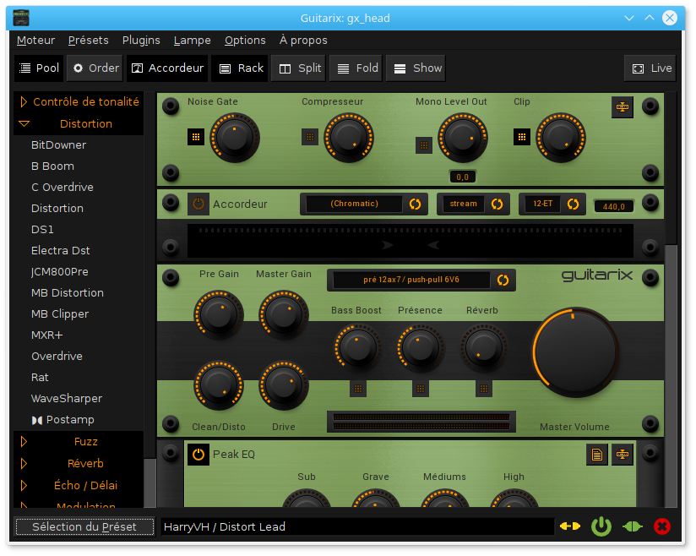
Guitarix
General appearance
Activation of different windows
Effects available
General parameters
Tuner
Effect rack
Presets

Slide 6
Guitarix
The buttons bar
Pool: activates / deactivate the display of the effect list bar.
Order: Reduces the height of all effect modules and allows you to easily click and reorganize these effects. This view is practical to reorganize large amounts of effects.
Tuner: Activates / deactivate the tacking of the tuning rack.
Rack: Activates / deactivate the Display of Effect Modules Rack.
Split: displays the modules rack in two columns, mono grafts on the left column and stereo grafts on the right column.
Fold / Show: the button less reduces the height of all effect modules. The button plus dilates.
Live: Displays a minimum full screen poster with preset information. Practical for live performance.

Slide 7
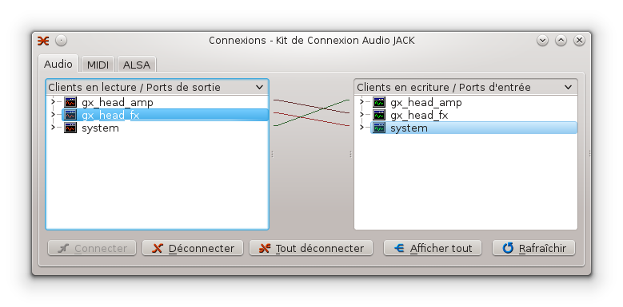
Guitarix
Jack side

Slide 8
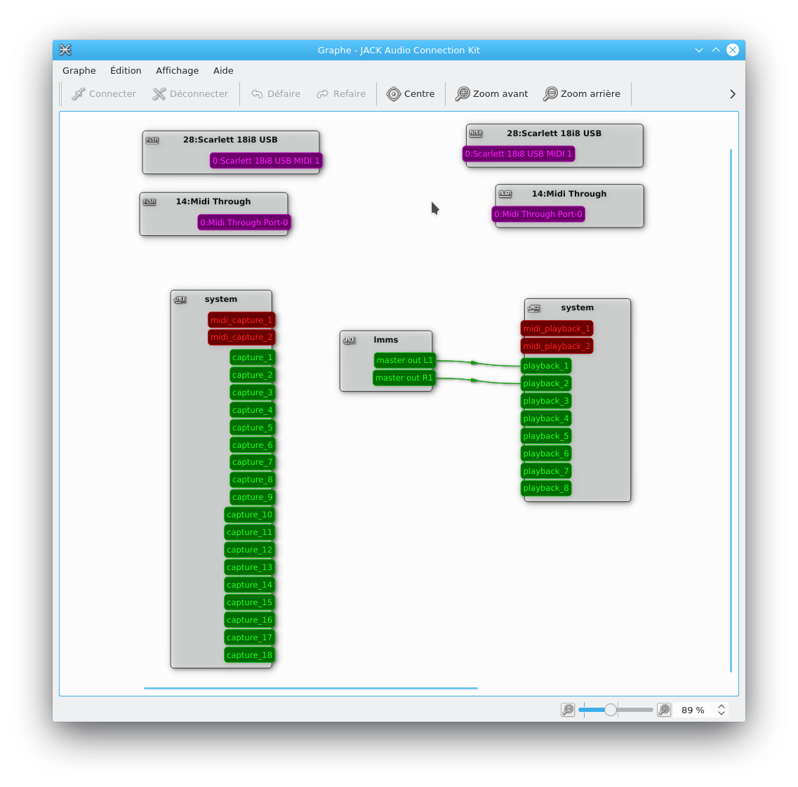
Guitarix
Jack side - New connection window

Slide 9
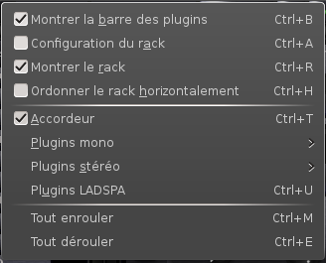
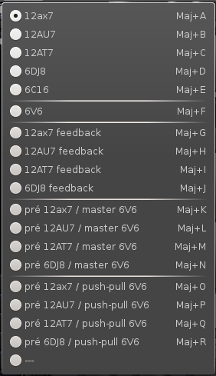
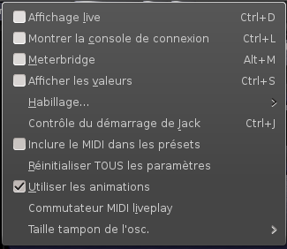
Guitarix
The Menus

Slide 10
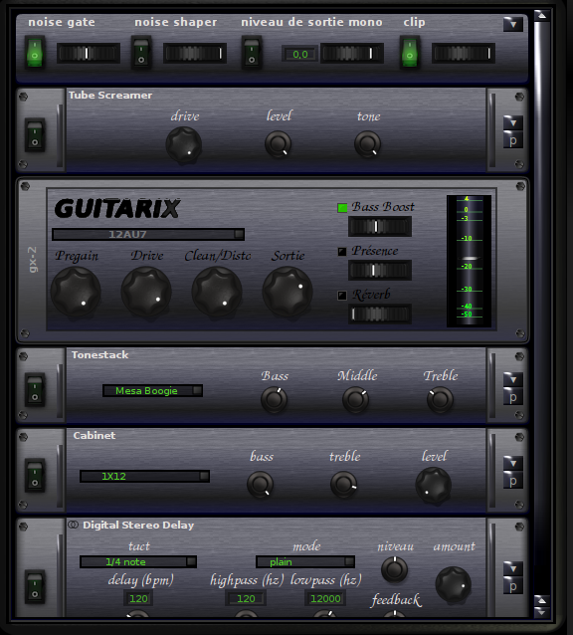
Guitarix
The structure of a rack
Pre-amplifier effects
Amplifier
Post-amplifier effects

Slide 11
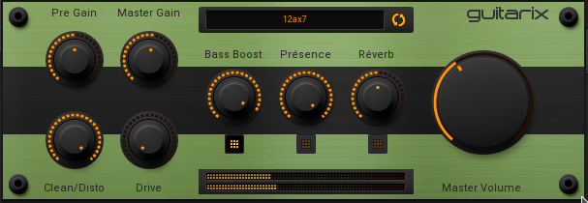
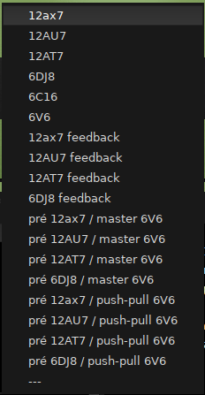
The tube amp emulator
Setting with lamp choice just for the amplifier
General volume
Sound characteristics settings
Mixture between signal with and without distortion
Signal gain
Setting with choice of lamp for pre-amplifier / amplifier

Slide 12
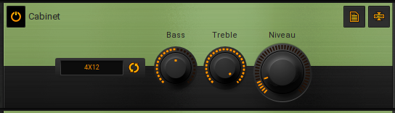
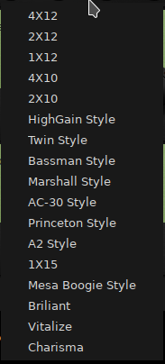
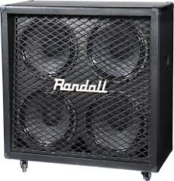
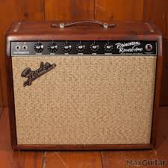
Cabinet
A cabinet is a baffle simulator.
It allows you to simulate different types of amplifier or a speaker combination.
Cabinet 4x12
Cabinet Princeton style

Slide 13
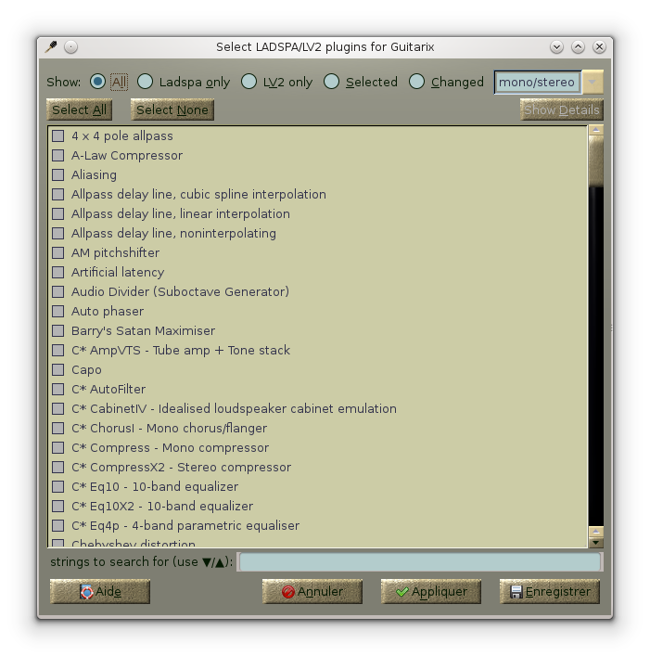
Plugin management
LADSPA / LV2
Plugin type selection area (LADSPA / LV2)
List and selection of plugins to add to rack

Slide 14
Plugins for guitar
Interesting plugins for the guitar:
https://portalmod.com
A distortion in LV2 format from Portalmod:
$ git clone https://github.com/portalmod/mod-distortion.git
$ cd mod-distortion
$ make # compilation
$ make install # Installation in the user directory
$ sudo dnf install mod-distortion
Tonality pedals in LV2 format from Portalmode:
$ git clone https://github.com/portalmod/mod-pitchshifter.git
$ cd mod-pitchschifter
$ make # compilation
$ make install # Installation in the user directory
$ sudo dnf install mod-gxpitchschifter

Slide 15
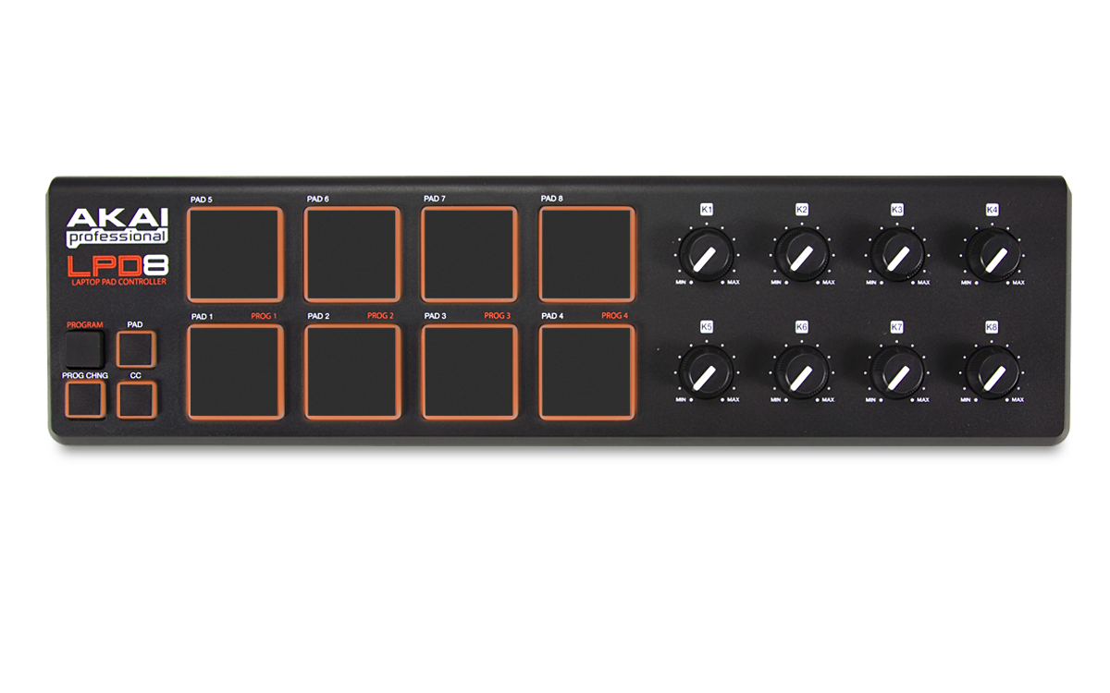
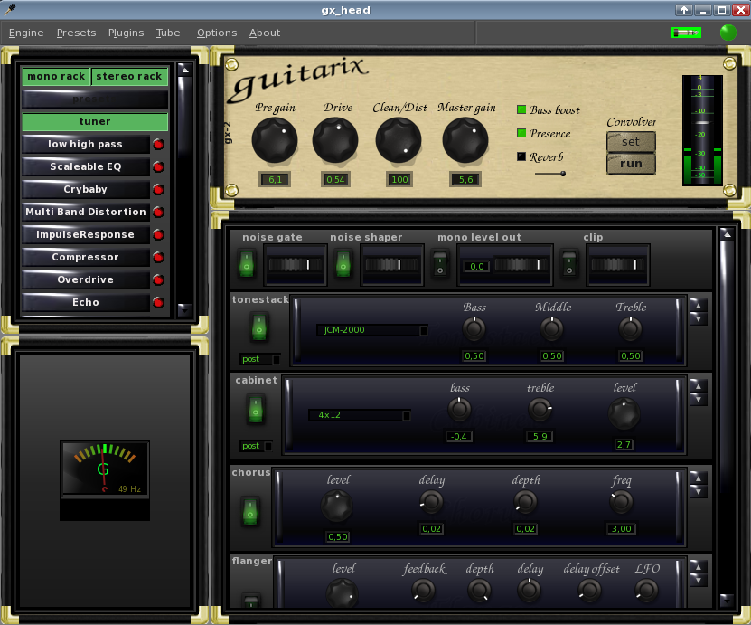
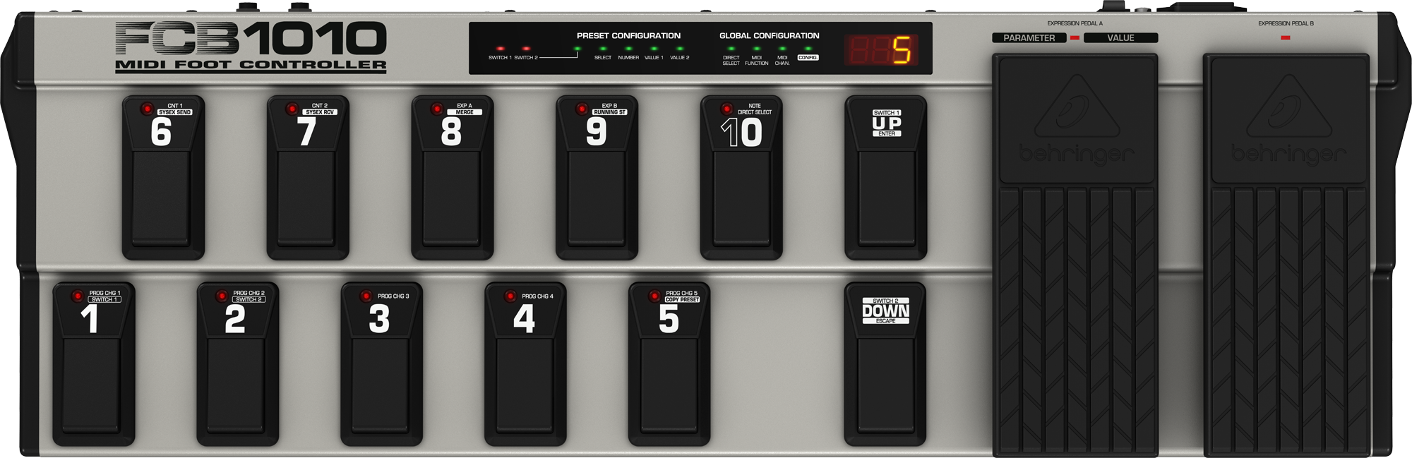
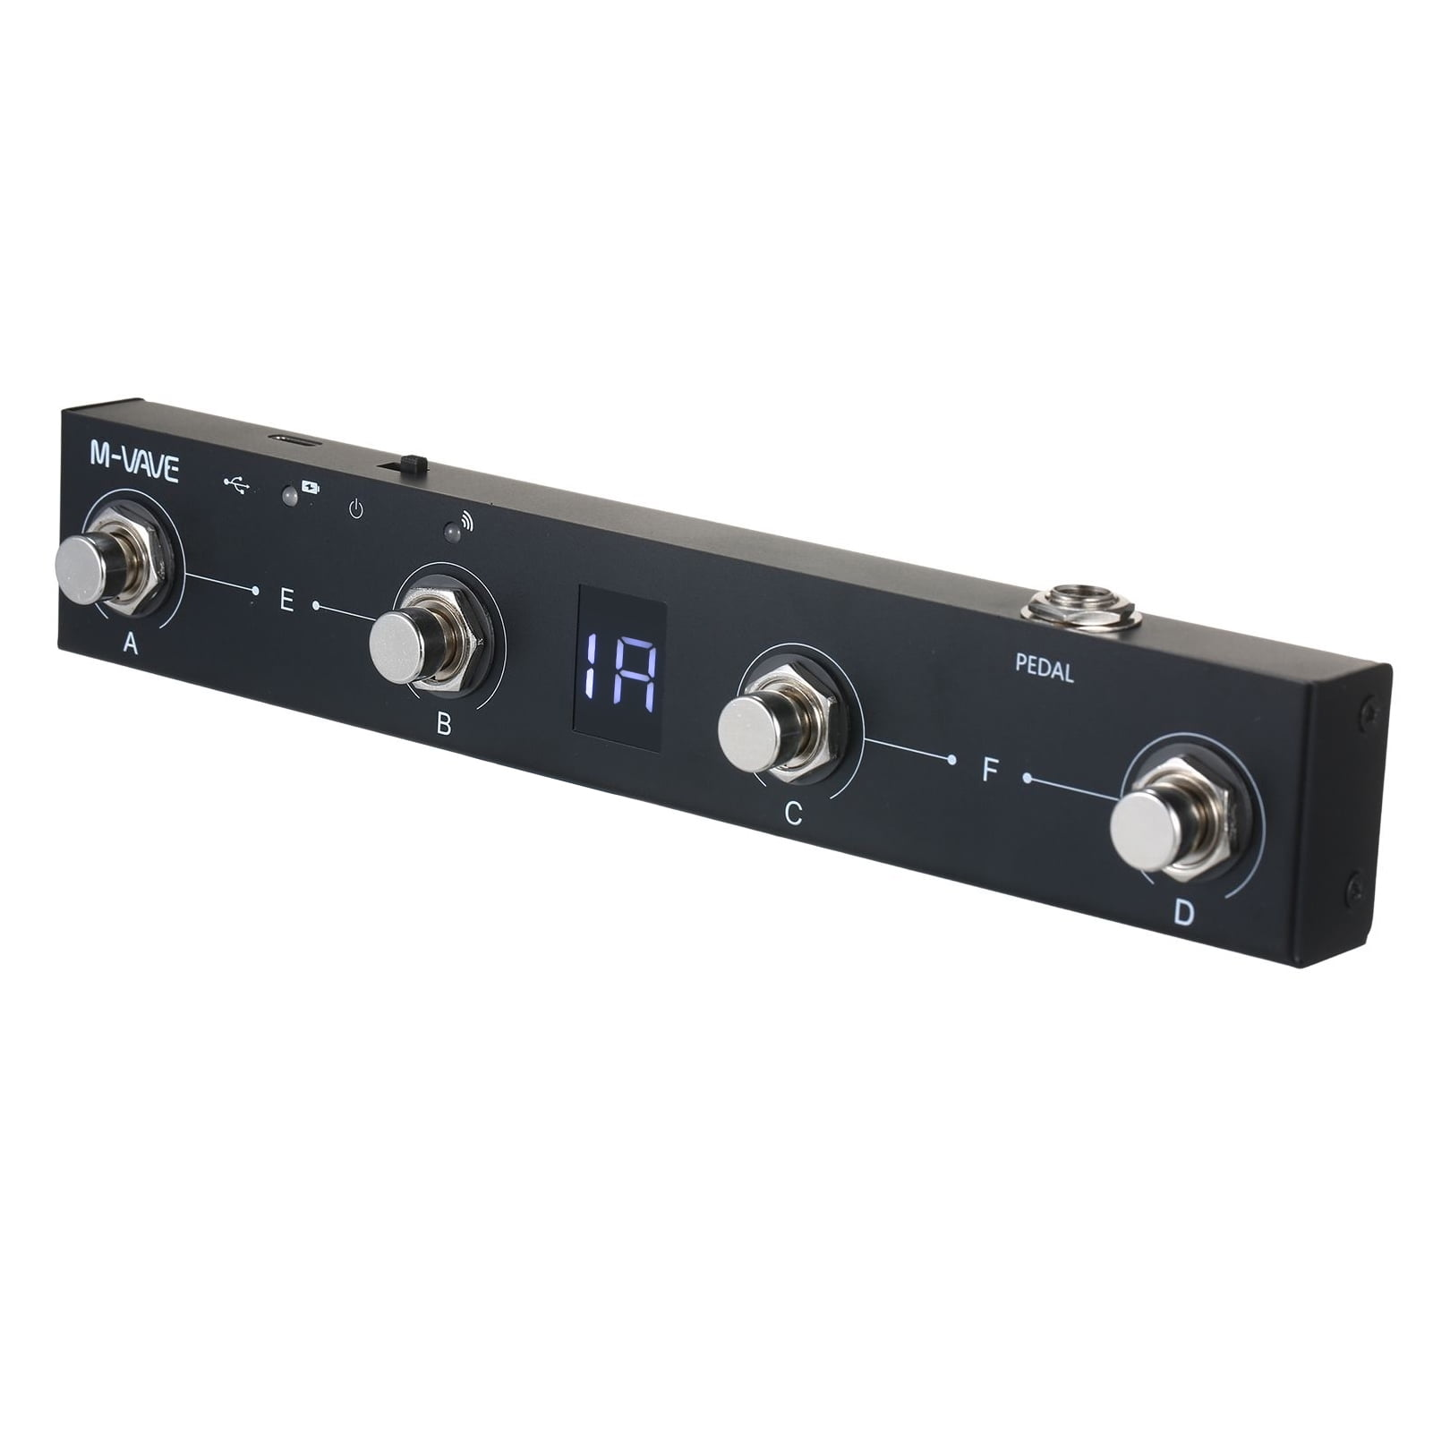
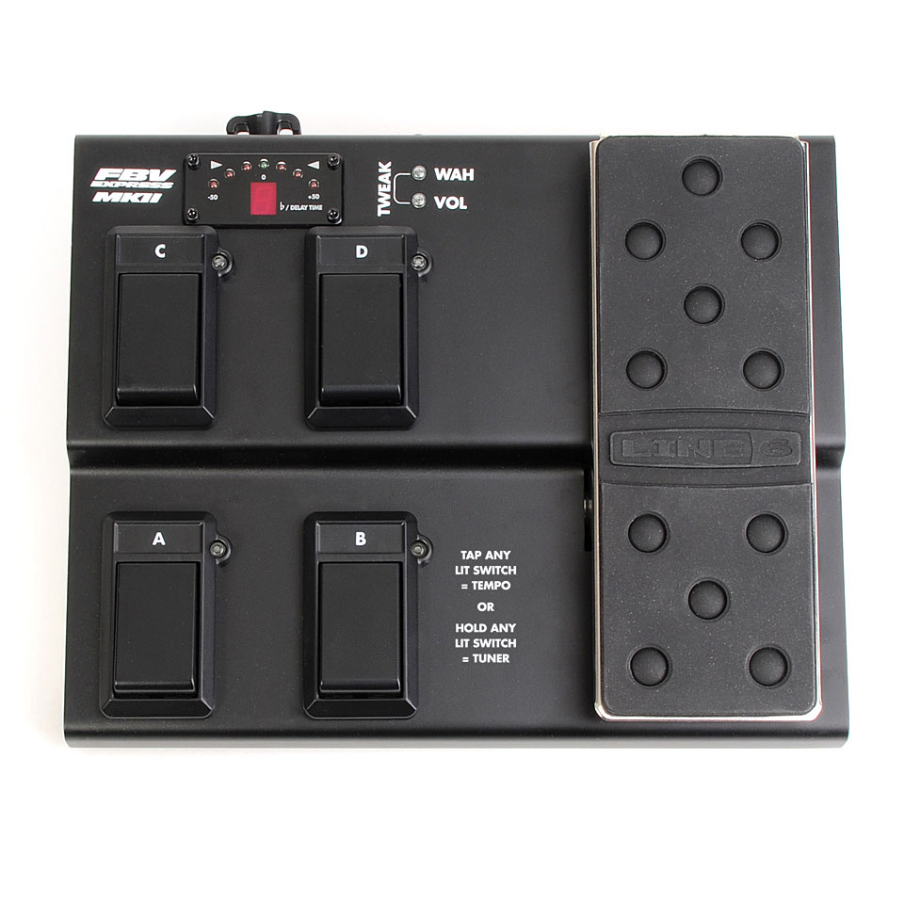
Check via MIDI
Objective: control an effect button via a MIDI instrument

Slide 16
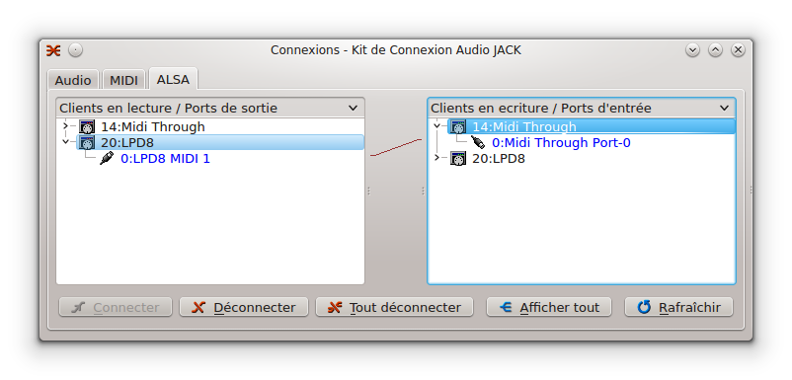
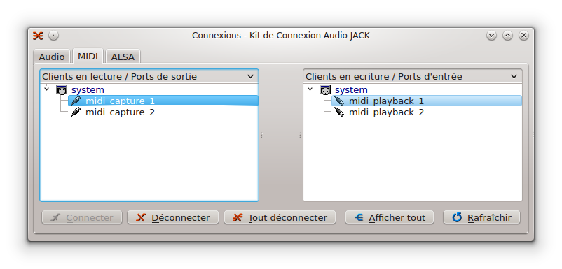
Control via Midi
Jack connections
First step:
Alsa tab:
We connect the MIDI output of the LDP8 to the System system input: MIDI_PLAYBACK_1
Second step:
Midi tab:
We connect the system system output: MIDI_CAPTE_1 to the system system output: MIDI_PLAYBACK_1

Slide 17
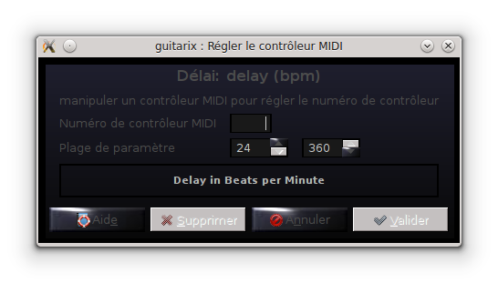
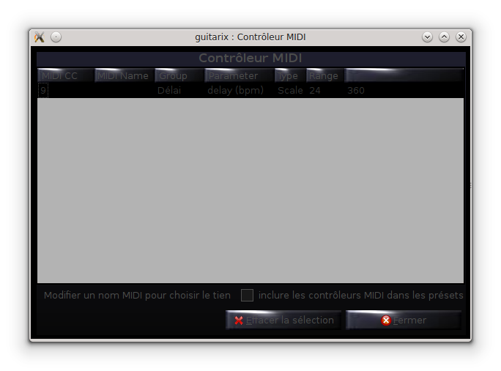
Control via Midi
MIDI / Guitarix association
A click on the guitarix button to control with the middle of the mouse button or on the two buttons for a two buttons mouse reveals this dialog window.
Then you have to move the MIDI button you want to use. The references of this MIDI button are then recovered by guitarix. You have to click on "Validate" to record the Association Midi / Guitarix button.
The engine menu → MIDI controller reveals this dialogue.
By clicking on "Including MIDI controllers in the Presets" allows you to save MIDI / Guitarix associations when you save the presets.

Slide 18
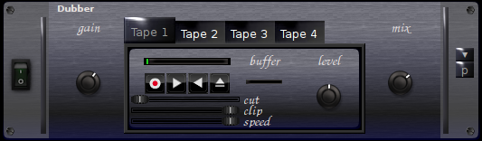
The Dubber
Reading sense
Overdub
Mix between signal and dubber
Registration
Dubber Level
Start and end adjustment
Delete
The Dubber allows you to record a sound loop and to replay it

Slide 19
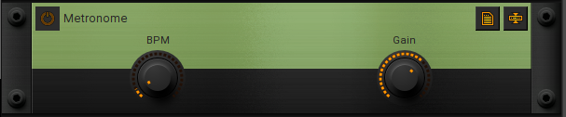
The metronome
Metronome pulsation
Metronome level
The metronome diffuses a beat. The sound level of the beat is proportional to the level of the sound at the input.

Slide 20
Guitarix and web server 1/2
Guitarix can be launched without graphical interface.
It is then controllable via a web server.
This web server can then be checked via a graphics tablet for example.
Guitarix compilation in web server mode:
# We recover the source code of guitarix (Git must be installed)
$ git clone https://github.com/brummer10/guitarix
# We initialize guitarix dependencies
$ git submodule update --init --recursive
$ cd trunk/webui/bootplate/
$ git submodule update –init --recursive
$ cd ../ ..
# We are now compiling guitarix (GCC must be installed)
$ ./waf configure –prefix =/opt/guitarix-Devel
$ ./waf
# We install everything
$ su -c ./waf install

Slide 21
Guitarix and web server 2/2
1. Starting guitarix:
$ /opt/guitarix-devel/bin/guitarix -N
2. start the websockify program from the current directory (webui):
$ python -m websockify.websocketproxy --web=. '*':8000 localhost:7000
3. open the URL http://localhost:8000 in the desktop browser
You should be redirected to debug.html. index.html expects preprocessed files which can be generated with the deploy script:
$ ./deploy.sh
This script creates the build/ directory which is used in index.html.
deploy.sh needs the node program from node.js. For Debian/Ubuntu:
$ su -c dnf install nodejs
Next step :
- open the port 8000 on the tablet and on the server ;
- connect to the guitarix web server via the tablet ;
- install this web server on the Raspberry Pi.

Slide 22
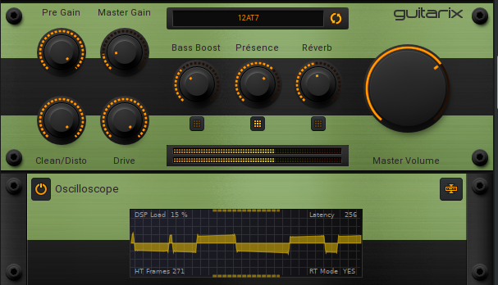
Guitarix Scope
The Scope allows you to visualize the signal to a given place in the rack.
It is practical because it makes it possible to visualize the influence of the settings of an effect.
In this way, we can dose the quantity of distortion.
Too much gain will generate an almost square signal.
Not enough gain, the signal will remain sinusoidal.
It remains to find the right dose.

Slide 23
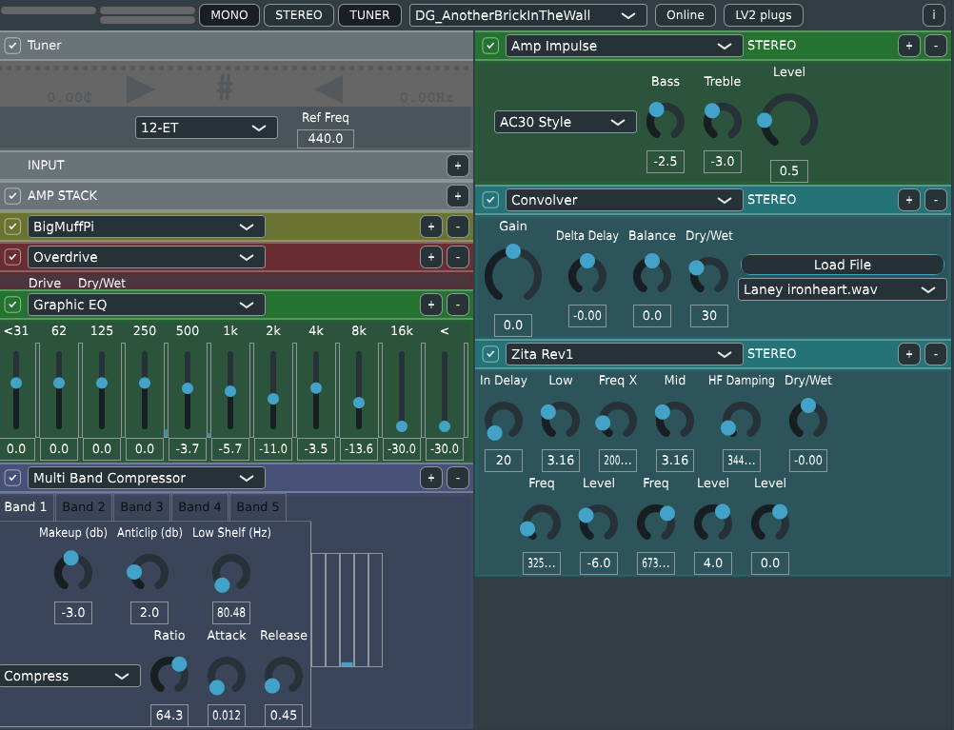
Guitarix / VST3
It’s now possible to use Guitarix as a VST3 plugin in Carla for example

Slide 24
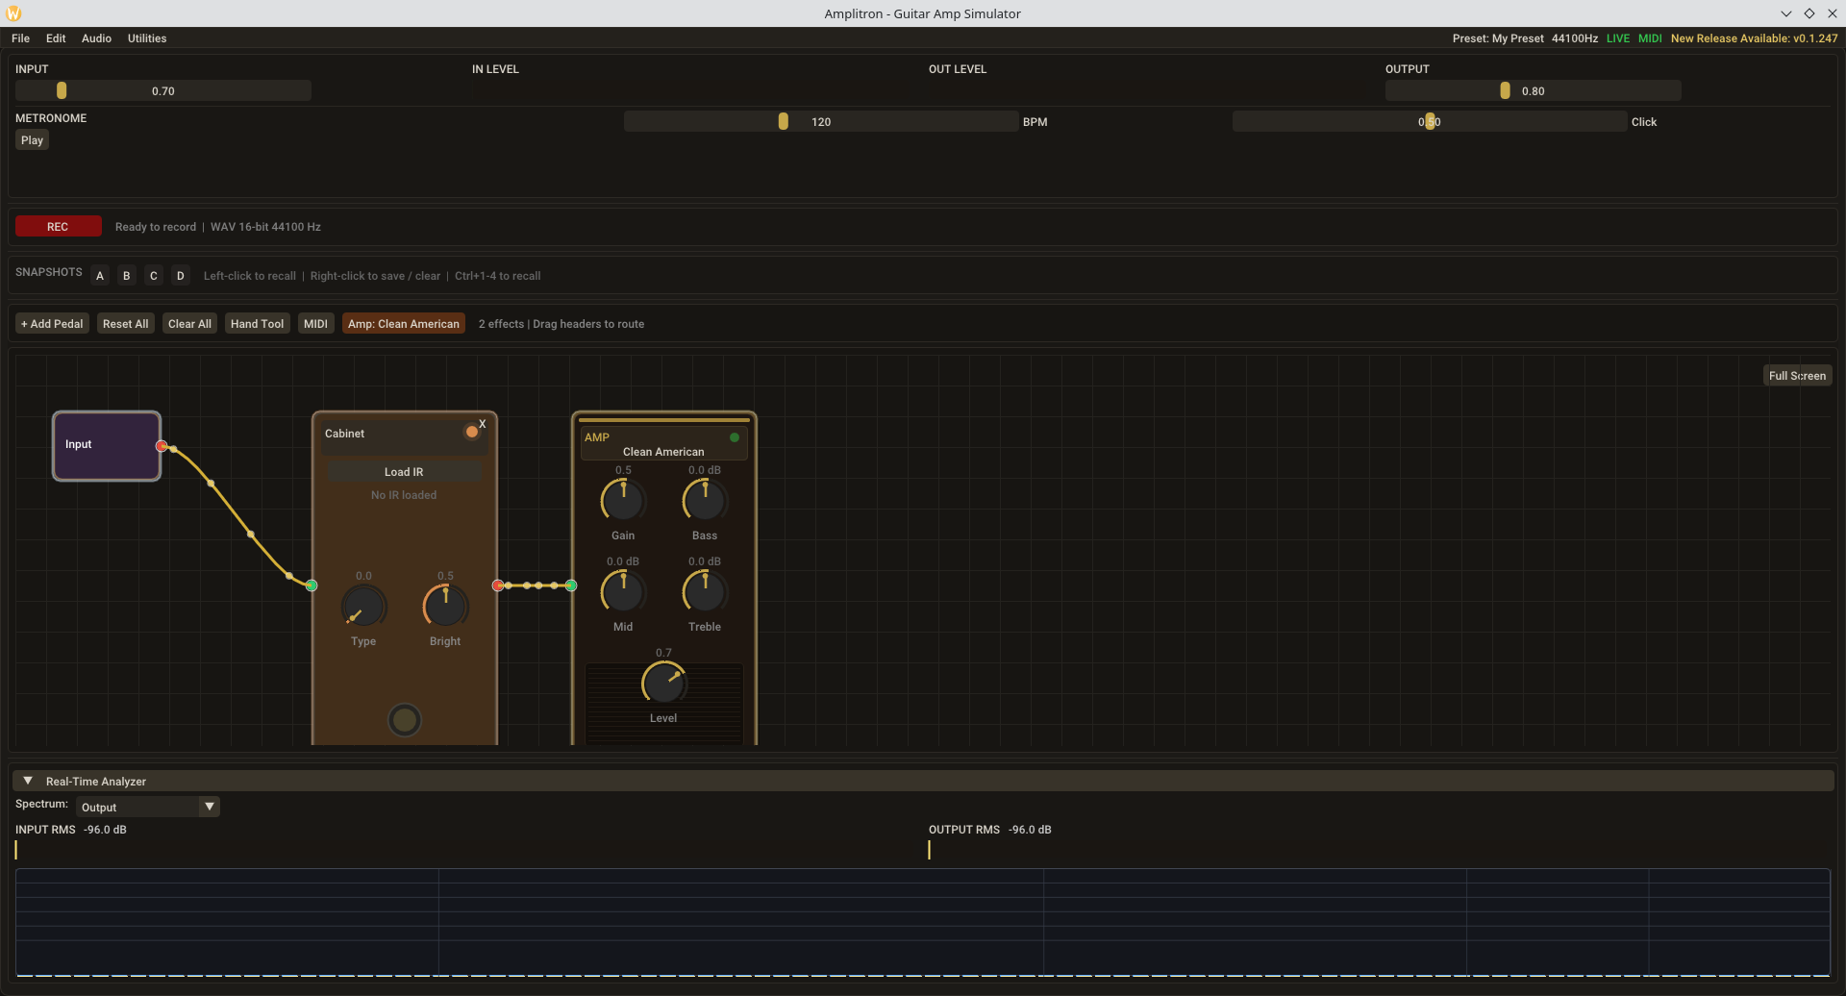
Amplitron
$ dnf install amplitron
https://github.com/sudip-mondal-2002/Amplitron

Slide 25
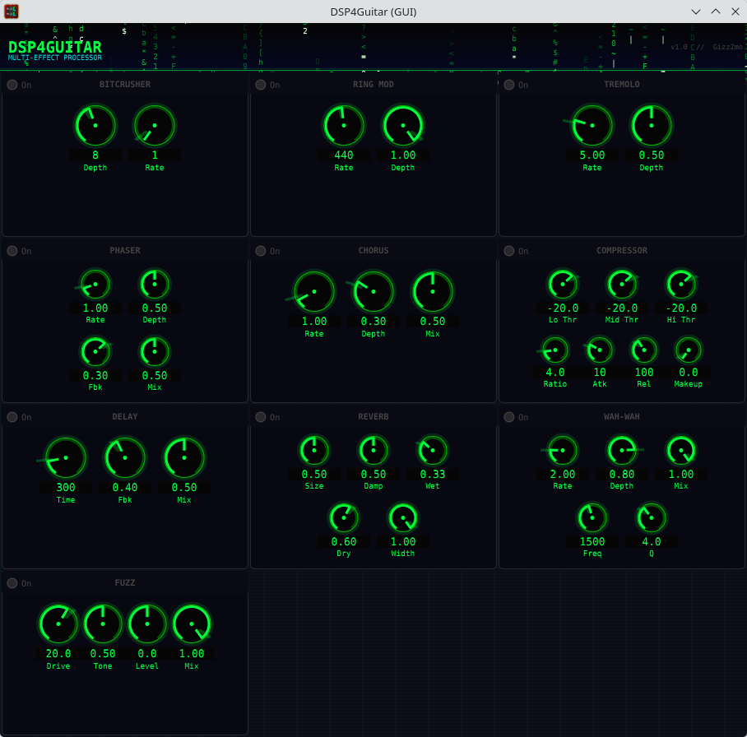
DSP4Guitar
$ dnf install vst3-dsp4guitar
https://github.com/GizzZmo/DSP4Guitar

Slide 26
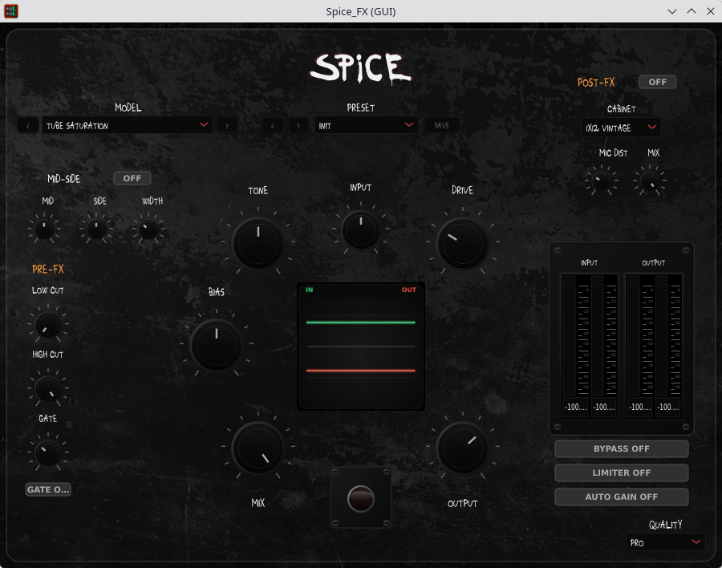
SpiceFX
$ dnf install lv2-spicefx
$ dnf install vst3-spicefx
https://fr.wikipedia.org/wiki/Fou_litt%C3%A9raire
https://github.com/DatanoiseTV/spice-oss

Slide 27
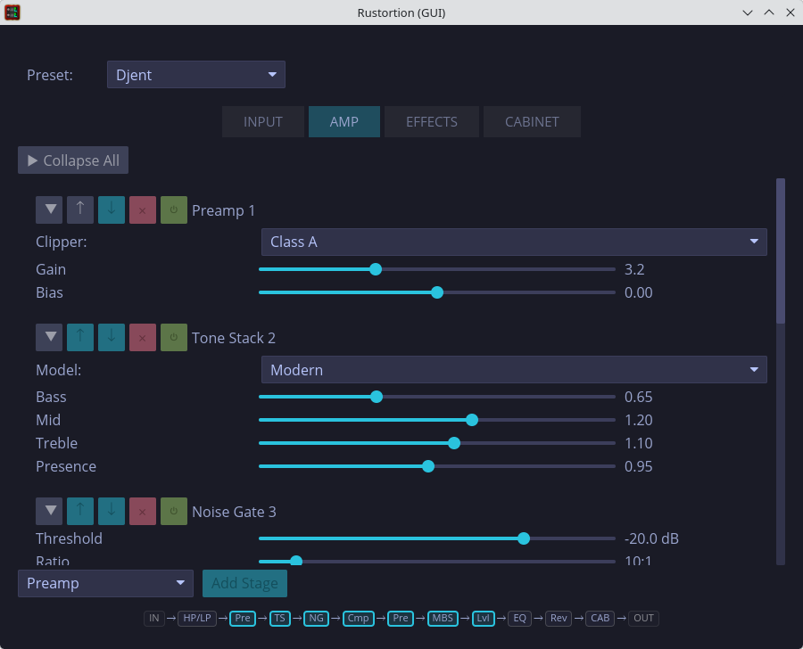
Rustortion
$ dnf install rustortion
$ dnf install clap-rustortion
$ dnf install vst3-rustortion
https://github.com/OpenSauce/rustortion

Slide 28
Muscriptor
Introduction
MuScriptor is a multi-instrument music transcription model developed by Kyutai and Mirelo. You will need a HuggingFace Token and a granted access to :
https://huggingface.co/MuScriptor/muscriptor-medium
https://huggingface.co/MuScriptor/muscriptor-large
https://huggingface.co/MuScriptor/muscriptor-small
The github repository of Muscriptor :
https://github.com/muscriptor/muscriptor
Create a Python virtual environment :
$ python3 -m venv muscriptor
Install muscriptor via pip (uses 4.8 Go of disk space):
$ source muscriptor/bin/activate
$ pip install muscriptor
Launch muscriptor :
$ source muscriptor/bin/activate
$ muscriptor transcribe -f midi -m medium Song.mp3

Slide 29
Webography
You can access to a huge set of presets for Guitarix on Musical Artifacts :
https://musical-artifacts.com/artifacts?apps=guitarix
All these artifacts can be easily downloaded into Guitarix because Musical Artifacts is now integrated into Guitarix.

Slide 30

Documentary
A good documentary about pedals, who made them …
The PEDAL Movie :
https://www.imdb.com/fr/title/tt11811310/

Slide 31
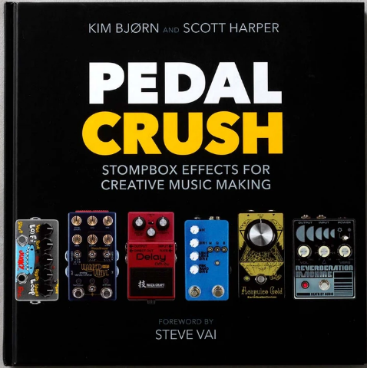
Book
A good book about pedals :
PEDAL CRUSH
https://bjooks.com/en-fr/products/pedal-crush-stompbox-effects-for-creative-music-making

