Slide 1
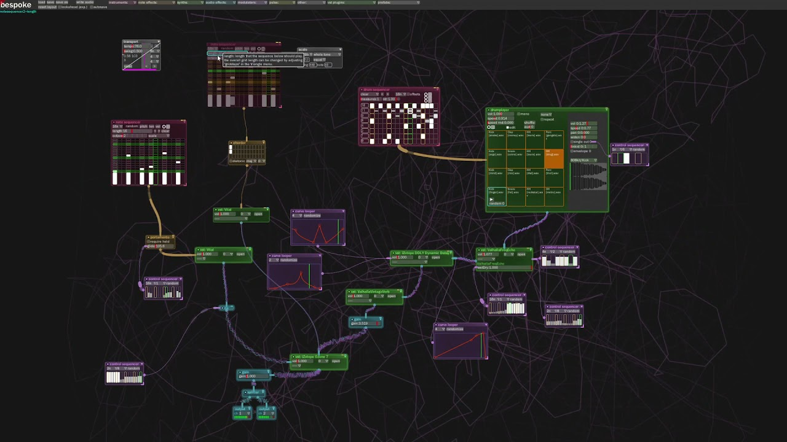
BespokeSynth
Y. Collette (ycollette.nospam@free.fr)
https://audinux.github.io/

Slide 2

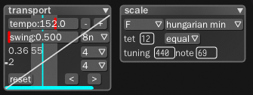
The Look

Slide 3

Some shortcuts
Ctrl + wheel : Zoom
Ctrl + space + mouse : translate canvas
Letter key in the canvas : shows a list of modules with name beginning with this letter
Click + drag : select an area
Click an a selected area + drag : move the selected modules
Backspace : delete a module or a selection
Alt+Click on module+Drag : duplicate a module
How to draw a wire ?
Click on the circle output of a module, while button is clicked, move the mouse to the module you want to connect to
How to delete a wire ?
Click on the wire and push backspace
Autoconnect 2 modules ?
Grab a module by the title bar, hold LEFT SHIFT while module is grabbed and move the mouse so as the output circle of the grabbed module touch the module you want to connect to.

Slide 4
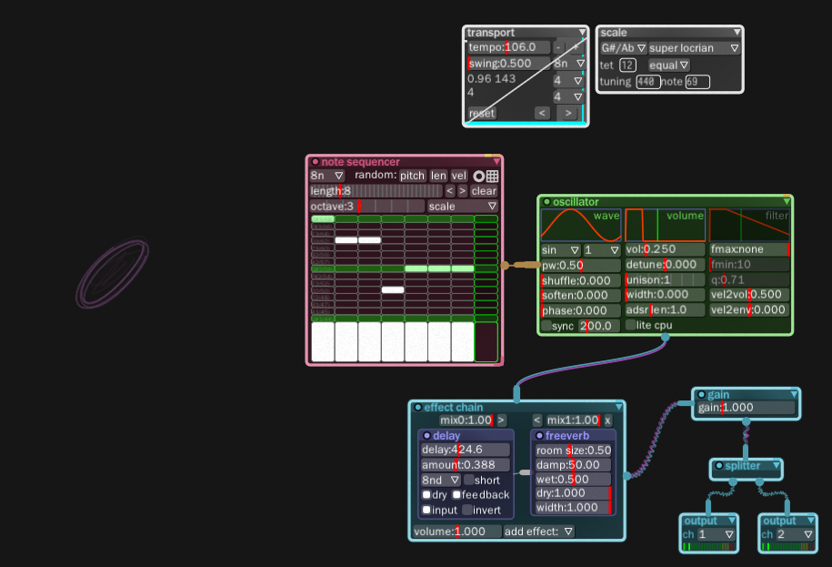
A First Experiment
Transport : allows tp tune the measure and the tempo
Scale: Set the scale used by sequencers
Notesequencer: a piano roll where to write notes
oscillator: the audio sound generator
effectchain: an area where one or several effet are applied to audio
Gain, splitter, Output : to control the audio level, split the audio in several channels and send it to the speaker

Slide 5






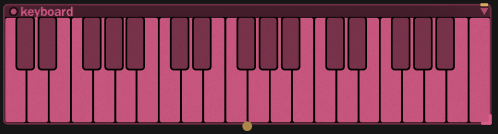
Some Main Modules - 2
Gain: amplify an input
Panner: place an audio signal in the stereo field. Can be used to transform a mono signal into a stereo signal (some modules are not able to manage mono signal).
Splitter: Add more output connexions to an input signal
Output: manage multi channel output
Ttimerdisplay: shows a timer of the audio duration (stopped in pause mode)
Comment: allow to add some comments in the canvas
keyboarddisplay: a virtual kayboard module

Slide 6
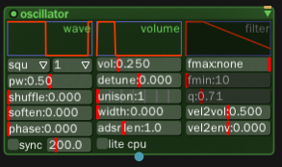
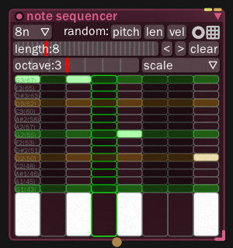
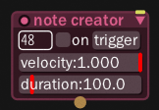
Some Main Modules - 3
oscillator
An essential module for sound generation. Able to manage multivoice sounds, sin, square and a lot of parameters can be tuned via this module. All the parameters can be LFO controlled.
Note sequencer
note creator
A module which can be used to produce one note on demand.
A piano roll to play a sequence of notes.

Slide 7
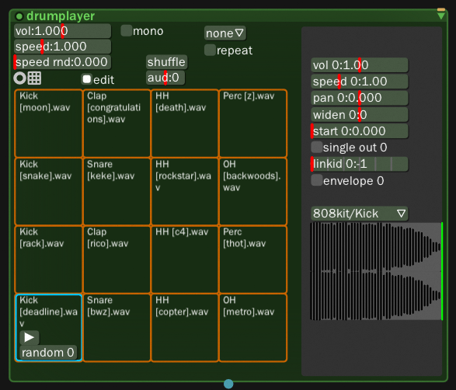
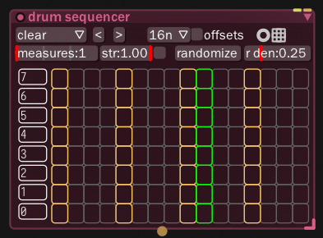
Some Main Modules - 4
drumplayer
A sampler based drum player. You need to drag and drop some drum samples in the various pad. These samples are then triggered using a sequencer like the drum sequencer below.
drumsequencer
A piano roll for drum sequencing.
You just need to click in a square to turn on / off a sample.

Slide 8
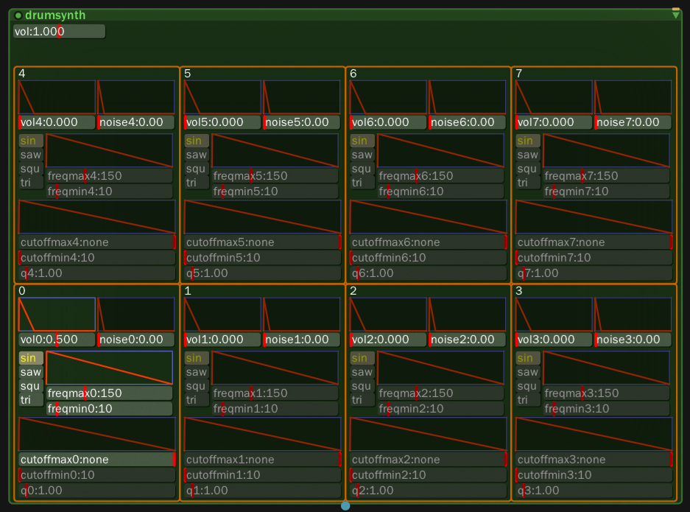
Some Main Modules - 5
drumsynth
Oscillator and noise drum synth
cutoffmax*: filter start cutoff freq
cutoffmin*: filter end cutoff freq
edit: display param for each hit
freqmax*: oscillator start frequency
freqmin*: oscillator end frequency
noise*: noise volume
q*: filter resonance
type*: oscillator type
vol: the output volume
vol*: oscillator volume

Slide 9

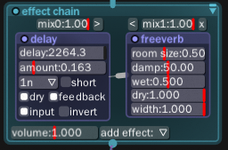
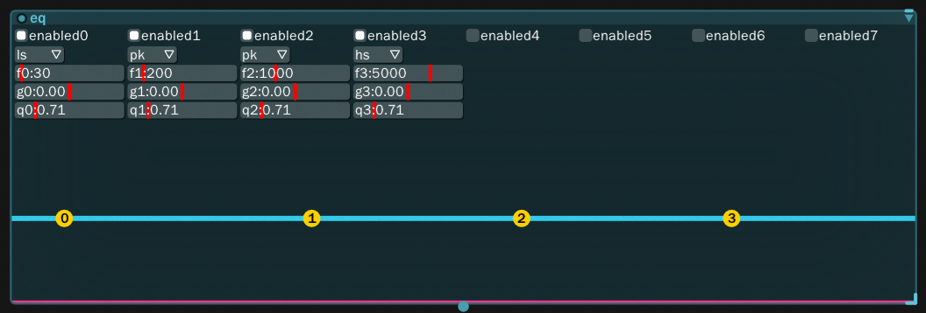
Some Main Modules - 5
effectchain
Example of an effect chain with two effects : a delay and a reverb. The ‘<’ and ‘>’ button can be used to reorder the effects in the chain.
A module where several effects can be chains via the « add effet » button
eq
A filtering module.
All the parameters can be controller via a LFO.

Slide 10
Some Main Modules - 6
Various interesting modules :
Multitrack recorder
Arpegiattor
Seaofgrain
Fubble
Chorder

Slide 11
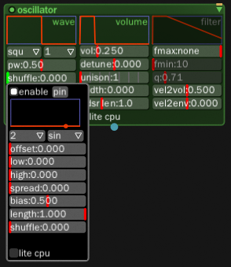
LFO
You can show up a LFO widget to control parameters by right clicking in the parameter are to be controlled.
The LFO widget can be « extracted » from its parent widget by clicking on the « pin » button.

Slide 12
Webography
BespokeSynth basic usage : https://www.youtube.com/watch?v=SYBc8X2IxqM
BespokeSynth MIDI mapping tutorial : https://www.youtube.com/watch?v=JkNXO55ogvQ
BespokeSynth website : https://www.bespokesynth.com
BespokeSynth references : https://www.bespokesynth.com/docs/index.html#basics
Ryan Chalidor YouTube channel : https://www.youtube.com/channel/UCBnLnfmXl4x2QmgTxwPbvEw
Some useful ressources for BespokeSynth : /usr/share/BespokeSynth/resource/userdata_original/
These ressources can be found in /home/<user>/Documents/BespokeSynth :
controllers drums internal layouts prefabs recordings samples savestate scales.json scripts tmp userdata_version.txt vst

