Slide 1
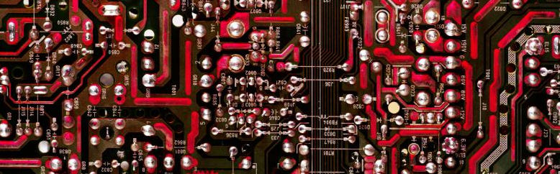
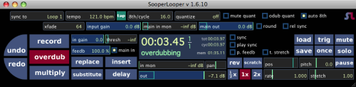

Sooper Looper
Y. Collette (ycollette.nospam@free.fr)
https://audinux.github.io

Slide 2
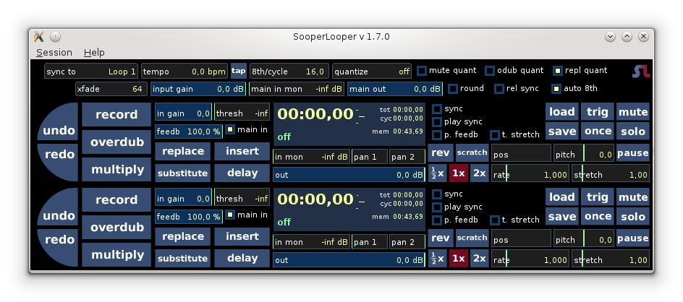
Main interfaces
Menu
Control bar
Loop 1
Loop 2

Slide 3
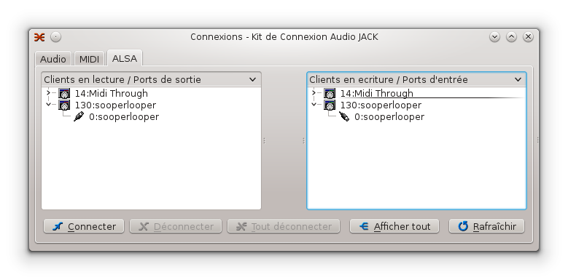
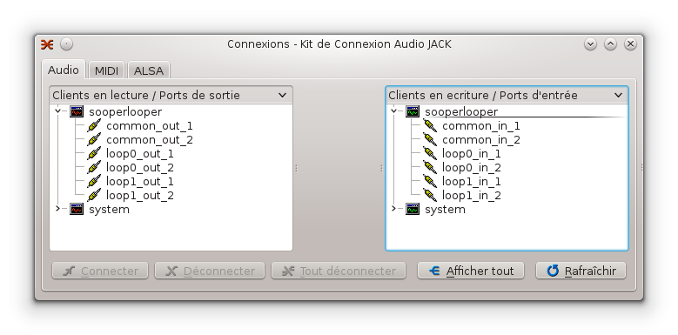
Jack side
A common inputs view,
An input by loop
A common outputs view,
One output by loop

Slide 4
Control zone
Sync to: in relation to what the other loops will synchronize
tempo: the tempo measured from the loop
8th/cycle: the number of quarter note per loop
Quantize: if quantification should be activated
Mute Quant: Quantification of 'Mute' operations
Odub Quant: Quantification of overdub 'operations
Repl Quant: quantification of 'replacement' operations'
xfade: Number of samples that will be used for Cross Fading
Input Gain: Input gain
Main in mon: gain in listening to the input (the fraction of the input that we will find
in the output)
Main out: output gain
Round: if we have to round the other tracks (black, loop, it depends on the others menus)
Rel sync :?
Auto 8th :?

Slide 5
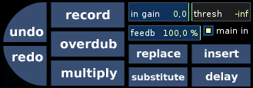
Zone Loop 1/3
The recording trigger threshold
Entry gain
The loop feedback (100% = infinite loop)
Recording (if the threshold is properly chosen, a click on record puts sooperlooper in recording / break mode. The recording is triggered by a sufficient sound level in input).
Recording with overdub (we add the new signal to the old).
Recording with multiply :?
Replace :?
Insert :?
Substitute :?
Delay :?

Slide 6
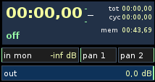
Zone Loop 2/3
Display of temporal loop information.
Entry level level
Panning 1:?
Panning 2:?
Output level of the loop

Slide 7
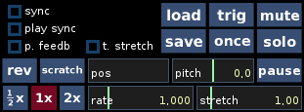
Zone Loop 3/3
Load: Loading a loop
Save: backup of a loop
Once: Play once
Solo: Solo mode for the loop
Mute: Make the loop silent
Trig: trigger
Break: break the loop
Sync : ?
Play sync : ?
p. feedb : ?
t. stretch : ?
Rev: Play the loop upside down
Scratch: Scratch mode for the loop
Pos: Position of reading the loop
Pitch:
Rate: Playing speed of the loop
Stretch: temporal stretching

Slide 8
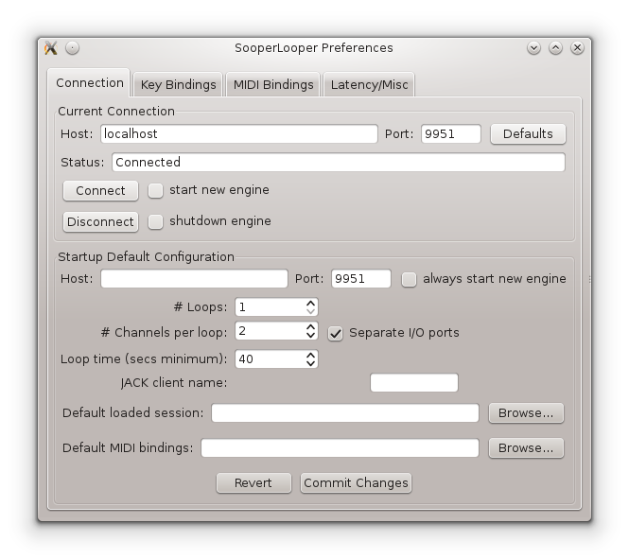
Preferences
1/4 connection
The Sooperlooper graphical interface is launching a command line tool.
These parameters correspond to the configuration of the communication channel which exists in the graphical interface and the online command tool.
These parameters are also used to configure OSC communication.

Slide 9
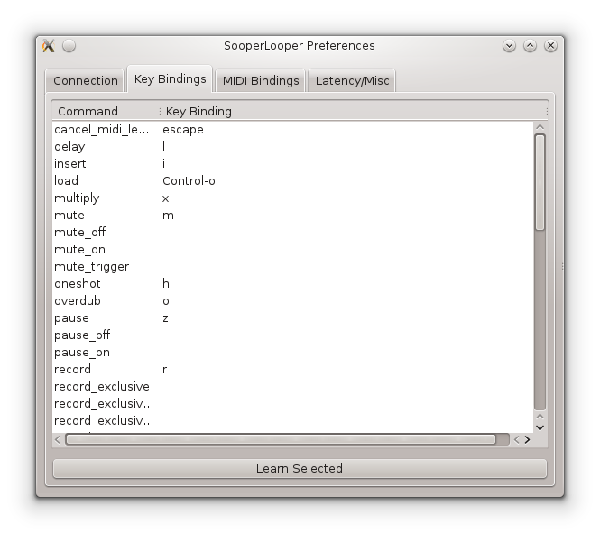
Preferences
2/4 keyboard shortcut
All keyboard shortcuts are configurable here.
They allow you to launch, stop track recordings, track readings.
They also make it possible to configure synchronization and other things.

Slide 10
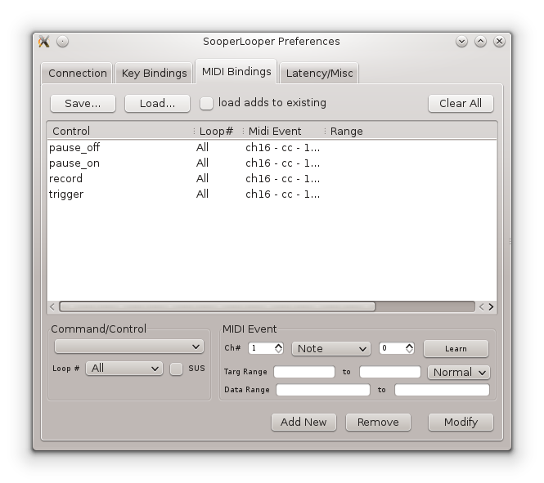
Preferences
MIDI 3/4 shortcuts
It is also possible to use MIDI messages to control Sooperlooper.
To do this, just select the command ...
To recover the MIDI message ...
And apply the new setting.

Slide 11
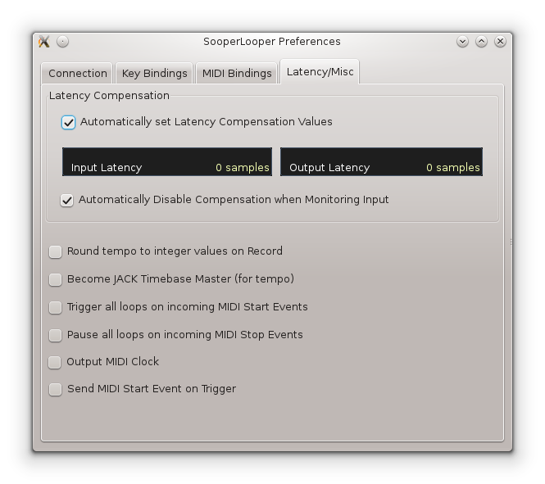
Preferences
Latency / Miscellaneous 4/4
Settings related to latency compensation and other Sooperlooper parameters.

Slide 12
SooperLooper
OSC
To control Sooperlooper with an OSC command, you must proceed as follows:
- Install Quickosc on Android
- Start Jack / SooperLooper et via the preference menu, note the port of the engine (9952 in our case)
- Via the firewall of the host machine of Sooperlooper, open the port 9952 UDP
- Recover the IP address of the WiFi connection of the host machine via 'ifconfig' (192.168.0.4 in our case)
In Quickosc:
- Configure the network (192.168.0.4:9952)
- Configure a key to send the message '/sl/0/down record'
This command allows you to activate the recording of the first track. A second sends this order will stop the recording.
To launch the recording of the second track, you must send: '/sl/1/down record'
To launch the recording of all the tracks, you must send: '/sl/-1/down record'
Sooperlooper's OSC documentation is available here:
https://sonosaurus.com/sooperlooper/doc_osc.html

