Slide 1

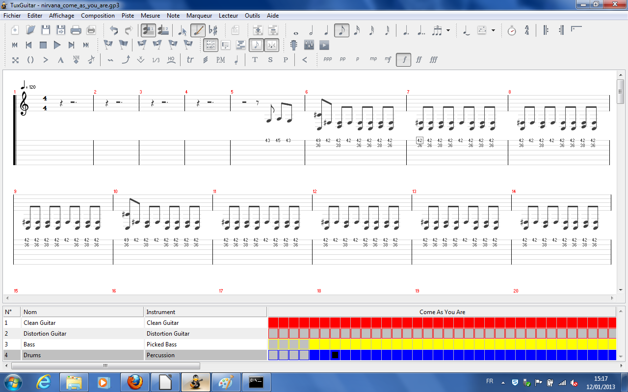
TuxGuitar
Y. Collette (ycollette.nospam@free.fr)
https://audinux.github.io

Slide 2
First settings
Some tuxguitar packages of certain Linux distributions do not have the fluidsynth module.
To activate the module, it may be necessary to download the binary archive of TuxGuitar from the website https://github.com/helge17/tuxguitar
Then you have to activate this module by going to the repertoire:
TUXGUITAR-1.2-Linux-X86/Share/Plugins/TUXGUITAR-FLUIDSYNTHE/META-INF/SERVICES
And edit the file:
org.herac.toxGuitar.Gui.System.Plugins.tgplugin
This file contains only a line:
#org.herac.tuxguitar.player.jprl.midiport.fluidsynth.midioutPutPutProviderplugin
The comment must be deleted:
org.herac.toxGuitar.player.Jprl.midiport.fluidsynth.MidioutPutPortProviderPlugin

Slide 3
Compile the development version
TuxGuitar’s development version contains interesting new features.
To compile it, you have to:
- The C compiler (GCC) and Java (Openjdk).
- Maven (MVN3).
- Development files (Jack-Dev, Fluidsynth-Dev, Alsa-Dev).
- The Git Program
# Récupérer le code source de tuxguitar
$ git clone https://github.com/helge17/tuxguitar.git
$ cd desktop/build-scripts/tuxguitar-linux-swt
# Compilation du code
$ mvn clean package -Dnative-modules=true
-Dtuxguitar-alsa.jni.cflags="-I/usr/lib/jvm/java/include -I/usr/lib/jvm/java/include/linux -O2 -fPIC"
-Dtuxguitar-jack.jni.cflags="-I/usr/lib/jvm/java/include -I/usr/lib/jvm/java/include/linux -O2 -fPIC"
-Dtuxguitar-fluidsynth.jni.cflags="-I/usr/llib/jvm/java/include -I/usr/lib/jvm/java/include/linux -O2 -fPIC"
-Dtuxguitar-oss.jni.cflags="-I/usr/lib/jvm/java/include -I/usr/lib/jvm/java/include/linux -O2 -fPIC"
# We can now start TuxGuitar
$ cd target/tuxguitar-1.3-SNAPSHOT-linux-x86_64/
$ ./tuxguitar.sh

Slide 4
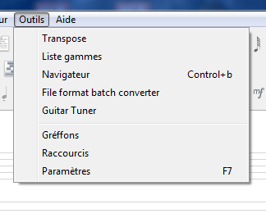
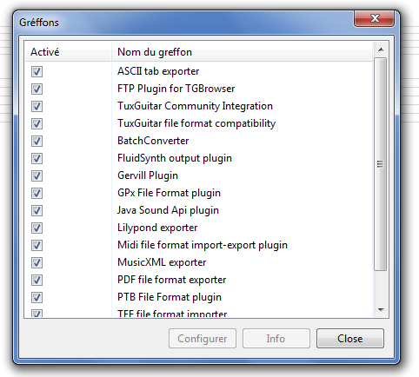
Sound libraries
1/7
To adjust the sound under TUXGUITAR, the fluidsynth plugin must be adjusted.
You have to start by clicking on tools → Plugins
Then, click on "Fluidsynth Output Plugin"
Finally, click on "Configure"

Slide 5
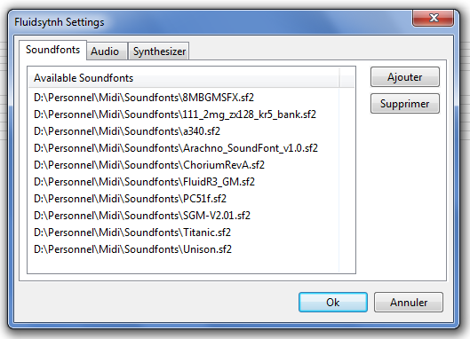
Sound libraries
2/7
We add the sound libraries by clicking on "Add".
Sound libraries are in SF2/3 formats.
They allow you to have a better sound rendering of the scores.

Slide 6
Sound libraries
3/7
The list of available sound banks.
Depending on the style of the song, one bank will be better than another.
Taille Nom
113 846 556 111_2mg_zx128_kr5_bank.sf2
7 557 598 8MBGMSFX.sf2
80 500 780 a340.sf2
91 051 196 ALL In ONE GM V1.1 Bank (87Mo).sf2
155 405 818 Arachno_SoundFont_v1.0.sf2
28 926 744 ChoriumRevA.sf2
1 689 192 084 CrisisGeneralMidi3.01.sf2
148 398 306 FluidR3_GM.sf2
52 489 526 JClive21(3).sf2
75 413 826 Musica Theoria v2 (GM).sf2
2 009 446 356 Musical Box.sf2
63 017 562 PC51f.sf2
247 406 594 SGM-V2.01.sf2
231 607 820 Titanic.sf2
29 258 148 Unison.sf2
The TuxGuitar audio system now supports the SF3 format which takes up much less space!

Slide 7
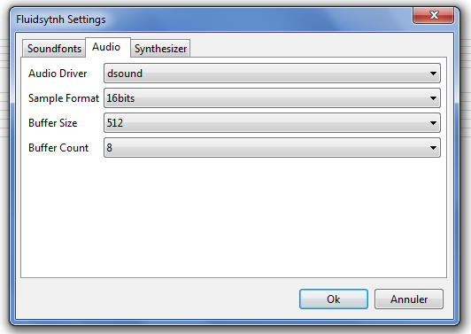
Sound libraries
4/7
Technical parameters to adjust the "reactivity" of the sound rendering.
A priori, it is not necessary to touch these parameters.
Here we choose the type of driver:
- under windows: dsound
- under Linux: jack or other

Slide 8
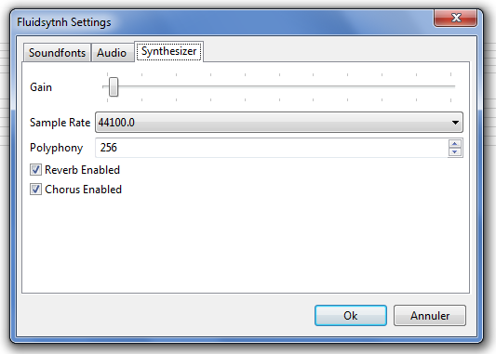
Sound libraries
5/7
Gain: allows you to adjust the basic volume of the sound. It may be necessary to increase this volume slightly.
Sample rate: Sampling frequency - We check that it corresponds to Jack, otherwise, we do not touch.
Polyphony: Number of notes playable simultaneously - we do not touch.
Reverb Enabled: if yes (checked) or not (not checked) we activate the reverberation. It increases the activity of the CPU, but the rendering is better.
Chorus Enabled: if so (checked) or not (not checked) we activate the reverberation. It increases the activity of the CPU, but the rendering is better.

Slide 9
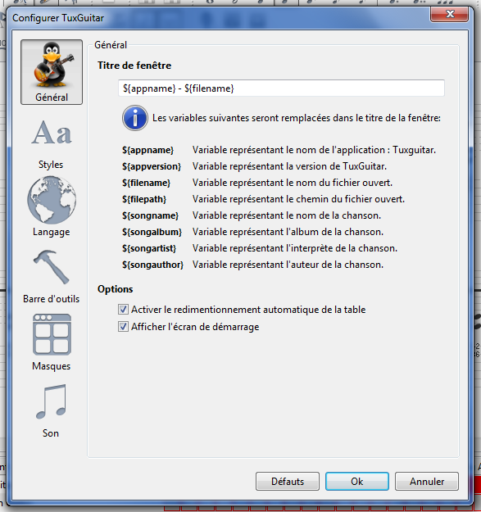
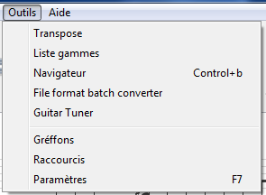
Sound libraries
6/7
Once the plugin is adjusted, you must select the sound under TuxGuitar.
You have to click on
"Tools → Settings"
Then on "Sound"

Slide 10
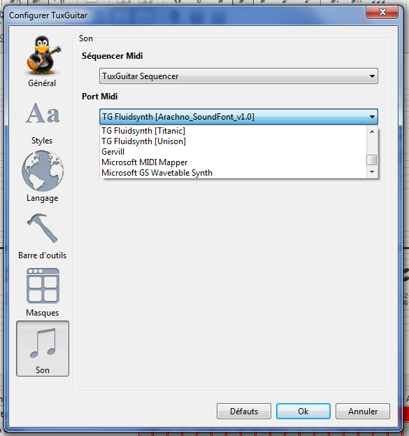
Sound libraries
7/7
Finally, we choose his sound bank and then click on "OK".
Fluidsynth sounds
Default sounds under Windows
The type of module to play the piece:
- TuxGuitar Sequencer
- Real Time Sequencer
- Jack Sequencer (controllable by Qjackctl)
The second is more greedy in CPU.

Slide 11
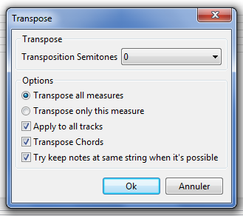
Transpose a partition
1/3
Transposition semitones: Number of half-tone for transpositions. For example, 3 → We transpose from 3 semitones to the treble.
Transpose All Measures: Transpose all measures
Transpose Only this Messure: transpose only the current measurement
Apply To All Tracks: Transpose all tracks (except percussion tracks and non transposable instruments)
Transpose Chords: also transpose the chords.
Try to Keep Notes at Same String when it's possible: we try to keep the notes on the same cords.
An example: we transpose the guitar of "nirvana - comes as you are" in 1 tone.
In certain types of music, the guitar can be granted ½ or 1 tone to the bass.

Slide 12
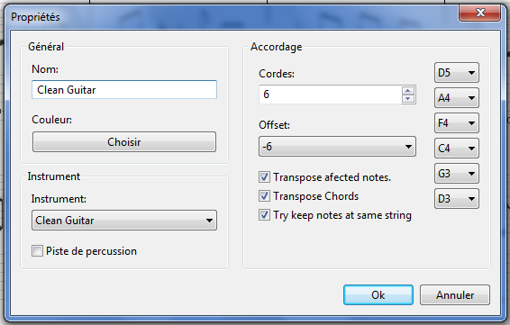
Transpose a partition
2/3
Define the number of ropes of the instruments (4 for a bass)
The standard tuning of each strings for a classic guitar:
E5-B4-G4-D4-A3-E3 (from sharp to grave)
Offset: shift the sound rendering to the treble or the grave (-6 half-people here)
Transpose Affected Notes:
Transpose the notes
Transpose Chords:
Transpose the chords
Try to Keep Notes at Same String:
Try to keep the notes on the same rope.
The Lanest of Engine: Anglo-Saxne:
A=La B=Si C=Do D=Re E=Mi F=Fa G=Sol

Slide 13
Transpose a partition
3/3
Instrument name
Track color
Instrument type
If we have a percussion track
For the example of Nirvana, after having the transposition, you have to go from:
D5-A4-F4-C4-G3-D3 in E5-B4-G4-D4-A3-E3

Slide 14
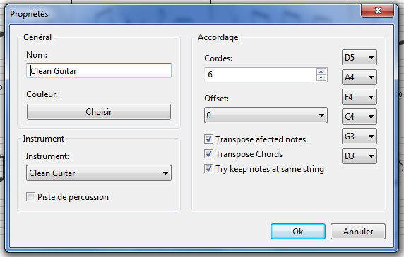
Transpose a partition
Simple version
To transpose the sound of a track without touching the notation, there is the "offset":
Offset allows you to shift the track in semitones.
Offset: number of semitones of shift
Transpose Affected Notes: Transpose the notes
Transpose Chords: Tranpose the chords
Try Keep Notes at Same String: Try to keep the notes on the same rope.
Take the piece of Nirvana and do the same exercise using the "offset".
Offset = Low in English

Slide 15
Transpose a partition
Summary
First method
Simple method
Advantage :
We transpose all the tracks at once (for sound) and just the guitar track that interests us.
Advantage :
Not many steps.
Inconvenience :
Lots of steps.
Inconvenience :
We only transpose one track.

Slide 16
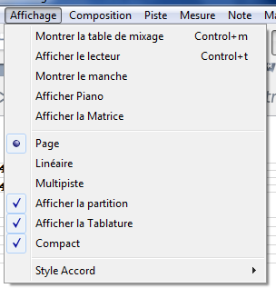
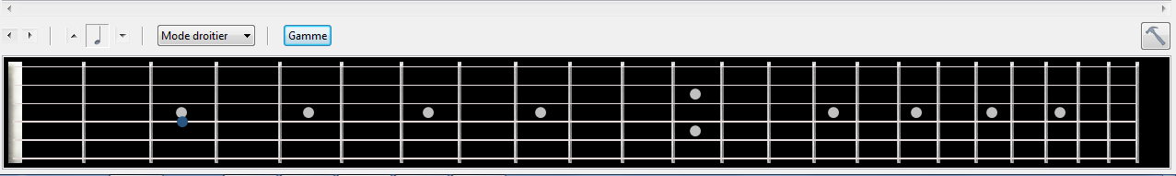
The ranges on the neck of the guitar - 1/4
We start by displaying the neck of the guitar
And we have a superb guitar neck that appears

Slide 17
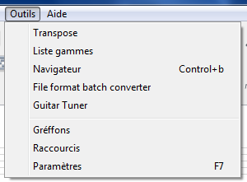
The ranges on the neck of the guitar - 2/4
Then we click on the "range" button on the neck or on tools → ranges lists

Slide 18
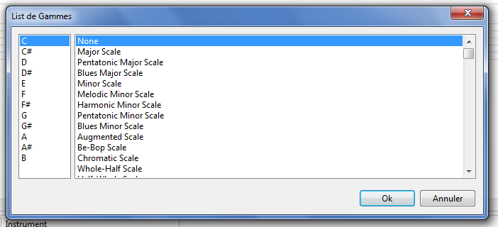
The ranges on the neck of the guitar - 3/4
A window is displayed that allows us to choose the range:
First column: the note from which we will build the range
Second column: the name of the range you want to build

Slide 19
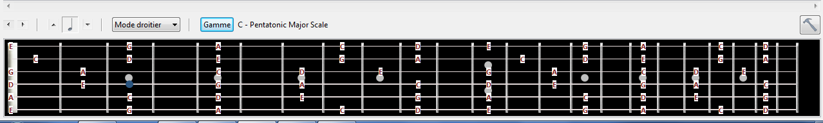
The ranges on the neck of the guitar - 4/4
An example with a range of C (DO) "Pentatonic Major Scale" (major pentatonic)
The notes in this range appear on the neck with their names

Slide 20
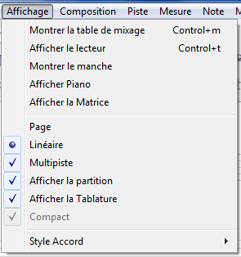
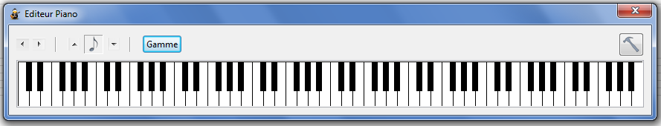
The ranges on the piano
1/2
Instead of a guitar handle, it is possible to have a piano keyboard.
You have to click on display → Show piano

Slide 21
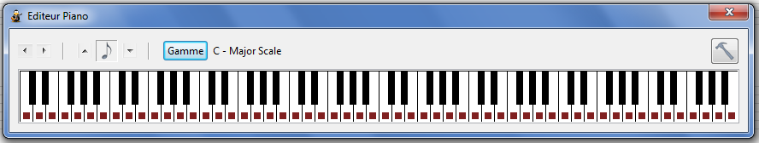
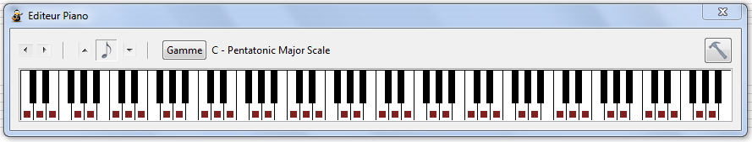
The ranges on the piano
2/2
As with the guitar handle, it is possible to display the ranges on the piano.
We click on the range then we select the range to be displayed.
Example: a range of major do
Example: a range of pentatonic major (blues).

Slide 22
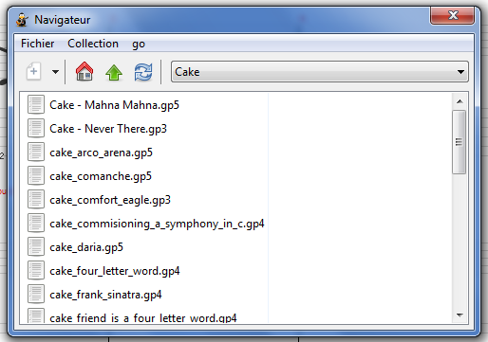
Manage tablature collections
This tool allows you to build a collection of tablatures.
Collection: allows you to add / remove directories containing tablatures.
Once a collection has been selected, to open a partition, just click on a name.

Slide 23
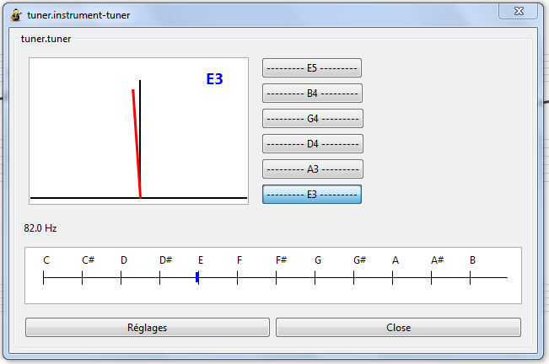
The tuner
Depending on the selected track, we have the list of strings to be tuned.
To tune a string, click on one of the buttons.
Above the high strings
Below the low strings.
In the event of difficulties in detecting the note played, you can play on certain settings.
The detection of the accuracy of the note is carried out via 3 means:
- Red needle
- The blue marker on the range
- the frequency of the note (but there, you have to know it)

Slide 24
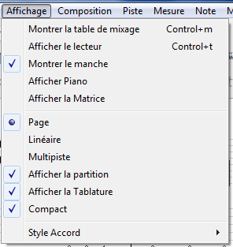
The mixer
1/2
To display the mixer: display → Show the mixer

Slide 25
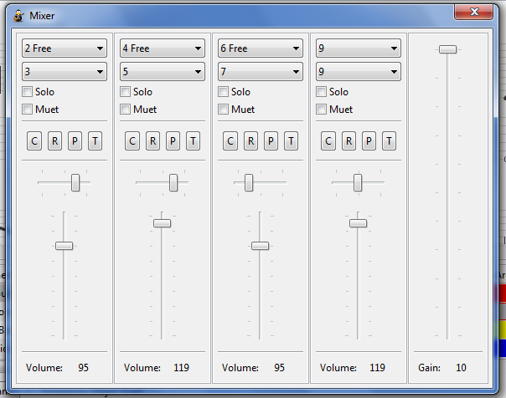
The mixer
2/2
Solo: We only play this track
Mute: we make this track silent
Midi channel
The effects associated with this track
C: chorus
A: Réverbération
P: phaser
T: Trémolo
Balance:
Center button - Sound in the center. Right button - sound to the right
Button on the left - sound on the left
Track volume
General volume

Slide 26
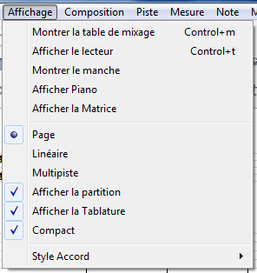
The percussion matrix
1/2
To display the mixer: display → Show the matrix

Slide 27
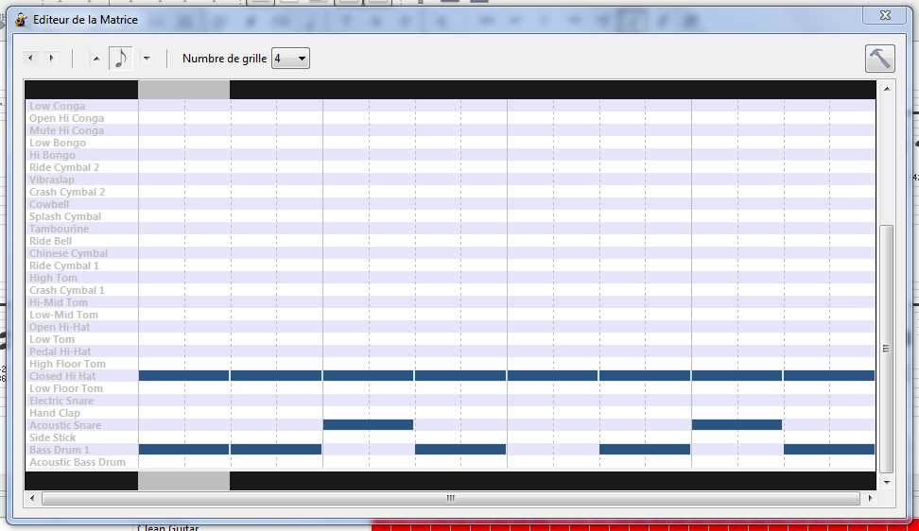
The percussion matrix
2/2
Set la size of the grid
The smallest note played
To move in a measure
List of available instruments
We click on a cell to play a percussion
Open a window to set the mode of the matrix

Slide 28
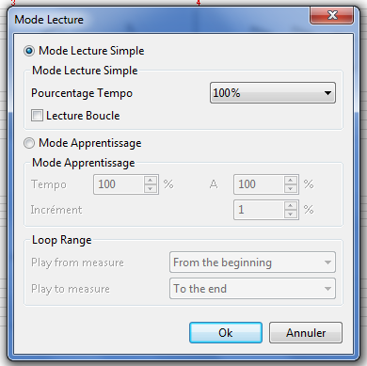
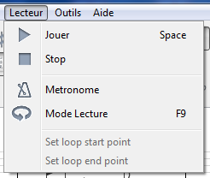
Learning mode
To learn a song, there is an interesting feature: reading mode
This mode allows you to configure a loop reading (or not) with an increase in progressive speed loop after loop.
To configure this mode:
Player → Reading mode

Slide 29
Learning mode
Percentage tempo: allows you to play the piece to a fraction of the tempo (at 50% for example). It allows you to affect the entire piece, even the tempo variations.
Loop reading: allows you to configure a reading loop (which is defined by "Loop Range" below).
Learning mode:
The first block% allows you to define the starting tempo (20% for example).
The second block% allows you to define the end tempo (80% for example).
Increment: how many percent of acceleration loop after loop.
Loop Range:
Play from Measure: Start measurement - Start -of -the -loop measurement number.
Play to Messure: end measurement - end -of -loop measurement number.

Slide 30
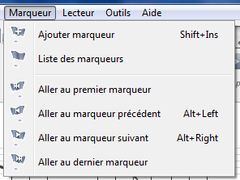
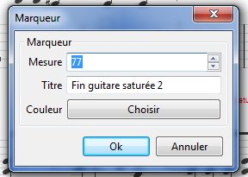
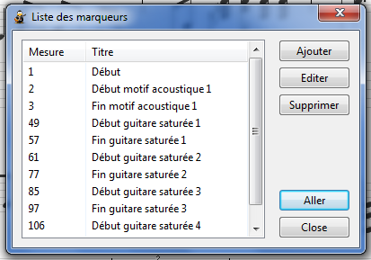
Markers
The markers allow you to add labels to a piece.
Add marker: add a marker - we choose a measure then a title for the marker and finally a color for the marker.
Lists of markers: displays all the markers of the song.
The last block allows you to move in the song via the markers

Slide 31
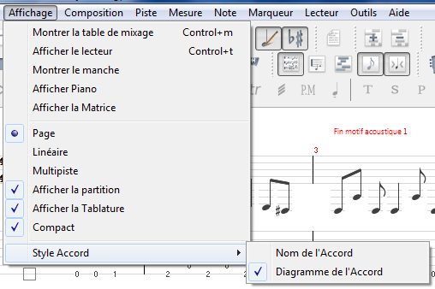
The display of a partition
Page: display page by partition page
Linear: displays on a continuous strip and not by page
Multitrack: displays all tracks under each other
Show the score: displays or not the part of the partition
Show the tablature: display or not the tablature
Compact: allows you to gain space when displaying the partition.
Chord name: displays or not the name of the chord
Chord diagram: displays or not the chord diagram

Slide 32
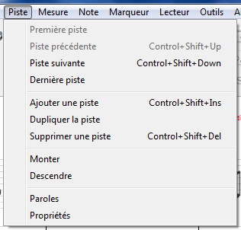
Track management
This menu allows you to manage the tracks.
You can move.
You can add / duplicate / delete.
You can move tracks.
We can manage properties as well as words associated with certain tracks.

Slide 33
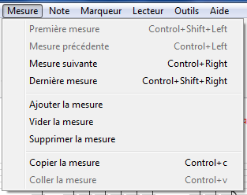
Measures management
This menu allows you to manage the measurements.
You can move.
You can add / empty / delete.
You can copy / paste.

Slide 34

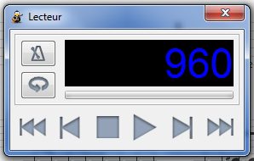
The metronome and the player
To activate / deactivate the metronome, click on this menu
The player allows you to play and move in the partition
We can activate / deactivate the metronome
We can manage the reading mode
Go to the end of the song
Go ahead
Play button
Stop button
Go back
Go to the start of the song
Position in the song in "MIDI bar"

Slide 35
Write a partition
As for writing a score, it is interesting to read this tutorial in French:
Tutorial

Slide 36
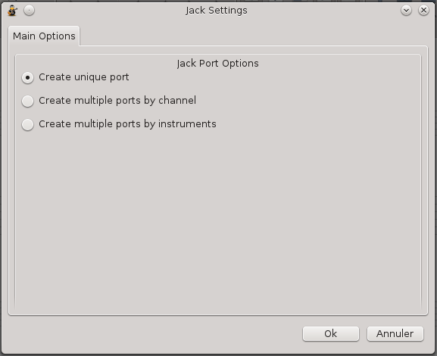
Tuxguitar
Jack plugin (linux) – 1 / 12
Single Port Create
We just have a single audio output
Create Multiple Ports by Channel
We have an output by MIDI channel.
A TuxGuitar track can contain several MIDI channels.
There are 16 MIDI channels accessible to the maximum.
Create Multiple Ports by instruments
We have an output by instrument (128 instruments in all) and an output for percussion.

Slide 37
Tuxguitar
Jack plugin (linux) – 2 / 12
The information concerning the "standard" General MIDI is accessible at the following address: https://fr.wikipedia.org/wiki/General_Midi
For sound rendering via the Jack plugin, we will use:
- Fluidsynth and its Qsynth graphical interface: https://qsynth.sourceforge.io/
- SF2/3 sound fonts
- Qtractor for multi-track recording: https://qtractor.org/

Slide 38
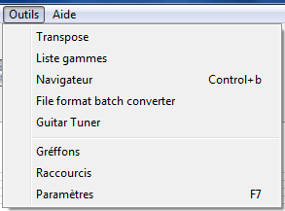
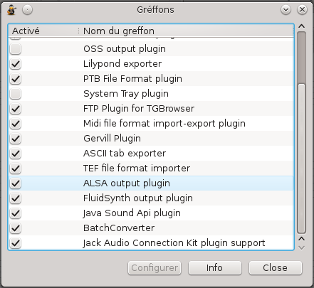
Tuxguitar
Jack plugin (linux) – 3 / 12
The Jack plugin is configurable via the “Tools → Plugins” menu

Slide 39
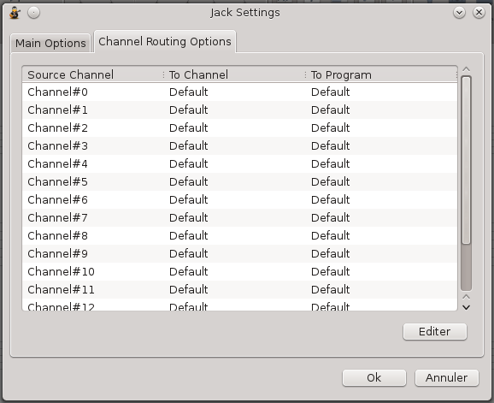
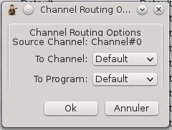
Tuxguitar
Jack plugin (linux) – 4 / 12
For each of the channels, you can select a separate output.
To do this, simply select a channel and click on "Edit".
Then the next window opens and allows you to adjust MIDI settings to which we will not touch.

Slide 40
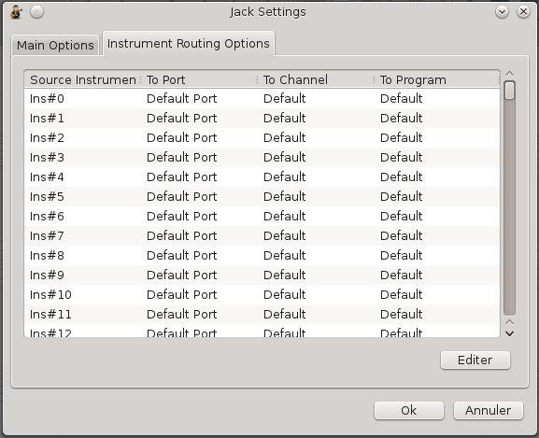
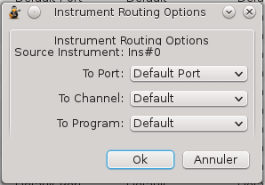
Tuxguitar
Jack plugin (linux) – 5 / 12
For each instruments, we can select a separate output.
To do this, simply select an instrument and click on "Edit".
Then the next window opens and you must select a separate output in the "to port" area.

Slide 41
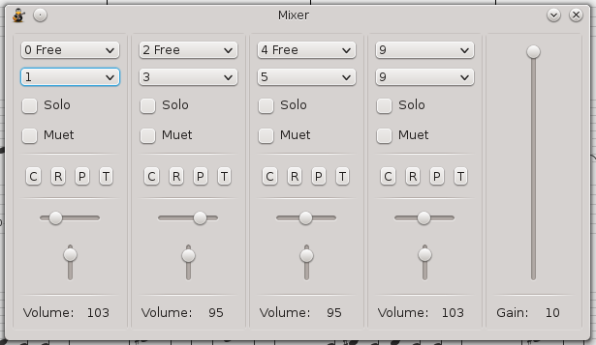
Tuxguitar
Jack plugin (linux) – 6 / 12
We will use the “Create Multiple Ports by Channel” option.
To find out the track number used by the song, we display the mixer.
For this song, the MIDI channels used are 0, 2, 4 and 9.
The first track actually uses channels 0 and 1: it is a guitar that uses "muted" sounds that uses a different MIDI channel.
It's the same with track 2 (+3) and 4 (+5). Track 9 is reserved for percussion.

Slide 42
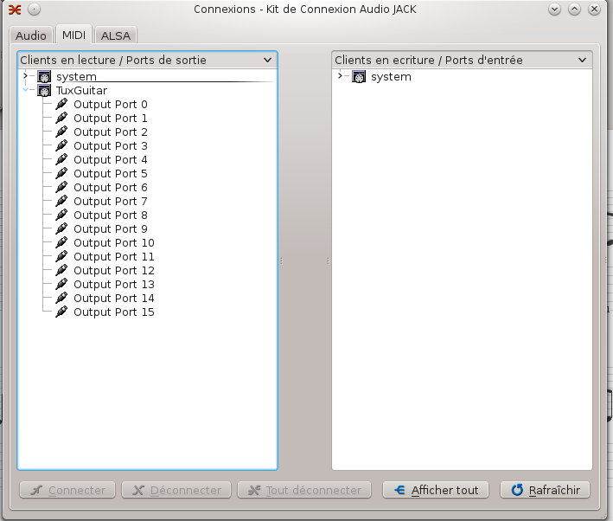
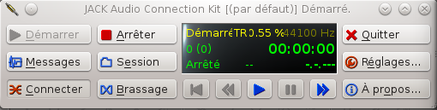
Tuxguitar
Jack plugin (linux) – 7 / 12
We start Jack then TuxGuitar by selecting the Jack MIDI jack output.
When we click on "Connect" + MIDI, we see that TuxGuitar comes out with 16 output connectors.

Slide 43
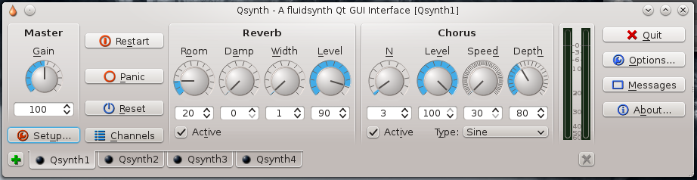
Tuxguitar
Jack plugin (linux) – 8 / 12
We are now launching "Qsynth".
We click 3 times on + to create 4 separate MIDI audio outputs.
For each tabs, we click on "Options" and we select the Jack output.
For each tabs, we click on "Options" and we select a SF2 sound make.

Slide 44
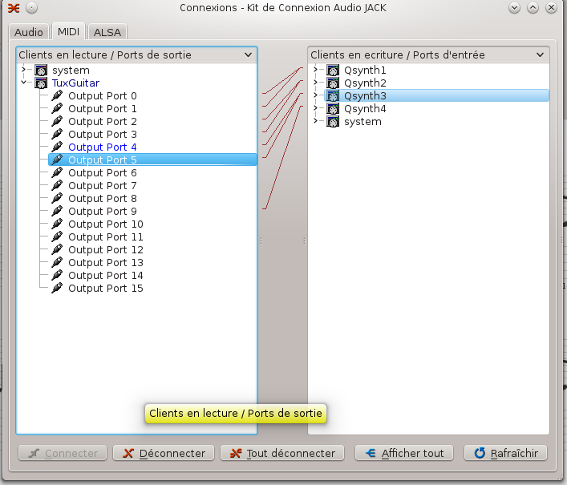
Tuxguitar
Jack plugin (linux) – 9 / 12
We connect now:
- Output Port 0
- Output Port 1
To QSynth1 → This will correspond to the instrument 1.
We connect now:
- Output Port 2
- Output Port 3
To QSynth2 → This will correspond to the instrument 2.
We connect now:
- Output Port 4
- Output Port 5
To QSynth3 → This will correspond to the instrument 3.
We connect now:
- Output Port 9
To QSynth4 → This will correspond to the drum.

Slide 45
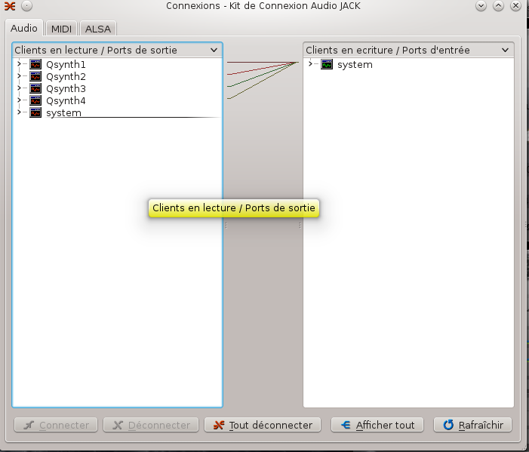
Tuxguitar
Jack plugin (linux) – 10 / 12
We now connect the audio outputs of the QSynth to the main audio output ("audio" tab).
Without this step, no sound when you start the song under TuxGuitar.

Slide 46
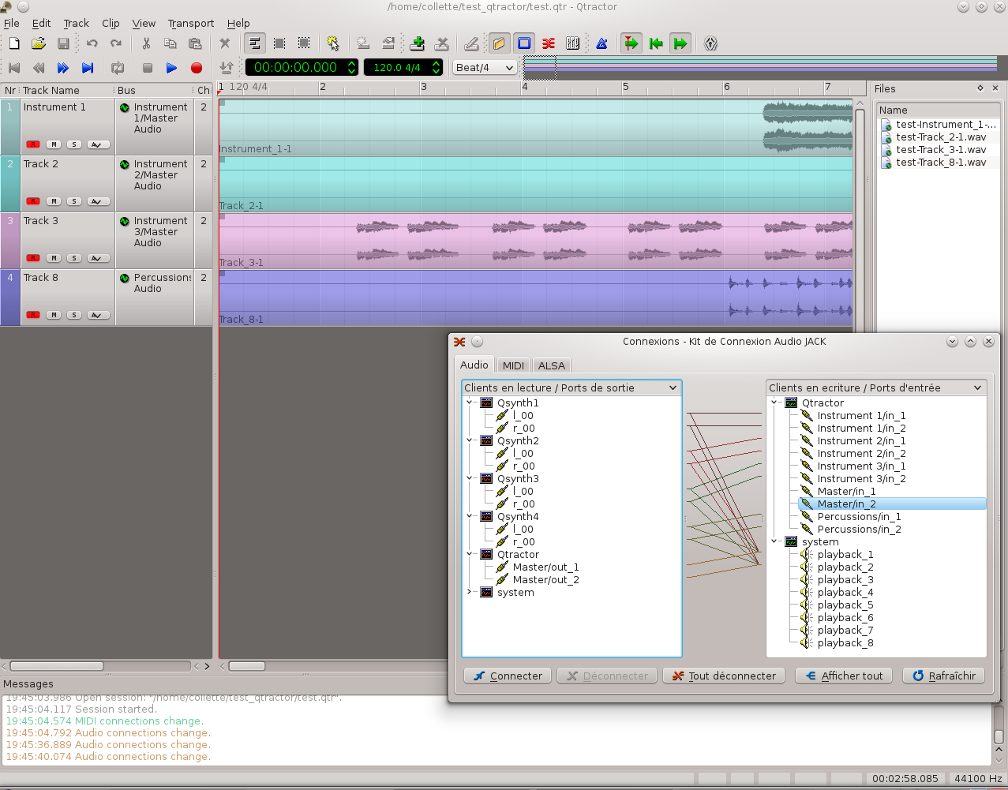
Tuxguitar
Jack plugin (linux) – 11 / 12
We are now launching "Qtractor".
We add 4 stereo audio tracks.
These tracks appear in Jack Audio tab.
For recording we connect each QSynth output to a Qtractor input.
The Qtractor output is then connected to the main audio output.
We also connect the QSynth outputs to the main audio output (to get along during recording).

Slide 47
Tuxguitar
Jack plugin (linux) – 12 / 12
It is now possible to add an additional track to Qtractor and record all of the track that we play.
Then comes the mixing stage (the placement of the tracks in the sound space and the addition of sound processing to improve the quality of the track) then the export of these tracks to a WAV or MP3 format.
It is possible to replace the Qsynth output which takes care of making the drum part with the "Hydrogen" software. The drum rendering will then be even better.
It is also possible to play on the channels and program in the Jack plugin of TuxGuitar to assign each outing to a channel and a particular program.
In some cases, the sound make them specialize in certain sounds (guitar, bass, piano) and the guitar instrument (for example) no longer has the same position as in the standard MIDI.

Slide 48


TuxGuitar 1.3
Mix it
V: Volume
B: Balance
A: Reverb
C: Chorus
T: Tremolo
P: Phaser
Main Volume
Instrument Zone

Slide 49


TuxGuitar 1.3
The sound mode 'Jack MIDI'

Slide 50
TuxGuitar 1.3
The sound mode 'Jack MIDI'
If we check 'Exclusive Jack Port', we have a unique output for the corresponding track, otherwise the track is assigned to the overall MIDI exit

Slide 51




TuxGuitar 1.3
The new menus
Metronome
Count before launch of the song
A reading mode panel
Play
Tools
Jack connections management

Slide 52

The rest ...
MuseScore: https://musecore.org/fr
Version 4 supports tablatures and GuitarPro format

Slide 53

The rest ...

