Slide 1
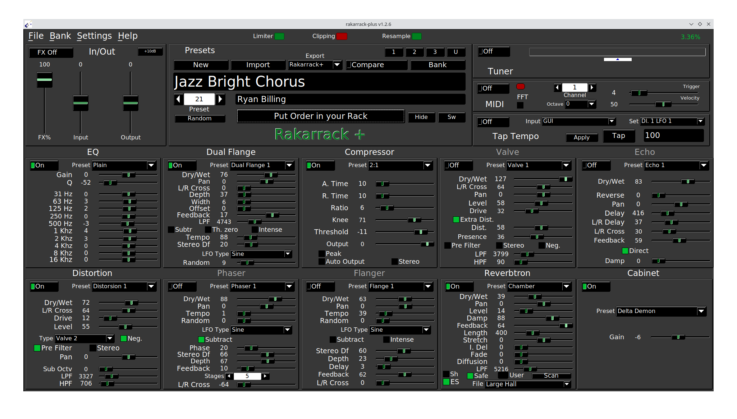
Rakarrack

Slide 2
Introduction
Rakarrack (plus) is a multi-effect for guitar. A little bit similar to guitarix.
Rakarrack is really interesting for creative sound.
It has some really interesting effect Guitarix has not.
In the mean time, rakarrack is a little bit less efficient with distortion / overdrive.

Slide 3
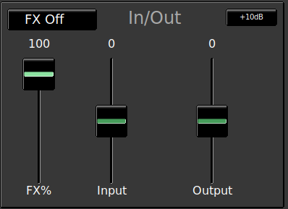
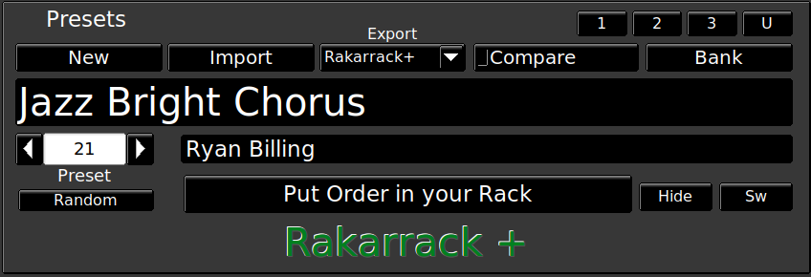
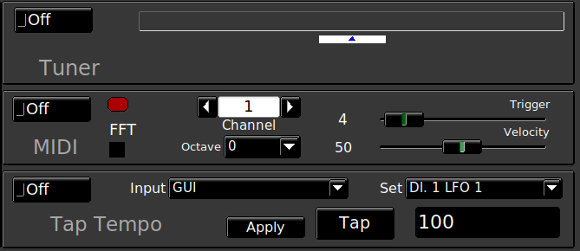
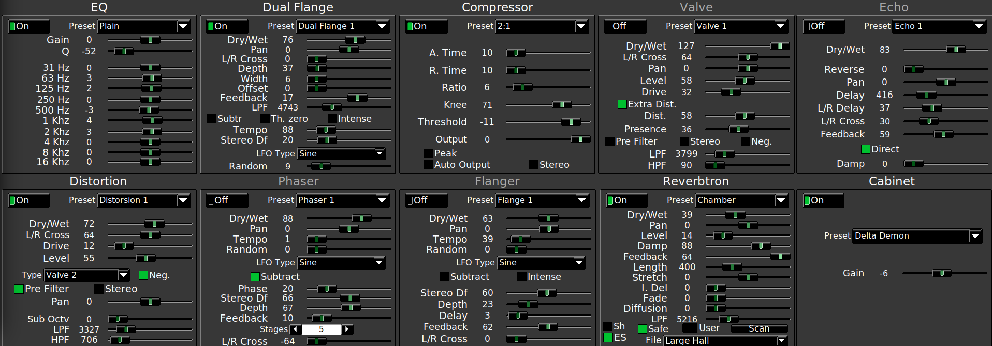
Global view
Input signal
Presets
MIDI / Tuning
Effects area

Slide 4
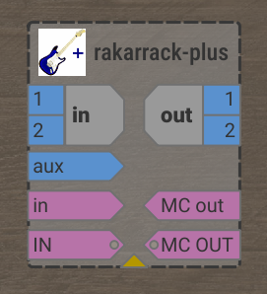
Jack View
Audio Input
Audio Output
Aux Input
MIDI Input
MIDI Output
The Aux input is mainly dedicated to vocoder but can also be used with the ‘ACI’ (Analog Control Input → Settings / ACI)

Slide 5
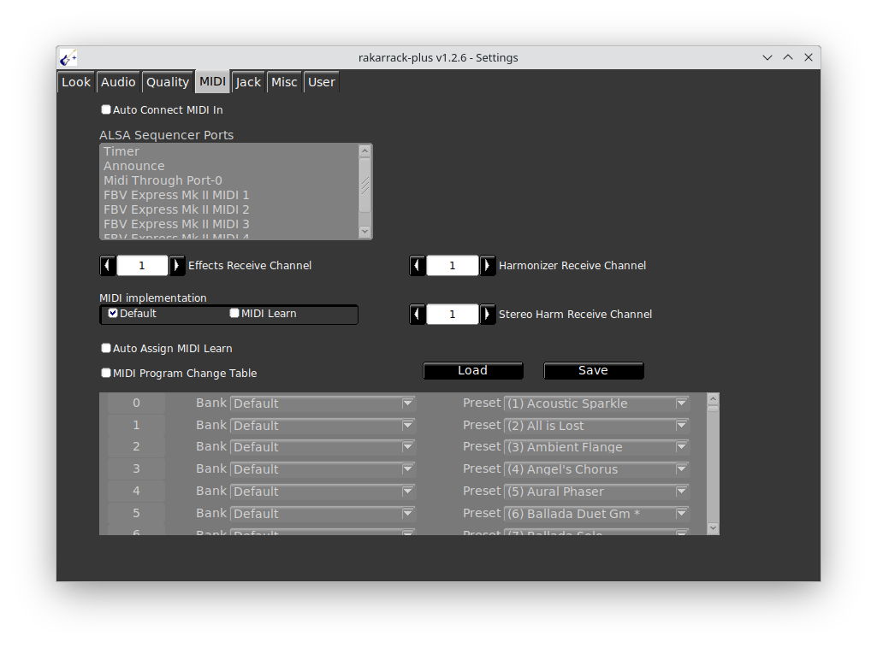
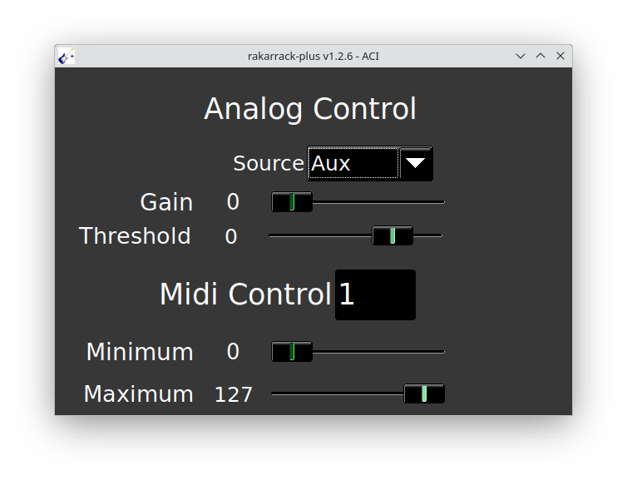
Control Parameters
The ACI allows you to generate a MIDI signal via an audio signal sent to the AUX input.
This MIDI Windows allows you to select presets triggered by MIDI Program change

Slide 6
Effect List
AlienWah
Analog Phaser
Arpie
Cabinet
Chorus
Coil Crafter
CompBand
Compressor
Convolotron
Derelict
DistBand
Distortion
Dual Flange
Echo
Echotron
Echoverse
EQ
Exciter
Expander
Flanger
Harmonizer
Infinity
Looper
MusicalDelay
MuTroMojo
NoiseGate
Opticaltrem
Overdrive
Pan
Parametric EQ
Phaser
ResSolution
Reverb
Reverbtron
Ring
Sequence
ShelfBoost
Shifter
Shuffle
StereoHarm
StompBox
Sustainer
Synthfilter
Valve
VaryBand
Vibe
Vocoder
WahWah

Slide 7
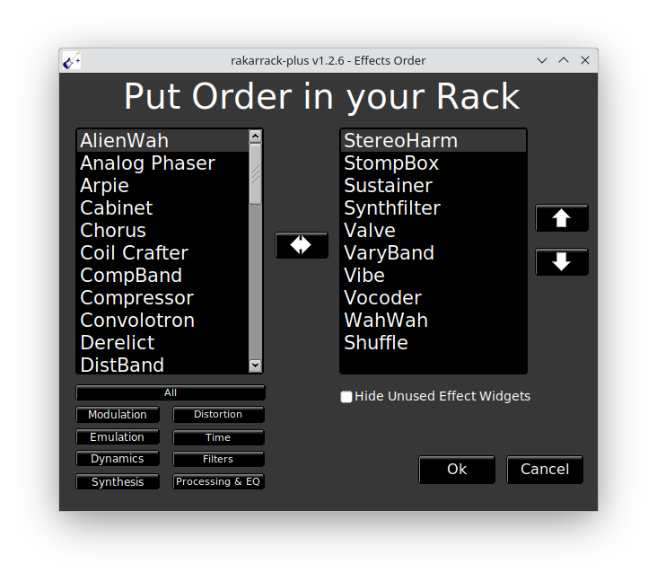
Preset configuration
Available effects
Preset effects
Reorder preset effects chain
Filter available presets

Slide 8
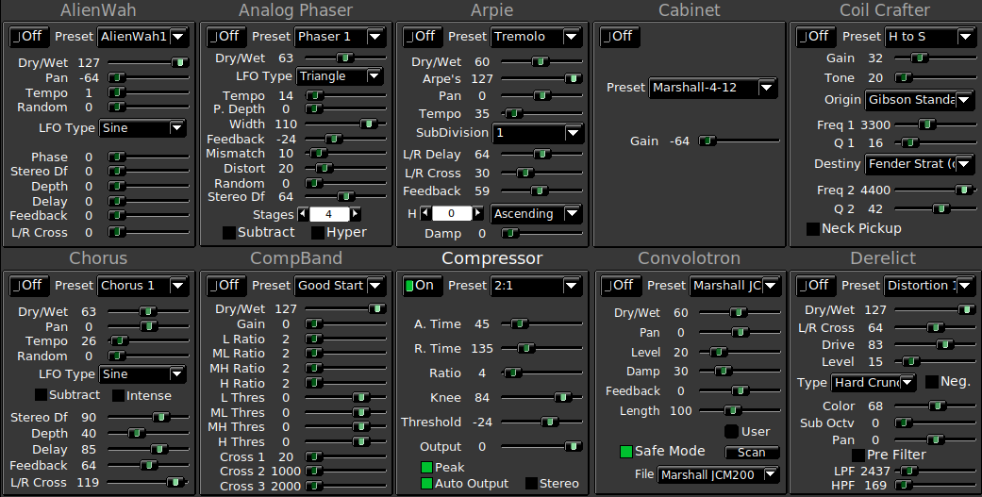
Effect List

Slide 9
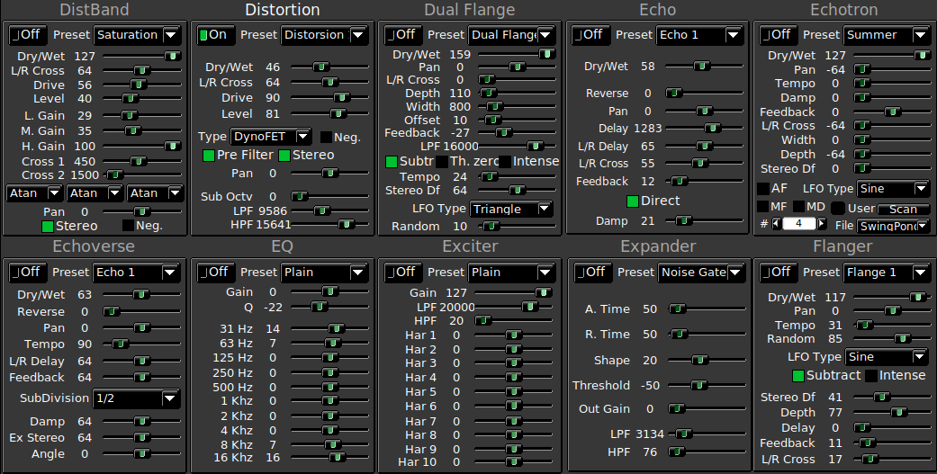
Effect List

Slide 10
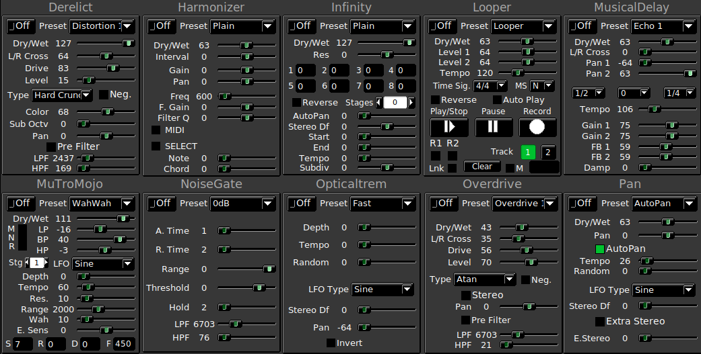
Effect List

Slide 11
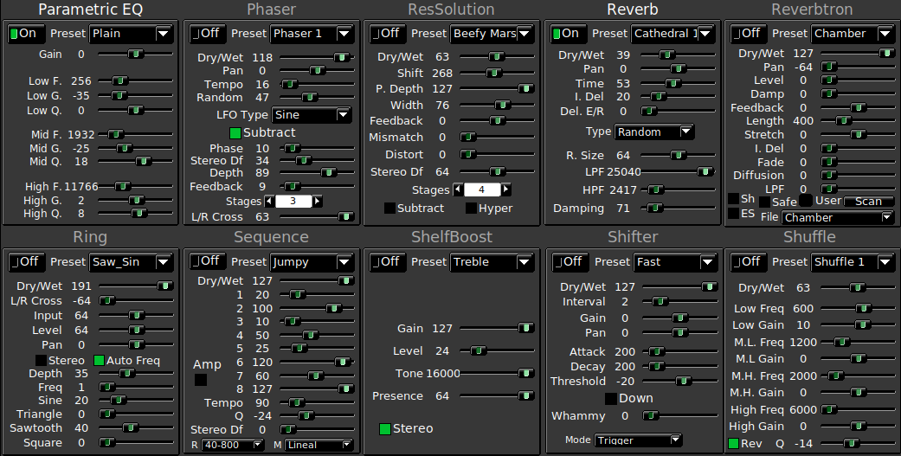
Effect List

Slide 12
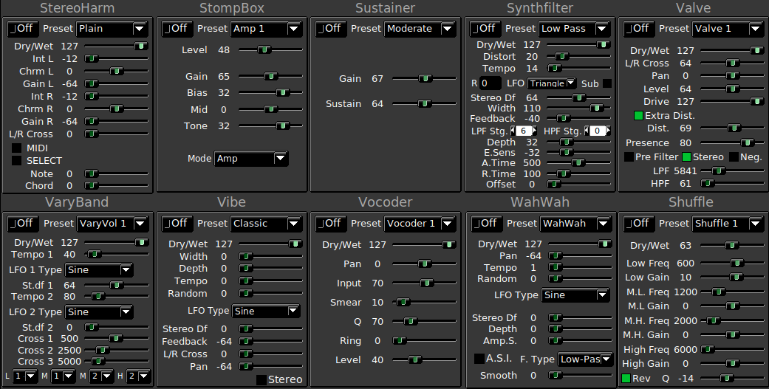
Effect List

Slide 13
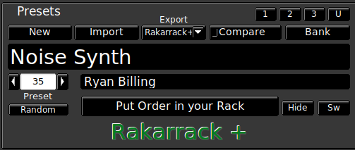
Preset management
Import a Rakarrack preset in rkr format
Compare changes made to default preset
Export to Carla or Non Mixer XT
New preset
Select set bank of presets
Switch between metronome and MIDI note detection
Fill randomly a preset
Change effects and reorder the effects in the preset
Hide unused effects

Slide 14
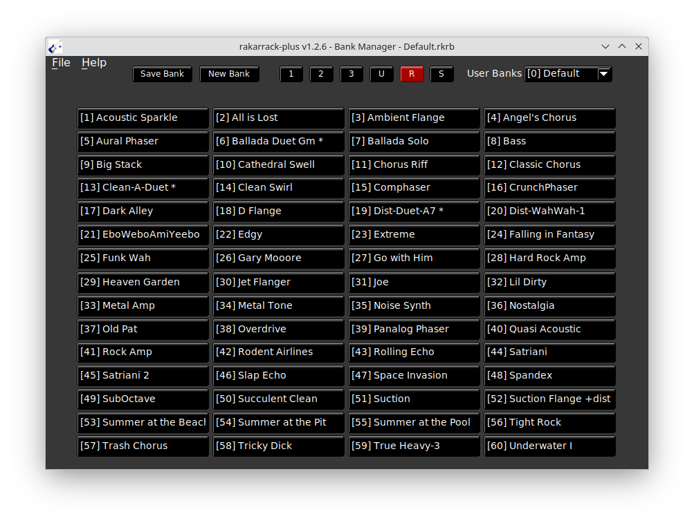
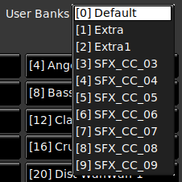
Preset Management
Default banks
User banks
Preset

Slide 15
Details
The Rakarrack-plus configuration file can be found here :
.fltk/github.com.Stazed.rakarrack.plus/rakarrack-plus.prefs
The github repository :
https://github.com/Stazed/rakarrack-plus
Installing rakarrack-plus :
$ dnf install rakarrack-plus

