Slide 1
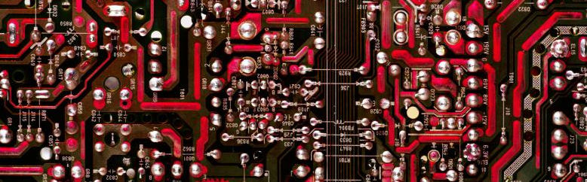
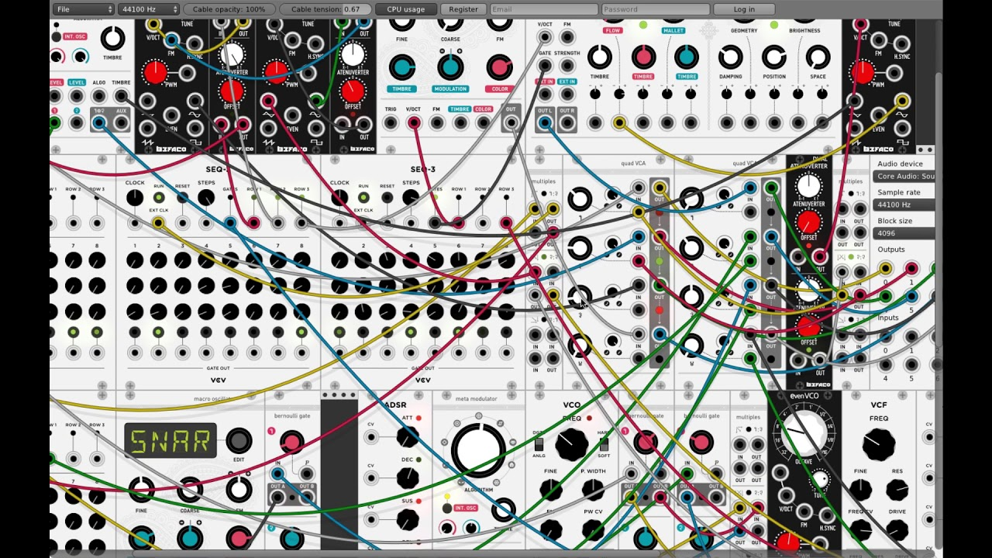
VCV Rack
Y. Collette (ycollette.nospam@free.fr)
https://audinux.github.io/

Slide 2
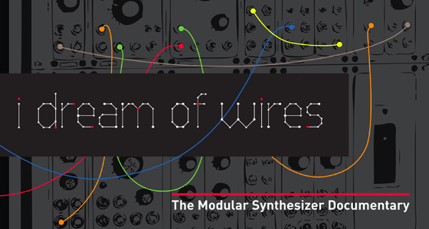
Modular Synthesis
http://www.idreamofwires.org/
A documentary on modular synthesis.

Slide 3
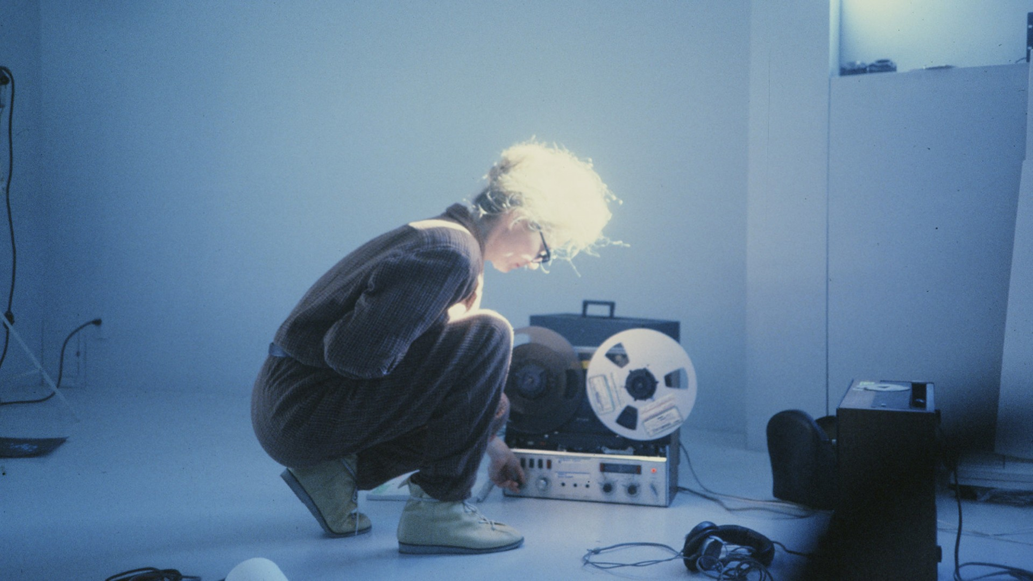
Modular Synthesis
https://sisterswithtransistors.com/
A documentary on the female pioneers of modular synthesis.

Slide 4
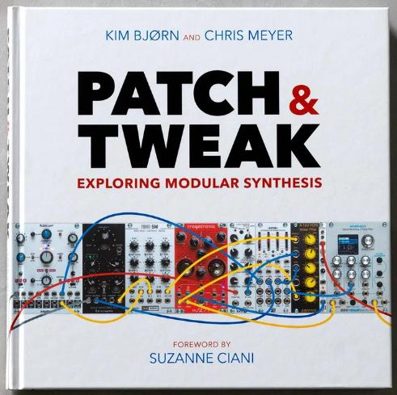
Book
A great book about modular synthesis :
PATCH & TWEAK
You can download associated resources via this link :
PATCH & TWEAK resources

Slide 5




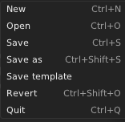

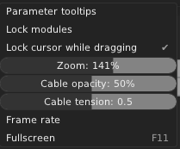
Menu bar
To be able to install VCV Rack plugins on Windows and MacOS, you must create an account on https://vcvrack.com/

Slide 6
Before we start
We will use the following modules from VCV Rack :
- Fundamental - https://vcvrack.com/Fundamental
- SV modular - https://vcvrack.com/DrumKit
- AS - https://library.vcvrack.com/AS
- Impromptu - https://library.vcvrack.com/ImpromptuModular
- Audible Instruments - https://library.vcvrack.com/AudibleInstruments
- Squinky labs - https://library.vcvrack.com/squinkylabs-plug1
- aridacity - https://library.vcvrack.com/aridacity
- Befaco - https://vcvrack.com/Befaco
- Eseries - https://vcvrack.com/ESeries
- Aaron Static - https://library.vcvrack.com/AaronStatic
- BogAudio - https://library.vcvrack.com/Bogaudio
- Valley - https://library.vcvrack.com/Valley
- Bark - https://library.vcvrack.com/Bark

Slide 7
Before we start
To install these modules :
- on MacOS / Windows : create an account (it’s free) and then click on each of the links and register to this module. An installation will be perfomed and once this is done, you will have to restart VCV Rack.
On Linux / Fedora, install the LinuxMAO COPR repository and then the VCV Rack plugins :
$ dnf copr enable ycollet/linuxmao
$ dnf install rack-v1-DrumKit \
rack-v1-AS \
rack-v1-ImpromptuModular \
rack-v1-AudibleInstruments \
rack-v1-squinkylabs-plug1 \
rack-v1-aridacity \
rack-v1-Befaco \
rack-v1-ESeries \
rack-v1-AaronStatic \
rack-v1-Bogaudio \
rack-v1-Valley \
rack-v1-Bark
And then start Rack &.

Slide 8
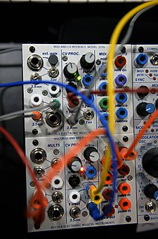
VCV Rack
Control Voltage / Gate /Trigger
Two methods exist to control via a voltage (CV) :
The CV (in octave per volt), which Robert Moog invented, is used by the majority of modular synth manufacturer, and also by the EuroRack norm.
To go to the next octave, you just have to add one volt (this will multiply by 2 the frequency), and substract one volt to go to the lowest octave (this will divide the frequency by 2).
The GATE signal is used to notify the switching on / off of an action.
The TRIGGER signal is a pulse notifying the switching on / off of an action.
https://fr.wikipedia.org/wiki/CV/gate

Slide 9
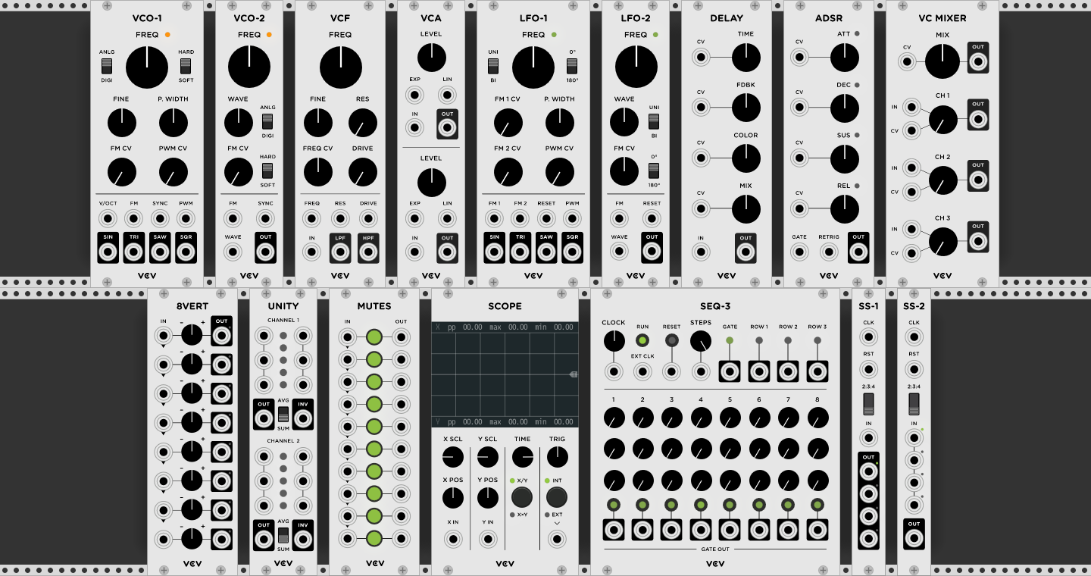
Fundamental Modules

Slide 10
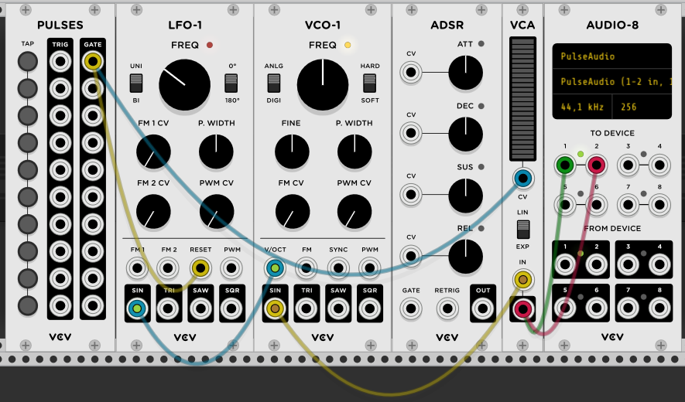
Fundamental Modules
The fundamental modules gives you access to all the basic modules we can find in modular synthesis. Really useful to learn modular synth.
We will present all these modules some slides after ...

Slide 11
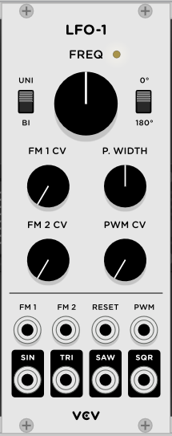
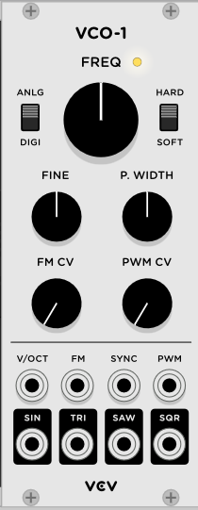
VCO / LFO
Some basic building blocks :
VCO : Voltage Control Oscillator
Black connectors : outputs
Grey connectors : CV inputs
This oscillator produces audible frequencies
LFO : Low Frequencies Oscillator
The oscillator produces low frequencies. It will be used to control other devices.

Slide 12
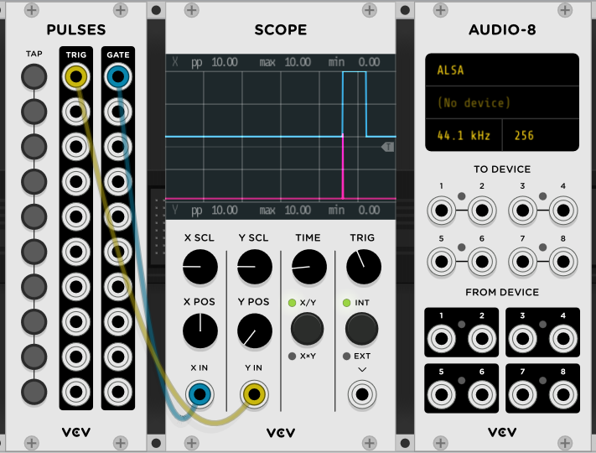
Gate / Trigger

Slide 13
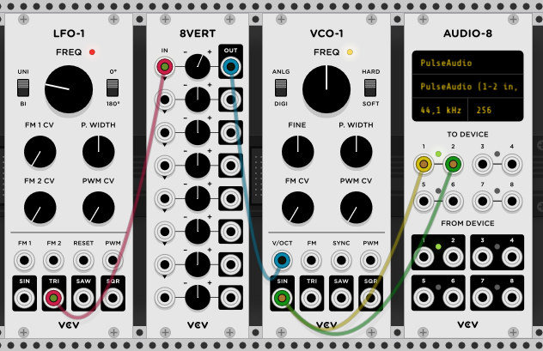
VCO / LFO
Example
You can use an attenuverter
Audio-8 Input / Output
Attenuator
To speaker
From Microphone

Slide 14
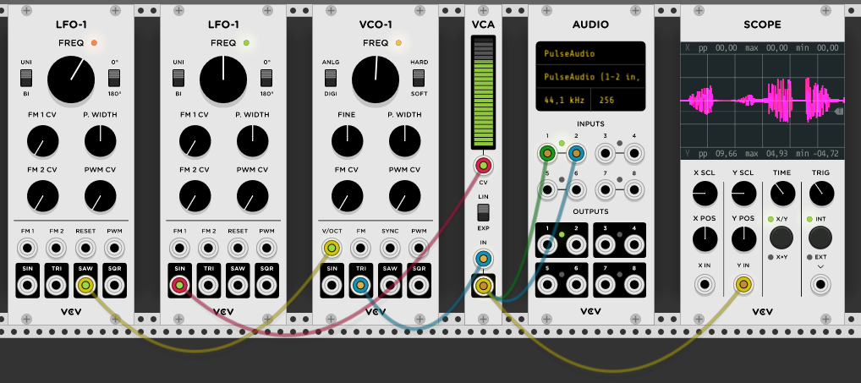
A Simple Example
Fundamental
LFO1
Fundamental
VCO1
Core
Audio
Fundamental
LFO1
Fundamental
VCA1
Fundamental
Scope

Slide 15
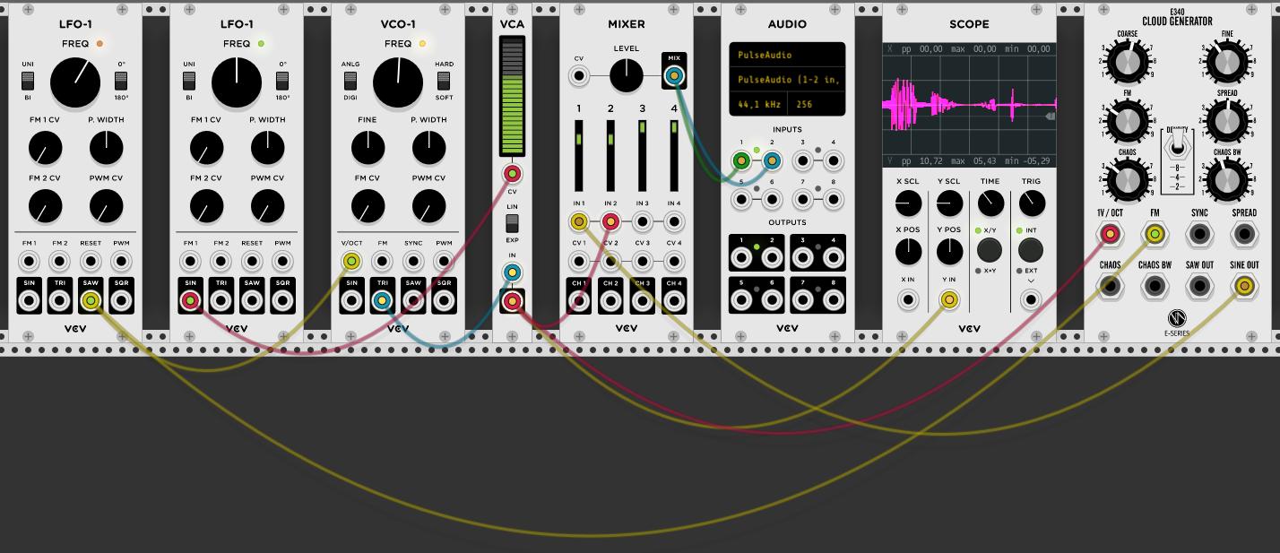
An Example with the Cloud Generator
Fundamental
LFO1
Fundamental
VCO1
Fundamental
Mixer
Fundamental
Scope
Fundamental
LFO1
Fundamental
VCA1
Core
Audio
Befaco
Cloud Generator

Slide 16

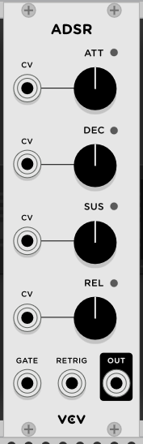
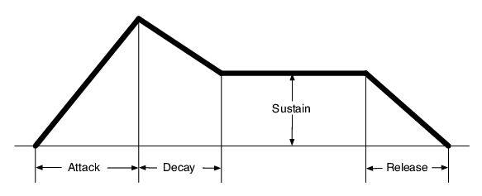
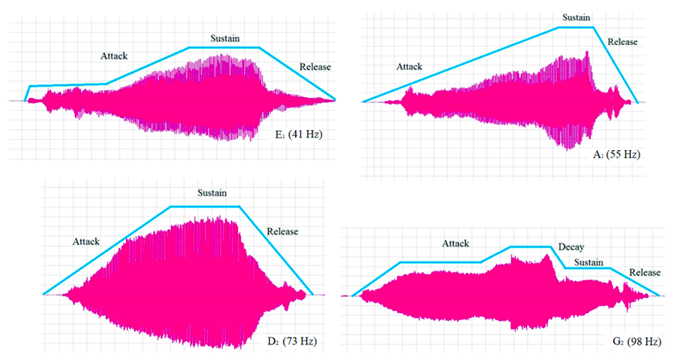
ADSR / VCA
ADSR :
Attack
Decay
Sustain
Release
Produces a signal which will be used to control the amplitude of a sound
VCA : Voltage Control Amplifier
Most of the time, an ADSR enveloppe is used with a VCA

Slide 17
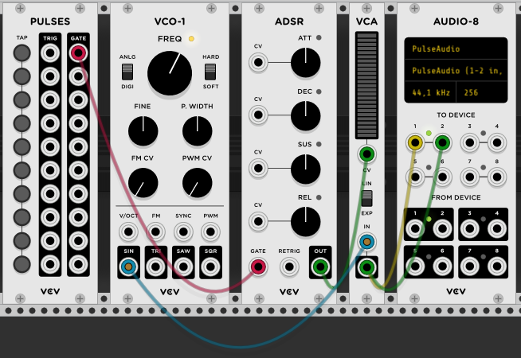
ADSR / VCA
Example
Pulses generator
This button will trigger the sound modulated by the enveloppe

Slide 18
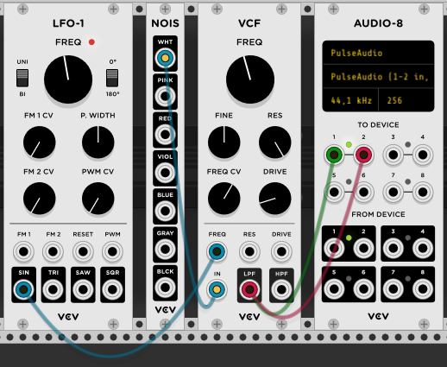
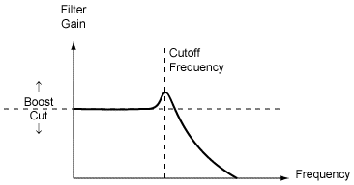
VCF
Example
VCF : Voltage Control Frequency
A filter (low pass or high pass) controled by a CV signal.
FREQ/CV : the sensivity to the of the cutoff frequency wrt the CV signal amplitude.
RES : The resonance of the filter

Slide 19
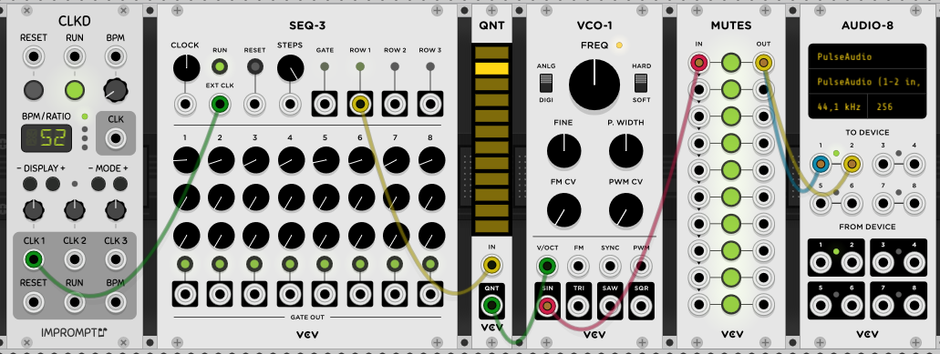
Sequencer
Example
Clock module
To adjust the speed of the sequencer
Quantizer
To transform the continuous signal into discrete levels
You can disable some levels by clicking on them
8 notes sequencer

Slide 20
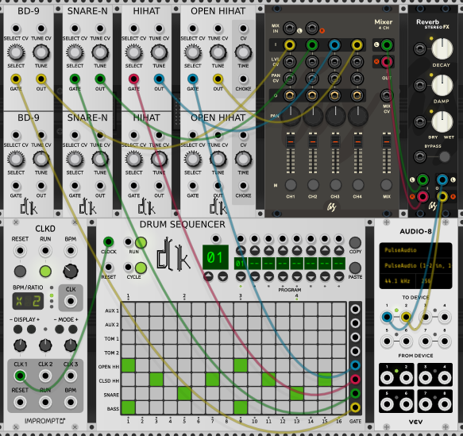
Drum Sequencer
Bass drum, snare, hit hat from SV modular
Drum sequencer from SV modular
Mixer and Reverb from AS
Clock from Impromptu

Slide 21
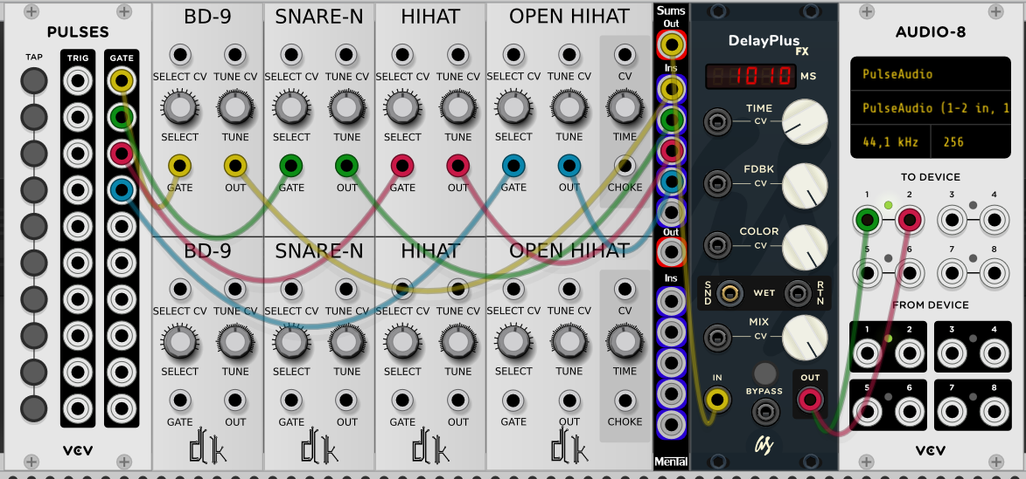
Drum Sequencer 2
Bass drum, snare, hit hat from SV modular
AUDIO-8 from Fundamental
PULSES from Fundamental
Sums from Mental
DelayPlus from AS

Slide 22
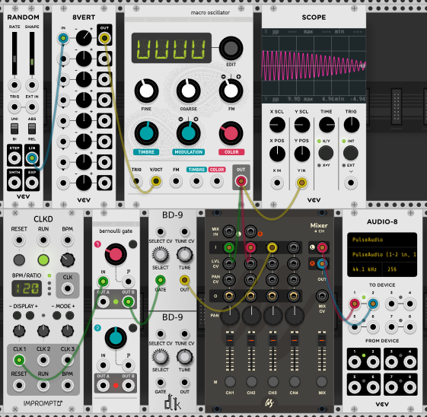
Playing with randomness
Macro oscillator and Bernouilli gate from Audible Instruments
Clock from Impromptu
Bass drum from SV Modular
Mixer from AS
All the other modules from Fundamental

Slide 23
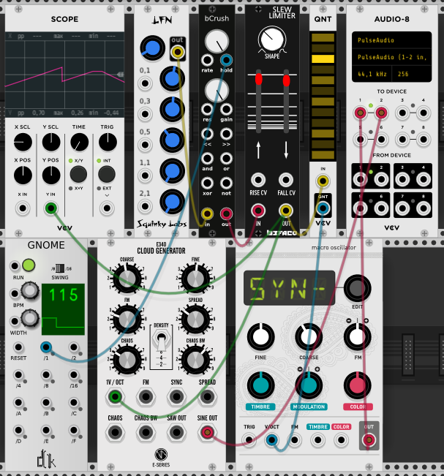
Some melodies ?
A random generator from Squinky lavs
bCrush from aridacity
Slew Limiter from Befaco
Cloud Generators from Eseries
Clock from SV Modular
Macro oscillator from Audible Instruments

Slide 24
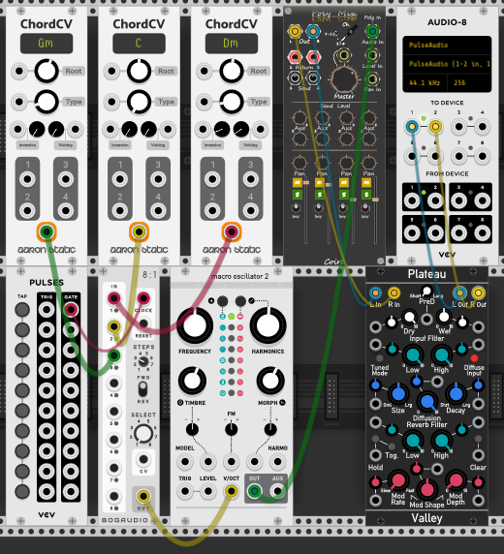
Chords progression
ChordCV from Aaron Static
8 to 1 from BogAudio
Macro Oscillator 2 from Audible Instruments
Plateau from Valley
Coirt from Bark (Poly to stereo mixer)

Slide 25
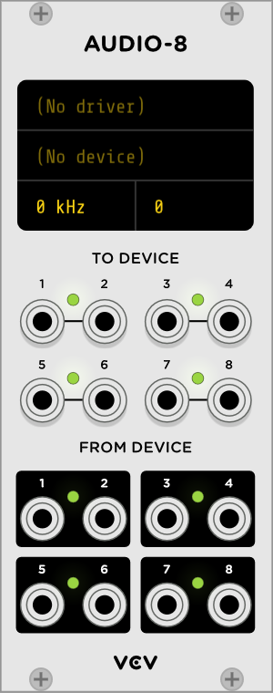
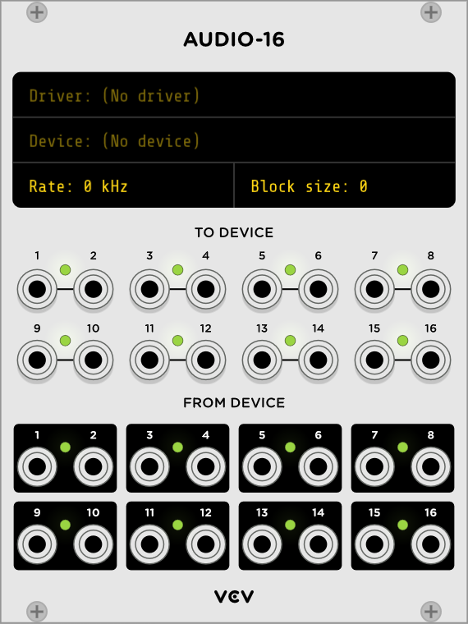
The Core Plugins https://vcvrack.com/manual/Core
Audio Driver
Audio Inputs
Sampling Frequency
Outputs
Inputs

Slide 26
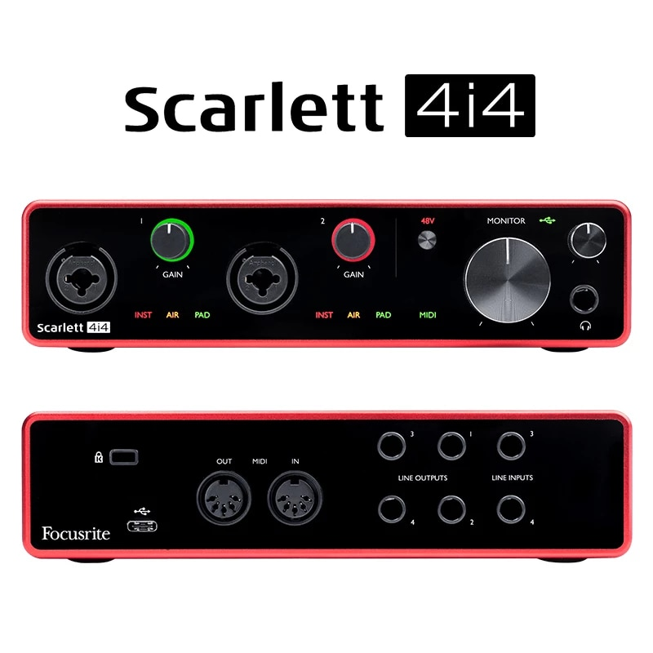
The Core Plugins https://vcvrack.com/manual/Core

Slide 27
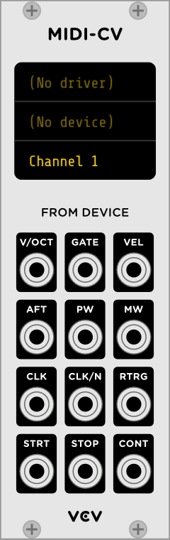
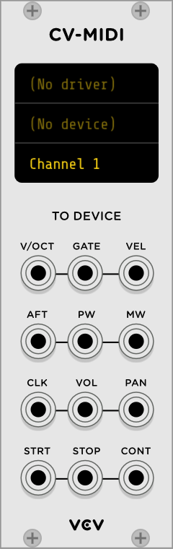
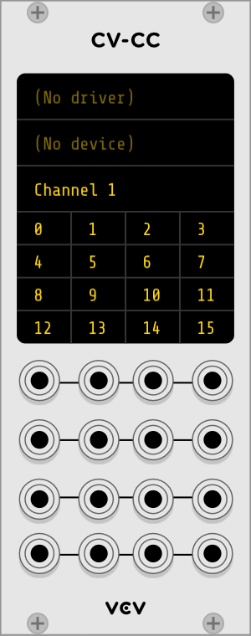
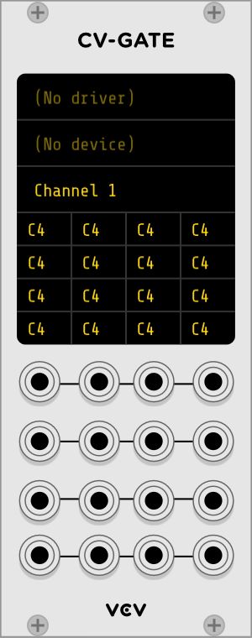
The Core Plugins https://vcvrack.com/manual/Core

Slide 28
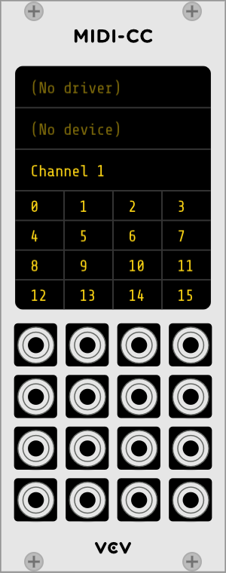
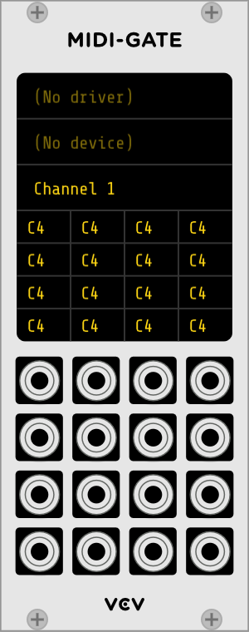
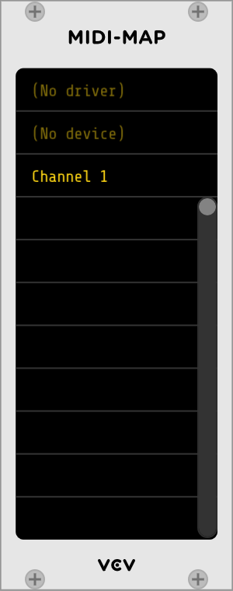
The Core Plugins https://vcvrack.com/manual/Core

Slide 29
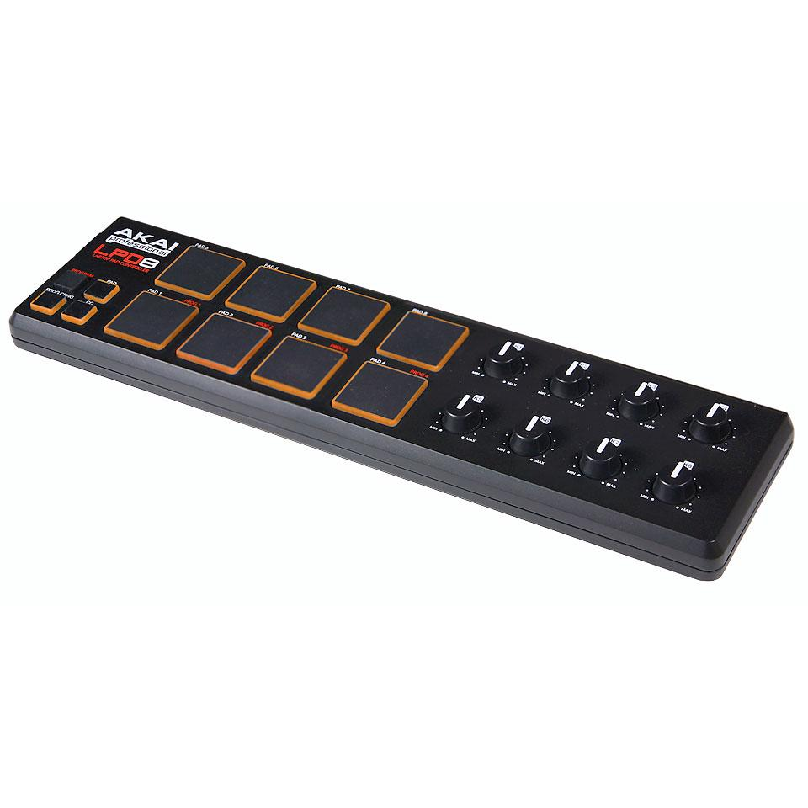
Control via MIDI
Rotage the knob in the module
Click on one empty space
And now the real knob is connected to the VCV Rack knob
Rotate the knob

Slide 30
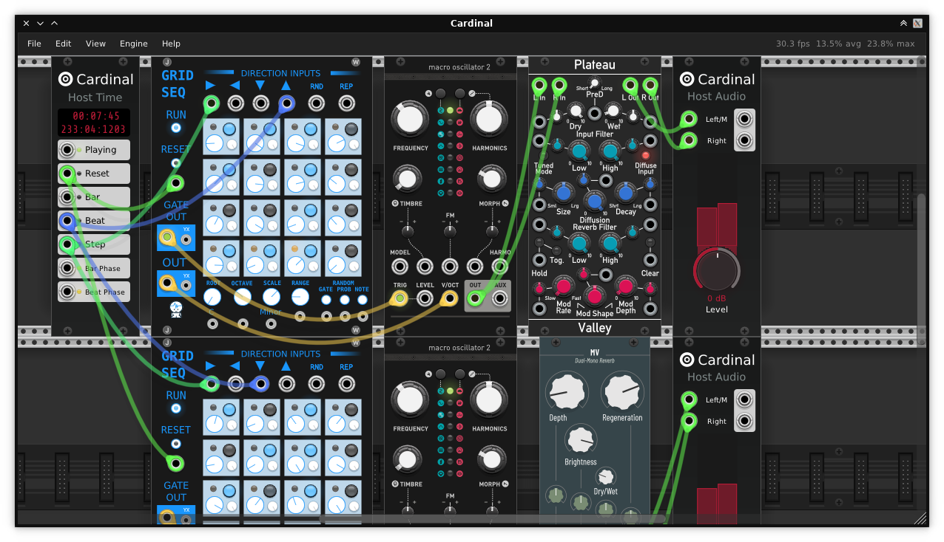
Cardinal
Cardinal is a monolithic version of VCV Rack. Not with all the modules, but as a standalone application and as VST3 / CLAP plugins
You can try it live :
https://cardinal.kx.studio/live

Slide 31
Webbography
VCV Rack : https://vcvrack.com/
Forum : https://community.vcvrack.com/
Omri Cohen : https://www.youtube.com/channel/UCuWKHSHTHMV_nVSeNH4gYAg
Fedoramagazine article : https://fedoramagazine.org/vcv-rack-modular-synthesizers/
Eurorack :
- FR : https://fr.wikipedia.org/wiki/Eurorack
- EN : https://en.wikipedia.org/wiki/Eurorack
Mutable Instruments :
- https://mutable-instruments.net/

