Slide 1


Audacity
Y. Collette (ycollette.nospam@free.fr)
https://audinux.github.io

Slide 2
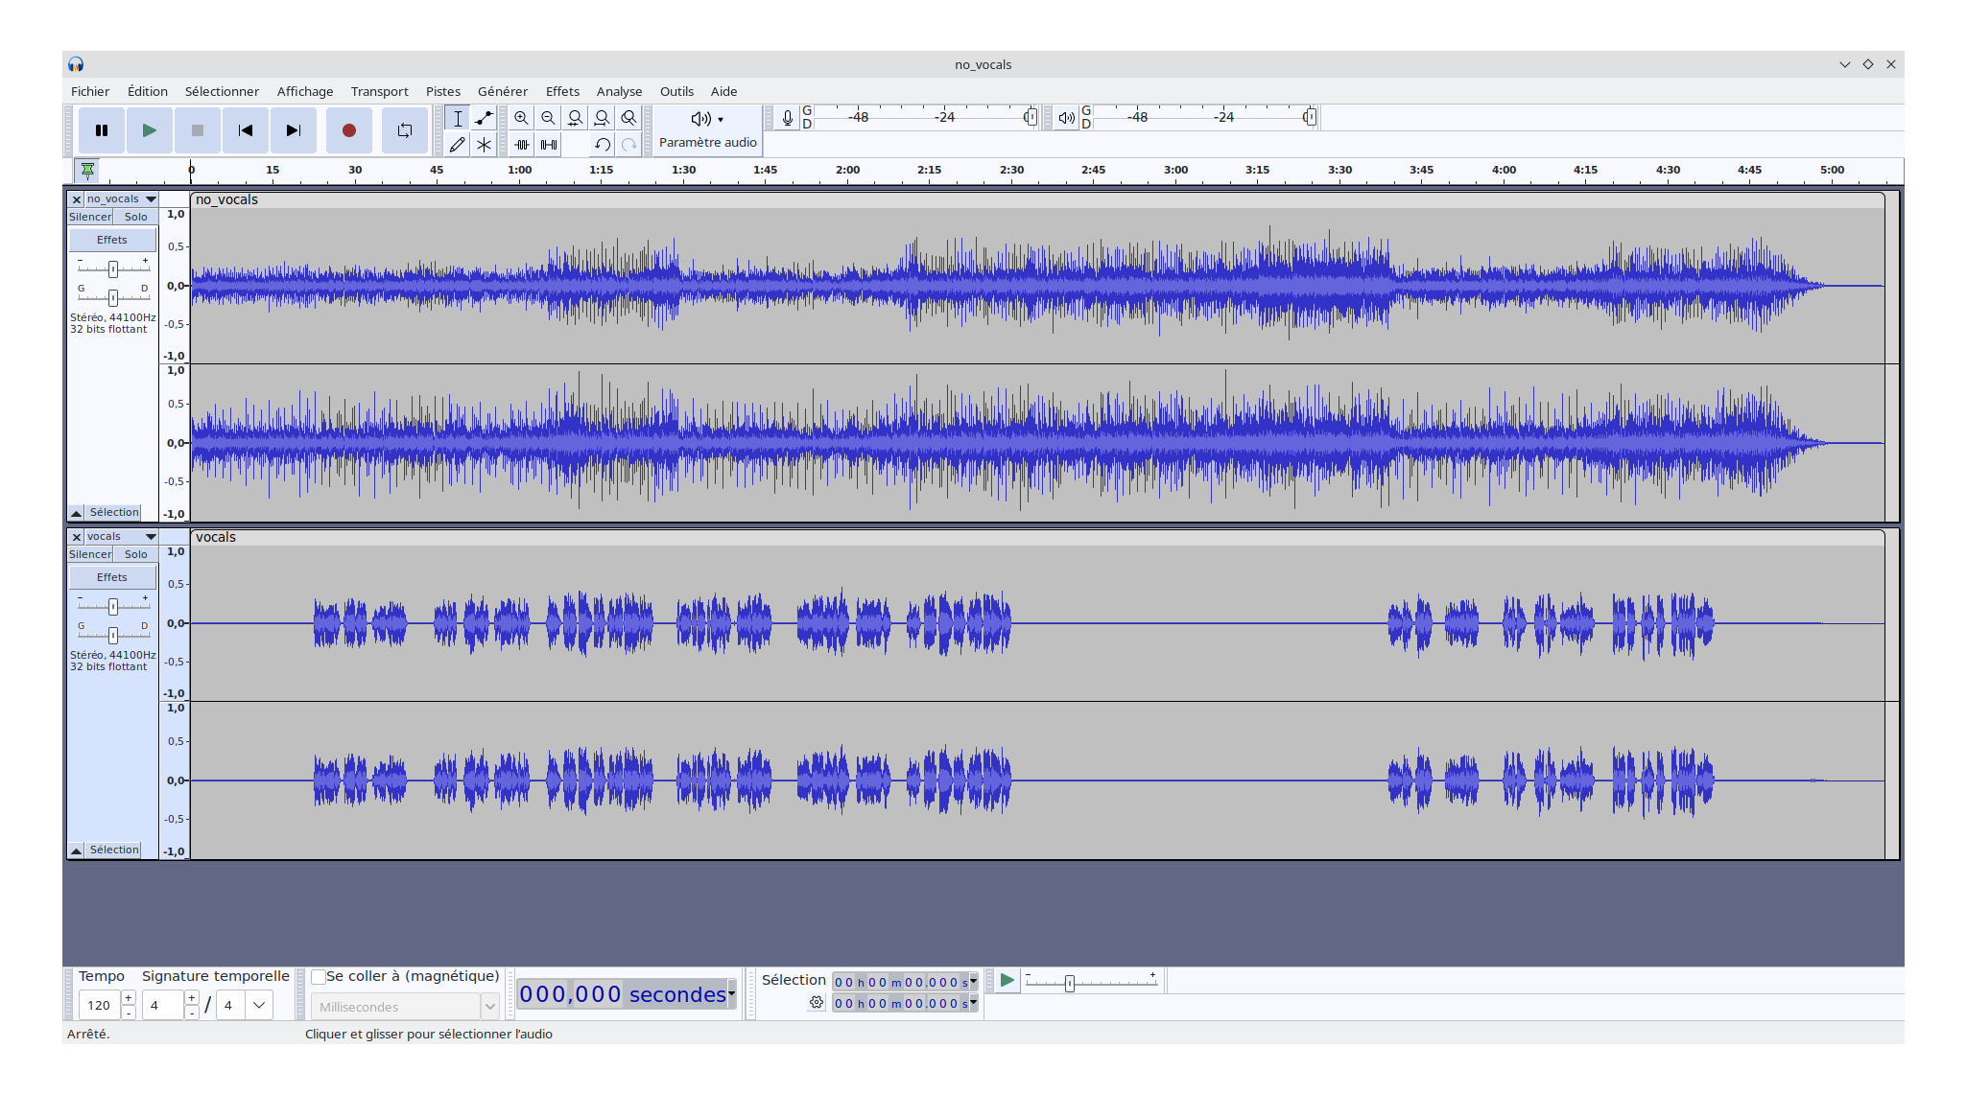
Audacity

Slide 3
Audacity
Labels
Add a label track :
- Track -> Add a new track -> Label track
Go to the point where you want to add a marquer
- Edition -> Markers -> Add a marker (Ctrl+B)
Navigate through the markers via :
- Navigate through the labels via TAB and Shift + TAB
The labels can be displayed via the karaoke mode

Slide 4
Audacity
Mix 2 tracks
File area with silence
Display the Mixer Windows
Adjust the level
Mix to a new track

Slide 5
Terms
Introduction
STEM is used to describe several tracks combined into one audio file. All the tracks of a stem are linked together. One or several elements of a mix are combined into one mono or stereo track.

Slide 6
Spleeter
Introduction
The github repository of spleeter (by Deezer) :
https://github.com/deezer/spleeter
Create a Python virtual environment :
$ python3 -m venv spleeter
Install spleeter via pip :
$ source spleeter/bin/activate
$ pip install spleeter
Launch spleeter :
$ source pleeter/bin/activate
$ spleeter separate -p spleeter:2stems -o Output InputFile.mp3

Slide 7
Demucs
Introduction
The github repository of demucs (by FaceBook) :
https://github.com/facebookresearch/demucs
Create a Python virtual environment :
$ python3 -m venv demucs
Install demucs via pip :
$ source demucs/bin/activate
$ pip3 install demucs
Launch demucs:
$ source demucs/bin/activate
$ demucs --mp3 --two-stems=vocals --jobs 2 --shifts 10 InputFile.mp3

