Slide 1
AVFoundation Overview

Slide 2
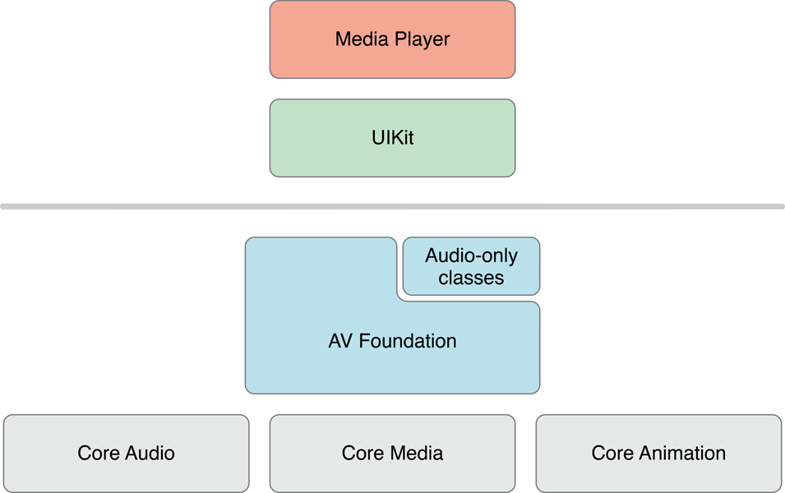
Where does it live?

Slide 3
Above: MediaPlayer.framework
MPMediaPickerController
MPMoviePlayer(View)Controller
MPMusicPlayerController
MPPlayableContentManager (CarPlay!)

Slide 4
Below: Core Audio
Low-level C API that gives loads of power
Required for doing real-time audio manipulation
Inter-app audio

Slide 5
AVFoundation
“Sweet spot” for non-trivial media usage
Modern Objective-C API
Continues to grow and evolve
Available on Mac since Lion

Slide 6
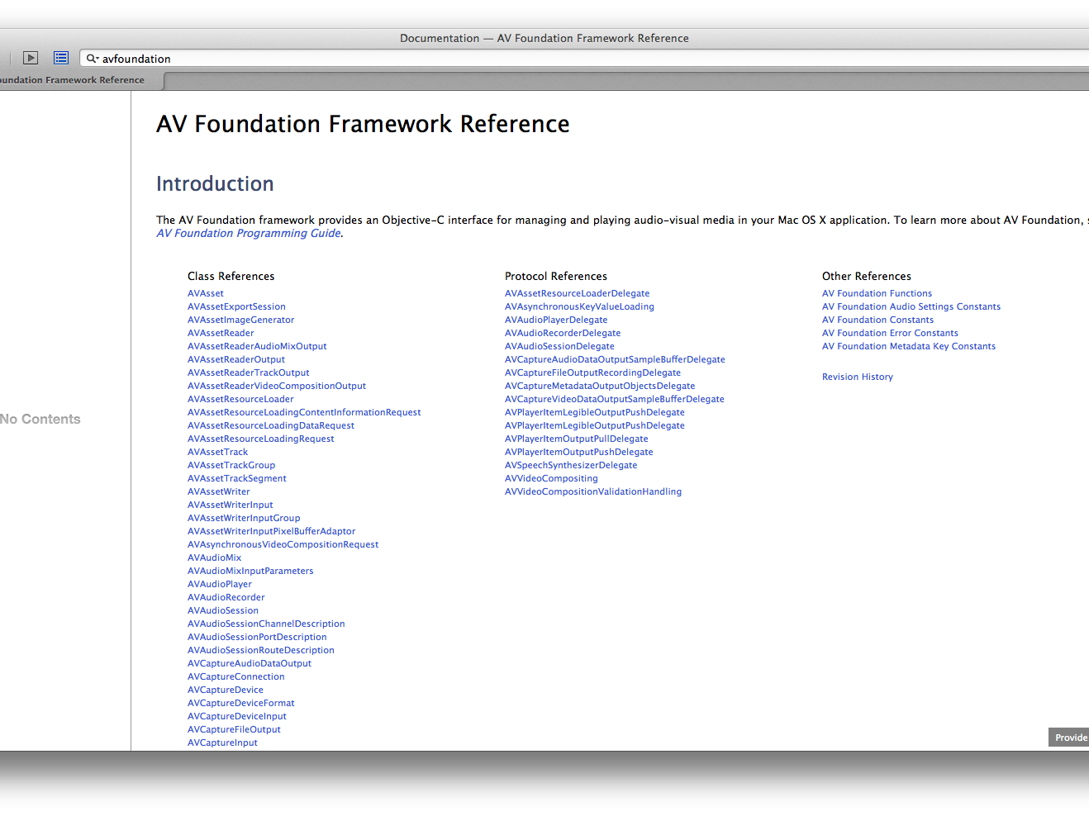
It’s big…

Slide 7
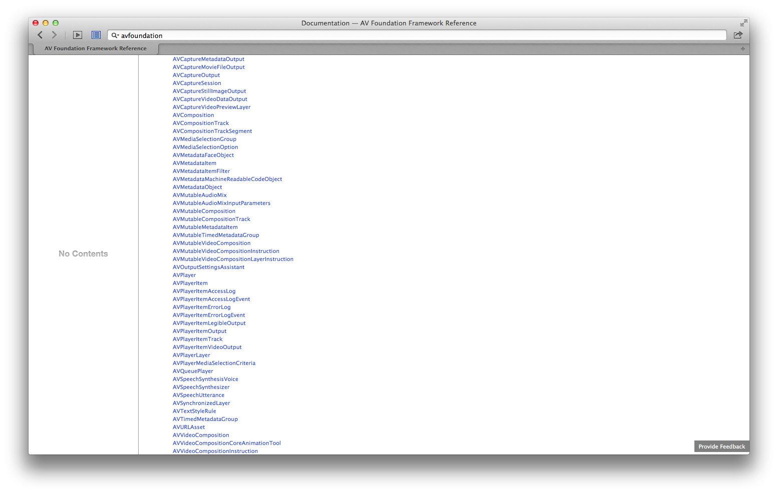
It’s big…

Slide 8
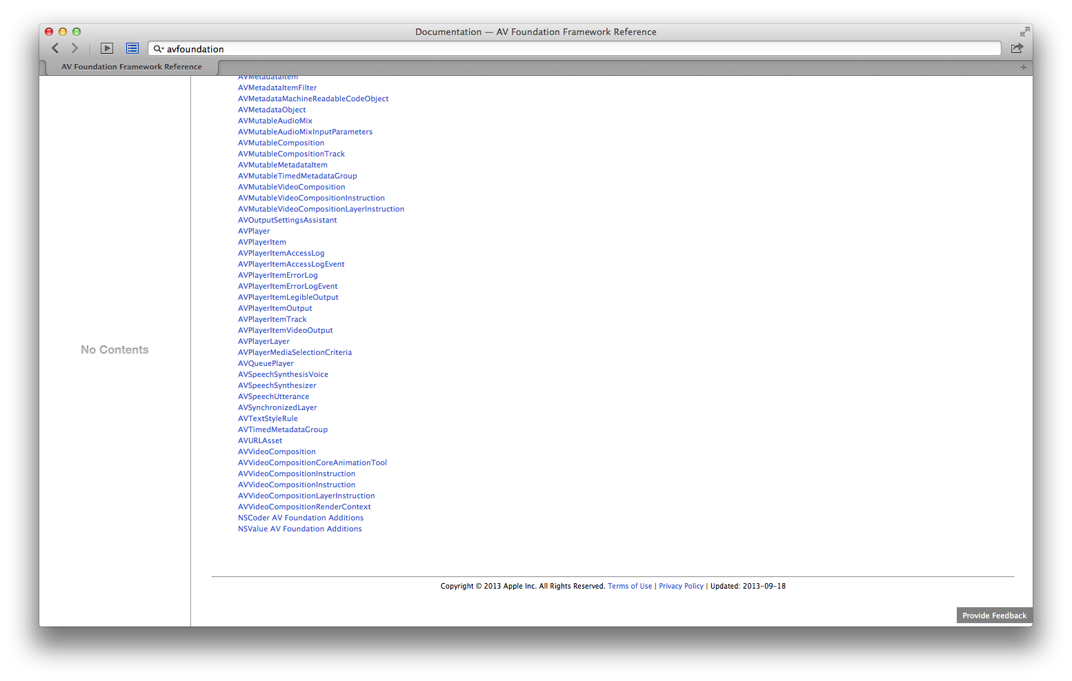
It’s big… 88 public classes, 16 protocols

Slide 9
The Tour

Slide 10
Basic Audio
AVAudioPlayer
AVAudioRecorder
[code]

Slide 11
Assets
Represents media content
AVURLAsset representing a file or network stream
AVComposition combines elements from other assets

Slide 12
Asset Resource Loading
AVAssetResourceLoader
Can hook into data loading to implement e.g. DRM decoding

Slide 13
CMTime
Widely used in AVFoundation to precisely represent time
Value / Timescale
Common timescale = 600
Allows for indicating a single media frame
CMTimeMake([value], [timescale])
CMTimeMakeWithSeconds([secs], [timescale])

Slide 14
AVPlayer
AVAsset -> AVPlayerItem -> AVPlayer
Renders audio directly to audio subsystem
View video content with AVPlayerLayer
Receive media data in addition to rendered playback
AVPlayerItemLegibleOutput
AVPlayerItemVideoOutput

Slide 15
Asset Reading
AVAssetReader
Add instances of AVAssetReaderOutput subclasses to pull out media data on-demand
Only direct access to hardware H.264 decoder
[code]

Slide 16
Asset Writing
AVAssetWriter
Add AVAssetWriterInput instances to provide samples
Only access to hardware H.264 encoder
Fill buffers with bitmap/audio data to generate frames

Slide 17
Media Capture
AVCaptureSession - "bus" for wiring up data flow
Add inputs
AVCaptureDevice, AVCaptureDeviceInput
Add outputs
AVCaptureMovieFileOutput – Write directly to disk
AVCaptureStillImageOutput – Camera image capture
AVCaptureVideoDataOutput – Raw video frames
AVCaptureAudioDataOutput – Raw audio samples
AVCaptureMetadataOutput – Presence of Faces, QR Codes
Watch camera with AVCaptureVideoPreviewLayer

Slide 18
Audio Session
Configure how the app interacts with other apps using audio
AVAudioSession
AVAudioSessionDelegate – informs of audio interruptions

Slide 19
Speech Synthesis
AVSpeechSynthesizer
Speaks texts represented by AVSpeechUtterance
Pick a AVSpeechSynthesisVoice for the desired language/region
[code]

Slide 20
Asset Export
AVAssetExportSession
Encapsulates workflow of asset reading -> frame processing -> asset writing
Queueing
Re-muxing, changing tracks, resizing

Slide 21
Mixing/Compositing
Combine multiple video or audio tracks into a combined stream
Adjust opacity/transform/volume over time
AVVideoComposition, AVAudioMix
Fully custom video compositing with AVVideoCompositing protocol
Usable with AVAssetExportSession, AVPlayerItem, AVAssetReader

Slide 22
AVFoundation + Core Animation
Camera capture content displayed in AVCapturePreviewLayer
Video asset content displayed in AVPlayerLayer
Core Animation content timed to match asset playback progress using AVSynchronizedLayer
Layer CA content while writing a movie using AVAssetExportSession and AVVideoCompositionCoreAnimationTool

Slide 23
Testing
Lots of fakes required, because the real objects are heavy
Many objects have heavy composition requiring chains of fakes
API is highly flexible to handle many uses, so:
Build wrappers with focused APIs where possible to prevent the complicated test setup from spreading too much

Slide 24
Example Use Cases

Slide 25
Screen Capture
AVAssetWriter with single input for writing video
Use a timer to trigger frame capture
Use UIKit/Core Graphics to fill pixel buffers with your window’s contents
Pass the pixel buffer with the current time into the asset writer
[code]

Slide 26
Add Watermark to Movie
AVAssetExportSession
Configure an AVVideoComposition to include a Core Animation layer on top of the video track
[code]

Slide 27
Camera Capture With Filter
AVCaptureSession, AVCaptureVideoDataOutput
Generate OpenGL texture with camera frame (optimized!)
Render texture with OpenGL with a pixel shader to perform filtering

Slide 28
Demos

Slide 29
Questions & Discussion

