Slide 1
Noisebridge Python Classes
Introduction to GPGPU with PyCUDA
Gareth Morgan
gareth@axum.graphics
Notes:
Good evening my name is Gareth Morgan
Tonight I’ll be giving a taster of my upcoming papers we love talk on what I think is, one of the most important 3D graphics papers of all time:
James Kah-Ji-Yah’s paper on the rendering equation

Slide 2
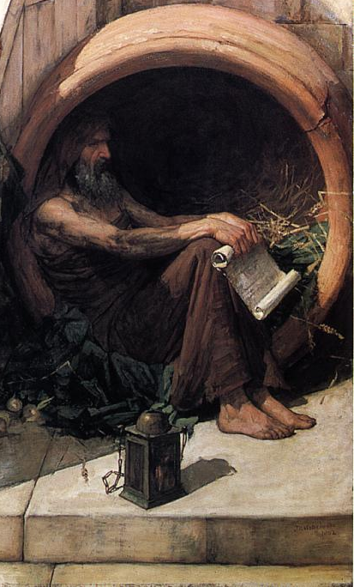
What Socrates actually said
I went to one who had the reputation of wisdom, and observed to him - his name I need not mention; he was a politician whom I selected for examination - and the result was as follows: When I began to talk with him, I could not help thinking that he was not really wise, although he was thought wise by many, and wiser still by himself; and I went and tried to explain to him that he thought himself wise, but was not really wise; and the consequence was that he hated me, and his enmity was shared by several who were present and heard me. So I left him, saying to myself, as I went away: Well, although I do not suppose that either of us knows anything really beautiful and good, I am better off than he is - for he knows nothing, and thinks that he knows. I neither know nor think that I know. In this latter particular, then, I seem to have slightly the advantage of him.
Not Socrates!

Slide 3
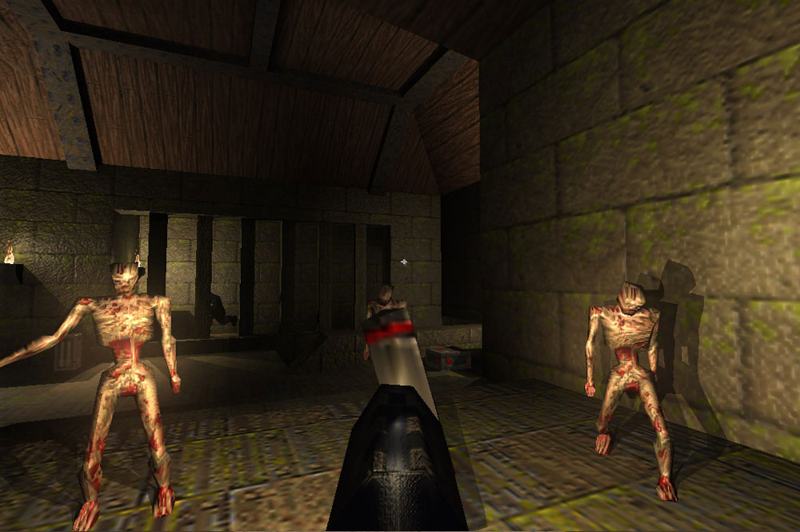
Introduction to GPUs
Graphics Processing Unit
Designed to render triangles using rasterization
Rasterization has two most important operations
Convert triangles from 3D world space to 2D screen space
Rasterize triangles into pixel colors on display
Originally fixed function operations
These became programmable as shaders

Slide 4
GPGPU
GPUs became more powerful and shaders become more complex
They don’t HAVE to be used to draw pictures
General Purpose GPU programming is using GPUs for everything else
GPUs are very powerful, very parallel processing units
But they have very particular characteristics and restrictions

Slide 5
Characteristics of GPUs
Lots of cores
Cores very simple compared to CPU
Lots of threads
Single Instruction Multiple Data
Works bests with big chunks on unrelated data
They have dedicated memory
thread₀
thread₁
thread₂
thread₃
thread_{n}
instruction₀
d₀
d₁
d₂
d₃
…...
d_{n}
instruction₁
d₀
d₁
d₂
d₃
…...
d_{n}
instruction₂
d₀
d₁
d₂
d₃
…...
d_{n}
instruction₃
d₀
d₁
d₂
d₃
…...
d_{n}

Slide 6
Slight tangent: NumPy
GPGPU generally involves big multi-dimensional arrays of numbers
NumPy is convenient python library for dealing with these
Convenient, efficient functions for manipulating arrays
Many more types than you are used to (int8, uint64, float32, etc.)
Turns out it *does* matter whether your 1x10¹² elements is stored as 8-bit char or 64 bit float!

Slide 7
Slight tangent: NumPy
>>> import numpy as np
>>> oneDimArray = np.arange(15)
>>> oneDimArray
array([ 0, 1, 2, 3, 4, 5, 6, 7, 8, 9, 10, 11, 12, 13, 14])
>>> oneDimArray.ndim
1

Slide 8
Slight tangent: NumPy
>>> twoDimArray = oneDimArray.reshape(3,5)
>>> twoDimArray
array([[ 0, 1, 2, 3, 4],
[ 5, 6, 7, 8, 9],
[10, 11, 12, 13, 14]])
>>> twoDimArray.ndim
2
>>> twoDimArray[(2,3)]=43

Slide 9
Slight tangent: NumPy
>>> x = np.random.random((2,3))
>>> x
array([[ 0.50391385, 0.18588888, 0.62190684],
[ 0.79682075, 0.13617726, 0.33293887]])
>>> y = x+2
>>> y
array([[ 2.50391385, 2.18588888, 2.62190684],
[ 2.79682075, 2.13617726, 2.33293887]])
>>> z = y*x
>>> z
array([[ 1.26175686, 0.40633244, 1.63058178],
[ 2.22856482, 0.29089877, 0.77672604]])

Slide 10
Slight tangent: NumPy
>>> charArray = np.arange(100, dtype=np.uint8)
>>> charArray
array([ 0, 1, 2, 3, 4, 5, 6, 7, 8, 9, 10, 11, 12, 13, 14, 15, 16,
17, 18, 19, 20, 21, 22, 23, 24, 25, 26, 27, 28, 29, 30, 31, 32, 33,
34, 35, 36, 37, 38, 39, 40, 41, 42, 43, 44, 45, 46, 47, 48, 49, 50,
51, 52, 53, 54, 55, 56, 57, 58, 59, 60, 61, 62, 63, 64, 65, 66, 67,
68, 69, 70, 71, 72, 73, 74, 75, 76, 77, 78, 79, 80, 81, 82, 83, 84,
85, 86, 87, 88, 89, 90, 91, 92, 93, 94, 95, 96, 97, 98, 99], dtype=uint8)
>>> floatArray = charArray.astype(numpy.float32)
>>> floatArray
array([ 0., 1., 2., 2., 4., 5., 6., 7., 8., 9., 10.,
11., 12., 13., 14., 15., 16., 17., 18., 19., 20., 21.,
22., 23., 24., 25., 26., 27., 28., 29., 30., 31., 32.,
33., 34., 35., 36., 37., 38., 39., 40., 41., 42., 43.,
44., 45., 46., 47., 48., 49., 50., 51., 52., 53., 54.,
55., 56., 57., 58., 59., 60., 61., 62., 63., 64., 65.,
66., 67., 68., 69., 70., 71., 72., 73., 74., 75., 76.,
77., 78., 79., 80., 81., 82., 83., 84., 85., 86., 87.,
88., 89., 90., 91., 92., 93., 94., 95., 96., 97., 98.,
99.], dtype=float32)

Slide 11
Why CUDA?
Proprietary close-source API from huge evil mega-corporation
But it is the original, and still best supported GPGPU API
So long as you have an Nvidia GPU!
The open-standards equivalent (OpenCL) not as well supported
Various other proprietary options (Metal, DirectX, etc.)
In the future Vulcan may be the answer!

Slide 12
Installing PyCUDA
First make sure your GPU is from Nvidia and supports CUDA
Next install the CUDA SDK
https://developer.nvidia.com/cuda-downloads
Get the PyCUDA version for your Python+CUDA version
http://www.lfd.uci.edu/~gohlke/pythonlibs/
For example
Python 3.5
CUDA 7.518
pycuda-2016.1+cuda7518-cp35-cp35m-win_amd64.whl
Install with PIP
pip install pycuda-2016.1+cuda7518-cp35-cp35m-win_amd64.whl

Slide 13
Why CUDA?
Proprietary close-source API from huge evil mega-corporation
But it is the original, and still best supported GPGPU API
So long as you have an Nvidia GPU!
The open-standards equivalent (OpenCL) not as well supported
Various other proprietary options (Metal, DirectX, etc.)
In the future Vulcan may be the answer!

Slide 14
Our first CUDA program
import pycuda.driver as cuda
import pycuda.autoinit
from pycuda.compiler import SourceModule
import numpy
myNumbers = numpy.random.randn(128,128)
myNumbers = myNumbers.astype(numpy.float32)
gpuBuffer = cuda.mem_alloc(myNumbers.nbytes)
cuda.memcpy_htod(gpuBuffer, myNumbers)
mod = SourceModule("""
__global__ void squareArray(float *a)
{
int blockId = blockIdx.x + blockIdx.y * gridDim.x;
int threadId = blockId * (blockDim.x * blockDim.y) + (threadIdx.y * blockDim.x) + threadIdx.x;
a[threadId] *= a[threadId];
}
""")
squareFunc = mod.get_function("squareArray")
squareFunc(gpuBuffer, block=(16,16,1), grid=(8,8,1))
myResults = numpy.empty([128,128], dtype=numpy.float32)
cuda.memcpy_dtoh(myResults, gpuBuffer)

Slide 15
Importing module
import pycuda.driver as cuda
import pycuda.autoinit
from pycuda.compiler import SourceModule
import numpy

Slide 16
Getting the data to the GPU
The device is the GPU and its associated memory
The host is the CPU and its associated memory
myNumbers = numpy.random.randn(128,128)
myNumbers = myNumbers.astype(numpy.float32)
gpuBuffer = cuda.mem_alloc(myNumbers.nbytes)
cuda.memcpy_htod(gpuBuffer, myNumbers)

Slide 17
Getting it back to the CPU
After running our CUDA code we have to copy data back to CPU
myResults = numpy.empty([128,128], dtype=numpy.float32)
cuda.memcpy_dtoh(myResults, gpuBuffer)

Slide 18
The kernel
mod = SourceModule("""
__global__ void squareArray(float *a)
{
int blockId = blockIdx.x + blockIdx.y * gridDim.x;
int threadId = blockId * (blockDim.x * blockDim.y) + (threadIdx.y * blockDim.x) + threadIdx.x;
a[threadId] *= a[threadId];
}
""")
squareFunc = mod.get_function("squareArray")
squareFunc(gpuBuffer, block=(16,16,1), grid=(8,8,1))

Slide 19
The CUDA language
There is no CUDA language! It’s just C!
__global__ void squareArray(float *a)
{
int blockId = blockIdx.x + blockIdx.y * gridDim.x;
int threadId = blockId * (blockDim.x * blockDim.y) + (threadIdx.y * blockDim.x) + threadIdx.x;
a[threadId] *= a[threadId];
}

Slide 20
Function qualifiers
Three types of function
__global__ functions are device programs that are called from the host
__device__ functions are device programs that are called from other device functions
__host__ functions don’t really exist on PyCUDA

Slide 21
Blocks and grids
int col = threadIdx.x + blockIdx.x * blockDim.x;
int row = threadIdx.y + blockIdx.y * blockDim.y;
int threadId = col + (blockDim.x*gridDim.x)*row ;
gridDim.x
blockIdx.y
gridDim.y
blockIdx.x
blockDim.x
threadIdx.y
threadIdx.x
blockDim.y

Slide 22
Memory hierarchy
Registers are the fastest (per-thread)
Global memory is the slowest
Shared memory is shared between all the threads in a block

Slide 23
Threads and warps
On physical GPU cores are grouped in to warps
Number of threads in a block should correspond to this number
Global memory access should be coalesced to minimize memory

Slide 24
Python conveniences
Argument handlers can simplify kernel calling
func(cuda.InOut(a), block=(4, 4, 1))
Gpu_array class abstracts away communication to GPU
gpuarray.to_gpu(numpy.random.randn(4,4).astype(numpy.float32))
Use meta-programming to avoid all that C code
mod = Module([
FunctionBody(
CudaGlobal(FunctionDeclaration(
Value("void", "add"),
arg_decls=[Pointer(POD(dtype, name))
for name in ["tgt", "op1", "op2"]])),
Block([
Initializer(
POD(numpy.int32, "idx"),
"threadIdx.x + %d*blockIdx.x"
% (thread_block_size*block_size)),
]+[
Assign(
"tgt[idx+%d]" % (o*thread_block_size),
"op1[idx+%d] + op2[idx+%d]" % (
o*thread_block_size,
o*thread_block_size))
for o in range(block_size)]))])

Slide 25
Any questions
?

Slide 26

Contracting anyone?
Gareth Morgan
gareth@axum.graphics

