Slide 1
Comfy Cozy
Cafe
Presented By: Kiara Bartuccio,
Audreane Deschenes, Jia-Yu JoyHo

Slide 2
Table of contents
01
02
03
Project Description
Features
Demonstration

Slide 3
01
Project Description

Slide 4

Description
Welcome to our Comfy Cozy Café, ordering system!
C# desktop application
Designed to help you choose your drinks and pastries quickly and efficiently.
Allows you to add items to the virtual cart
Choose to have it delivered or to pick them up yourself.

Slide 5
Description
This application is offered in 3 languages:
English (Default)
French
Spanish

Slide 6
Description
Select sizes, quantity, and custom additions
This system lets you:
Provide customer information for pickup and delivery
Browse Hot Drinks, Cold Drinks, Pastries, and prices
Provides confirmation messages
Review, edit, and remove items in the Cart
A database
Change the language of the entire application

Slide 7
Description
System requirements:
Database files
Windows 10 or 11
.NET Desktop Runtime
At least 300 MB
of free space

Slide 8
02
Features

Slide 9
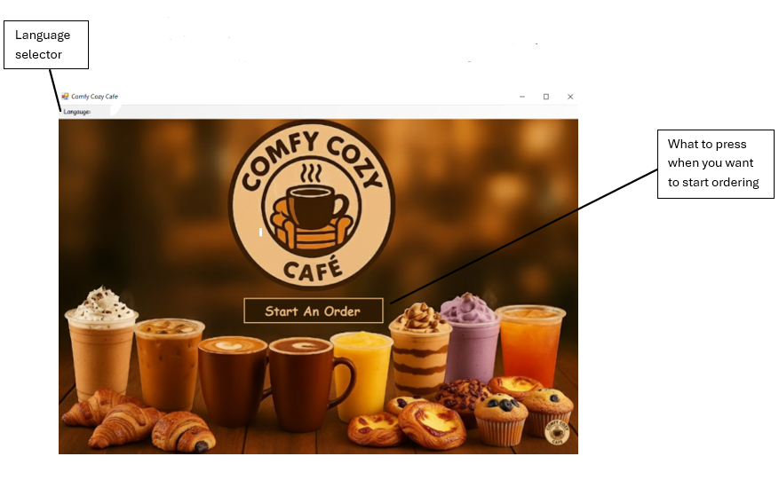
Features
The start page:
Start order button
Language drop down with:
  -English
  -French
  -Spanish

Slide 10
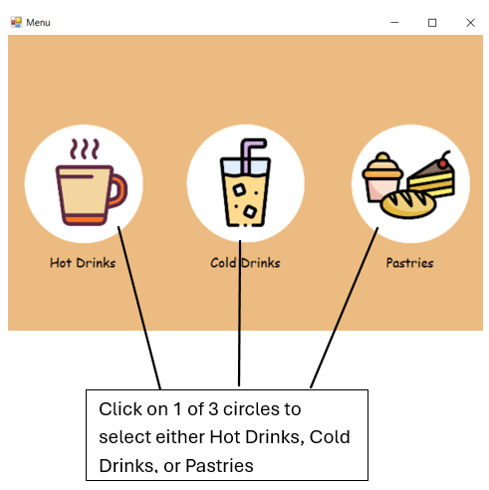
Features
The start menu:
3 circles (clickable) to choose items

Slide 11
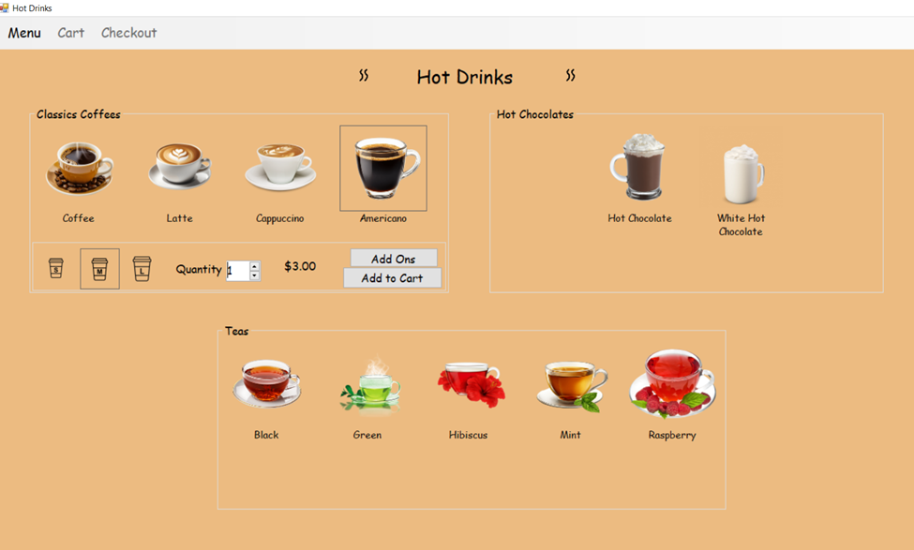
Features
Hot Drinks Menu:
Choose if including an Add-On or go to checkout
Will not be able to move on without selecting a size first (pop up will show)
Options of size, quantity, price, and buttons only appear after you have selected an items picture
Cold Drinks menu and Pastry menu are the same but without Add-Ons and for Pastry no size as well

Slide 12
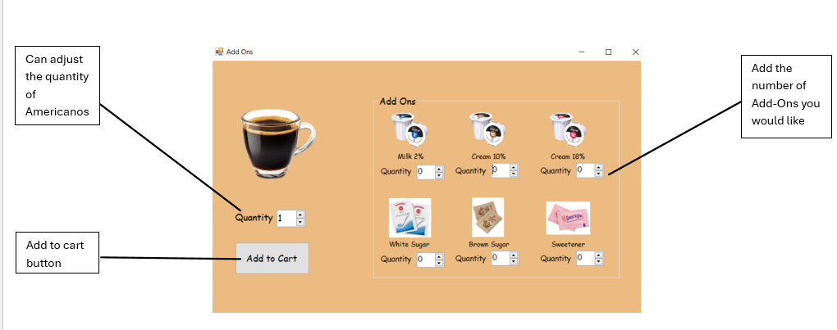
Features
Add – Ons (only for Hot Drinks Menu), will get confirmation once item added

Slide 13
Features
Shortcuts - press Menu button, shows a drop-down menu of all 3 menus:
Hot Drinks
Cold Drinks
Pastries
Easier and quicker to change between all 3 menus instead of having to close and reopen the program all over again.
Once you have added an item to cart, the Cart and Checkout button will change from light grey(unclickable) to black(clickable)

Slide 14
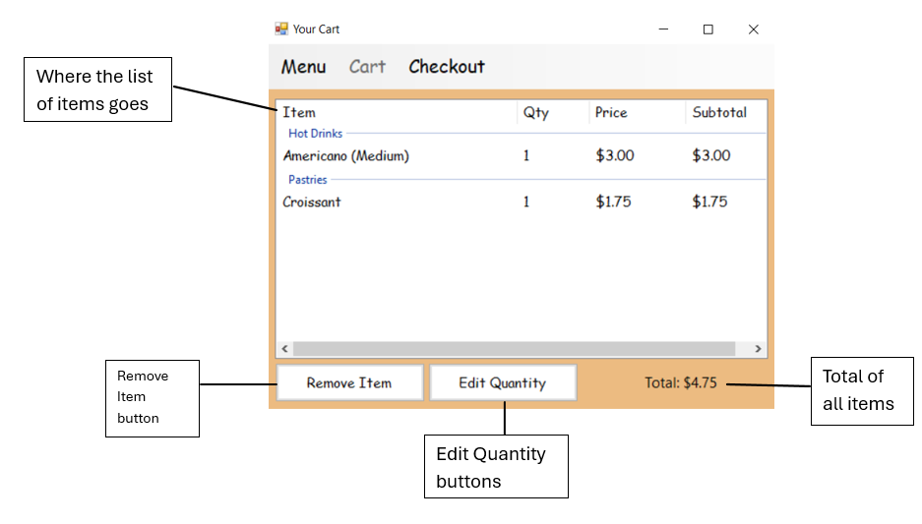
Features
Cart - all the items you added to cart get put into a list(select item before clicking a button)

Slide 15
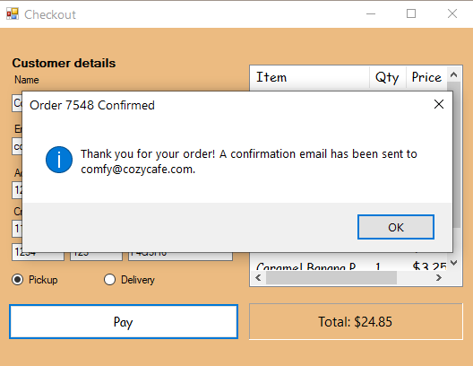
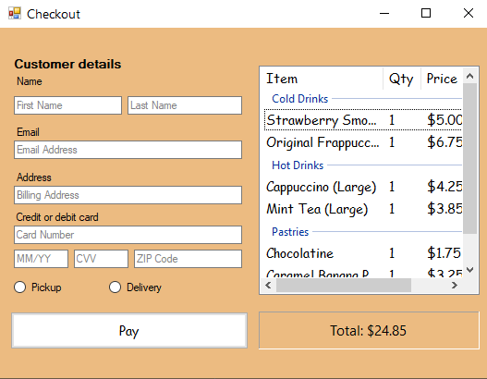
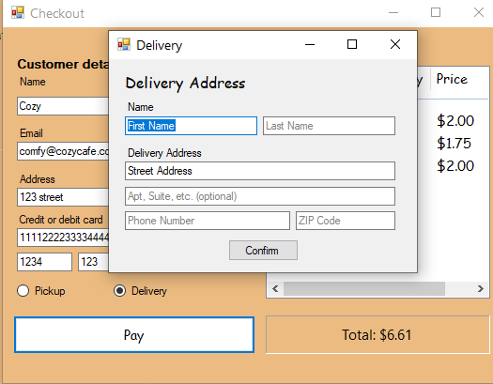
Features
Checkout Screen (Pickup and Delivery)

Slide 16
03
Demonstartion

Slide 17
Thank you

