Slide 1
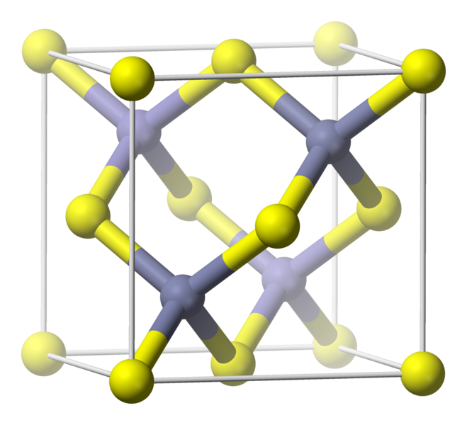
b)
p anti-bonding
E
a)
p orbitals
s anti-bonding
p bonding
s orbitals
Cd/Zn
Te
s bonding

