Slide 1
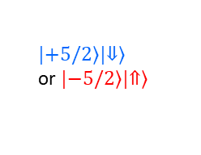
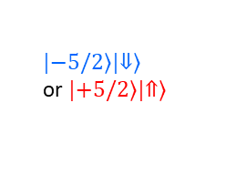
σ-
M=2
σ-
M=3
û
$$\left|\left.−5/2\right\rangle \right.\left|\left.⇓\right\rangle \right.$$
or $\left|\left.+5/2\right\rangle \right.\left|\left.⇑\right\rangle \right.$
…
$$\left|\left.+5/2\right\rangle \right.\left|\left.⇓\right\rangle \right.$$
or $\left|\left.−5/2\right\rangle \right.\left|\left.⇑\right\rangle \right.$
1
σ+
Probability
σ+
Energy

