Slide 1
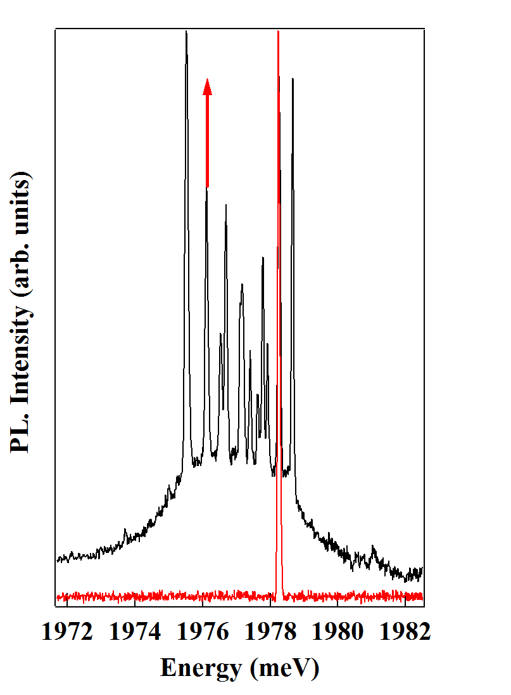
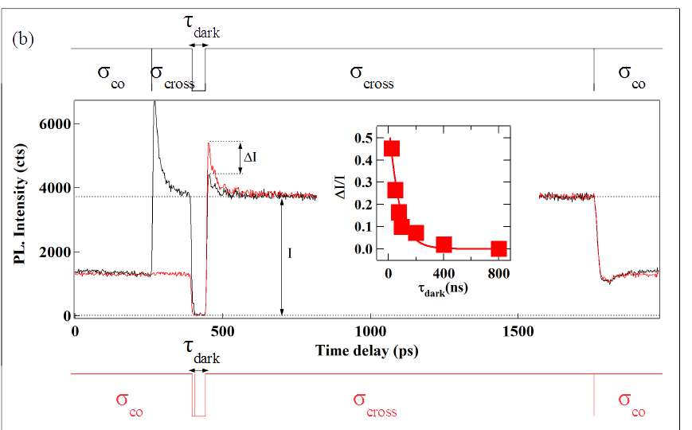
Spin dynamic under resonant excitation
|3,+2>
= Dark time dependence of the amplitude of the pumping transient (ΔI/I, inset) gives an estimation of 75 ns for the h-Mn relaxation time.
E
Γ_{in}
σ+
σ-
Γ_{out}
τ_{ff}
0
+1
+2
+3
M_{z}

Slide 2
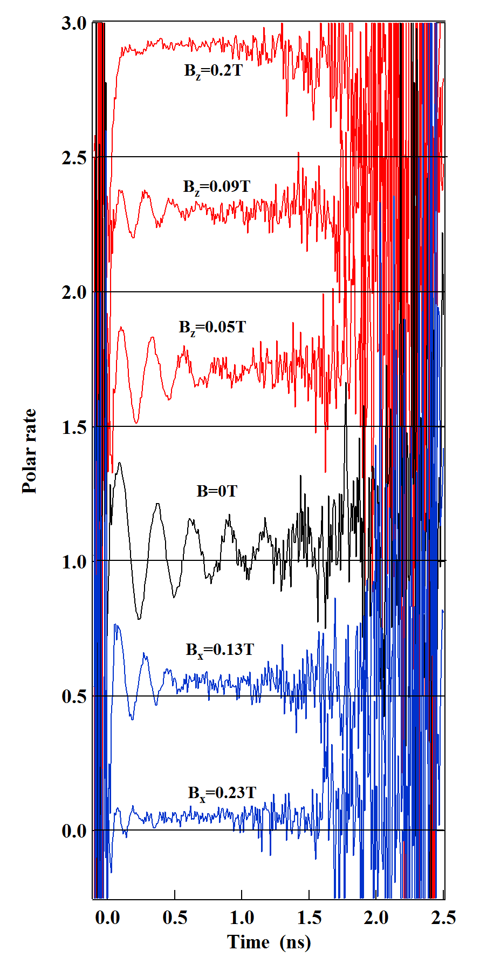
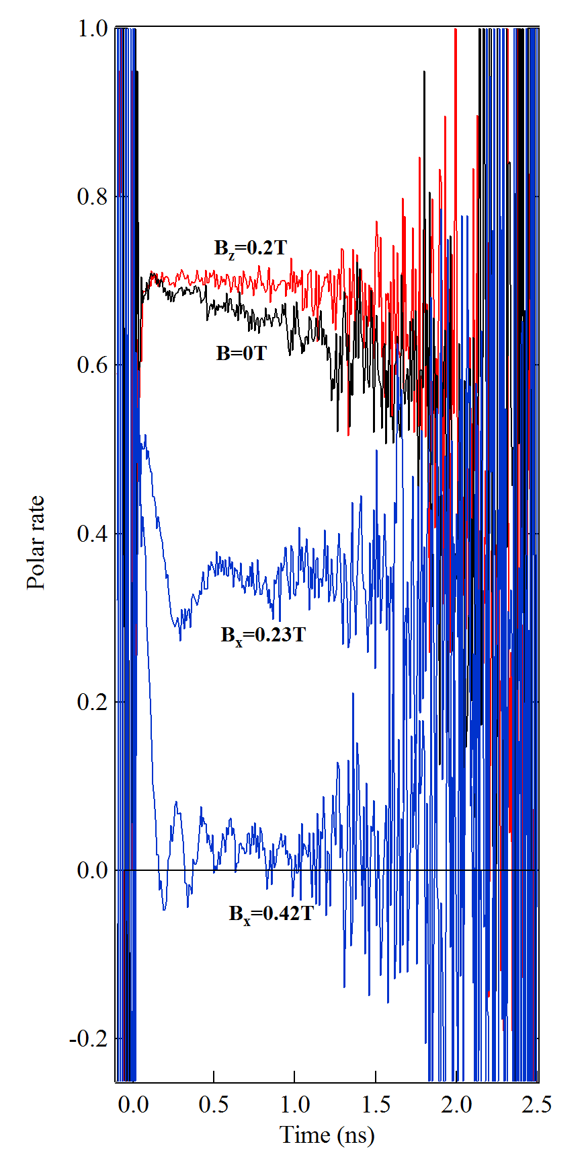
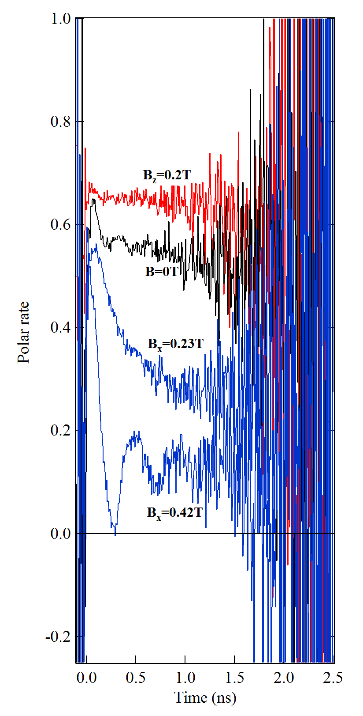
Coherent dynamics under magnetic field
Magnetic field parallel to growth axis (B// ): tune splitting of levels and block the strain induced dynamics
In plane magnetic field (B┴ ): induces a coherent precession
B_{z}=0.2T
B//
B_{z}=0.2T
B_{z}=0.2T
B_{z}=0.09T
B=0T
B=0T
B=0
Polar. rate
B_{z}=0.05T
B_{x}=0.23T
B_{x}=0.23T
B=0T
B_{x}=0.42T
B┴
B_{x}=0.13T
B_{x}=0.42T
B_{x}=0.23T

Slide 3
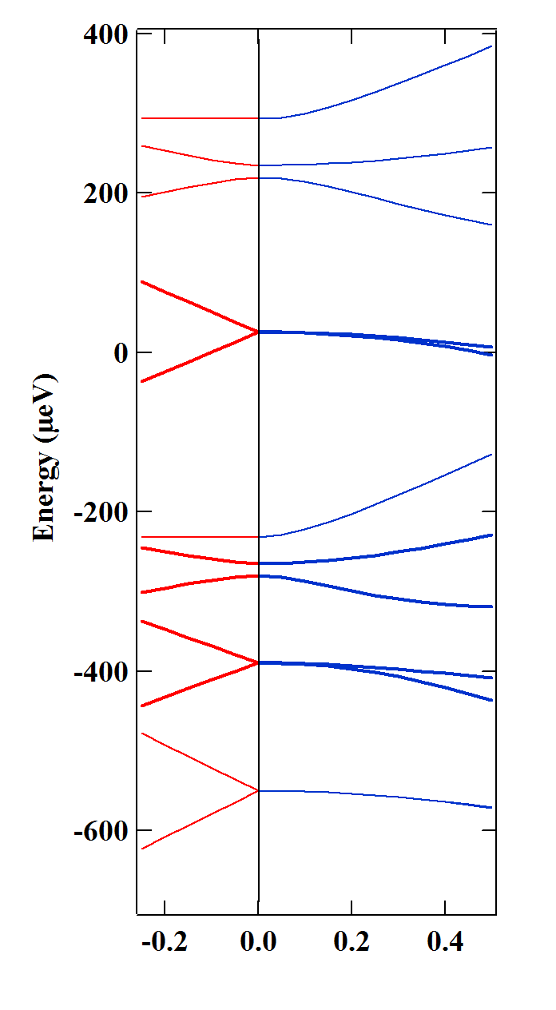
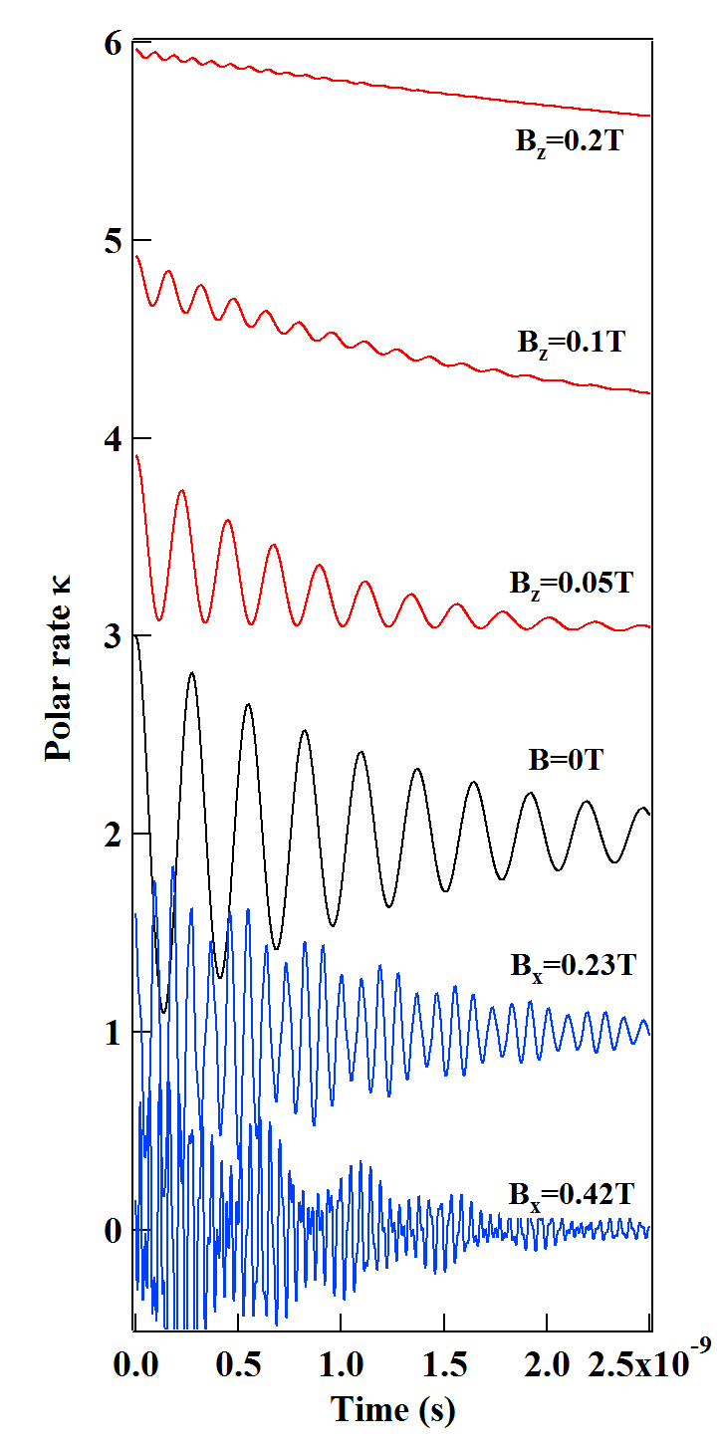
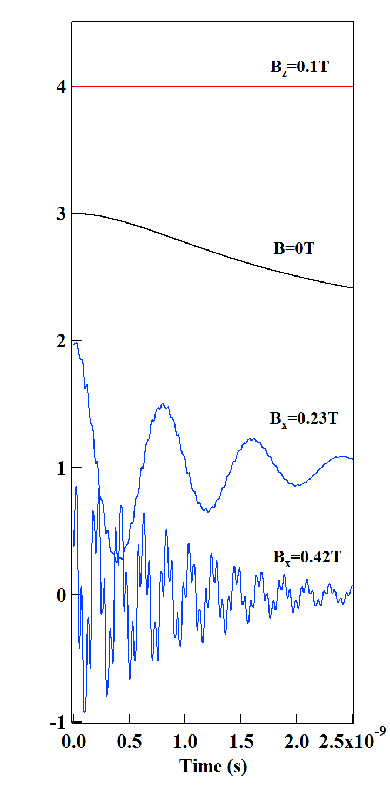
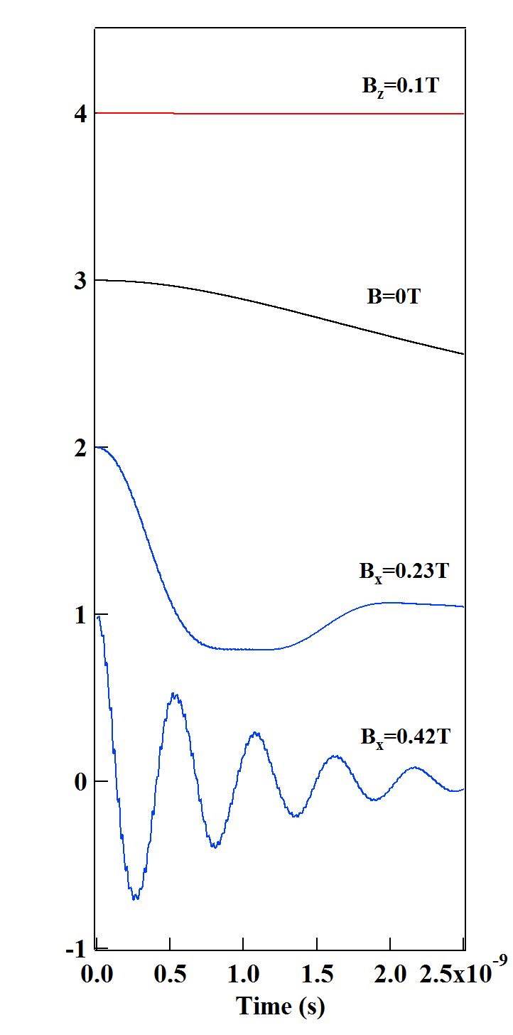
Coherent dynamics under magnetic field
B//
B=0
B//
B┴
B┴
= e-Mn energy levels
= Model: coherent dynamics controlled by local strain
A. Lafuente-Sampietro et al., Phys. Rev. B 92, 081305(R) (2015)

Slide 4
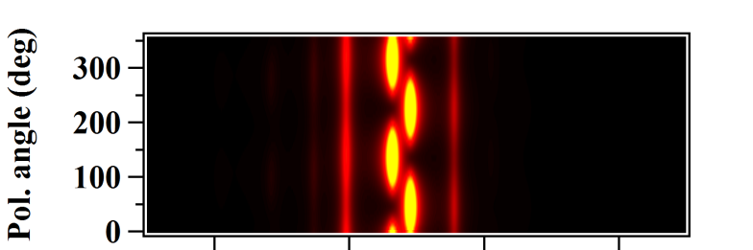
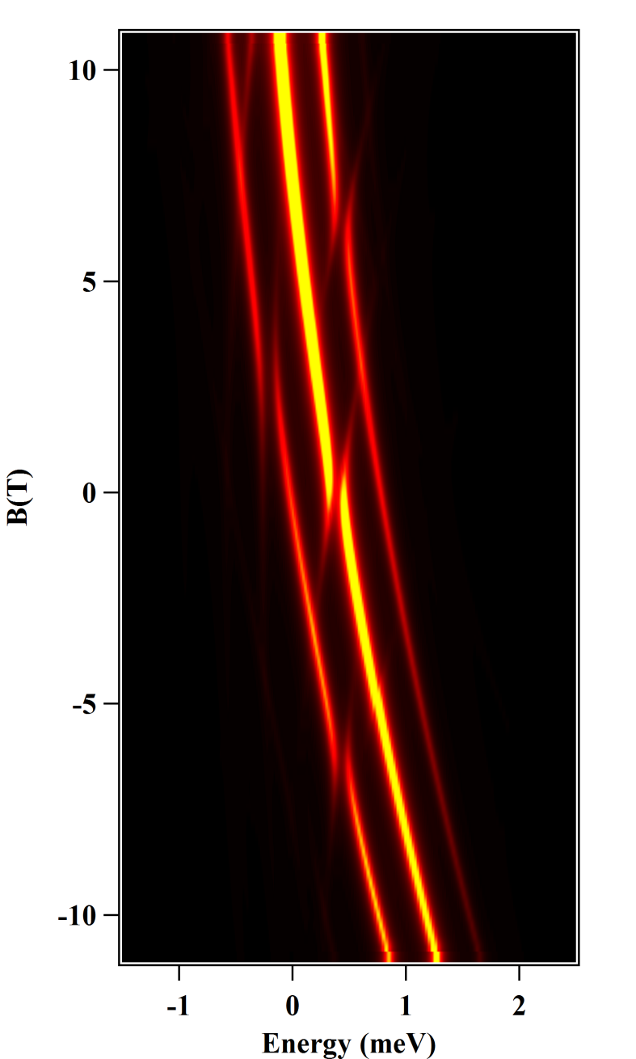
Magneto-optical properties: model
IS_{z}=+1,+1>
E
IS_{z}=+1,+2>
σ-
IS_{z}=+1,-1>
(6)
(4)
(2,3)
= Modeling with a spin effective Hamiltonian including:
Zeeman energy (e, h, Cr)
Carrier-Cr exchange
e-h exchange interaction and hh-lh mixing in a low symmetry QD.
Effective spin temperature
Magnetic anisotropy D₀
IS_{z}=+1,-2>
(2)
IS_{z}=-1,+1>
D₀
X-Cr
IS_{z}=-1,-1>
(1)
IS_{z}=0,+1>
(5)
IS_{z}=-1,+2>
(4)
IS_{z}=0,-1>
(1)
(6)
IS_{z}=0,+2>
S_{z}=+1
(5)
(3)
S_{z}=-1
Cr
D₀
σ+
σ-
σ+
A. Lafuente-Sampietro et al., Phys. Rev. B 93, 161301 (R) (2016)
S_{z}=0
0
B_{z}

Slide 5
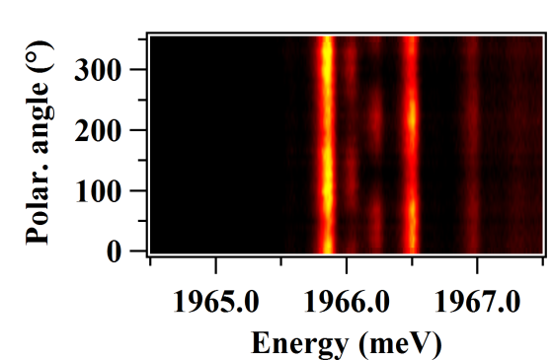
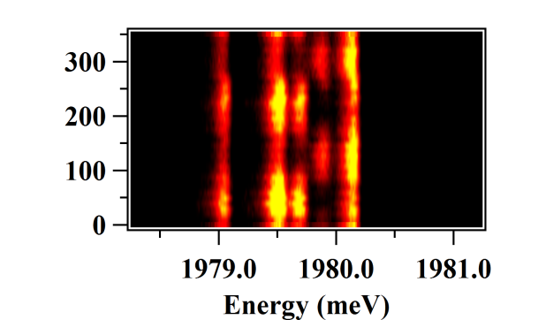
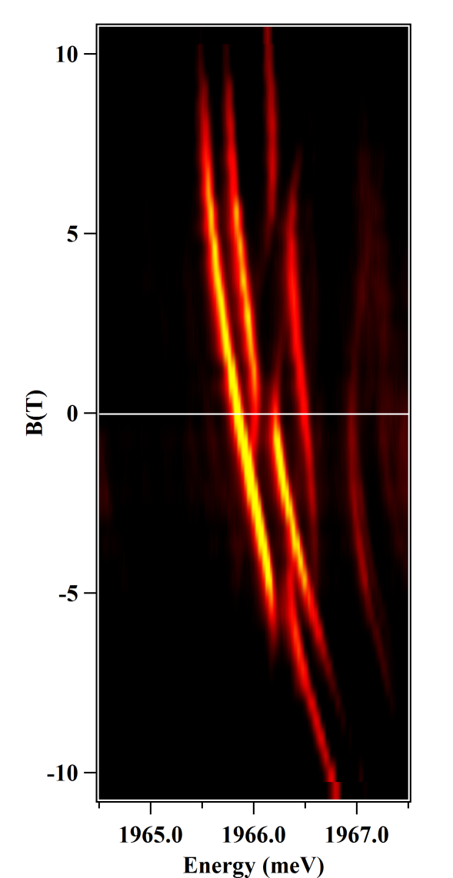
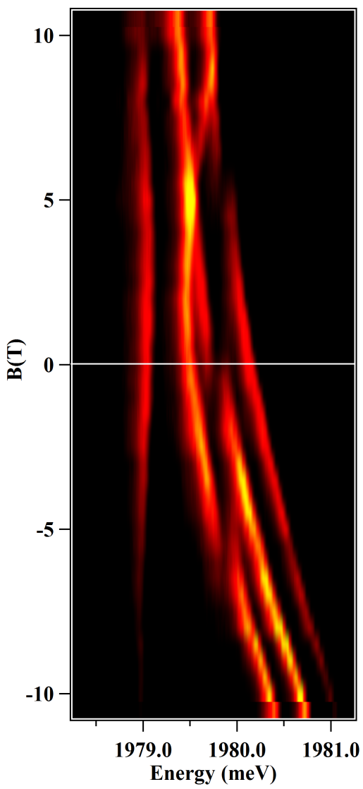
Magneto-optical properties of Cr-doped QDs
X₂-Cr
X-Cr
X₂-Cr
QD3
QD3
I-1>
I+1>
σ-
σ-
X-Cr
σ+
π_{y}
π_{x}
σ−
Cr
S_{z}=-1
S_{z}=0
S_{z}=+1
σ+
σ+
= With two excitons in the QD, the exchange interaction with the Cr spin vanishes: mirror symmetry in the optical transitions.

Slide 6
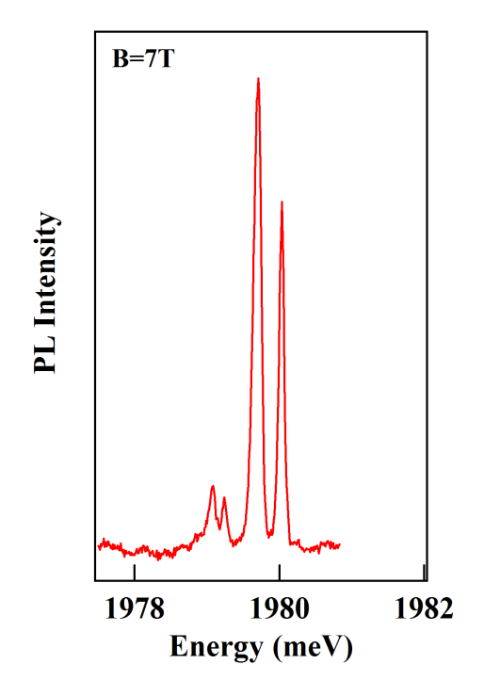
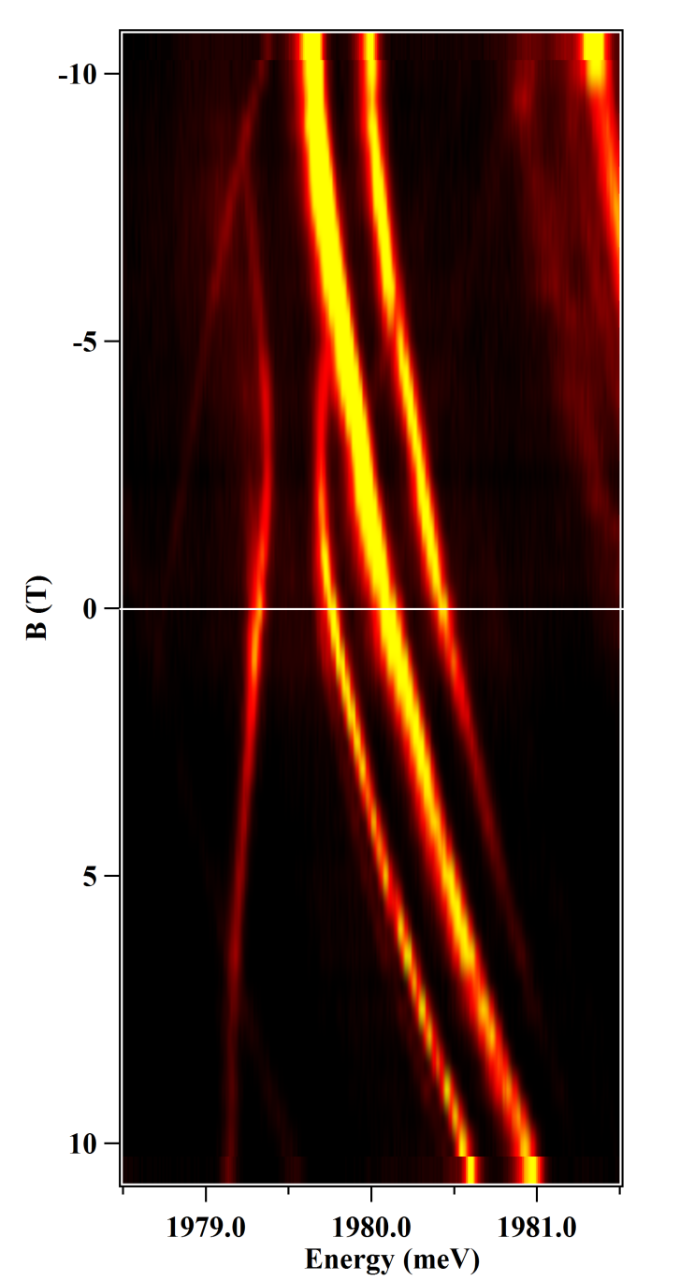
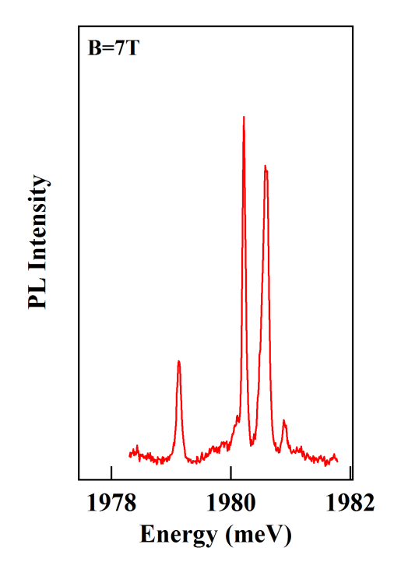
A material issue: Hole-Cr exchange interaction in CdTe QDs
E
S_{z}=0
S_{z}=+1
σ-
S_{z}=-1
S_{z}=-1
S_{z}=-1
S_{z}=0
σ-
B_{z}
S_{z}=+1
- The e-Cr exchange interaction is weak and ferromagnetic.
σ-
- Polarization under magnetic shows that h-Cr exchange is antiferromagnetic.
- A material issue: h-Cr is found to be ferromagnetic in all the bulk II-VI compounds?
σ+
σ+
- But Cr is a tricky system where the 3d orbitals are close to the top of the valence band… influence of
strain on the Cr²⁺ to Cr³⁺
transition?
S_{z}=-1
S_{z}=0
S_{z}=-1
S_{z}=+1
σ+

Slide 7
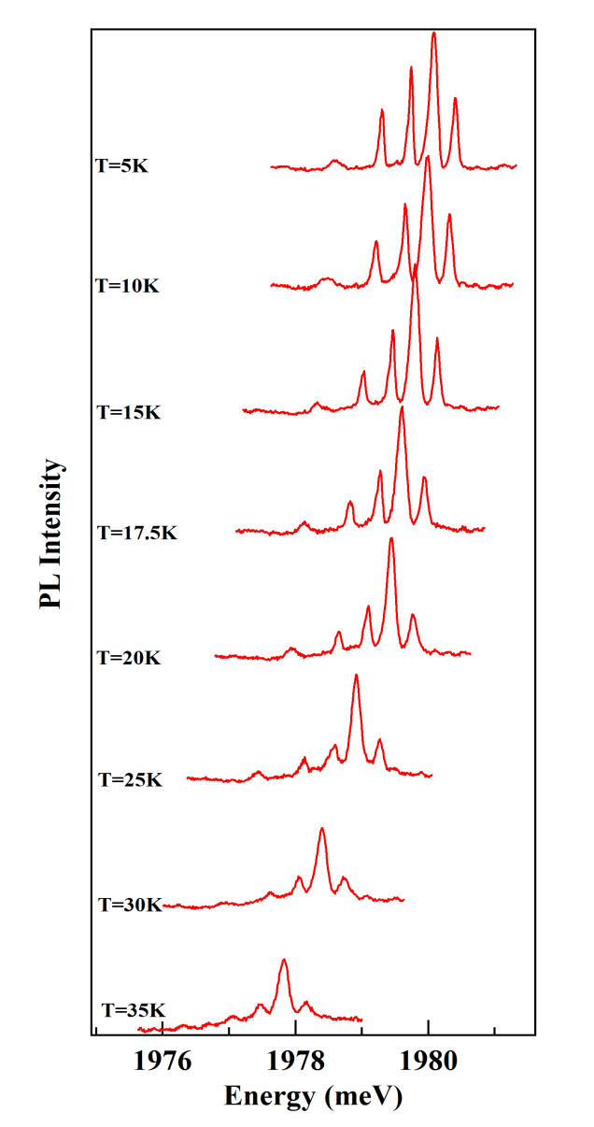
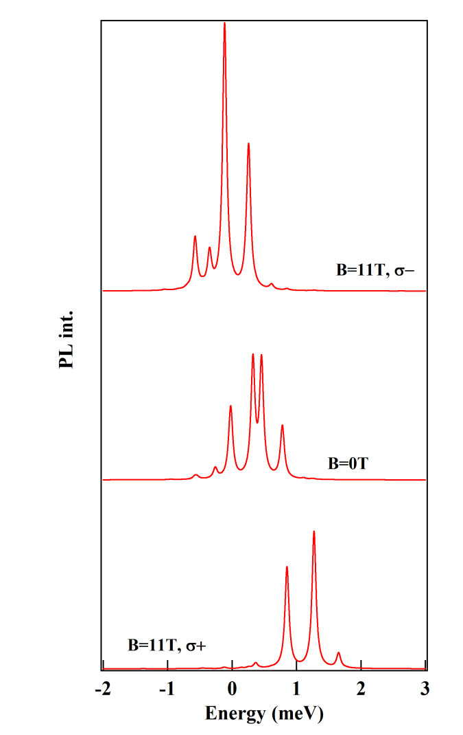
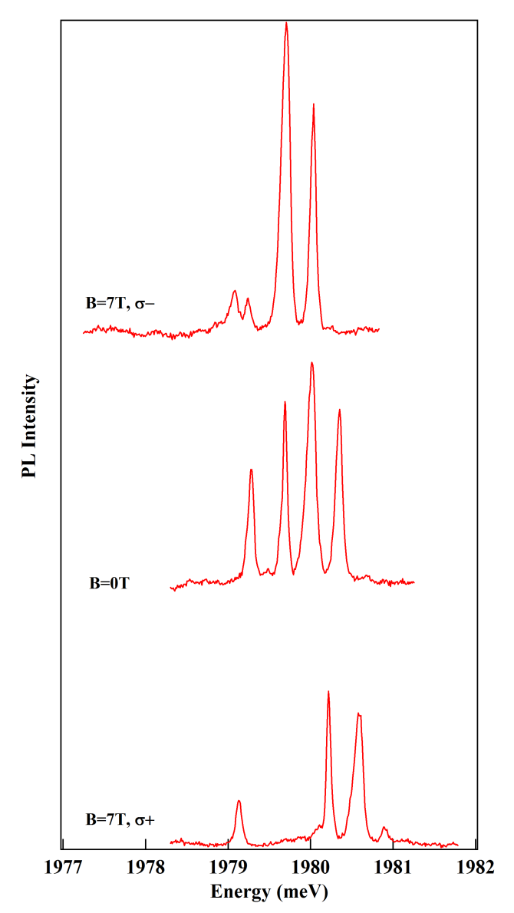
Magneto-optical properties: model
D₀=2,2 meV
T_{eff}=20K
= The thermalization (below 50K) explains why the ±2 Cr spin states are not observed. The thermalization under B is qualitatively reproduced.
= Not possible to probe the spin states ±2 at higher temperature with these QDs.

Slide 8
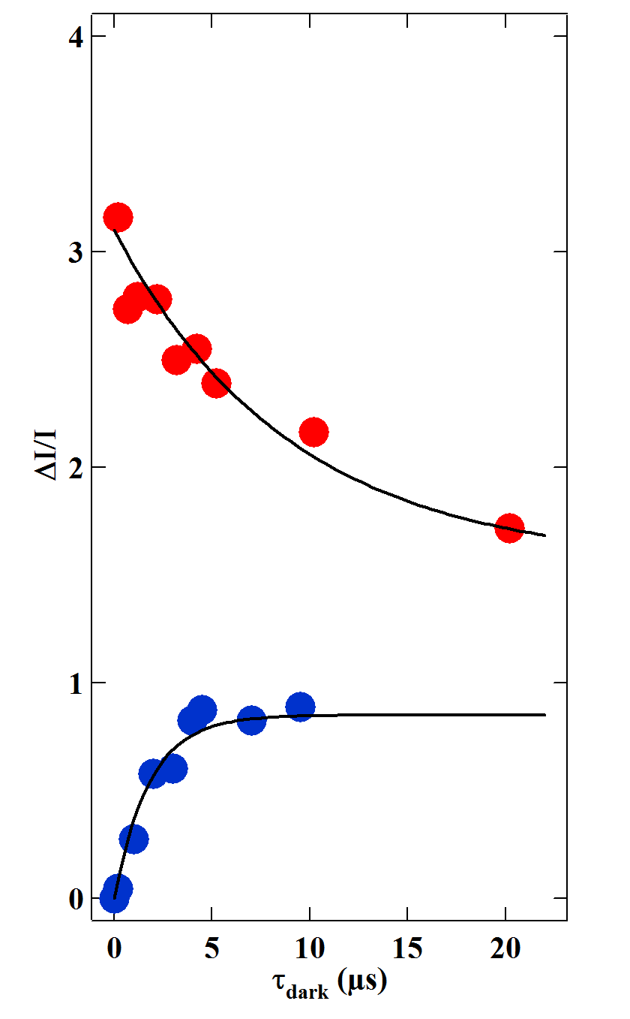
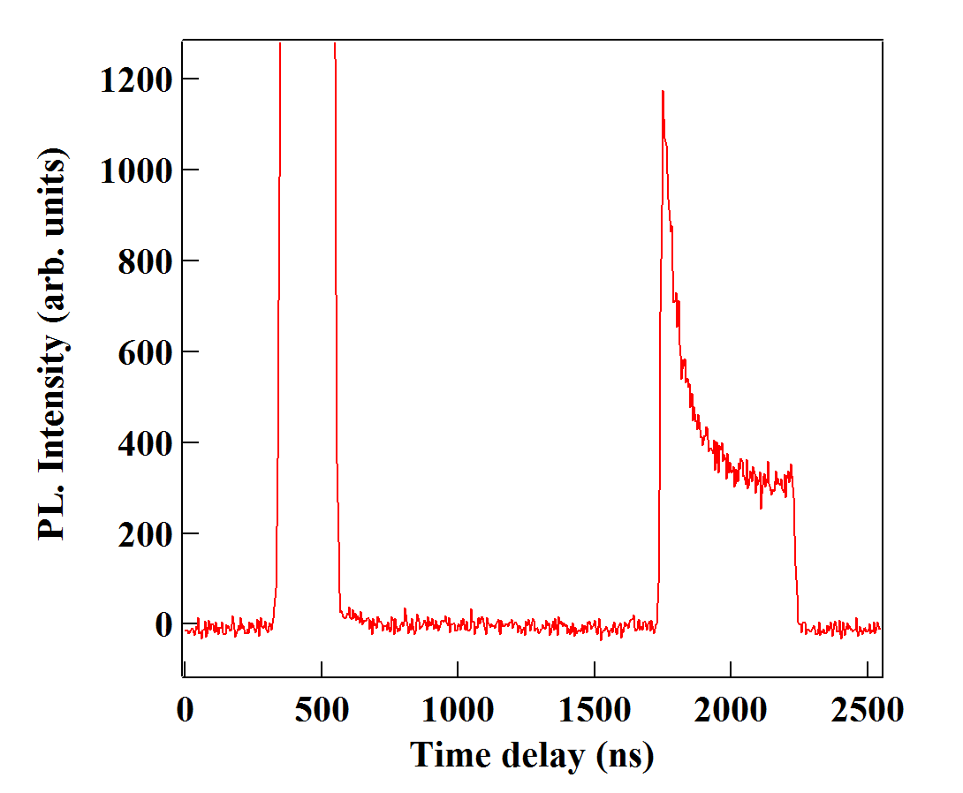
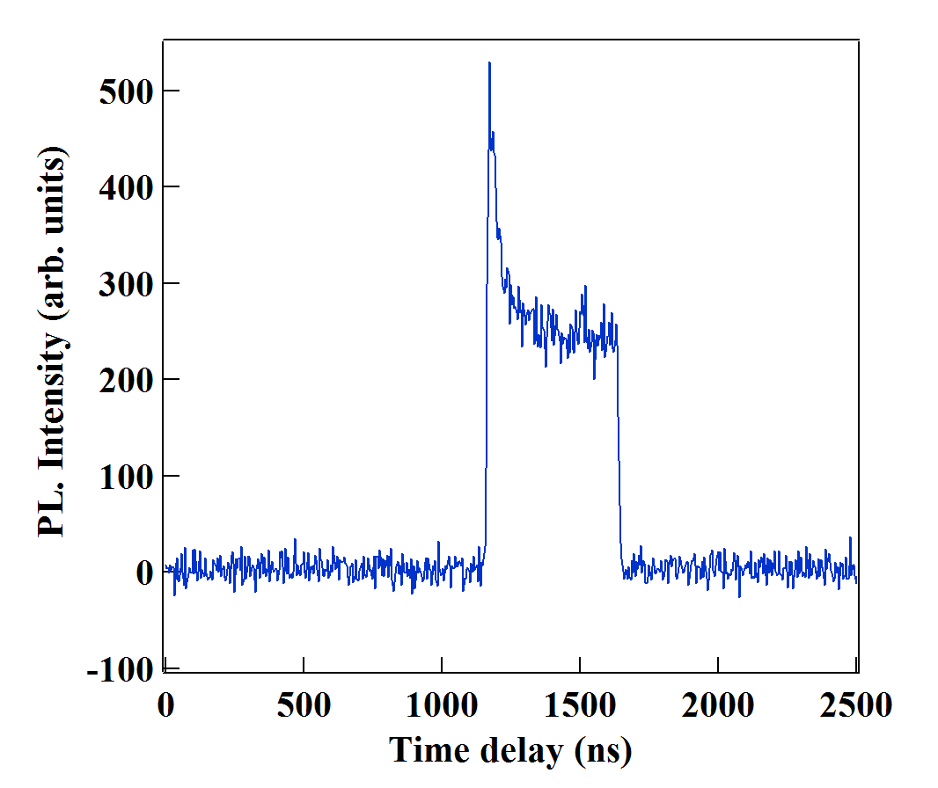
Dynamics of Cr under optical excitation
Resonant pumping transient after:
A non-resonant excitation
τ_{Cr,1} ≈ 20 ns
= Two different relaxations times linked to two different relaxation processes
A resonant excitation
τ_{Cr,2} ≈ 2 ns

Slide 9
Dynamics of Cr under optical excitation
Heating with a non-resonant probe in-between pump pulses
E
E
D₀
D₀
τ_{Cr,1}
0
0
S_{z}=-1
S_{z}=0
S_{z}=+1
S_{z}=-1
S_{z}=0
S_{z}=+1
= The probe pulse create a non-equilibrium state, populating the states S_{z} = ±1
= During the dark time, the non-equilibrium state relaxes, repopulating S_{z} = 0
= S_{z} = ±1 can relax toward S_{z} = 0 via a 1 phonon mechanism with a characteristic time τ_{Cr,1}
= The pumping transient after a heating pulse probe the transfer from S_{z} = ±1 to S_{z} = 0

Slide 10
Dynamics of Cr under optical excitation
Relaxation in the dark with only a pumping pulse
E
E
Excited state
τ_{Cr,2}
D₀
D₀
τ_{Cr,1}
0
0
S_{z}=-1
S_{z}=0
S_{z}=+1
S_{z}=-1
S_{z}=0
S_{z}=+1
= The pump pulse empty the states S_{z} = -1, transfering the population to S_{z} = +1 and S_{z} = 0
= During the drak time, the state Sz = -1 is repopulated from Sz = 0 and Sz = +1
= S_{z} = +1 can transfer to S_{z} = +1 via a 2 phonon mechanism involving an excited state with a characteristic time τ_{Cr,2}
= S_{z} = ±1 can relax toward S_{z} = 0 via a 1 phonon mechanism with a characteristic time τ_{Cr,1}, longer than τ_{Cr,2}
= The pumping transient after a heating pulse probe the transfer from S_{z} = ±1 to S_{z} = 0

