Slide 1
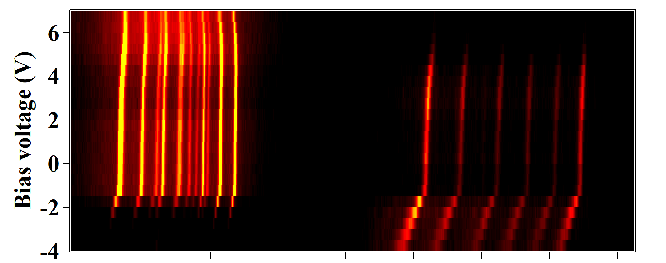
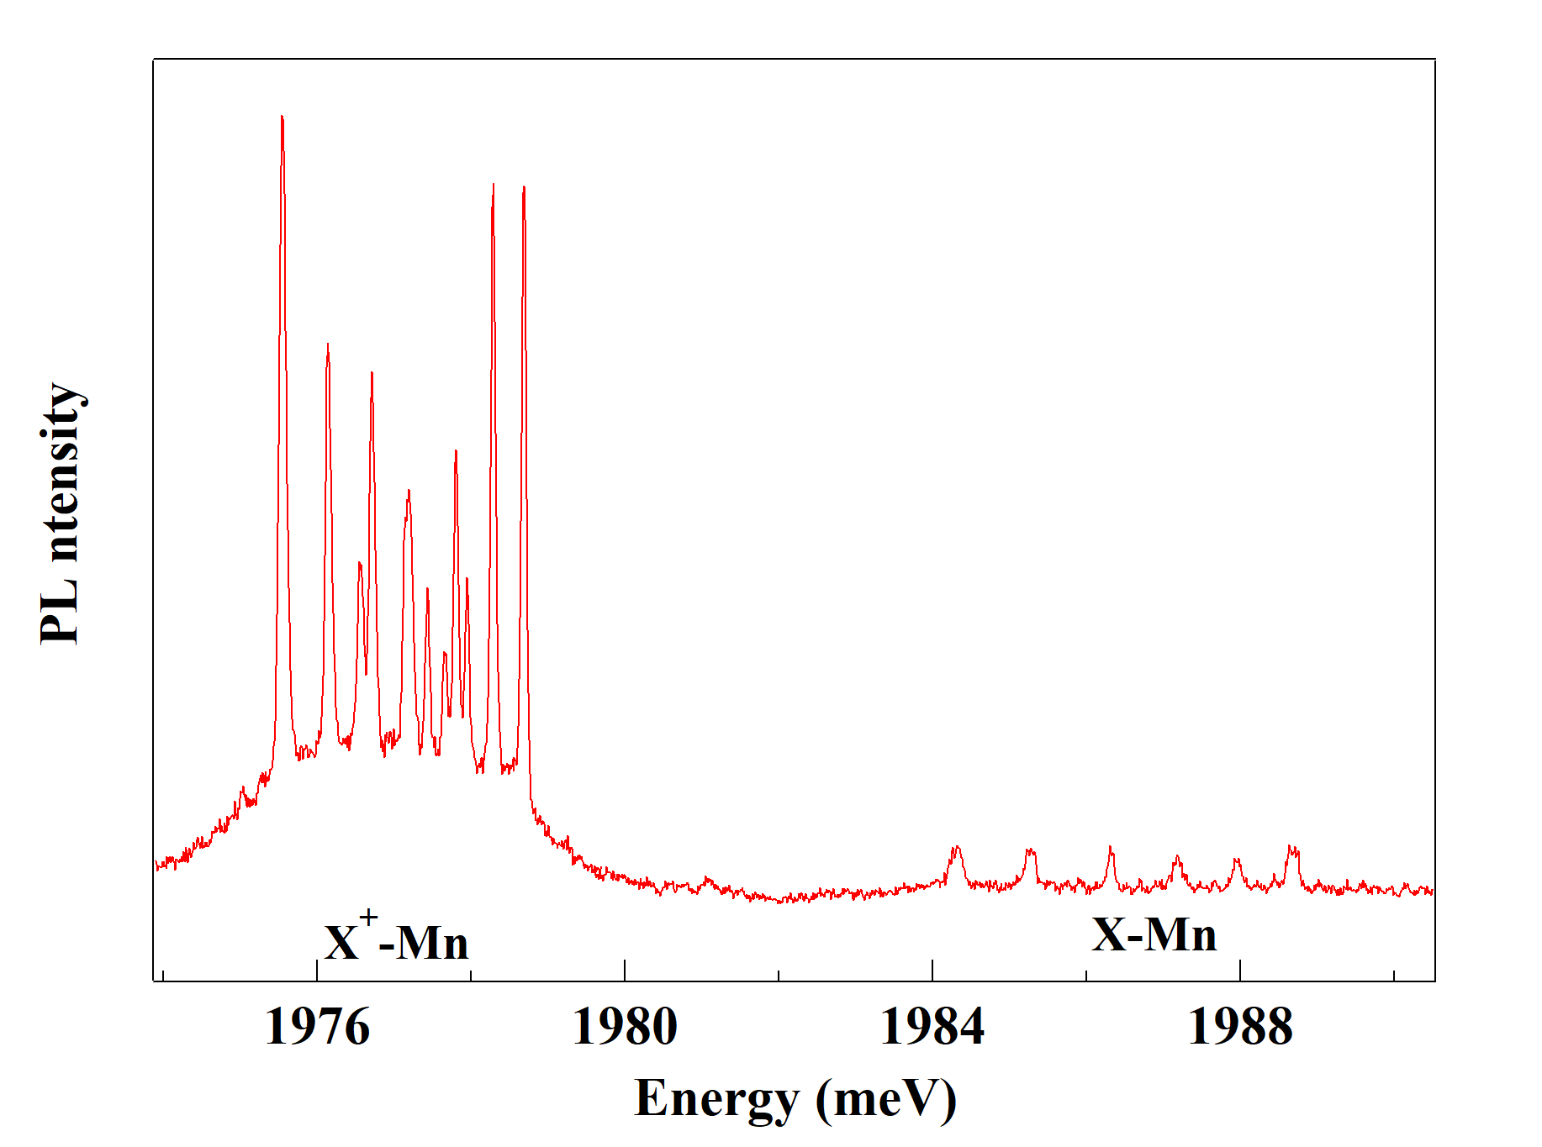
(a)
X⁺-Mn
X-Mn
(b)
V=5.5V

