Slide 1
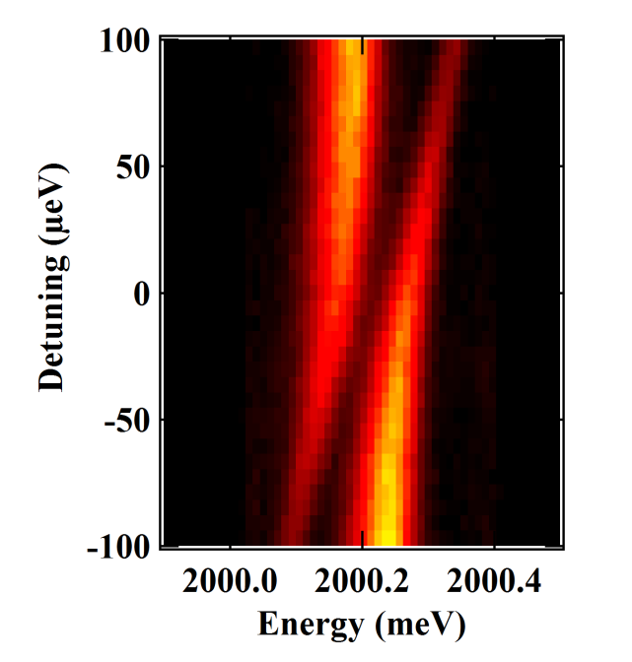
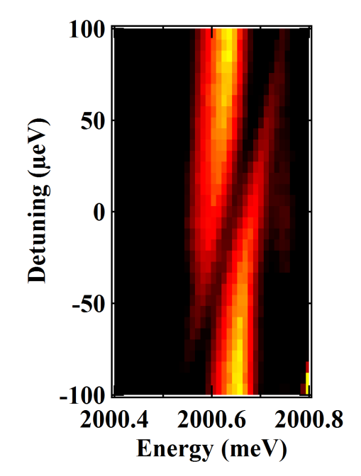
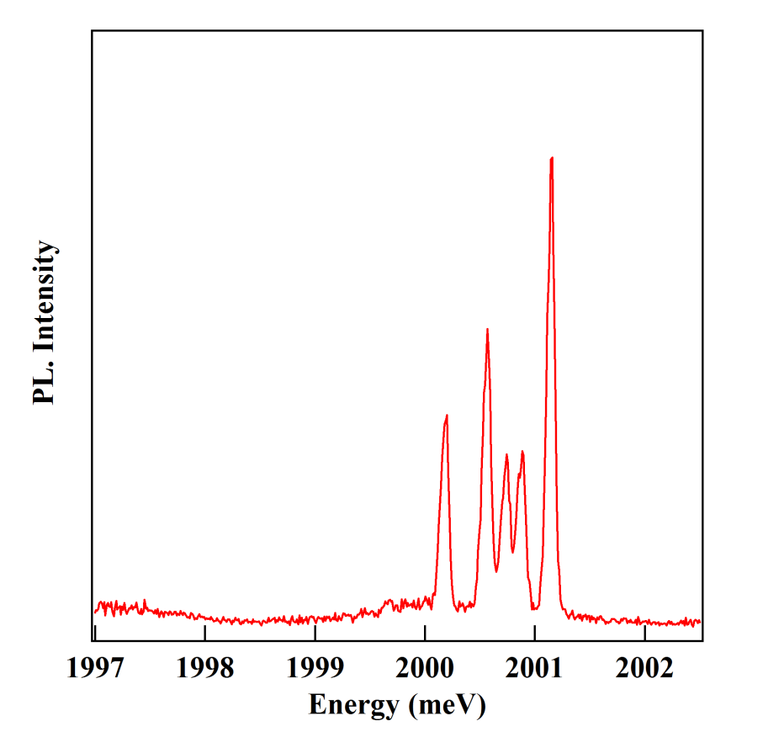
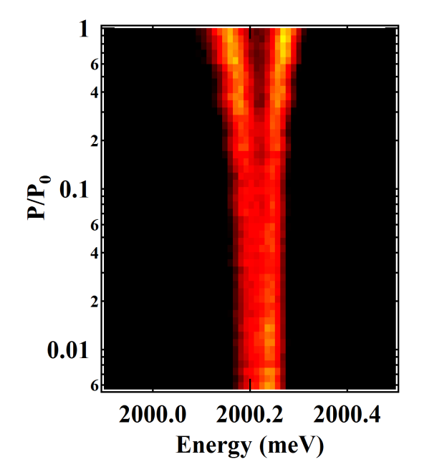
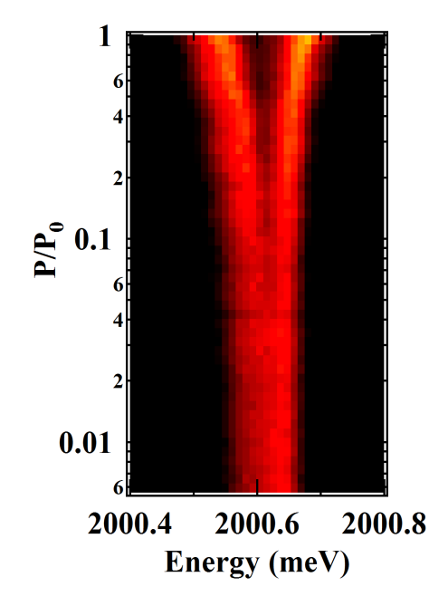
(b)
(a)
(1)
σ+
σ−
(3)
(4)
(2)
S_{z}=+1
S_{z}=-1
S_{z}=0
(4)
(3)
Notes:
1

