Slide 1
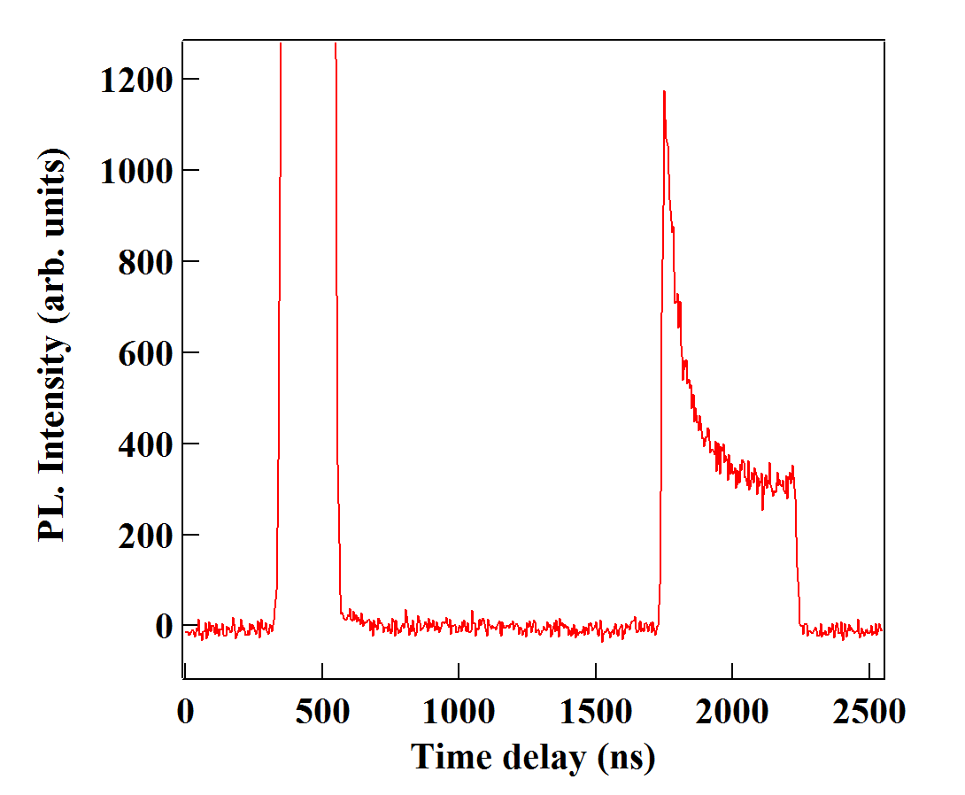
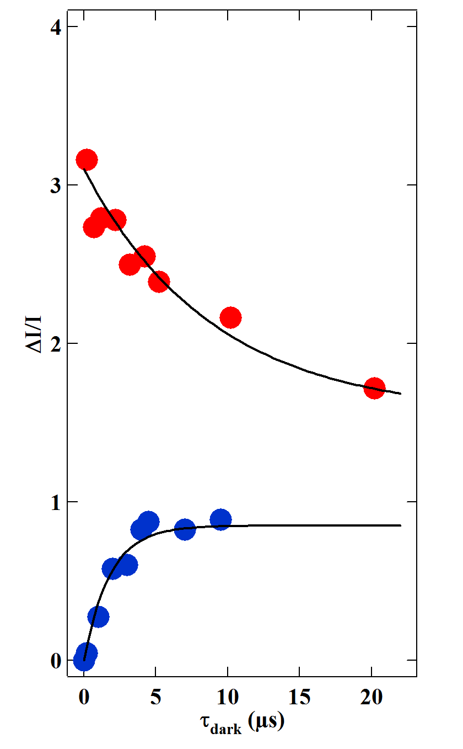
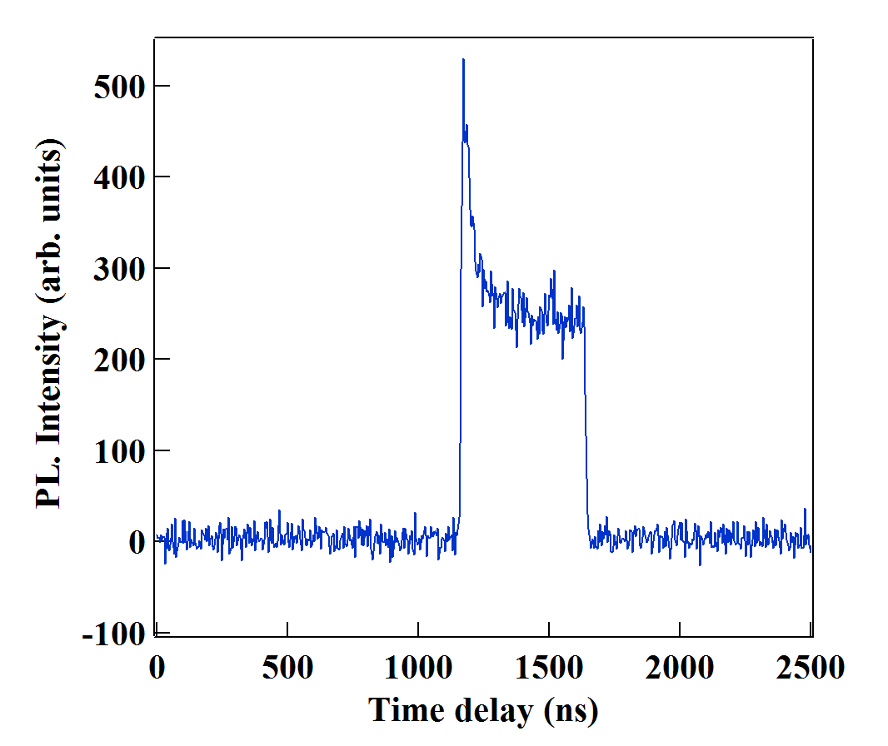
(a)
(b)
Resonant
pump
τ_{dark}
τ_{dark}
(c)
τ_{dark}
Quasi-res.
probe
Resonant
pump

