Slide 1
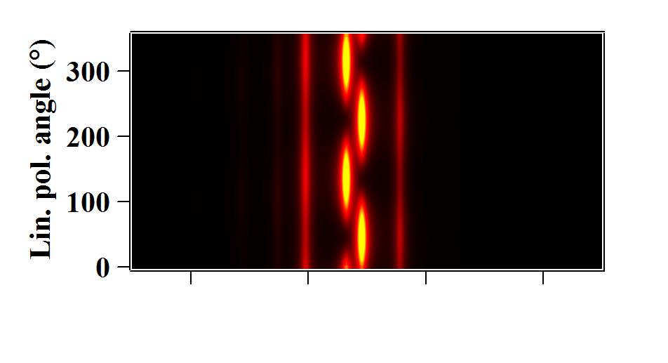
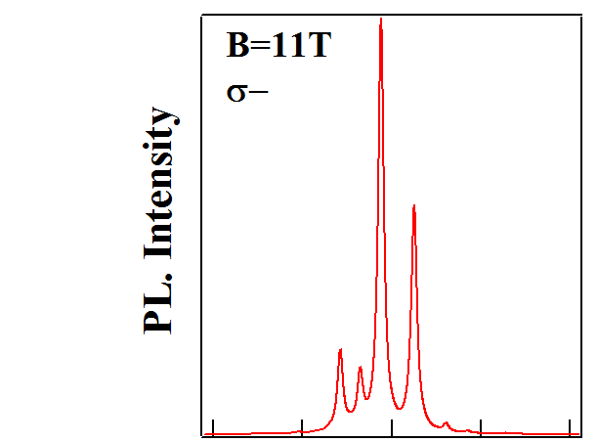
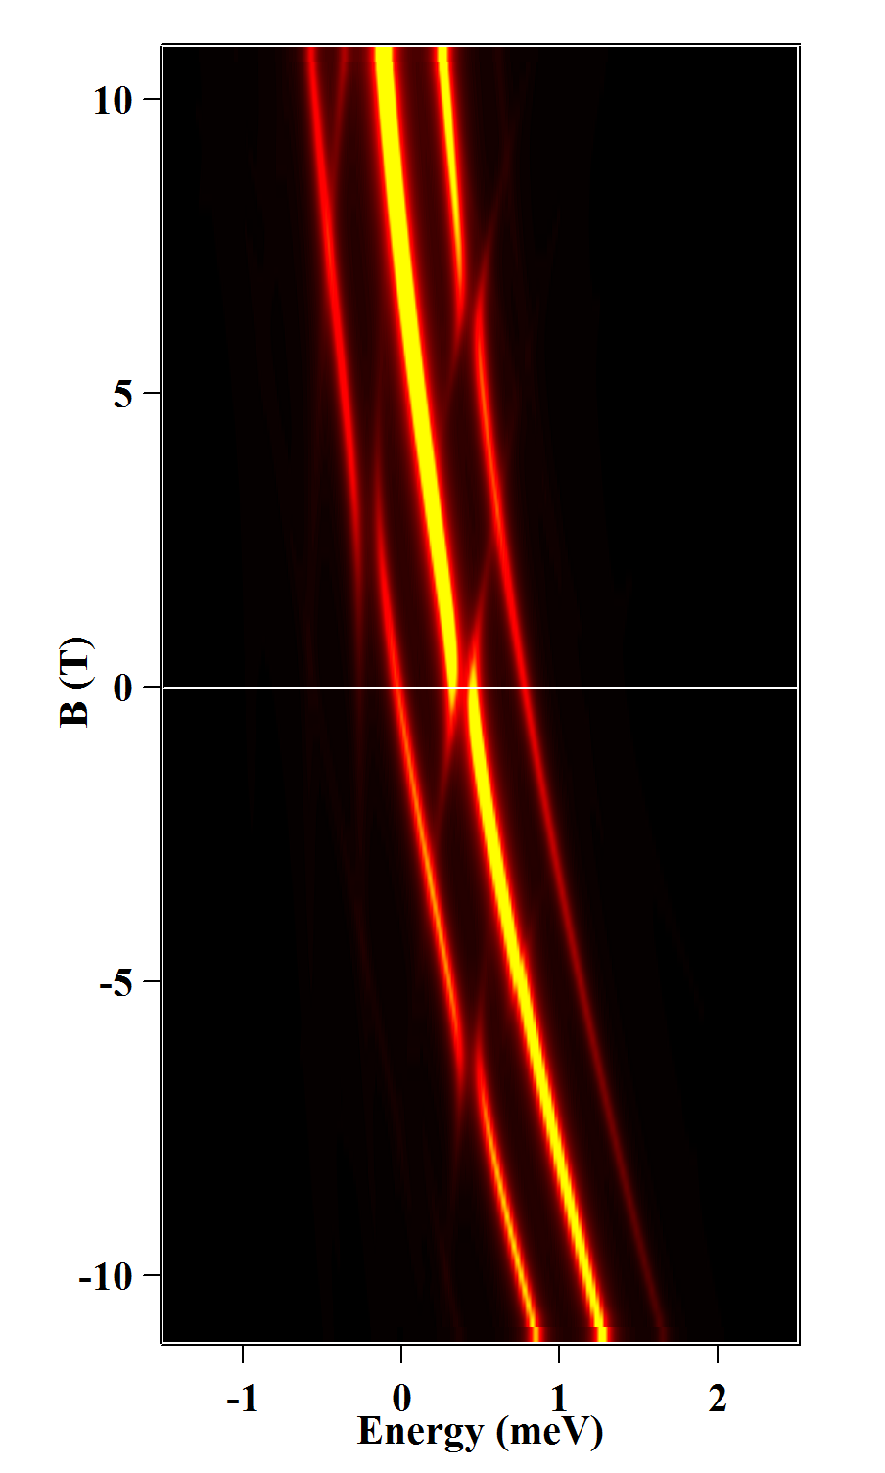
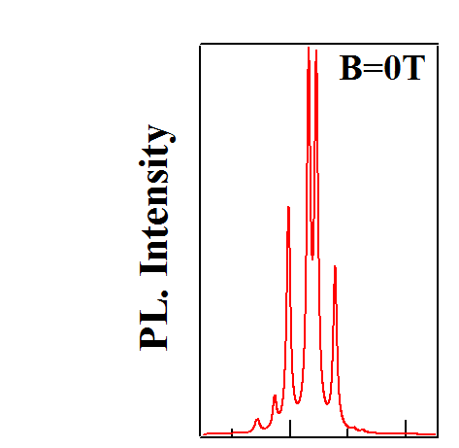
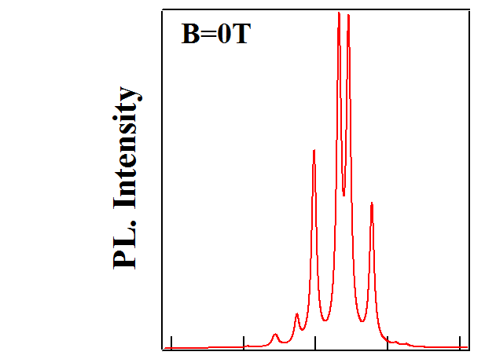
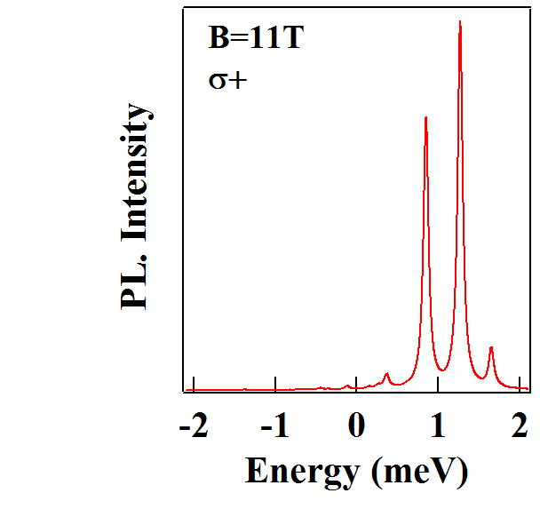
(a)
(b)
E
IS_{z}=+1,+1>
IS_{z}=+1,+2>
(4)
IS_{z}=+1,-1>
(6)
σ−
(2,3)
IS_{z}=+1,-2>
D₀
IS_{z}=-1,+1>
(2)
X-Cr
IS_{z}=-1,-1>
IS_{z}=0,+1>
(5)
IS_{z}=-1,+2>
(1)
IS_{z}=0,-1>
(4)
IS_{z}=0,+2>
(6)
(1)
S_{z}=+1
(5)
(3)
S_{z}=-1
D₀
Cr
σ+
σ-
σ+
S_{z}=0
0
B_{z}

