Slide 1
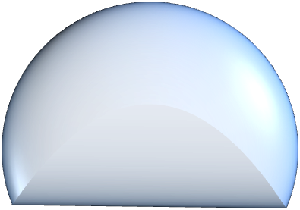
z
⁵⁵Mn S=5/2, I=5/2
6D₀
S_{z}=+5/2, I_{z}
S_{z}=-5/2, I_{z}
~9 μeV
(A)
E
~40 μeV
2D₀
S_{z}=+3/2, I_{z}
S_{z}=-3/2, I_{z}
0
S_{z}=±1/2, I_{z}

