Slide 1
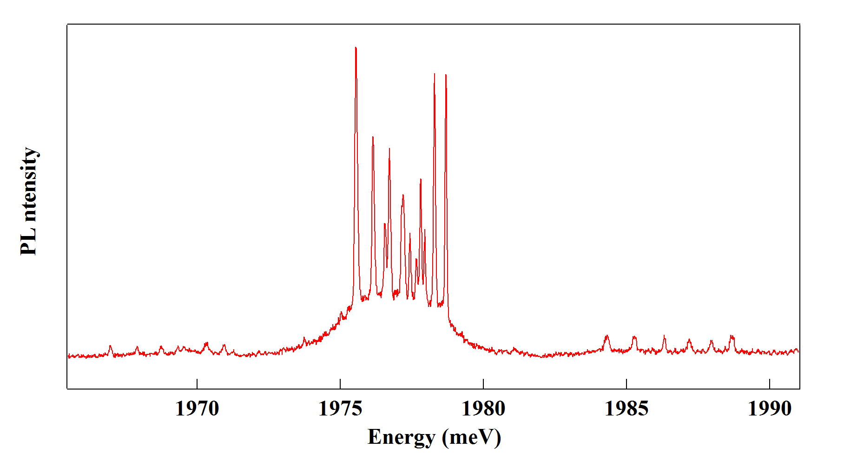
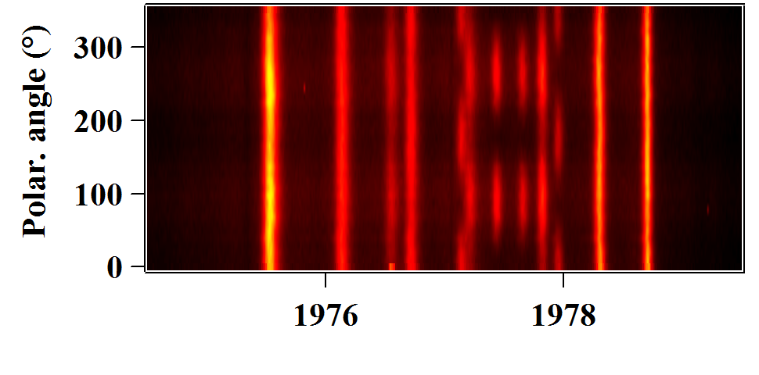

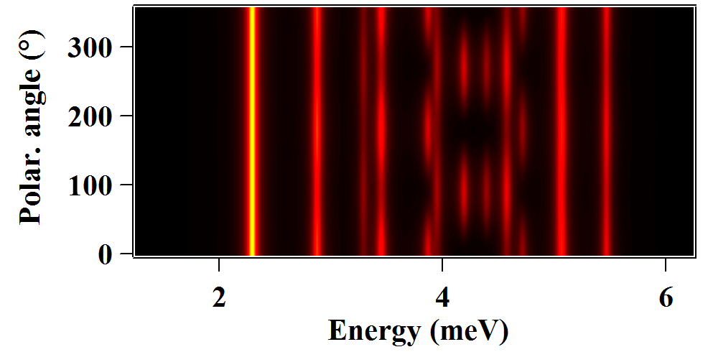
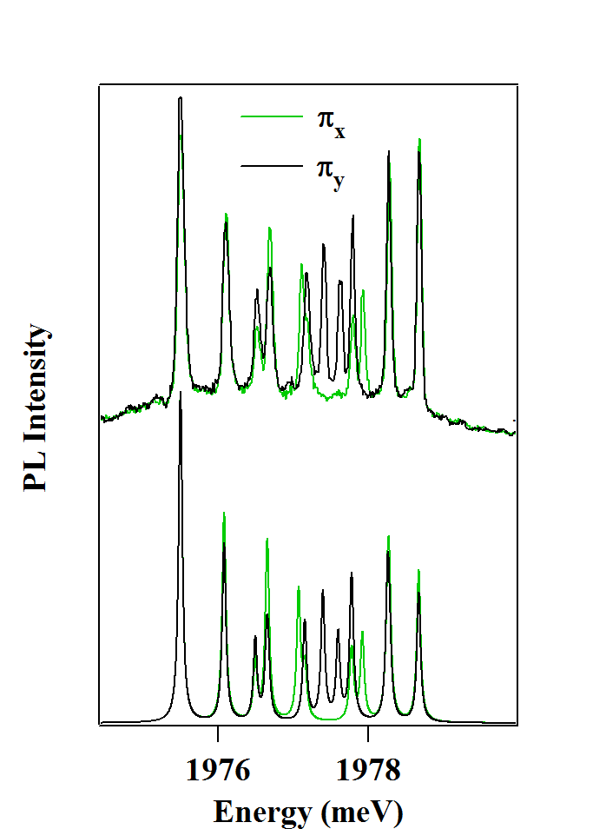
(a)
Exp.
Th.
X⁺-Mn
X₂-Mn
X-Mn
(b)
(c)
E
M=2
E (S_{y}² - S_{x}²)
X⁺-Mn
M=3
Exp.
σ+
σ-
S_{z}=-5/2
S_{z}=+5/2
J_{z}=-3/2
J_{z}=+3/2
h-Mn
Th.
S_{z}=-5/2
S_{z}=+5/2
-4
-3
-2
-1
0
+1
+2
+3
+4
M_{z}

