Slide 1
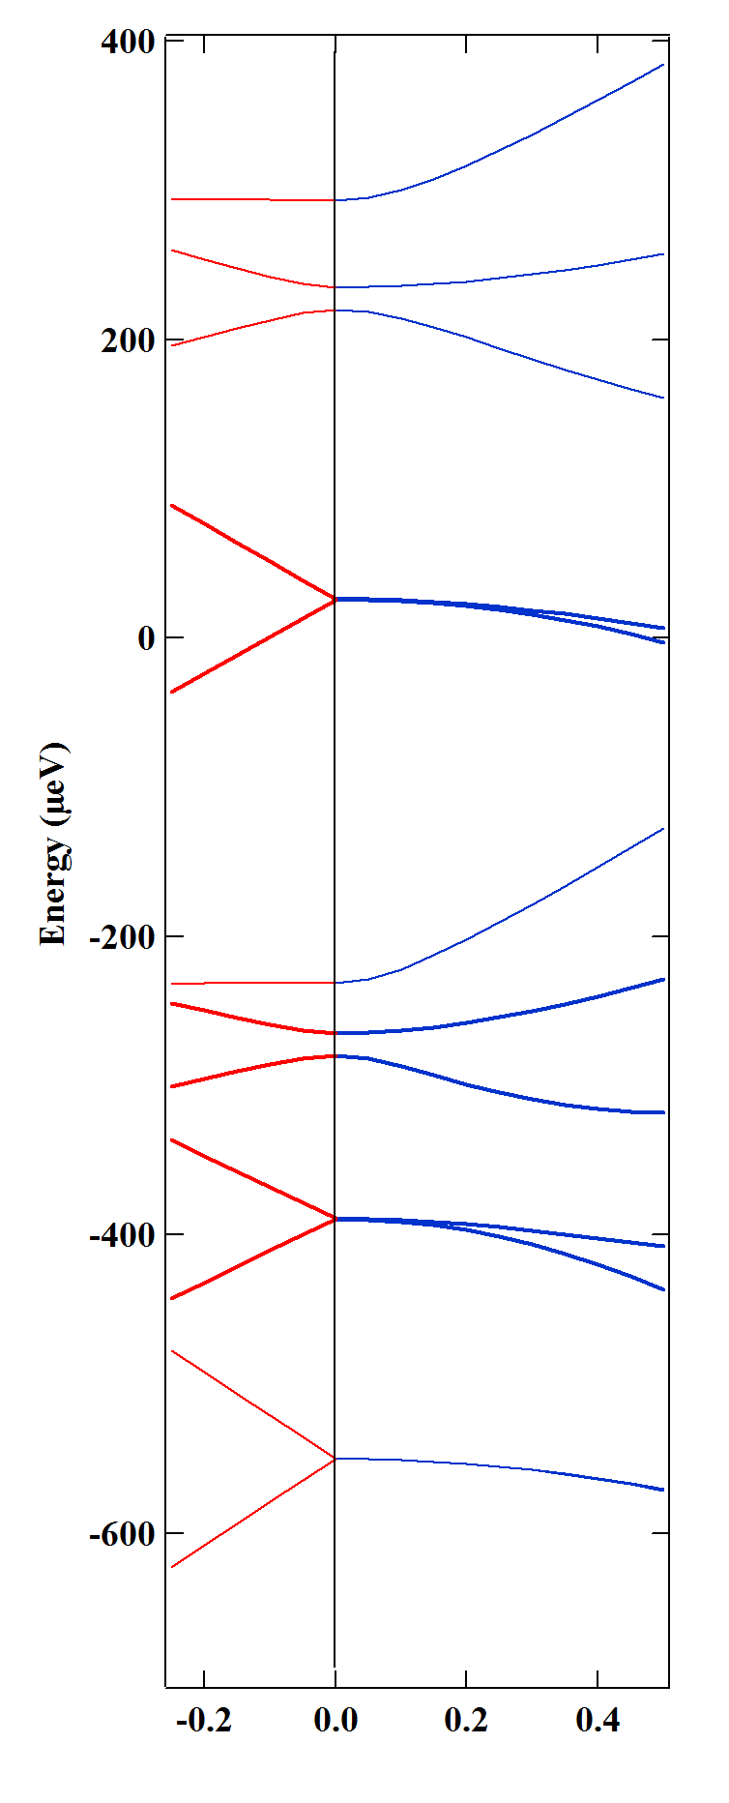
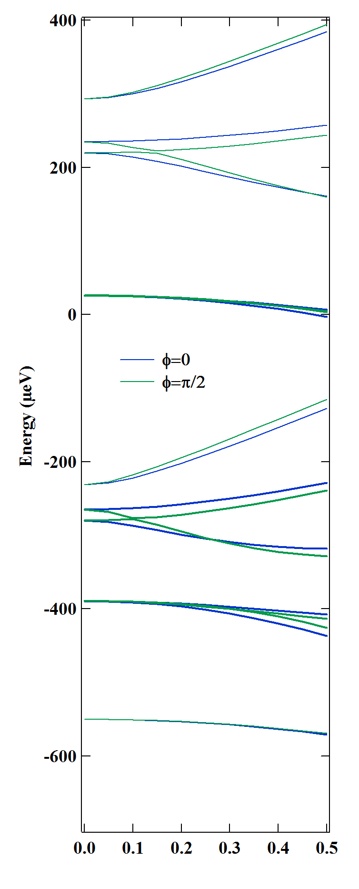
(a)
(b)
M_{z}=0
M_{z}=±1
M=2
M_{z}=±2
M_{z}=0
M_{z}=±1
M_{z}=±2
M=3
M_{z}=±3
B_{z}(T)
B┴(T)
B┴(T)

