Slide 1
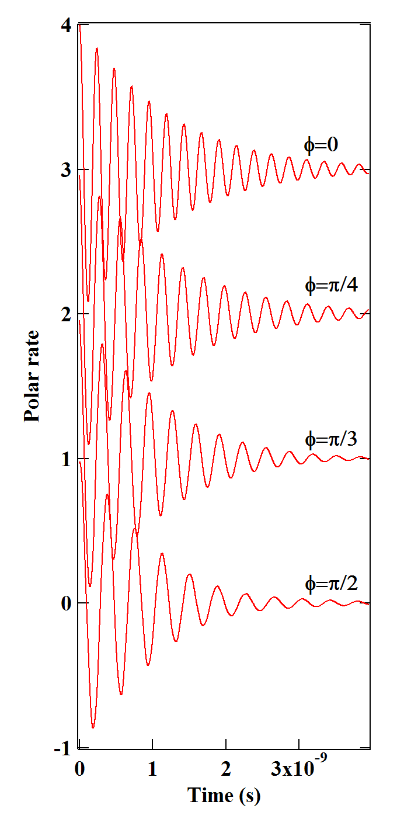
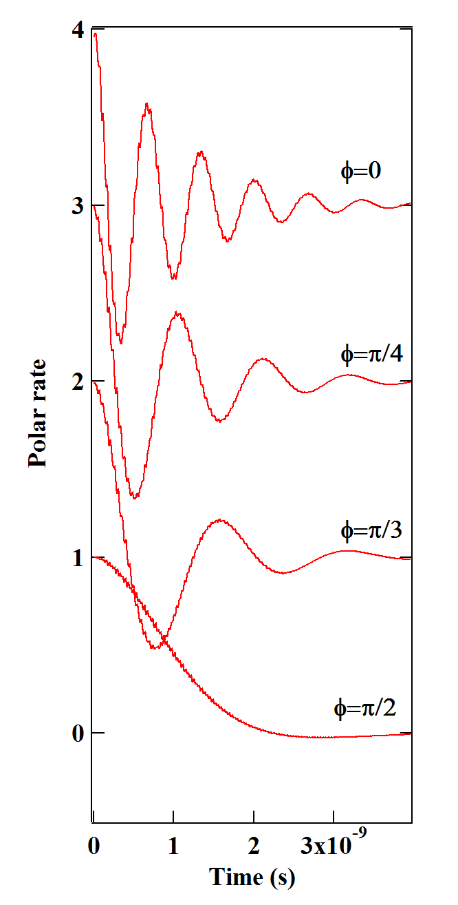
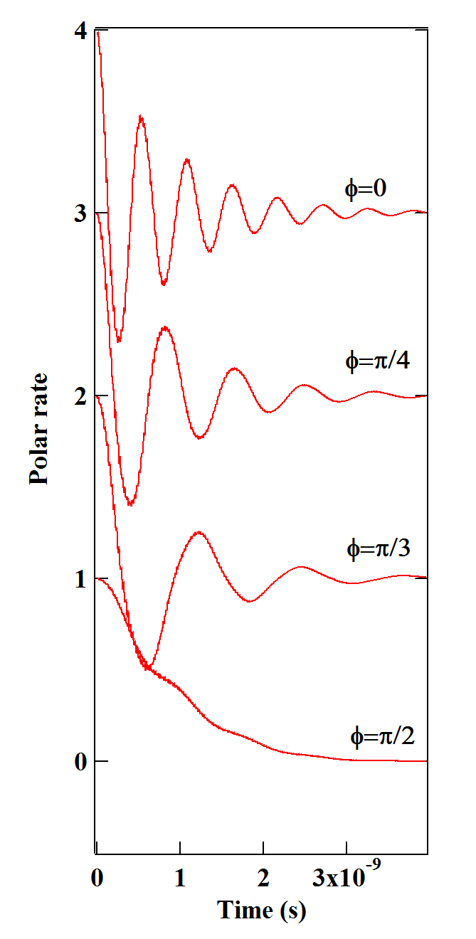
(a)
(b)
(c)
B┴=0,05T
B┴=0,25T
B┴=0,4T

