Slide 1
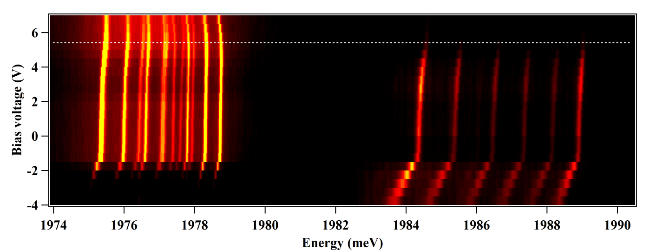
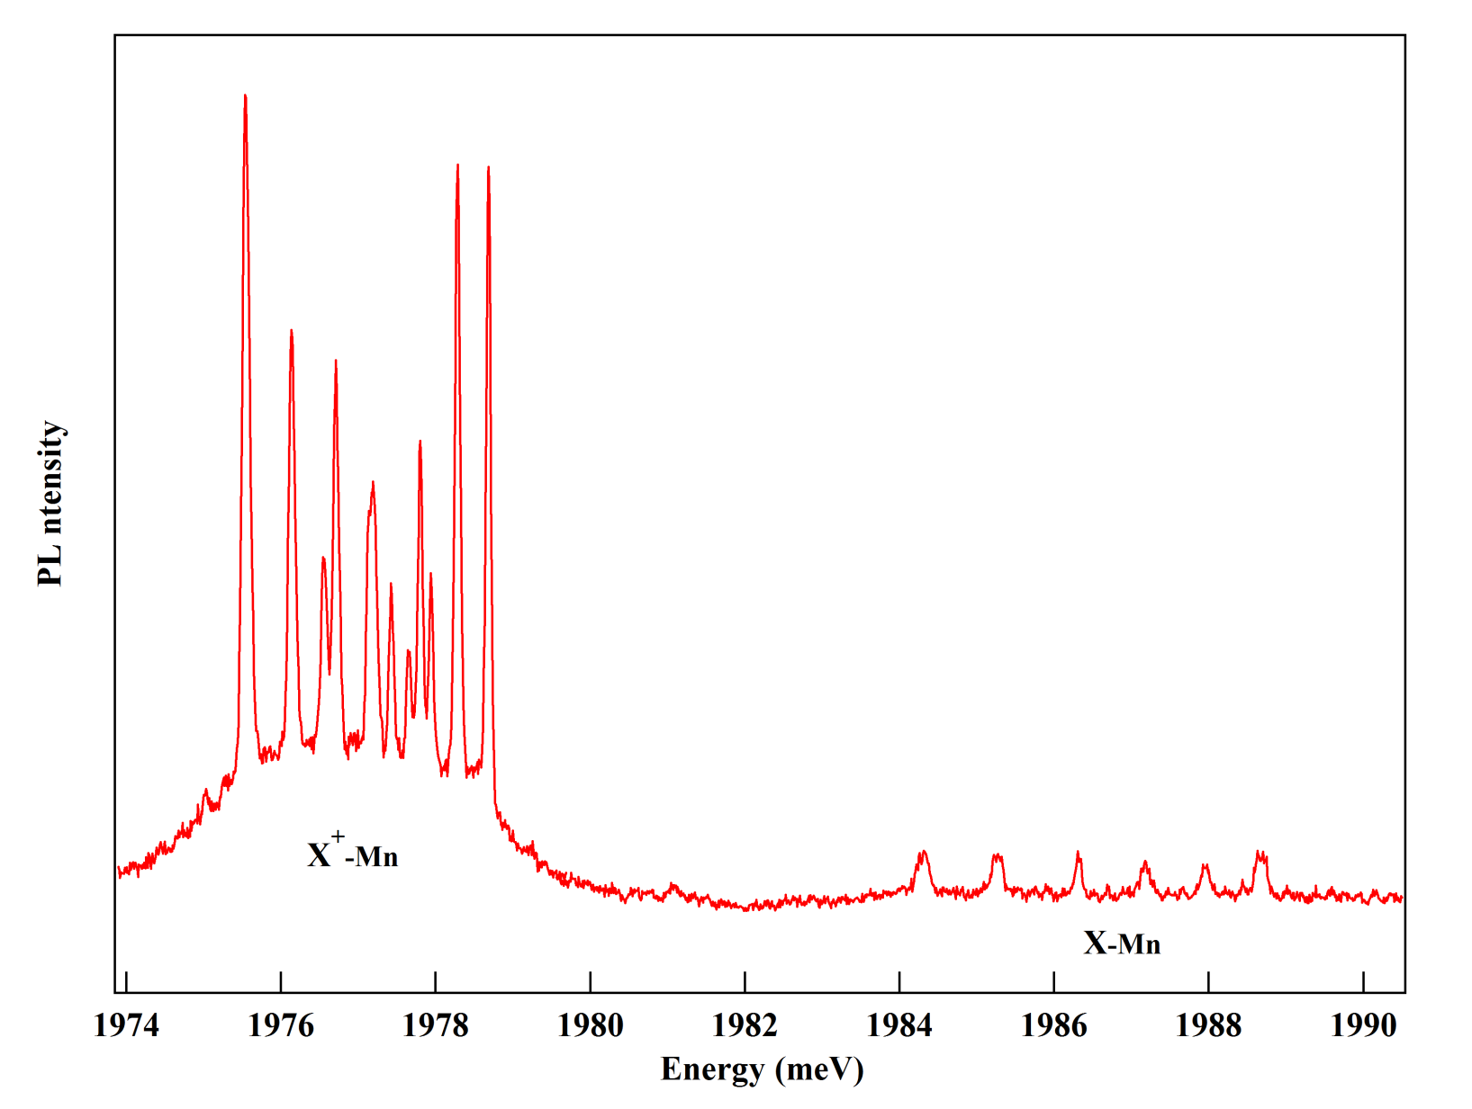
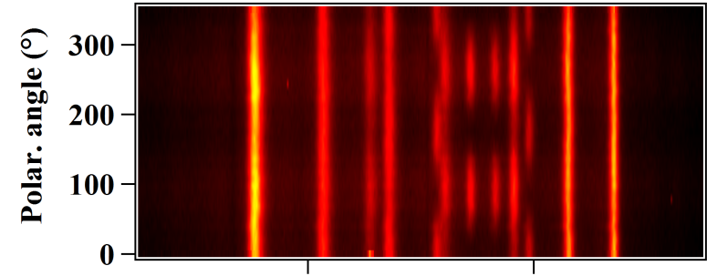
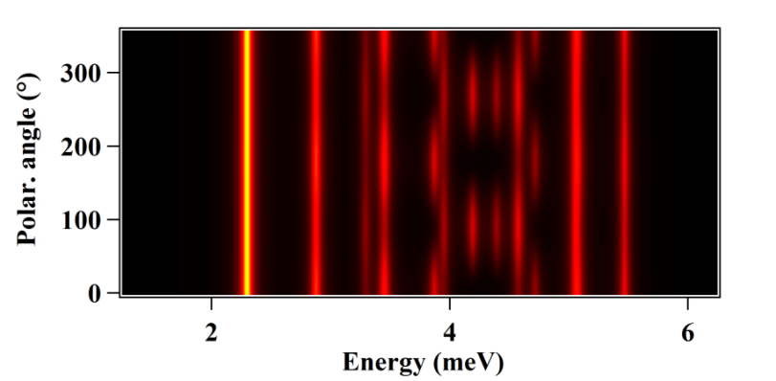
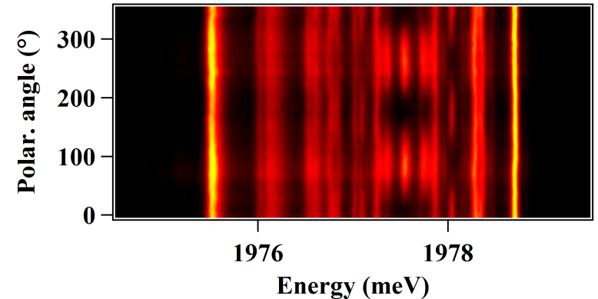
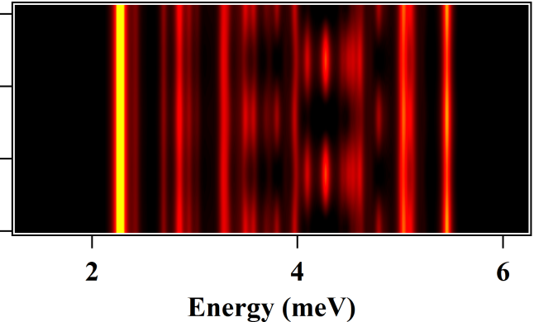
(a)
(b)
V=5.5V
E
M=2
X⁺-Mn
M=3
σ+
σ-
S_{z}=-5/2
S_{z}=+5/2
J_{z}=-3/2
J_{z}=+3/2
h-Mn
S_{z}=-5/2
S_{z}=+5/2
(c)
-4
-2
0
+2
+4
M_{z}
(c)
Exp
Th

