Slide 1
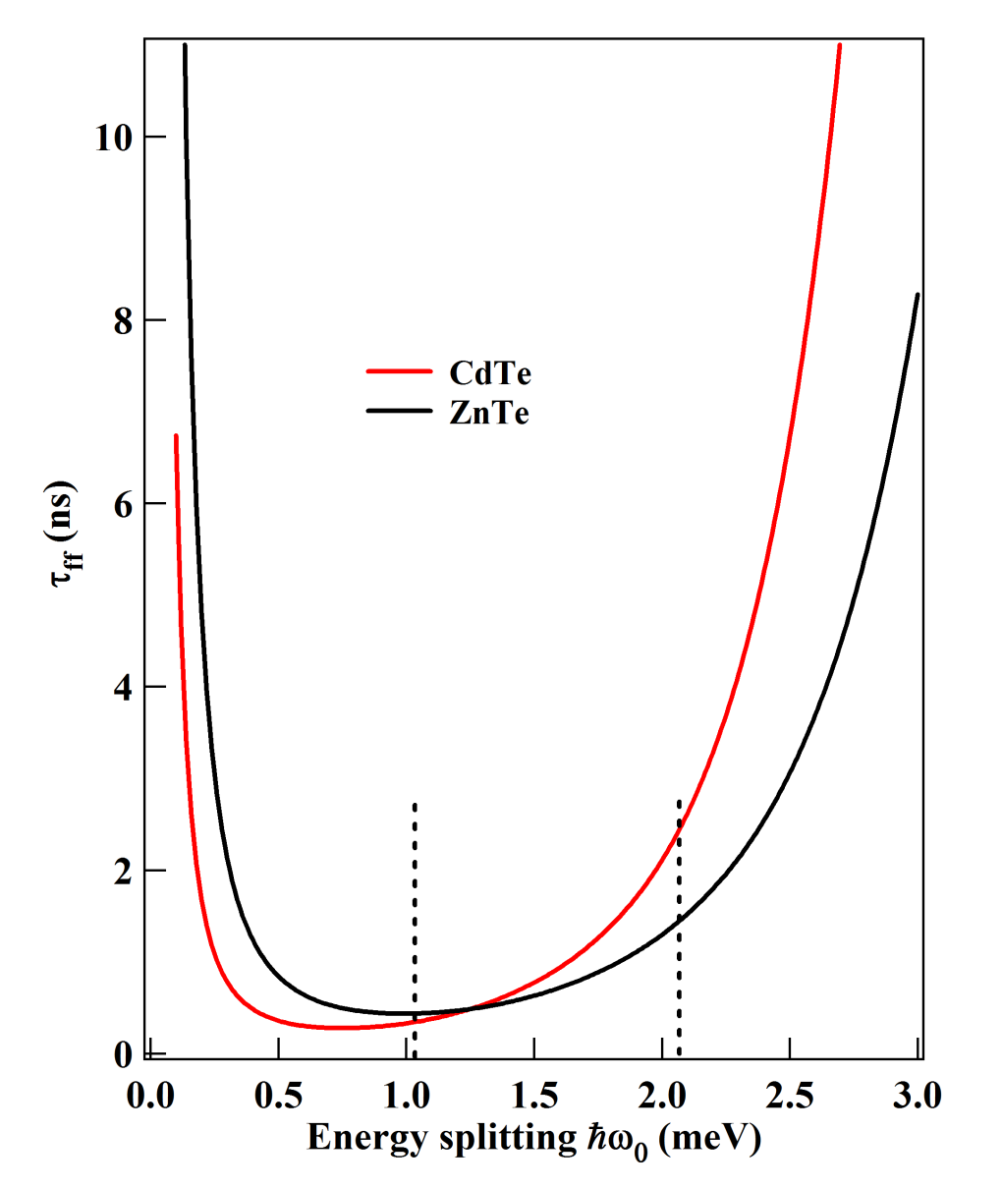
(a)
(b)
E
σ+
σ-
τ_{ff}
+1
+3
M_{z}

