Slide 1
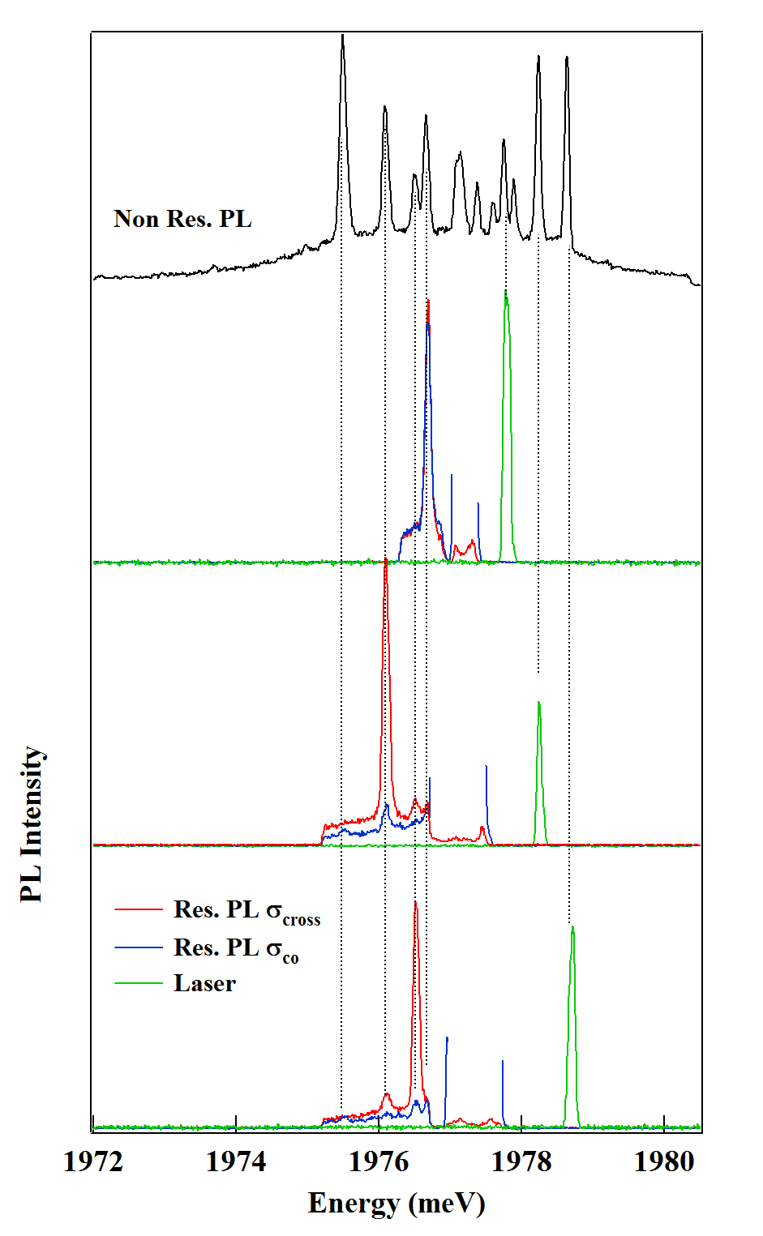
(a)
(b)
E
σ+
σ-
(1)
-4
-3
-2
-1
0
+1
+2
+3
+4
M_{z}
E
σ+
σ-
(2)
-4
-3
-2
-1
0
+1
+2
+3
+4
M_{z}
E
(3)
σ+
σ-
-4
-3
-2
-1
0
+1
+2
+3
+4
M_{z}

