Slide 1

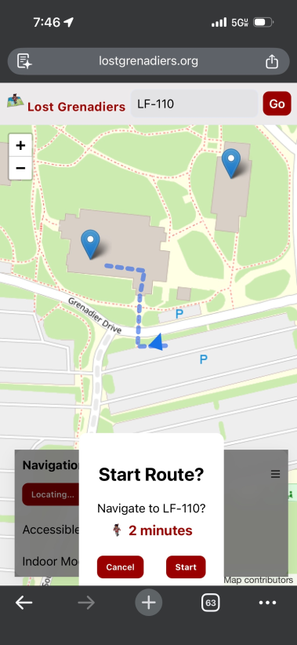
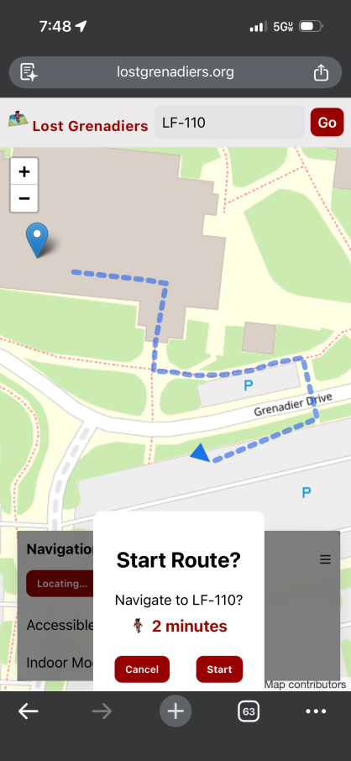
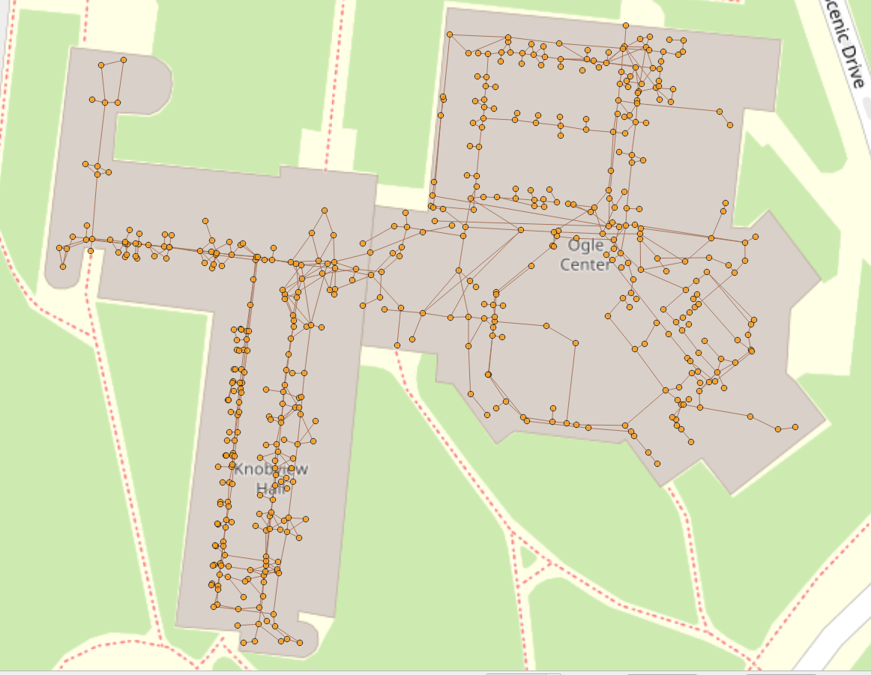
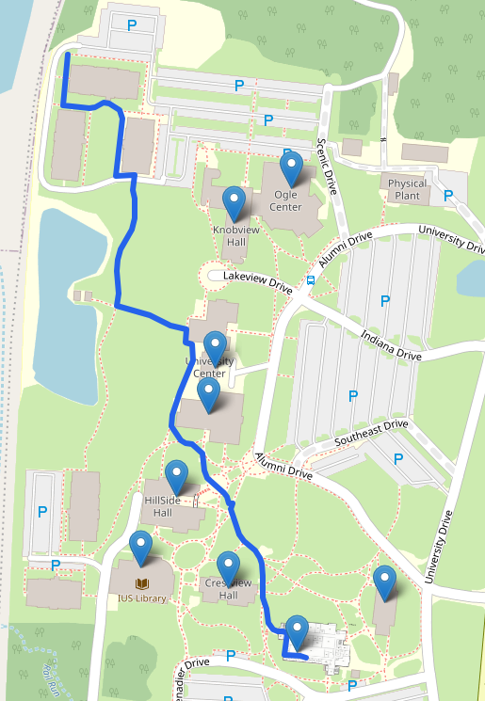
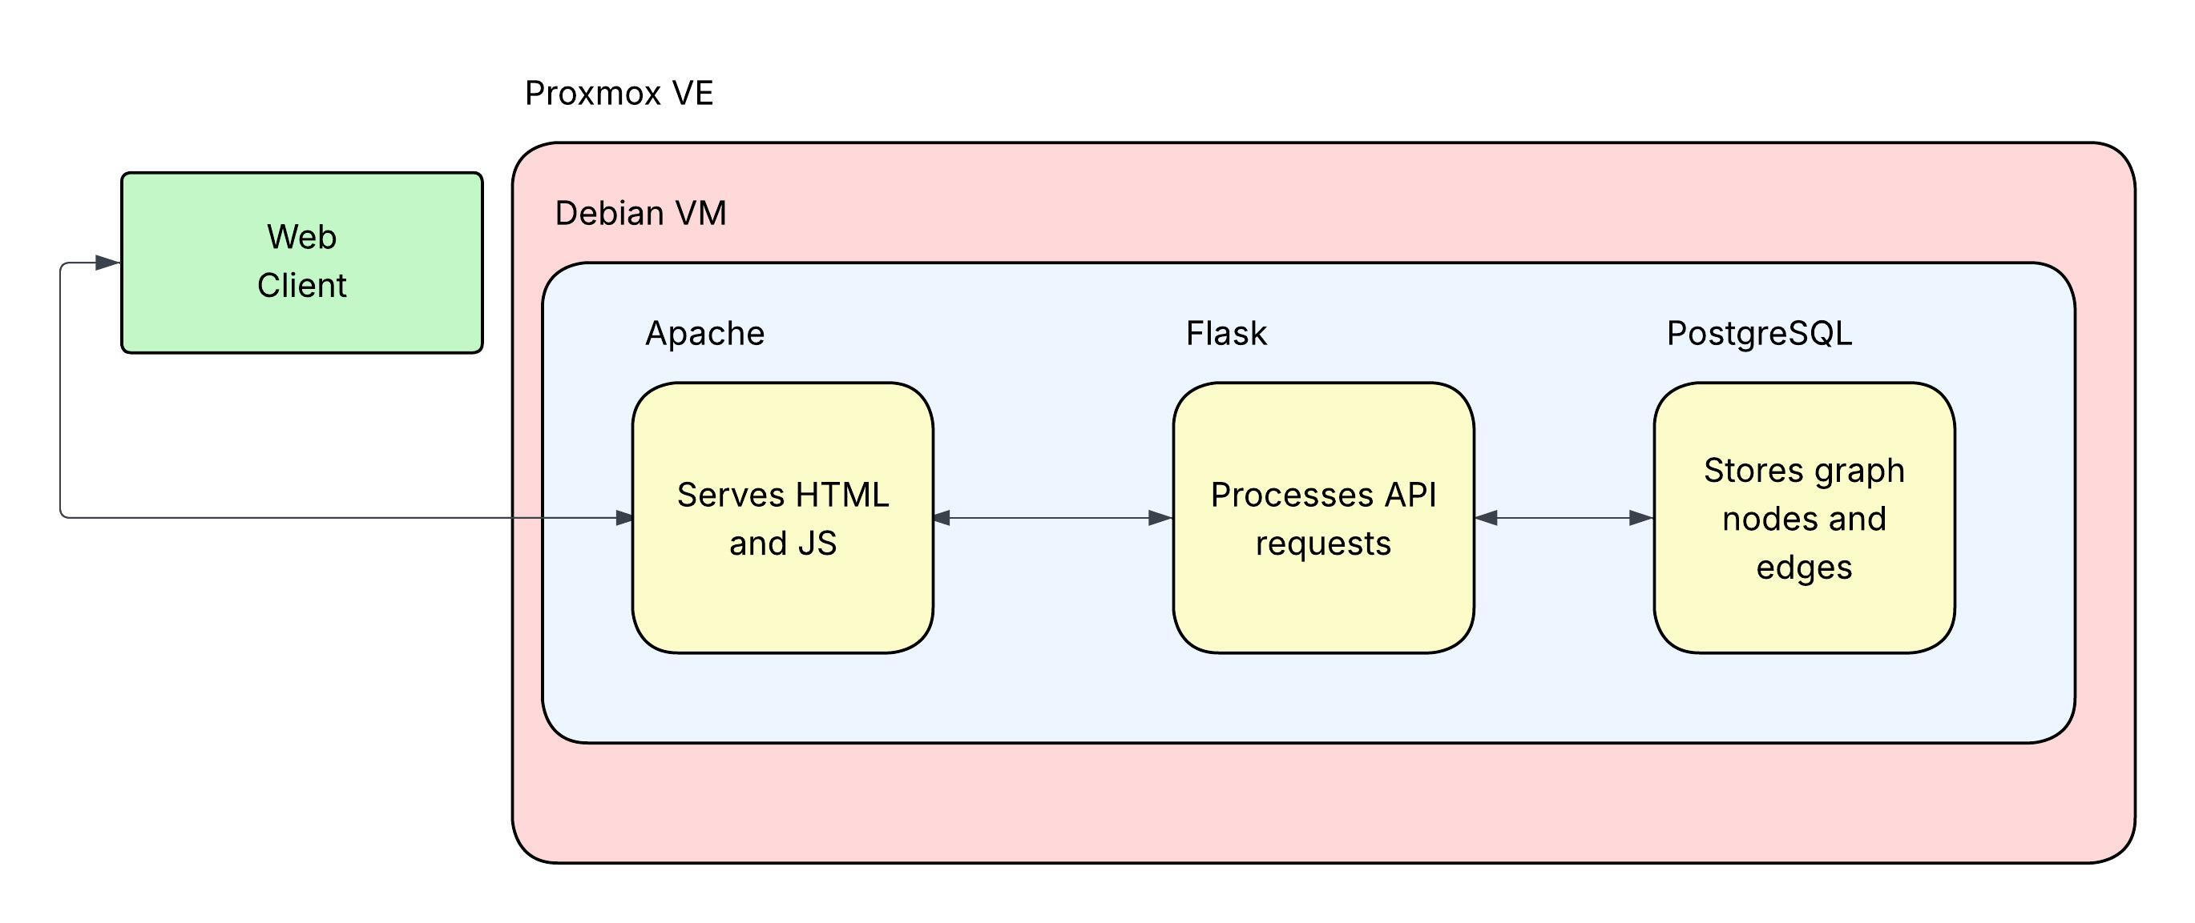

Lost Grenadiers: IU Southeast Campus Navigation System
Audrey Dickson, Kaden Langford, Andrew Swartz – IUS Computer Science
Faculty Advisor: Chris Sexton
lostgrenadiers.org
Abstract
Accessibility Toggle
Enables accessible routing mode by removing edges containing stairs and prioritizing elevators and ramps, producing a fully accessible shortest path.
Backend Data
Finding your way around a university campus for the first time isn’t always straightforward. Wrong turns, unmarked buildings, and confusing room numbers can quickly overwhelm new students, parents, and other guests. The Lost Grenadiers campus navigation system was built to address this problem specifically for Indiana University Southeast. The system uses a Leaflet.js frontend, Flask API, and PostgreSQL/pgRouting backend to calculate optimal routes between any two points on campus using Dijkstra’s algorithm, with support for accessible path filtering. All communications are encrypted and routing queries are protected against injection attacks.
Campus is represented as a graph structure with nodes (buildings, entrances, hallways, rooms) and edges (walkable connections between nodes).
Supports indoor and outdoor integration
Built using real campus geometry
Enables direct use of Dijkstra's algorithm (optimal paths)
Routing Demonstration
Accessibility Off
Accessibility On
System Architecture
Results and Discussion
Fast query response under simulated load
Accessibility filtering adds minimal overhead
Challenges and solutions:
Graph integrity solved with topology validation
Indoor routing solved with segmented building graphs
API security solved with rate limiting + input validation
A virtualized Proxmox environment hosts a Debian VM running Apache, Flask, and PostgreSQL in an isolated, secure setup. The frontend delivers an interactive Leaflet.js campus map with real-time route display. Routing requests are handled by a Flask API which validates inputs and manages application logic. A PostgreSQL + pgRouting database stores all nodes, edges, and building geometry.
Future Work
Deployment on campus infrastructure
Improve graph editing tools
Increased node density for higher accuracy
Live routing across campus is shown above through navigation to a specific room, LF-210. The route is generated in real time using the user's GPS position, combining outdoor and indoor navigation into a single continuous path.
References
pgRouting Project. (2025). pgRouting 4.0 documentation.. Retrieved from https://docs.pgrouting.org
PostGIS Development Group. (2026). PostGIS 3.6 documentation. Retrieved from https://postgis.net/documentation
Leaflet Contributors. (2025). Leaflet 1.9.4 documentation. Retrieved from https://leafletjs.com.
Internet Security Research Group. (2025). Let’s Encrypt documentation. Retrieved from https://letsencrypt.org/docs
Technical Contributions
Audrey Dickson: Graphic Design + Frontend Development
Kaden Langford: Database & API development
Andrew Swartz: DevSecOps + penetration testing

