Slide 1
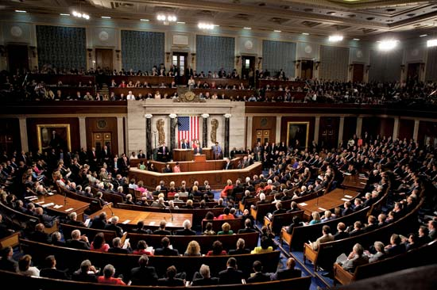
Modeling Voter Turnout in US House of Representatives Elections
Audrey Baker
January 26, 2018

Slide 2
Agenda
Background
Exploratory Analysis
Modeling
Insights and Next Steps

Slide 3
Background

Slide 4
Objective
Predict votes cast in each congressional district for a US House of Representatives Race in order to help national political groups determine optimal allocation of resources for canvassing and ‘Get Out The Vote’ operations.

Slide 5
Data sources
Vote counts by district in 2014 and 2016 elections, from US House of Representatives election statistics records
Dollars raised and spent by each candidate for election in 2014 and 2016 elections, from Federal Election Commission campaign finance records

Slide 6
Exploratory Analysis

Slide 7
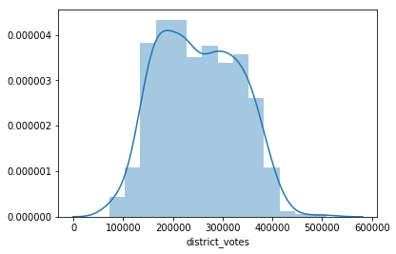
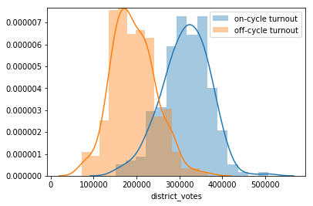
Distribution of voter turnout

Slide 8
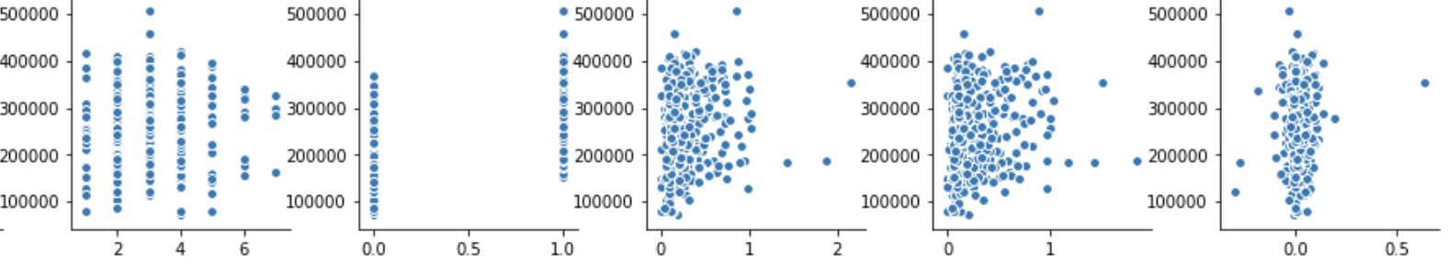
Feature correlations with voter turnout
# candidates
On-cycle year
$ raised
$ spent
$ after vote

Slide 9
Modeling

Slide 10
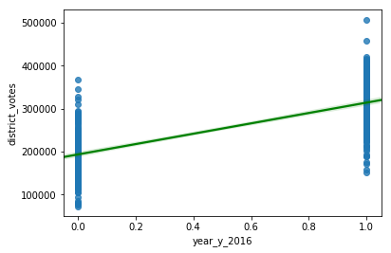
Bivariate model, on-cycle year
Model
Votes cast = 1.9e4 + 1.2e5(On-cycle) + error
R²
Training data | 0.5420345
Testing data | 0.6586412

Slide 11
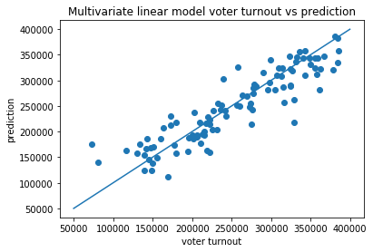
Multivariate linear regression
R²
Training data | 0.8521351
Testing data | 0.8141485
Top Features
$ at campaign end | -2.12e12
$ raised | 2.12e12
$ spent | -2.12e12

Slide 12
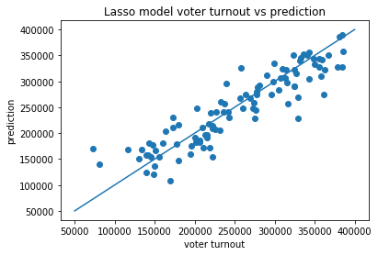
Lasso regression
R²
Training data | 0.8596246
Testing data | 0.8187493
Top Features
Montana | 1.47e5
On-cycle | 1.17e5
Rhode Island | -8.78e4

Slide 13
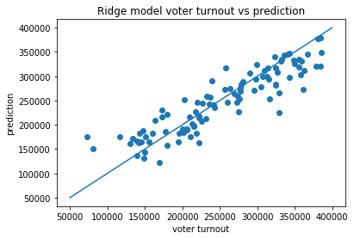
Ridge regression
R²
Training data | 0.8521260
Testing data | 0.8059614
Top Features
Montana | 1.46e5
On-cycle | 1.06e5
Maine | 8.28e4

Slide 14
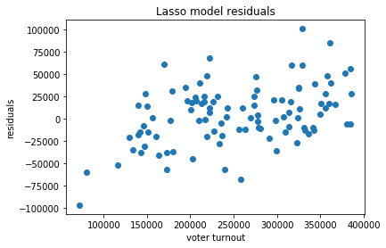
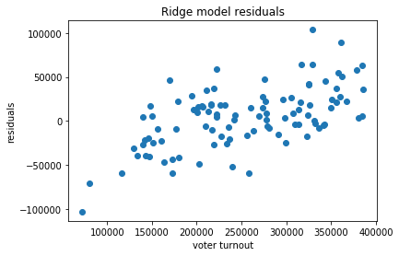
Residuals

Slide 15
Insights and Next Steps

Slide 16
Takeaways
State average turnout and whether the election is on- or off-cycle are strongest predictors
This model is unlikely to beat local, within-state knowledge on resource allocation
This model will over-predict low turnout and under-predict high turn-out

Slide 17
A word of caution
Although R² is high for unseen data, all models are based on only two election years
2016 is widely considered an unusual election
Midterm elections affect Republican and Democratic areas differently depending on who controls the presidency

Slide 18
Next steps
Gather data on more election cycles
Incorporate additional features, e.g. ACS census data from year prior to election, incumbency, political lean, economic trends, presidential and congressional approval ratings

