Slide 1
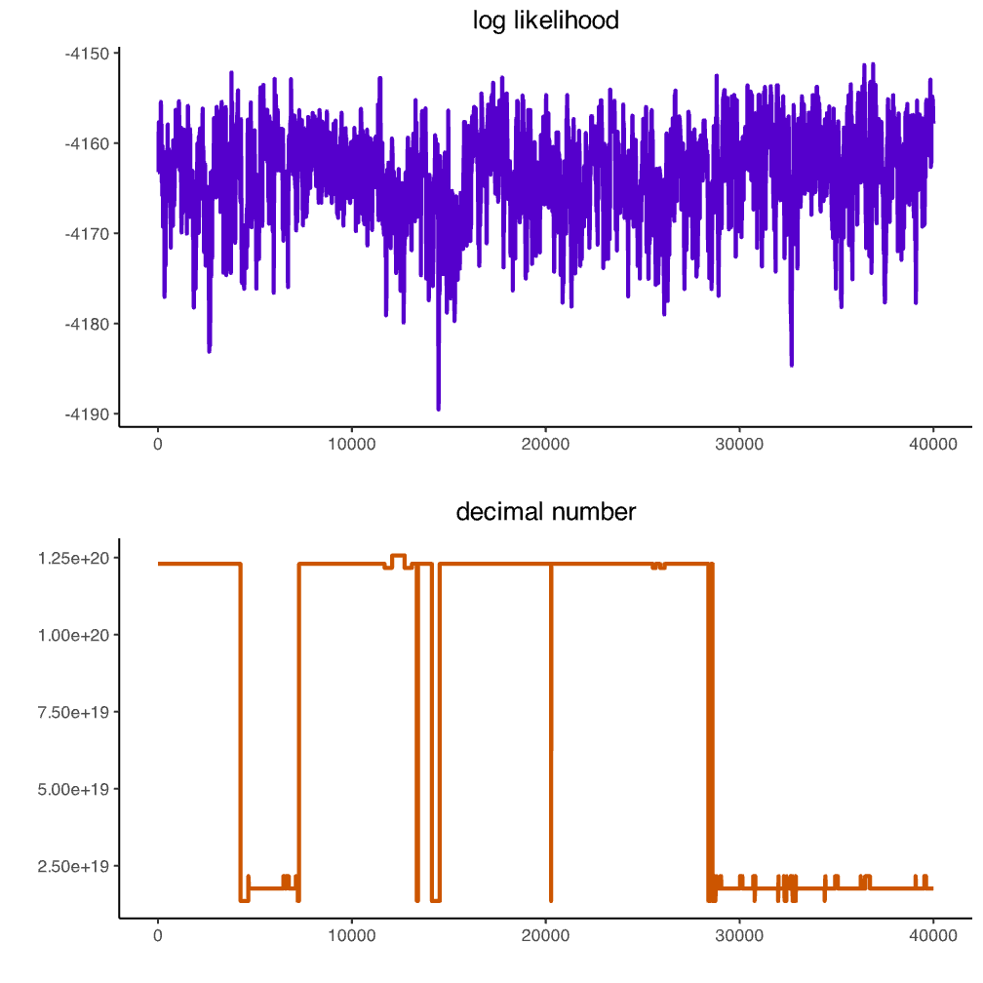
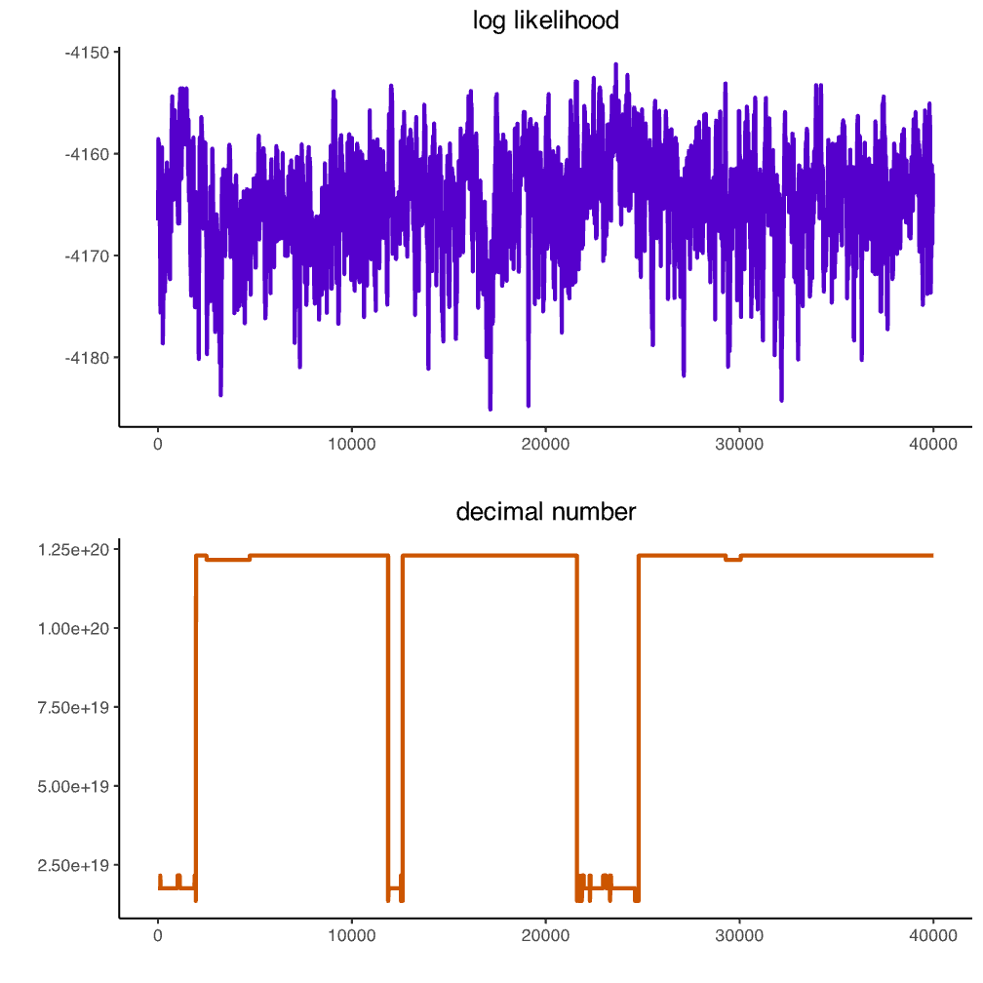
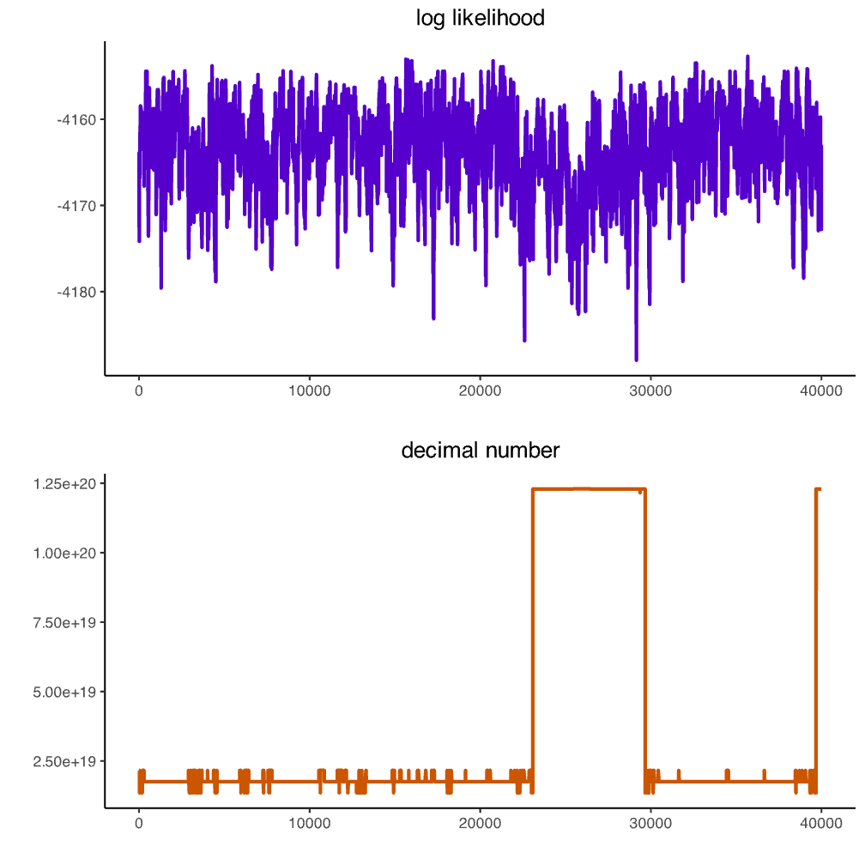
log pseudo-likelihood
log pseudo-likelihood
log pseudo-likelihood
graph
graph
graph

