Slide 1
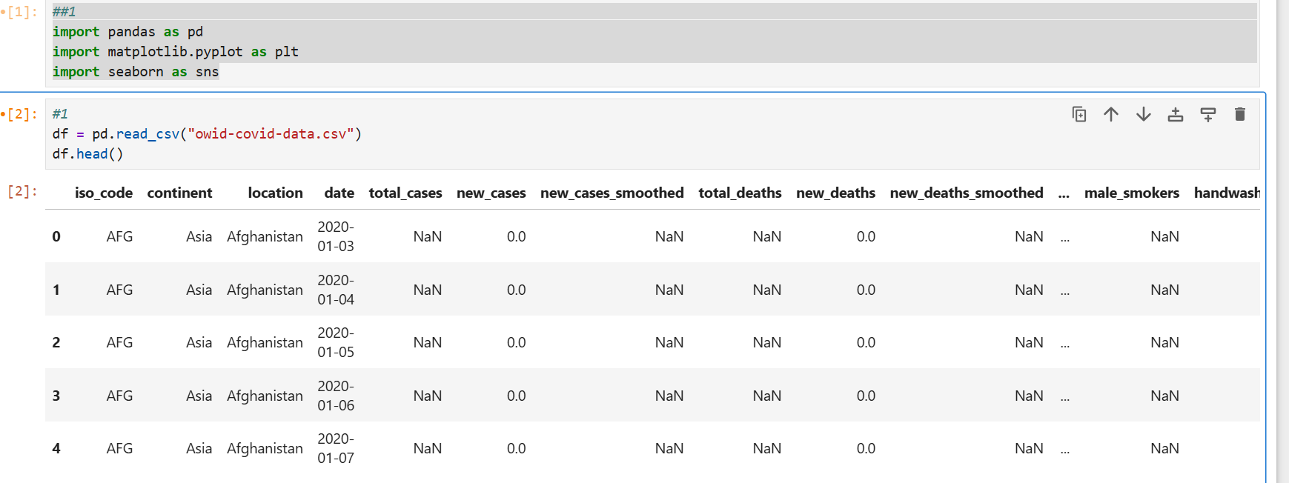
Data Loading & Exploration

Slide 2
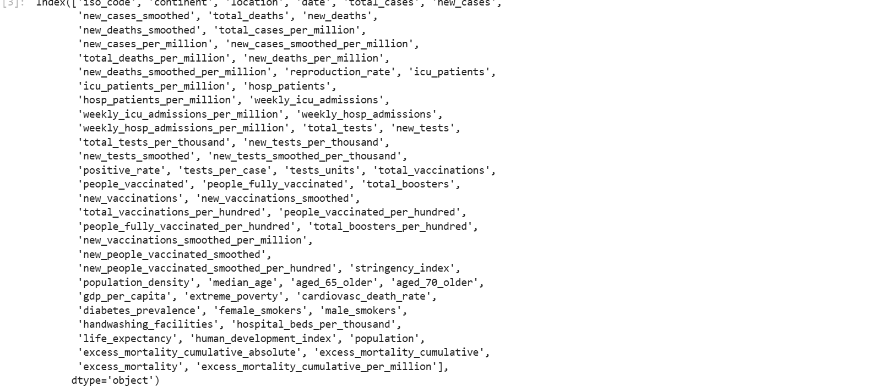
b). Check columns: df.columns.

Slide 3
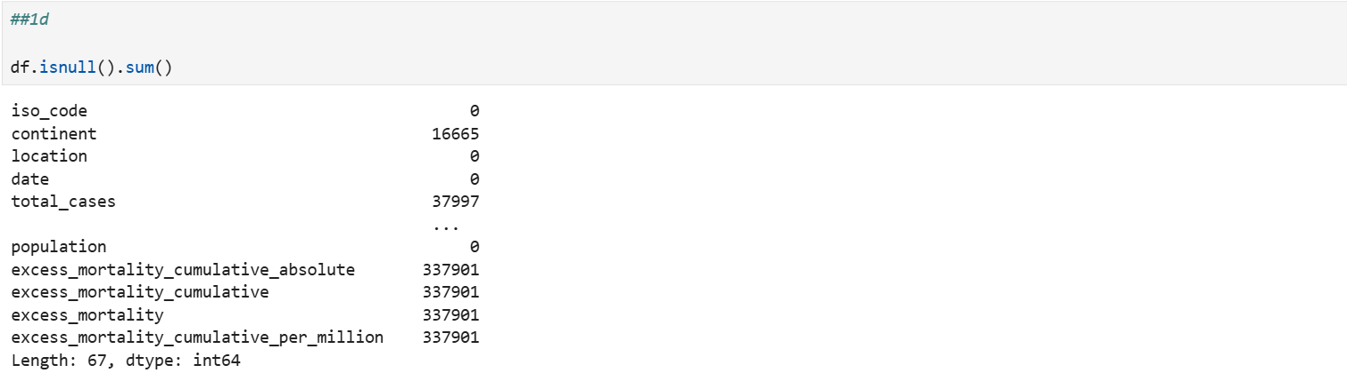
Identify missing values: df.isnull().sum().
2d). Identify missing values: df.isnull().sum().

Slide 4
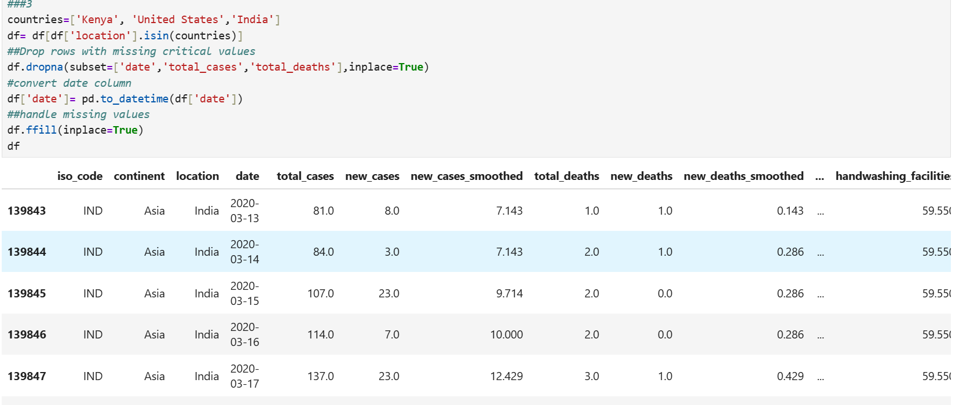

Slide 5
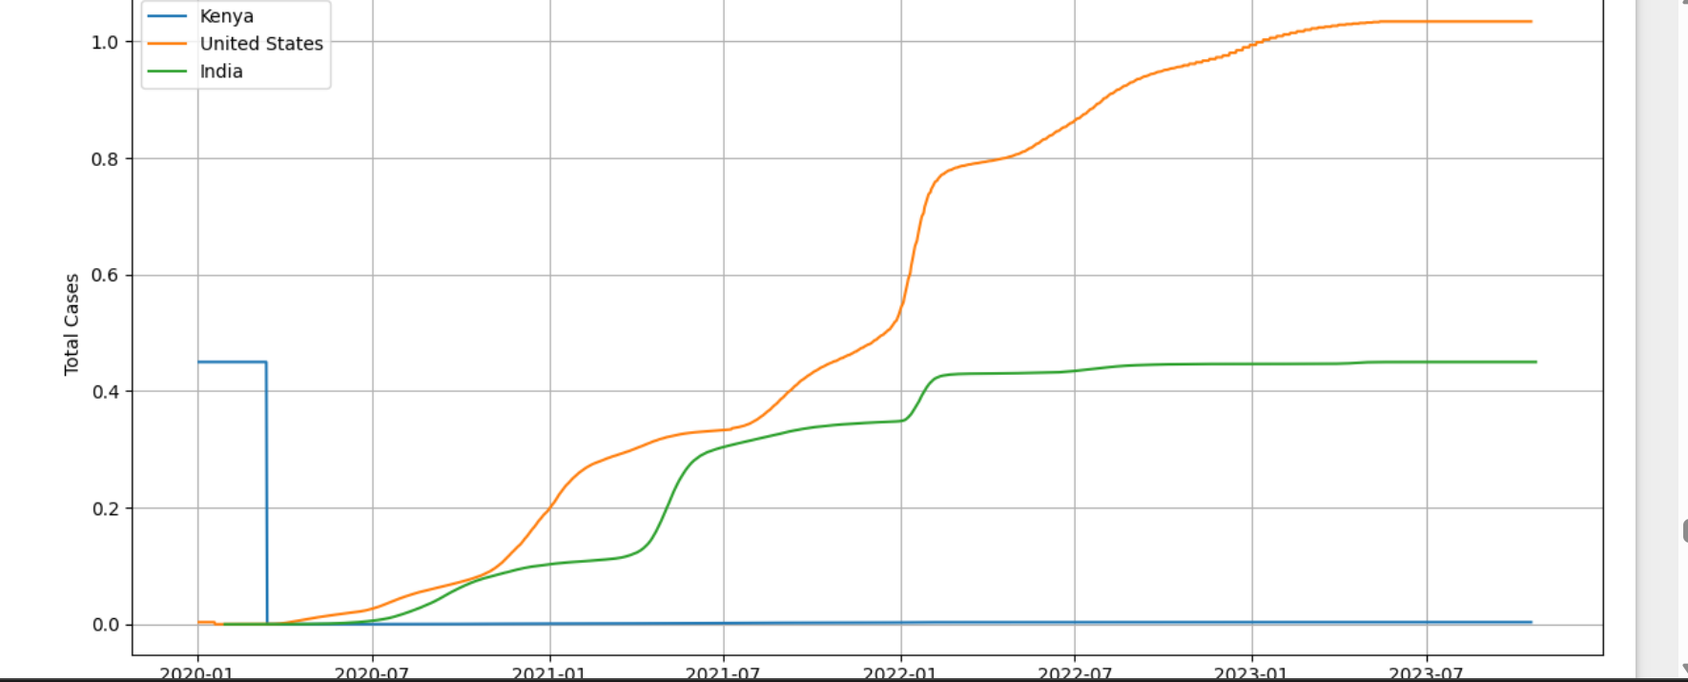
Plot total cases over time for selected countries.

Slide 6
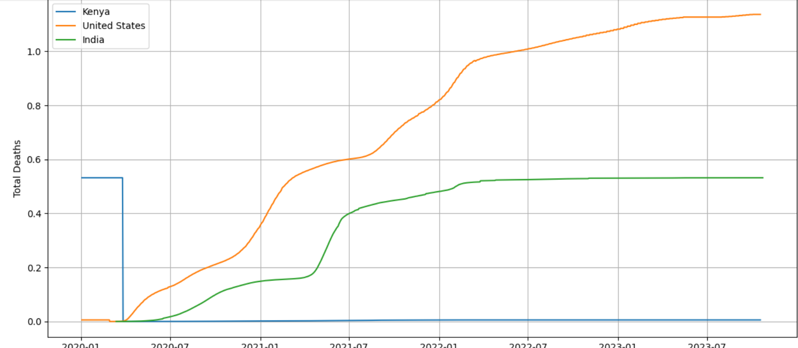
Plot total deaths over time.

Slide 7
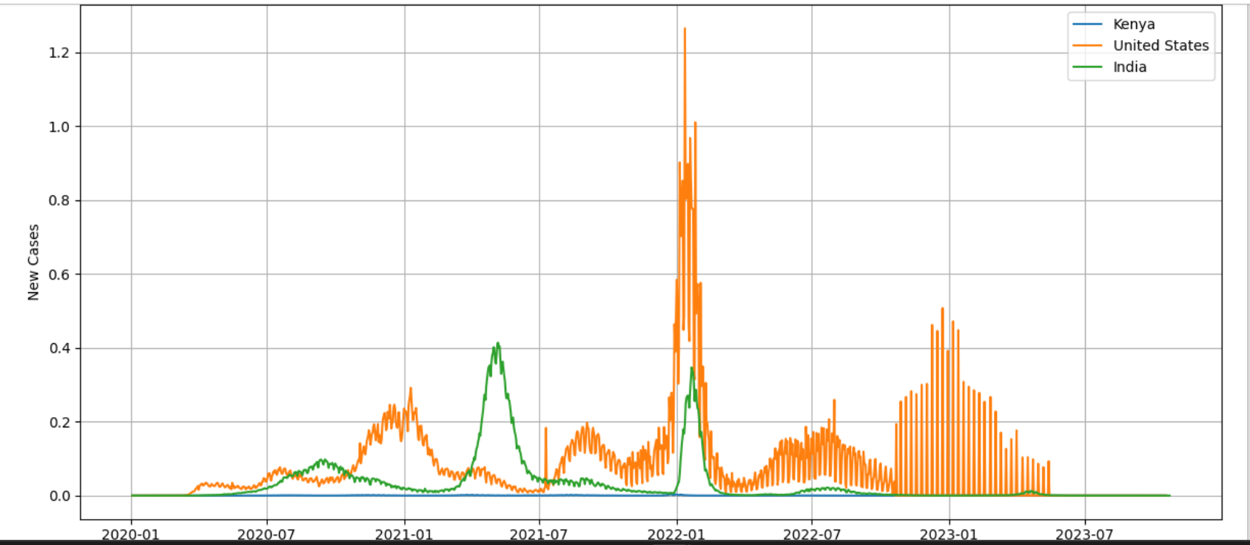
Compare daily new cases between countries.

Slide 8
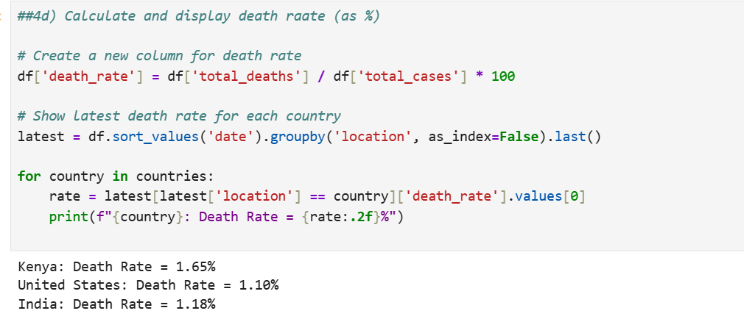
Calculate the death rate: total_deaths / total_cases.

Slide 9
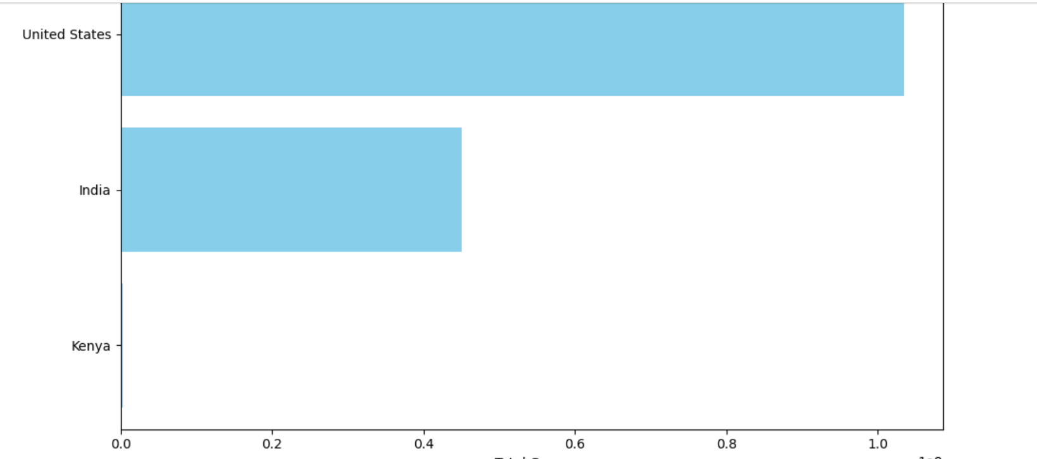
Bar charts (top countries by total cases).

Slide 10
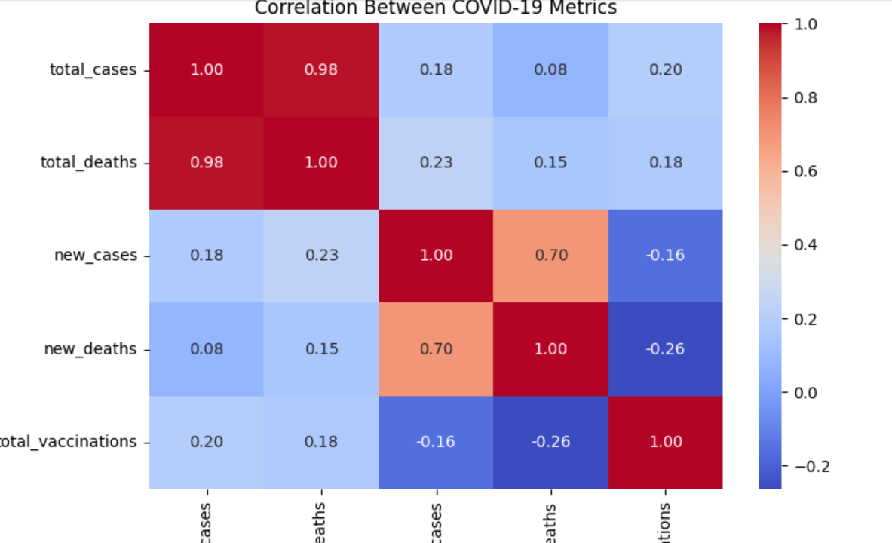
Heatmaps (optional for correlation analysis).

Slide 11
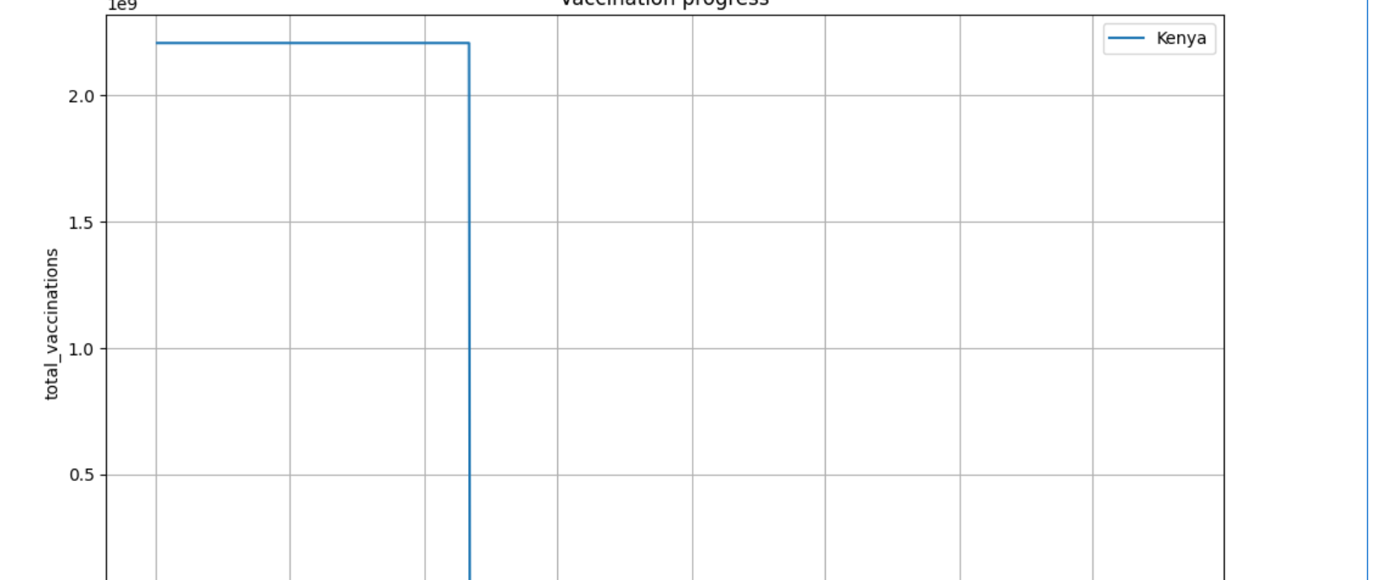
Plot cumulative vaccinations over time for selected countries.
kenya

Slide 12
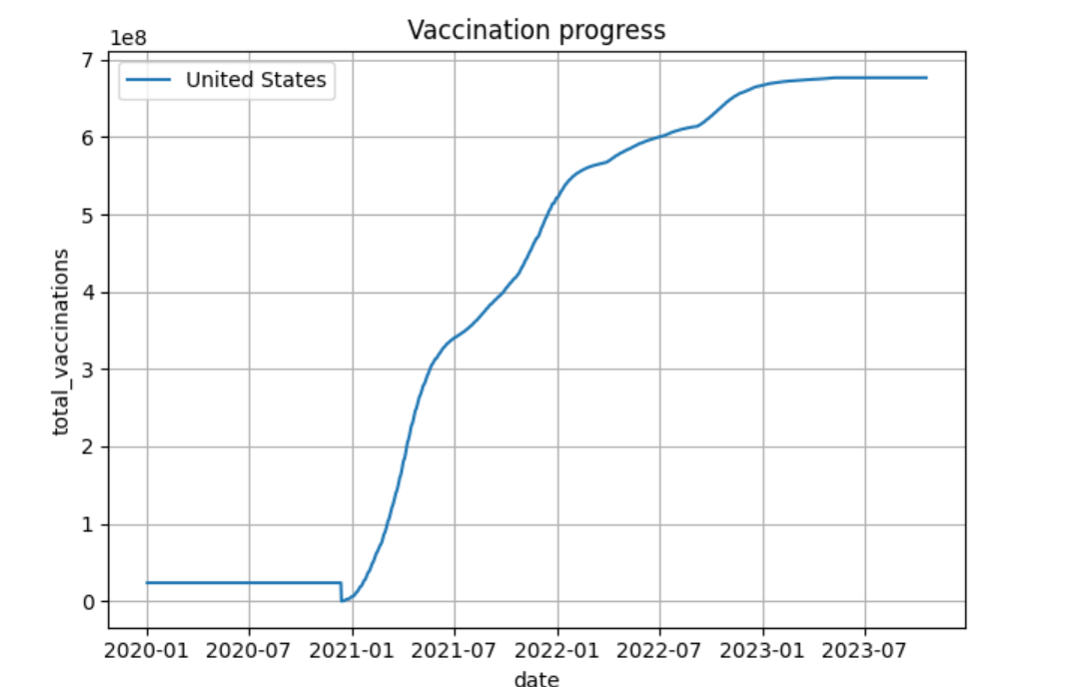
Plot cumulative vaccinations over time for selected countries.
United States

Slide 13
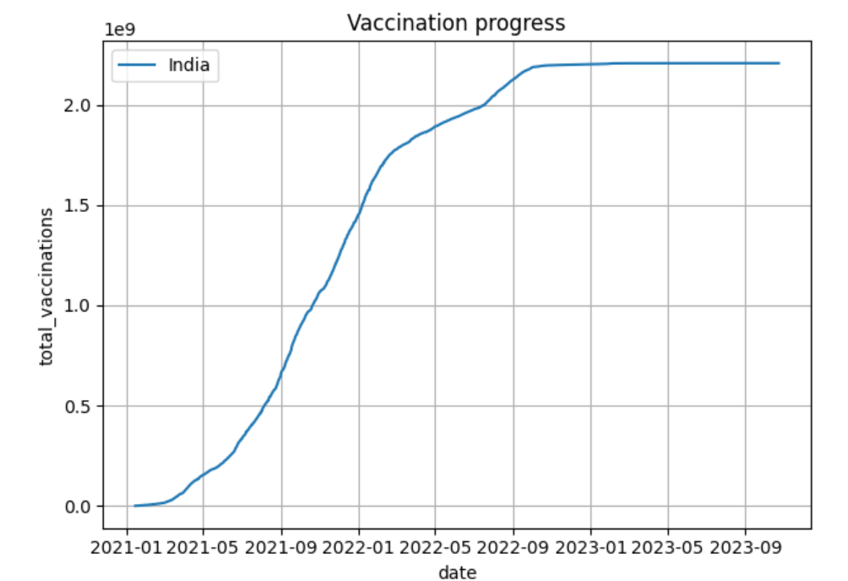
Plot cumulative vaccinations over time for selected countries.
India

Slide 14
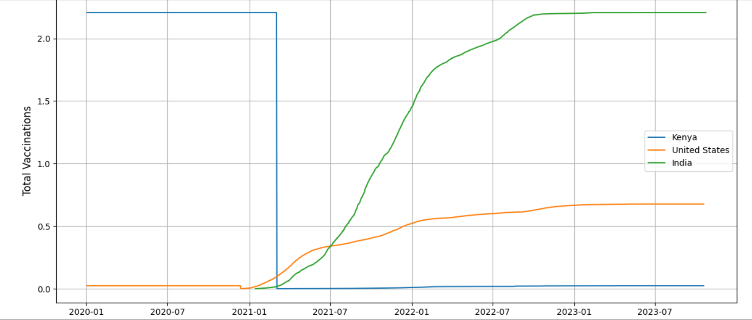
Line charts.

Slide 15
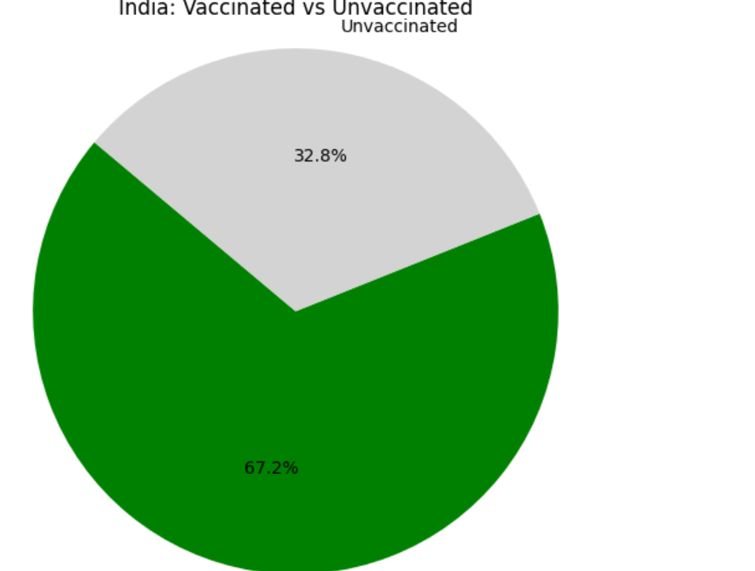
Optional: Pie charts for vaccinated vs. unvaccinated.

Slide 16
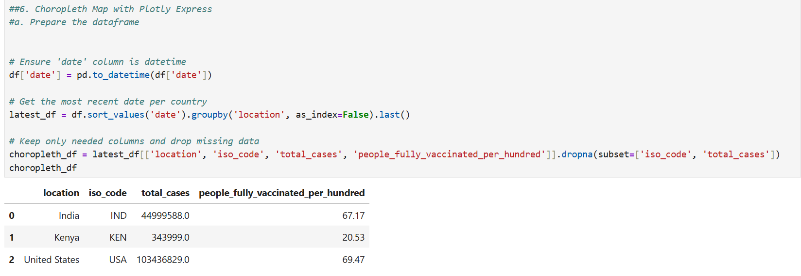

Slide 17
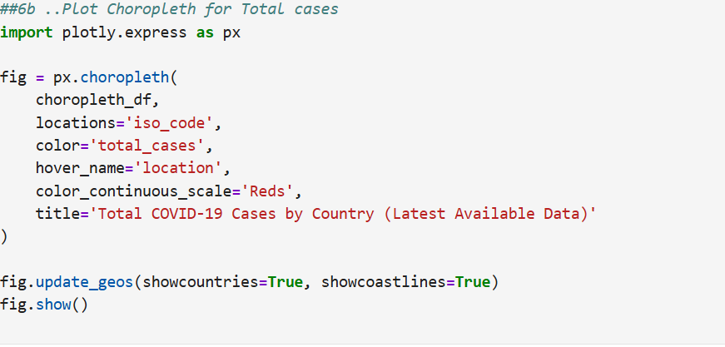

Slide 18
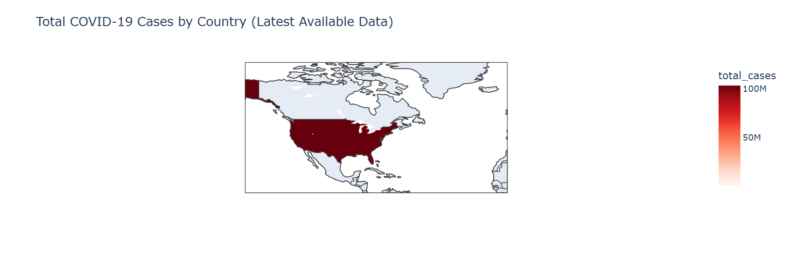
Visualize cases or vaccination rates by country on a world map.

Slide 19
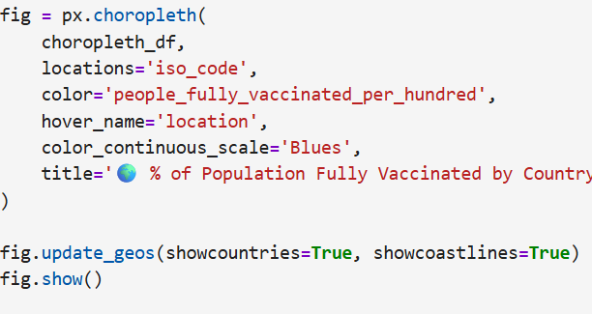
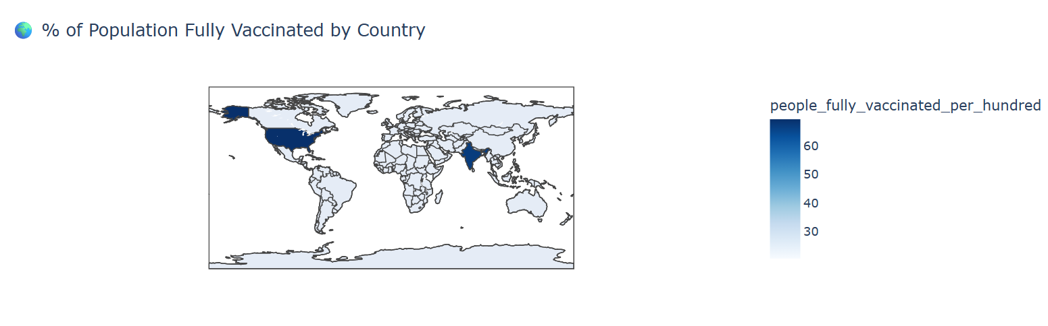

Slide 20
Markdown insights and reporting
Insights & Reporting
1. Vaccination RolloutIndia had the highest absolute vaccination numbers, while the USA led in percentage coverage.
2. Case Trends
New cases peaked sharply during the Delta and Omicron variants, especially in the USA.
3. Death Rate DisparitiesKenya had a higher fatality rate relative to total cases, highlighting healthcare access challenges.
4. Choropleth FindingsCase density maps show concentration in North America, India, and parts of Europe. Africa shows low cases but this may reflect data limitations
Data insights
Vaccination Rollout Comparison
In India showed the fastest increase in cumulative vaccinations in absolute numbers, while 🇺🇸 the USA had one of the highest percentages of population fully vaccinated.
Project highlights and patterns
a)Case TrendsDaily new cases in 🇺🇸 peaked significantly in mid-2021 and early 2022, reflecting the impact of Delta and Omicron waves.
b) Death RatesAlthough 🇰🇪 Kenya reported fewer total cases, its case fatality rate (total_deaths / total_cases) was relatively high compared to developed nations — potentially due to limited healthcare access.
c) AnomaliesSome countries (like small island nations) reported vaccination rates over 100%, likely due to reporting errors or counting multiple doses per person.
d) Choropleth Map ObservationsThe choropleth revealed higher case densities in 🇺🇸, 🇮🇳, 🇧🇷, while many low-income countries had lower reported cases — this may be due to under-testing or limited reporting.

