Slide 1

Forecasting Solar Power with Machine Learning Techniques
Subtitle: Exploring ARIMA and Prophet Methods for Solar Predictions
Author: Audrey Malloy
Date: April 28th, 2025

Slide 2
Introduction
Solar power is key to sustainable energy but highly variable due to weather and seasonality.
This project develops short-term forecasting models to tackle these challenges.

Slide 3

Why it Matters
An accurate forecast model better resource allocation, grid stability, and reduced environmental impact.
Solar power is key to sustainable energy market but highly variable due to weather and seasonality.
Notes:
Enables better resource allocation, grid stability, and reduced environmental impact.
Solar power is key to sustainable energy but highly variable due to weather and seasonality.
Accurate predictions improve grid stability, resource allocation, and economic benefits.

Slide 4





Methodology: Data
POWER PLANT 1
POWER PLANT 2
Power Generation
+
Weather
Sensor Data
Power Generation
+
Weather Sensor Data
Power Generation
+
Weather Data
Complete cleaned dataset
Notes:
2 power plants with concurrent power generation dataset and weather sensor

Slide 5
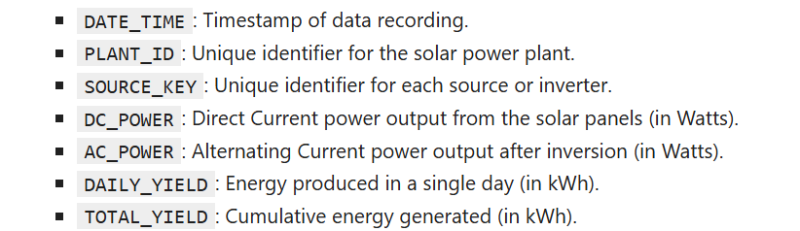
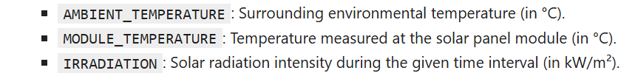
Data Overview:
Generation Data:
Weather Data:

Slide 6
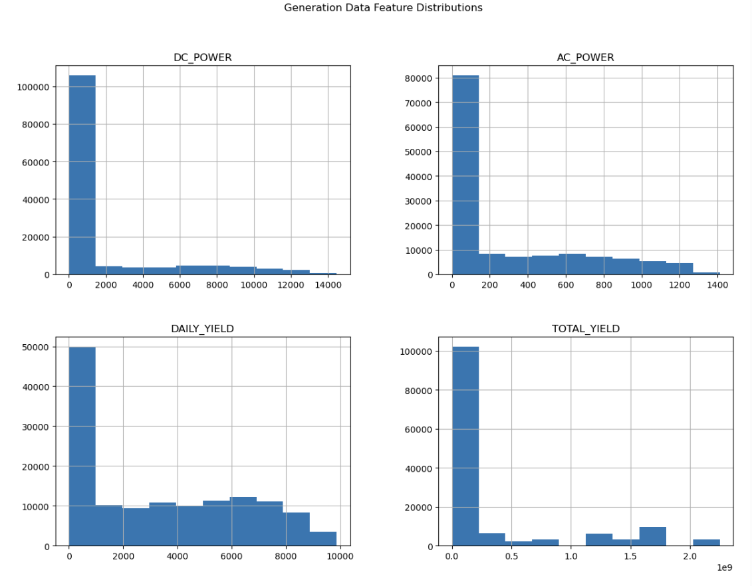
Exploratory Data Analysis (EDA)
Solution: Transformations like scaling or normalization can help manage such discrepancies and skewness.

Slide 7
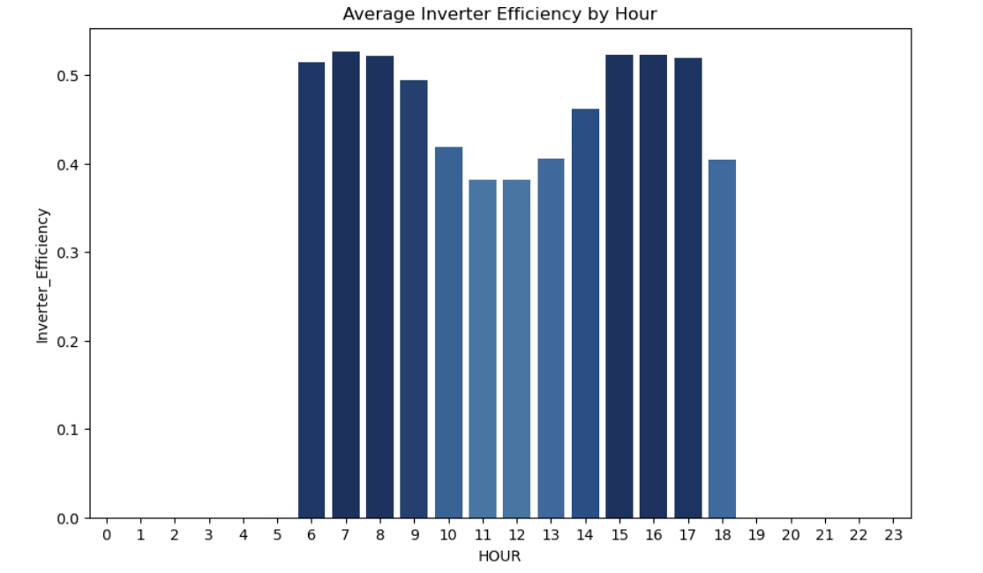
Hour Observations
Investigating inverter potential and evaluating potential thermal challenges and patterns
Should we investigate the different the different power output currents?
Notes:
This pattern may suggest operational inefficiencies or thermal challenges affecting inverter performance during peak sunlight hours. Investigating inverter cooling systems could provide improvements.

Slide 8
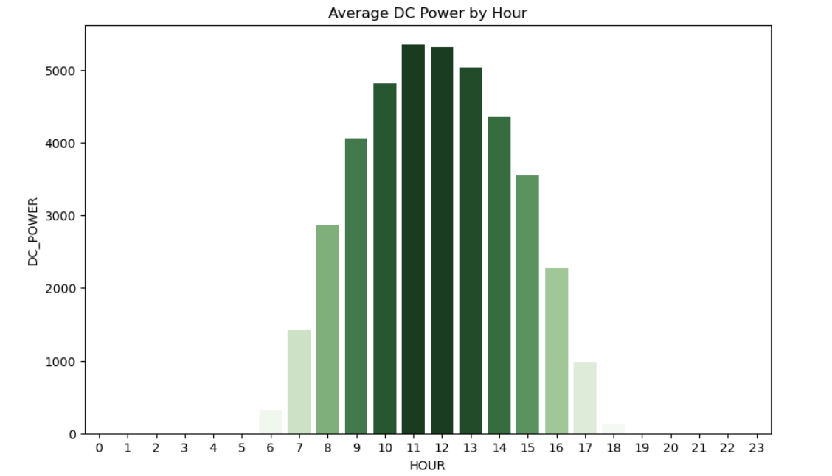
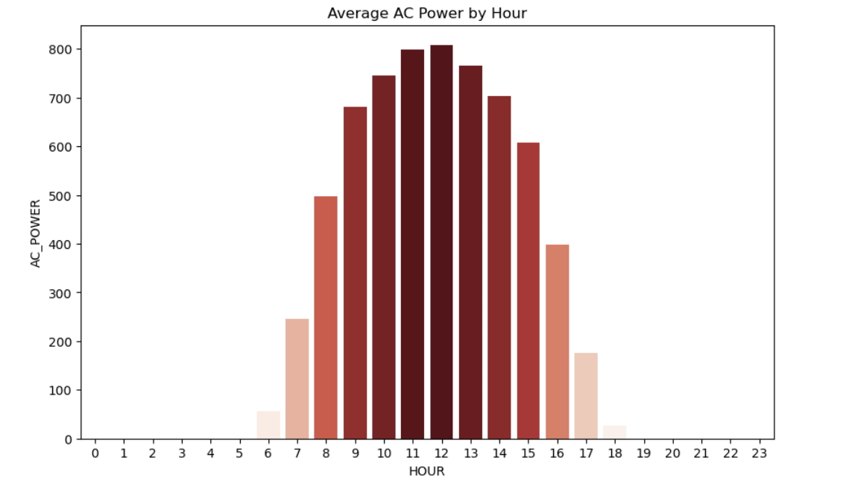
Power Output
Should we consider the difference in Direct Current and Alternating current power generation as a factor?
DC power output closely follows the same pattern as AC power, peaking at midday and dipping during non-solar hours.
Notes:
Flucation in power generation indicates variations in solar power generation on different days.

Slide 9
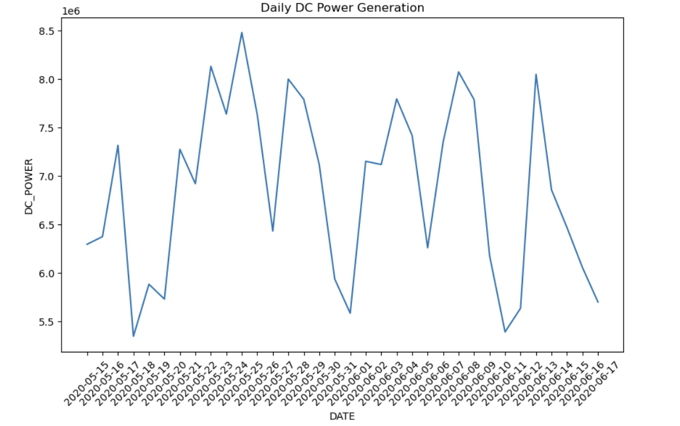
Time Series
Oscillation in power generation indicates variations in solar power generation on different days.
Solution: Feature engineer `day of the week` and `day` features.

Slide 10
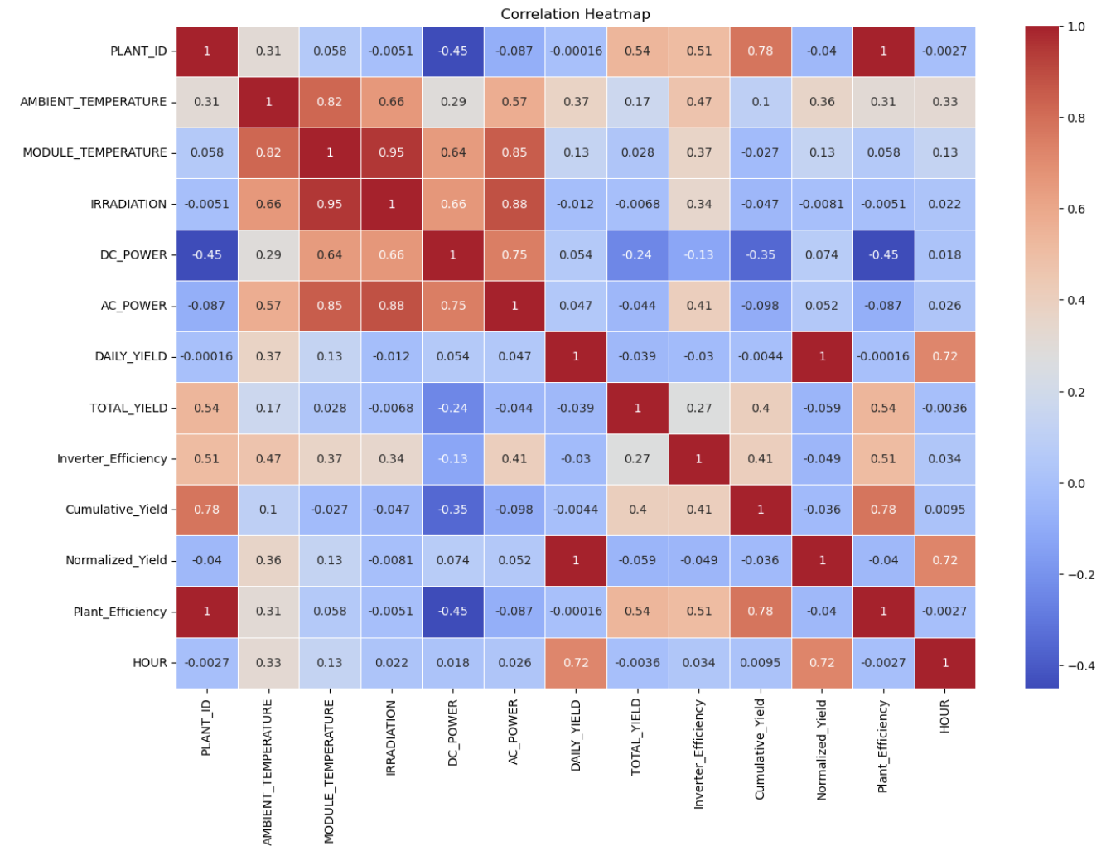
Correlation Analysis
1. Positive Correlations:
- Module Temperature ↔ DC Power: Higher temperatures boost energy generation.
- Irradiation ↔ DC Power: Sunlight intensity drives power output.
- DC Power ↔ AC Power: Perfect correlation reflects efficient conversion.
2. Negative Correlations:
- Hour ↔ Power Metrics: Energy generation declines during non-solar hours.
3. Low Correlations:
- Plant ID & Source Key: Serve as identifiers, no predictive impact.
4. Efficiency Metrics:
- Highlight operational optimizations and inefficiencies.

Slide 11
Model Selection
Model | Description | Justification
ARIMA | Statistical model for short-term forecasting; captures dependencies like trends and seasonality. | Ideal for modeling stationary
Prophet | Handles trends, seasonality, and external factors using interpretable components. | Great for non-stationary data with clear trends and seasonal variations.
XGBoost | Gradient boosting machine learning model for structured data; excels in regression tasks. | Effective for regression problems with engineered features and non-linear relations.
LSTM | Deep learning model for sequential data; learns complex temporal dependencies. | Best for capturing long-term patterns in time-series data like solar power.

Slide 12
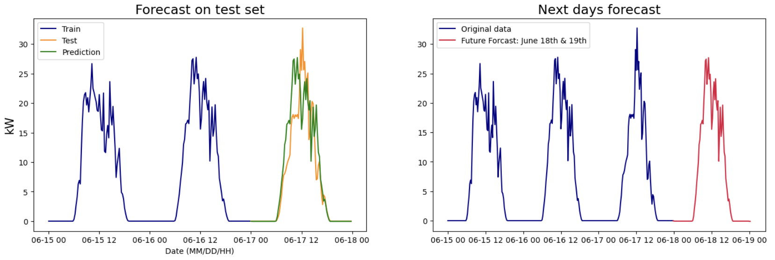
ARIMA
Reliable for short-term forecasting.
Effective for stationary time series with clear autocorrelations
MAE: 2.26+/- kW RMSE: 4.02 +/- kW

Slide 13
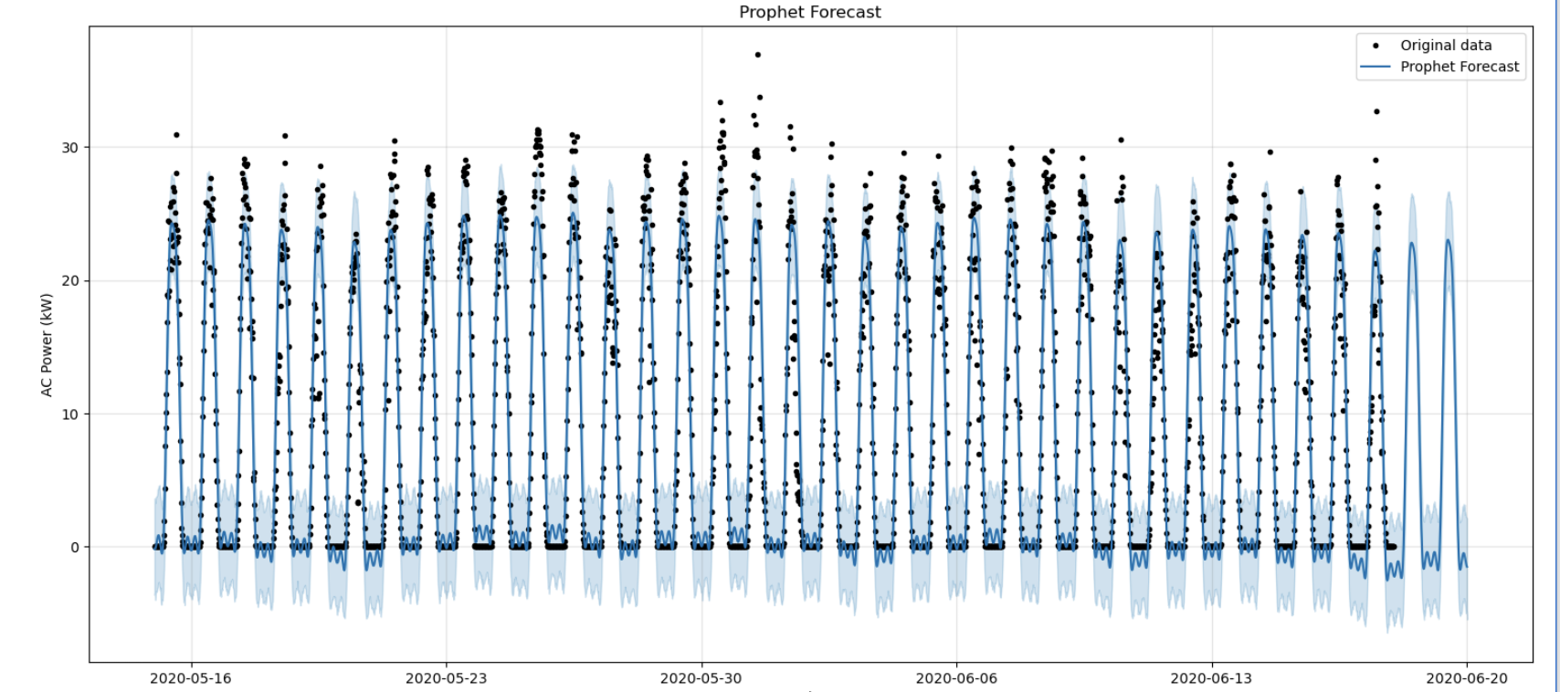
Prophet
Excels at modeling trends and seasonality.
Captured gradual increases or decreases highlight changes in generation efficiency or environmental conditions.
MAE: 2.43 +/- kW, RMSE: 3.06 +/- kW

Slide 14
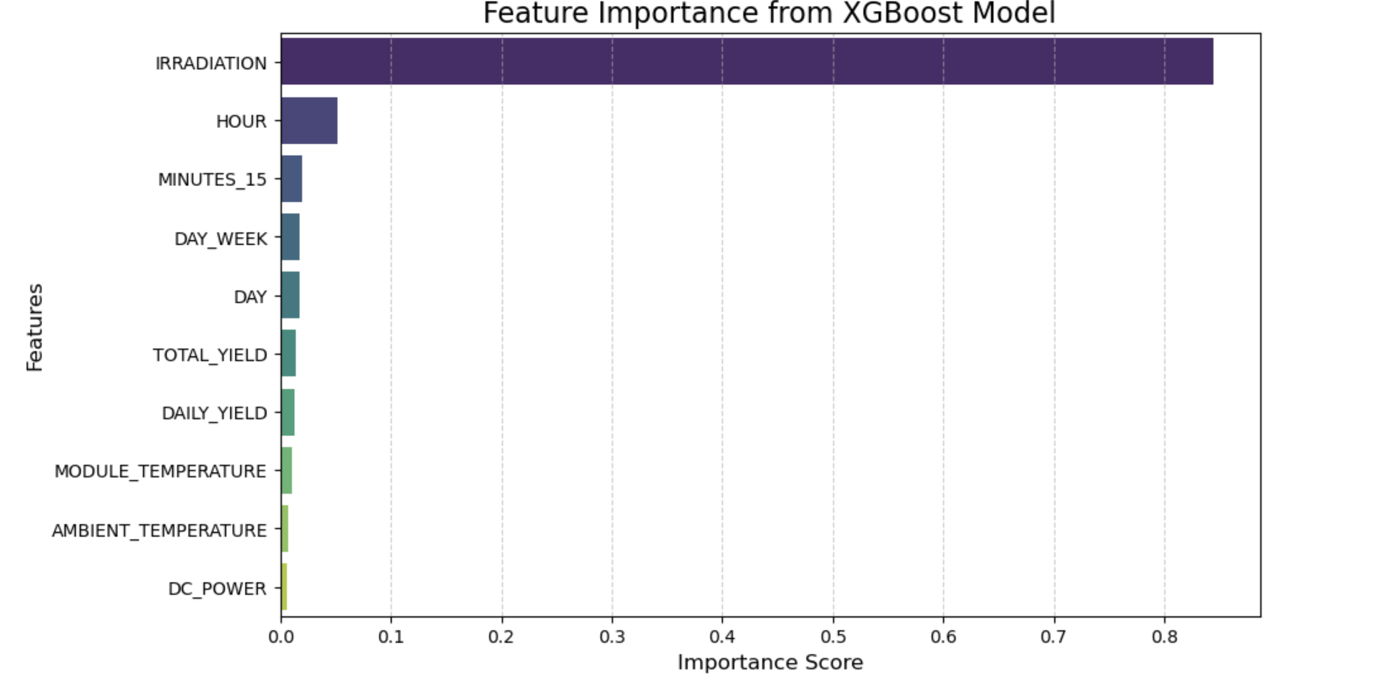
XGBoost
Strong in error minimization but struggled with generalization (R2: -0.54).
Identify the most significant predictors of solar power (`AC_POWER`) and improve forecasting accuracy.
MAE: 0.005 +/- kW, RMSE: 0.009 +/- kW

Slide 15
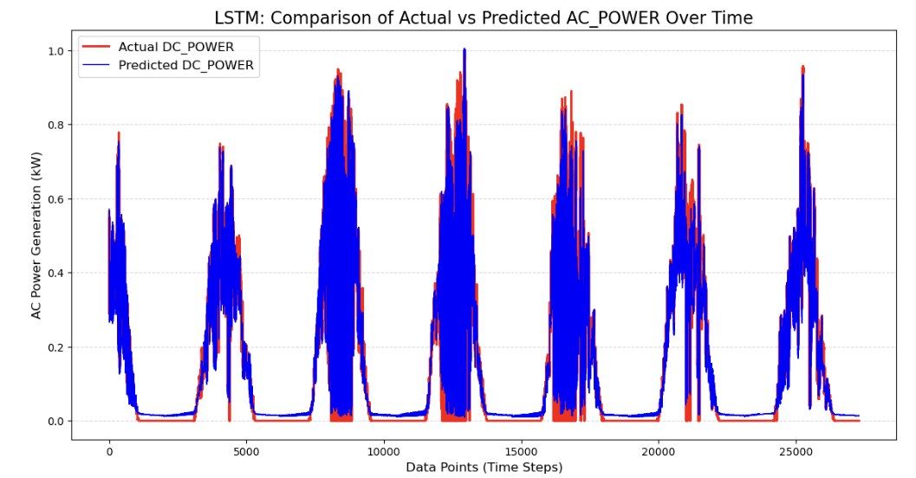
LSTM
Captures complex nonlinear dependencies; ideal for high-accuracy forecasting.
MAE: 0.02 +/- kW, RMSE: 0.03 +/- kW

Slide 16
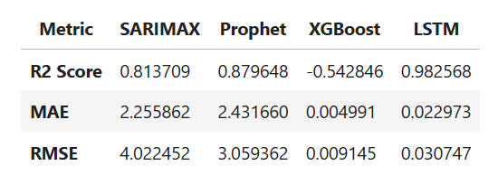
Performance Evaluation

Slide 17
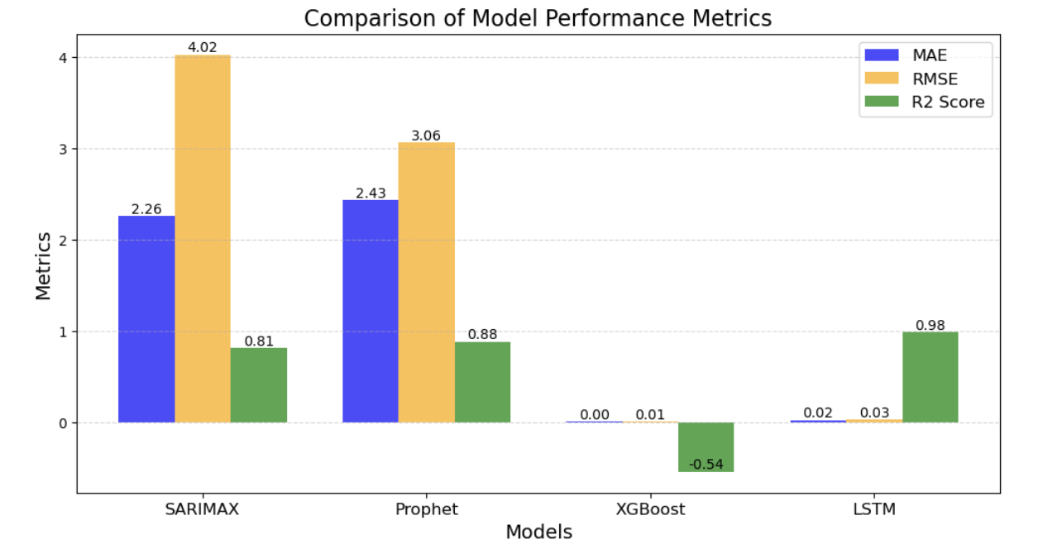
Best Model
The LSTM model had the best overall performance (R2: 0.98, MAE: 0.02, RMSE: 0.03)

Slide 18
Recommendations
Feature Enrichment
Add weather features: Cloud cover, wind speed, and humidity.
Incorporate spatial data to enhance context-based forecasting.
Model Enhancements
Explore ensemble modeling to combine ARIMA, Prophet, and LSTM for better accuracy.
Optimize XGBoost with hyperparameter tuning and additional engineered features.
Real-Time Forecasting
Build real-time data pipelines for dynamic solar power predictions.
Implement automated model updates to adapt to changing conditions.

Slide 19



Conclusion
Accurate solar forecasting optimizes energy management and supports renewable systems.
This project demonstrates the strengths of statistical, machine learning, and deep learning models in addressing solar variability.
Future work should explore hybrid models and real-time deployment to enhance predictions and accelerate the shift to renewable energy.

Slide 20

References
Solar Power Generation Dataset
Source: Kaggle
Link: Solar Power Generation Data
Time Series Forecasting Techniques
Source: Innovate Yourself
Link: Long Short-Term Memory(LSTM) with Python 3: A Comprehensive Guide – Innovate Yourself

