Slide 1


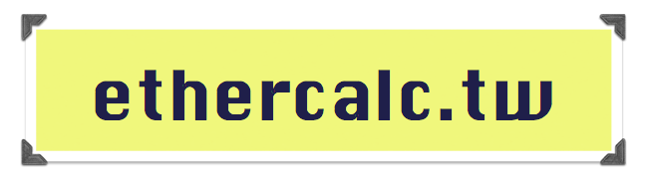
EtherCalc
Multiplayer
Spreadsheet

Slide 2



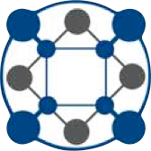



Slide 3
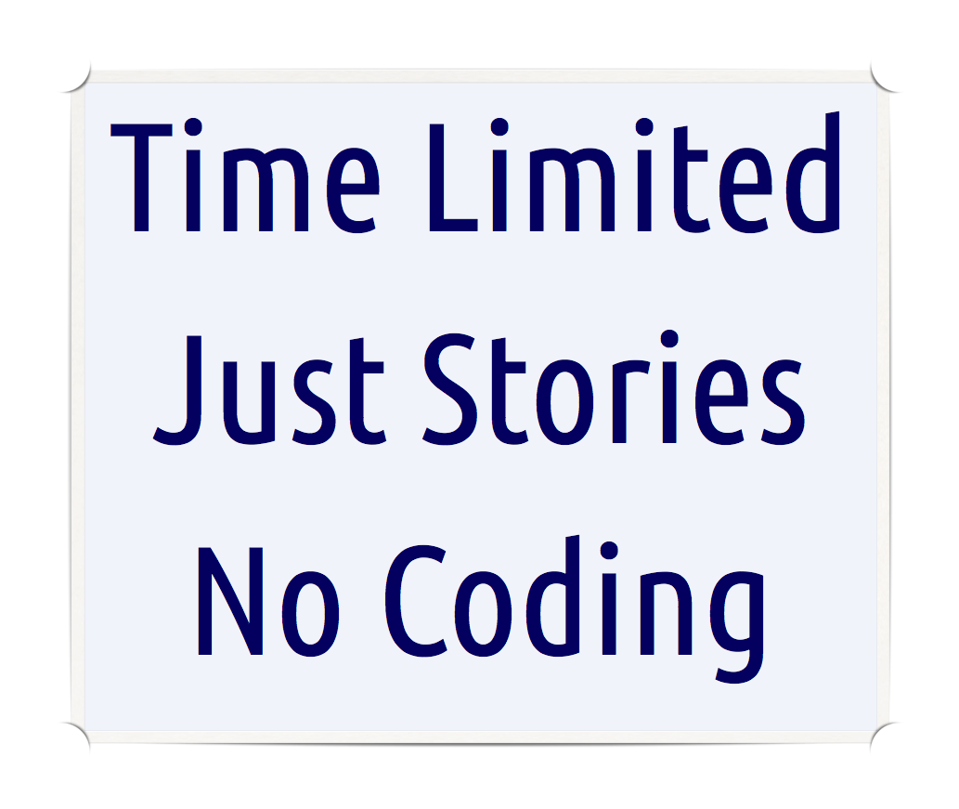


Slide 4
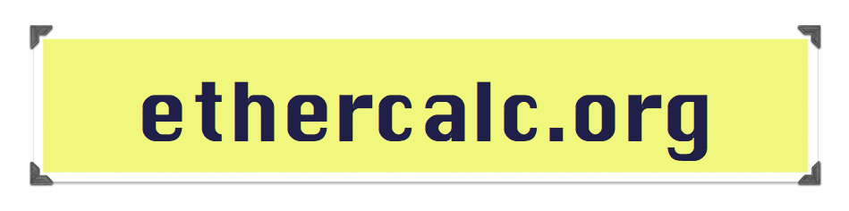
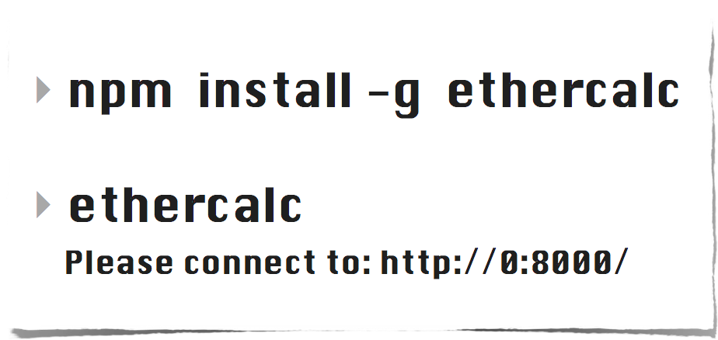
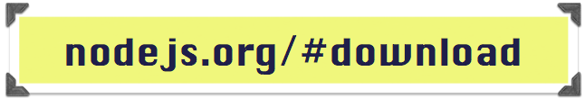

Slide 5

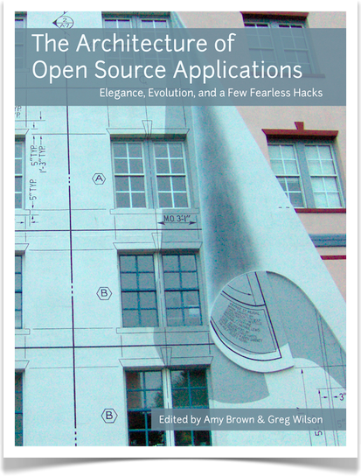
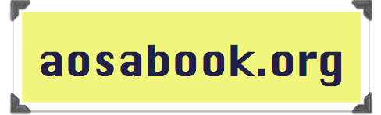
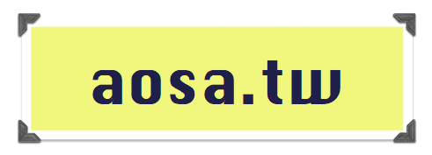

Slide 6


Slide 7
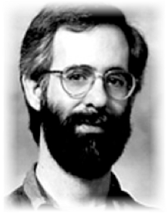
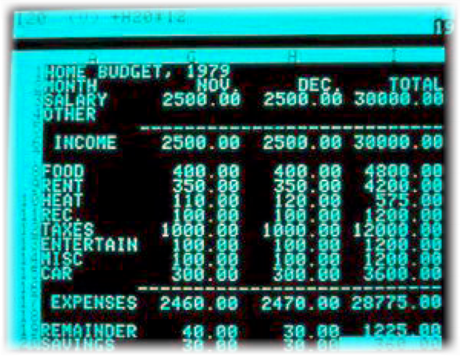
VisiCalc, 1979
Dan Bricklin

Slide 8
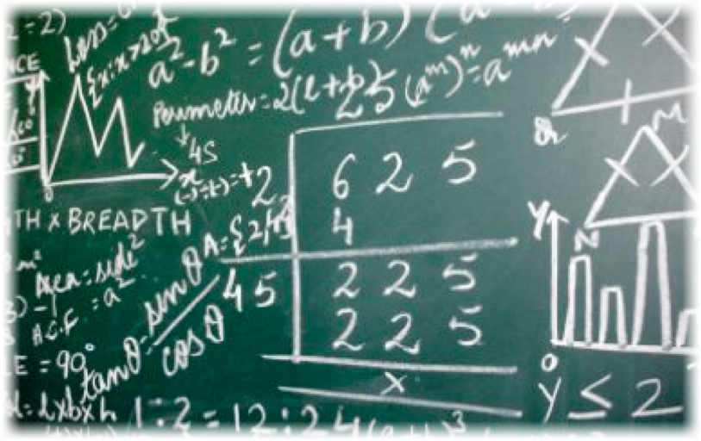
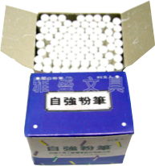
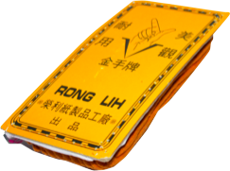

Harvard, 1977

Slide 9
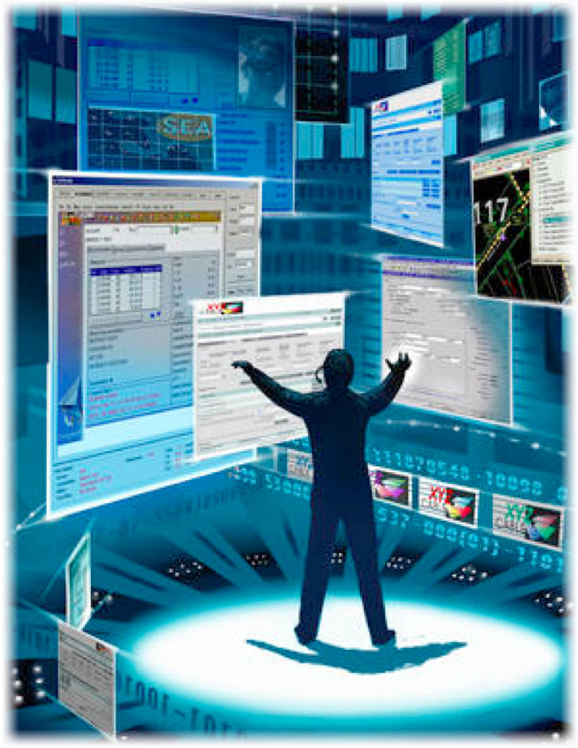

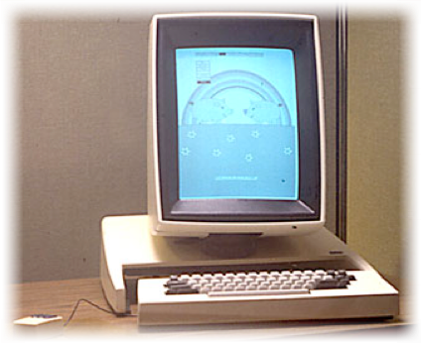
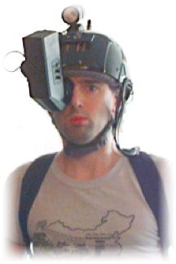
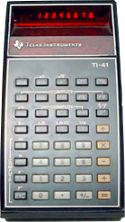
Original Vision
Alto Workstation
Calculator
Mouse
Head-Mounted
Display

Slide 10





10
20
30
30
60
10
=SUM( )
0

Slide 11
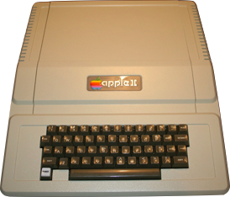
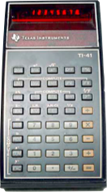
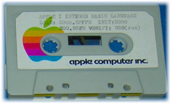
1977 → 1978
+
Integer BASIC

Slide 12
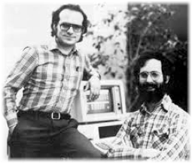
1978 → 1979
A B C D
1
2
10
20
30
60
=SUM( )
A1,B1,C1
Dan prototypes in BASIC
Bob codes in 6502 ASM
700,000 copies in 6 years
The first “Killer App”
Bob & Dan

Slide 13
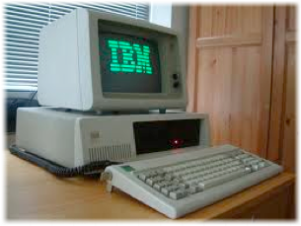
1981

Slide 14
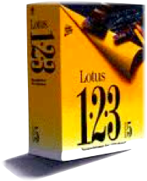
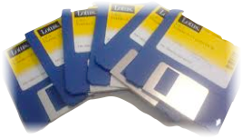

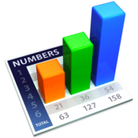


Slide 15
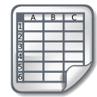





20 years passed
Nothing changed

Slide 16






“Can’t open”
“Garbled”
“Virus!”

Slide 17
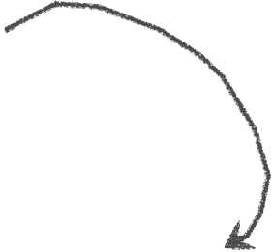



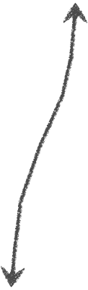
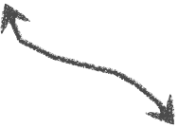


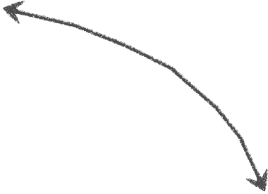
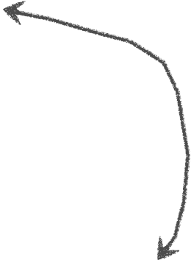
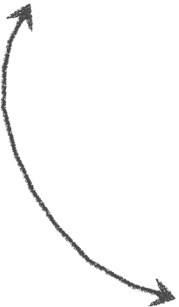




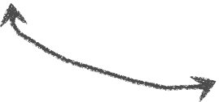


Slide 18
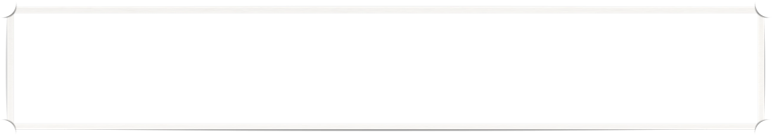









Wikipedia, 2001

Slide 19
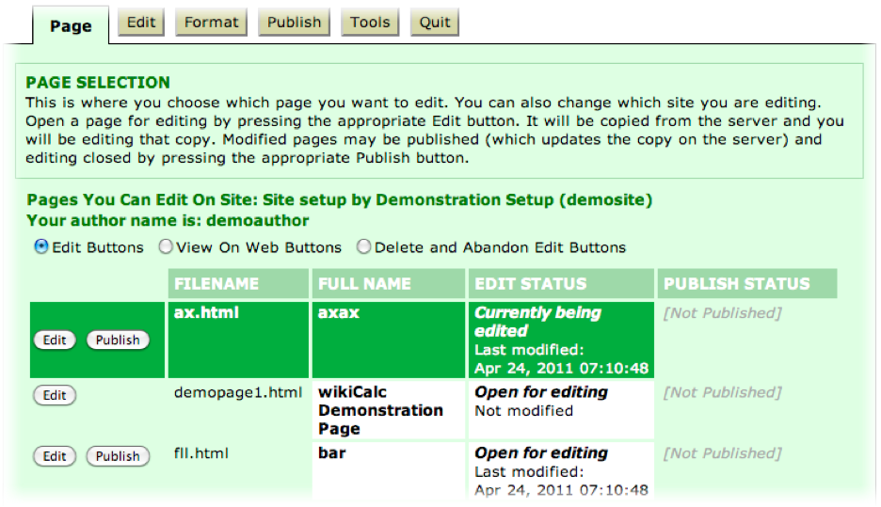
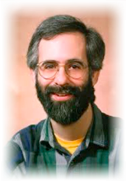
wikiCalc, 2005
Plain text, HTML & Wiki syntax
References cells on other servers
Keeps all operations for auditing
Revert to any revision
Open Source! (GPLv2)

Slide 20
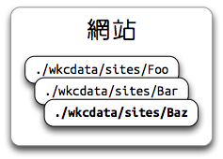
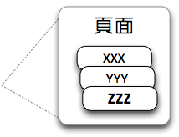
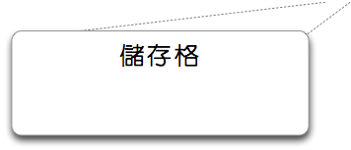
wikiCalc.pl
Sites
Pages
Cells
A1: 100
A2: =A1*2
B1: =XXX!C1
B2: =YYY!D2
Cross-page References

Slide 21
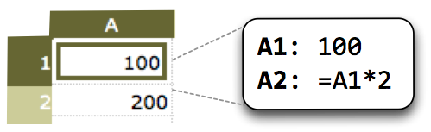

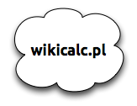


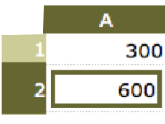
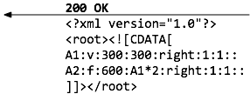
wikiCalc Edit Flow

Slide 22
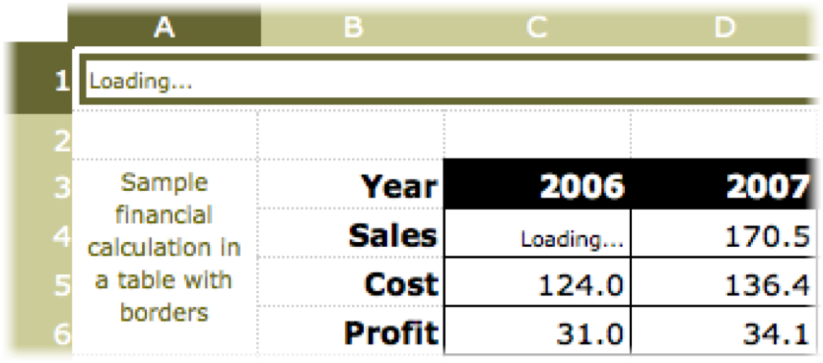

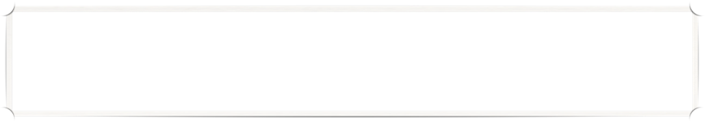
“Loading…”
“C100k” Problem

Slide 23




Redo

Slide 24
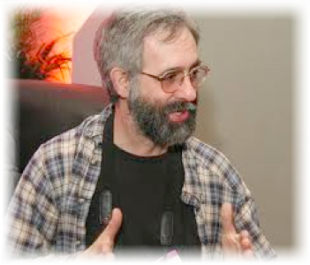
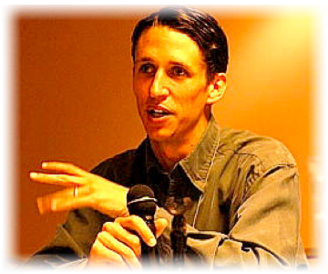
SocialCalc, 2006
Dan Bricklin
Ross Mayfield

Slide 25

Design Goals
Rewrite calc engine in JS
Real-time responsive editor
Supports 100,000+ cellsWorks on all browsers (IE6+)
Client-side log & undo/redo

Slide 26

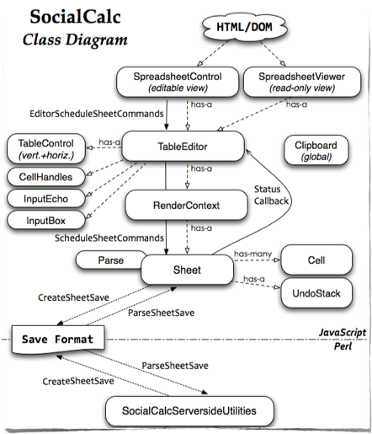




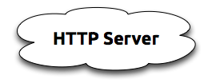
Architecture
PUT
GET
GET
($)

Slide 27

Command Pattern
set A1 value n 42
set A2 formula A1*2
merge A1:B2
cut A3
paste A4
sort A1:B9 A up B downset sheet defaultcolor blue
...
Async recalc loop
Visible-only redraw
Unlimited undo/redo
Always responsive

Slide 28










“Social”Calc

Slide 29













Objects ⇔ Relations

Slide 30



Slide 31







Common Public Attribution License
©
++©
ⓐ
BSD, MIT
LGPL, MPL
GPL
“ASP loophole”
CPAL
Affero GPL

Slide 32





Sheetnode, 2008
Views + Fields + CCK
SocialCalc.js
Karim Ratib

Slide 33


OLPC, 2008
Luke Closs & Dan

Slide 34








Mesh
P2P

Slide 35










set A1 value n 42
Manusheel
Gupta
Broadcast
set A1 value n 42
Vijit Singh

Slide 36


Great, but...
Must log on same time
Can’t replay missed logs
Race condition on cells
OLPC-specific code!

Slide 37

YAPC::Tiny, 2009

Slide 38






Tatsumaki
EV/AnyEvent
Web::Hippie
Feersum
@miyagawa
@clkao
@stash

Slide 39





WebSocket Channels
Relay
Send

Slide 40
New Features
Fetch logs on join
Reconnection recovery
Show peer cursors
Cross-browser support!

Slide 41
Much better, but...
Which peer’s log to take?
What if everyone leaves?
Who would keep the logs?
Replay 1,000+ commands?

Slide 42


Redo?

Slide 43

YAPC::NA, 2006
“I think, but I cannot prove, that by the next year JavaScript 2.0 will bootstrap itself, complete self hosting, compile back to JavaScript, and replace Ruby as the Next Big Thing in all environments. ”

Slide 44
YAPC::NA, 2006
“JavaScript will become the common backend for all dynamic languages, and so you can write Perl to run in the browser, on the server, and inside databases, all with the same set of development tools. ”

Slide 45

YAPC::NA, 2006
“Because, as we all know, worse is better, so the worst scripting language is doomed to become the best.”

Slide 46






Slide 47




CoffeeScript: Half the Noise
JavaScript: Good Part Only
cs = (js) => js/2
“Original JavaScript: 22k LOC.
Ported to CoffeeScript: 5k LOC.
{async, jsdom, zappa, optimist etc}++”
Jeremy
Ashkenas

Slide 48



{x,y} = @offset
var _ref = this.offset;
var x = _ref.x;
var y = _ref.y;

Slide 49



Function::ᵒ = (fun) ->
(arg) => @ fun arg
f = (x) => x * 2
g = (x) => x * 3
h = f .ᵒ g
h 100 # 600

Slide 50


Zappa: Lazy Node.js
“If you can describe it in 495 characters, why on earth should it take 879?”
MauriceMachado

Slide 51



require('zappa') -> @view layout: -> html => body => @body @get '/': -> @render 'index' @view index: -> for name, value of { wiki: "Wiki to HTML" html: "HTML to Wiki" } form method: 'post', => p => textarea {name} p => input {type: 'submit', value}
@post '/': -> if @data.wiki? @send w2h @data.wiki else if @data.html? @send h2w @data.html else redirect '/'

Slide 52




COSCUP, 2011
hack hack hack ...

Slide 53








EtherCalc Edit Flow
MULTI
GET snapshot
LRANGE log
EXEC
MULTI
DEL log
SET snapshot snapshot
EXEC
RPUSH log cmd

Slide 54







Recalc Subscription
ask.log: Foo
log: Foo,snapshot,log
execute: set A1
formula Bar!B2
ask.recalc: Bar
recalc: Bar,snapshot
recalc: Bar,snapshot

Slide 55



PaaS Deployment
stackato.yml
app.js
dotcloud.yml
server.js
server.js

Slide 56



REST Interface

Slide 57

TODO, 2012
Chat & EtherPad Lite
Export/Import, Charts
Drupal Integration
Socialtext Integration
Forks welcome!

Slide 58


EtherCalc
Multiplayer
Spreadsheet

Slide 59





EtherCalc

