Slide 1
HEALTHCARE • PUBLIC HEALTH ANALYSIS • POWER BI
GLOBAL HIV TRENDS & TREATMENT EFFECTIVENESS
A data-driven view of the global HIV landscape, 2000–2024
Data source: World Health Organization (WHO) | 150 countries • 6 WHO regions

Slide 2
The Big Picture (2024)
HIV has shifted from a fatal disease to a managed chronic condition — but the job is unfinished.
984K
523K
35.2M
79%
NEW INFECTIONS
HIV DEATHS
PEOPLE LIVING w/ HIV
ART COVERAGE
−59% since 2000
−70% from 2004 peak
Rising prevalence
PLHIV-weighted
1
2
3
Infections down, but stalling
Treatment is working
Burden keeps growing
Down 59% since 2000 — yet essentially flat from 2023 to 2024 (+0.25%).
ART coverage and death rate move in opposite directions (r ≈ −0.48).
More people live with HIV every year, so the care burden expands.

Slide 3
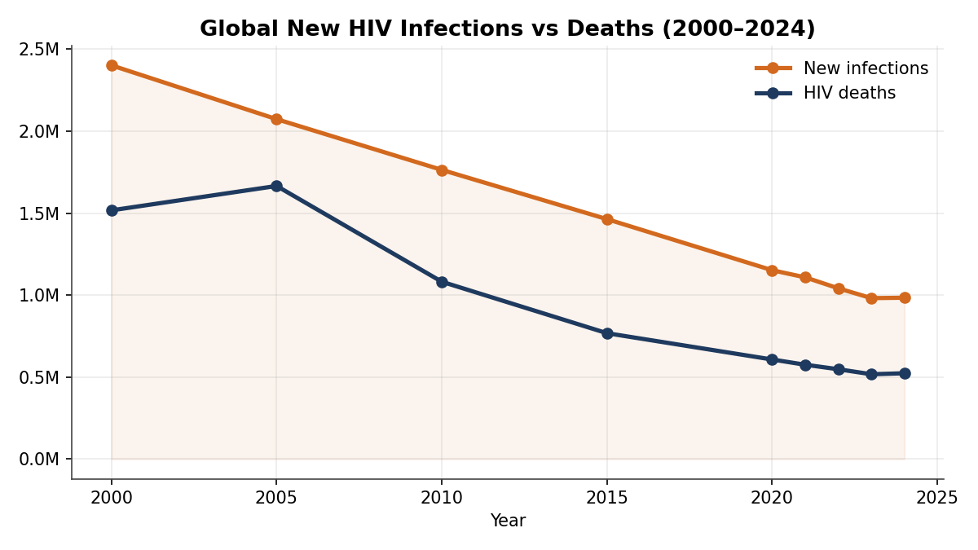
Are infections truly declining?
Both new infections and deaths have fallen sharply — but the decline is flattening.
What the data says
New infections: 2.40M → 0.98M
a 59% drop since 2000.
Deaths: down ~70% from the 2004 peak.
BUT: 2023→2024 infections barely moved (+0.25%).
Implication: prevention gains are plateauing — renewed effort is needed to keep the curve falling.

Slide 4
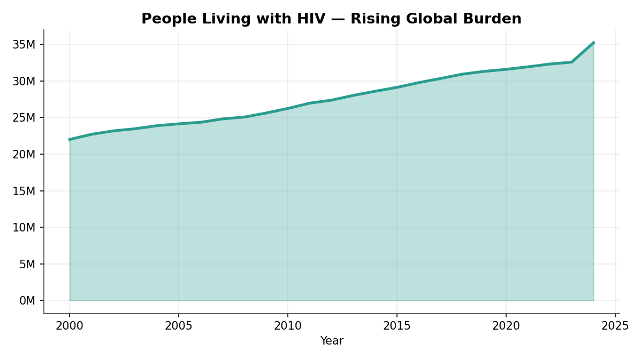
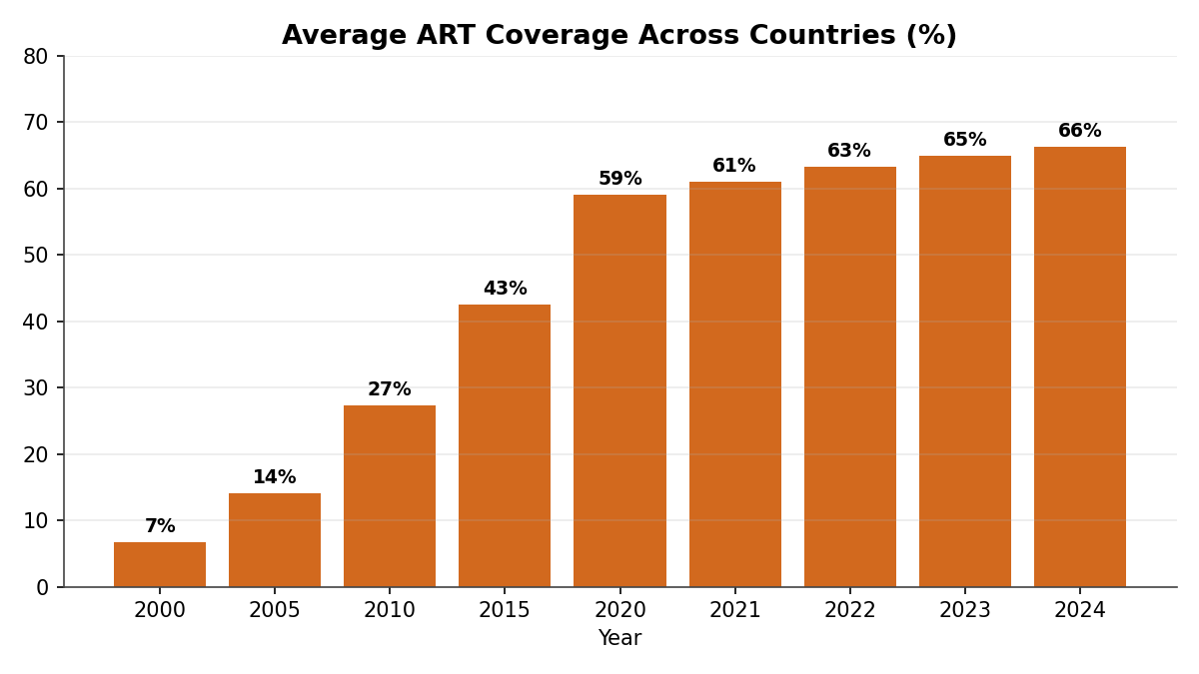
A success that creates a new challenge
As deaths fall, more people live with HIV — driven by a ten-fold rise in treatment access.
The chronic-condition signature. People living with HIV climbed from 22M (2000) to 35.2M (2024) precisely because ART now keeps people alive — average coverage rose from 7% to 66%. The mortality win is real, but it locks in a permanent, growing need for lifelong treatment and financing.

Slide 5
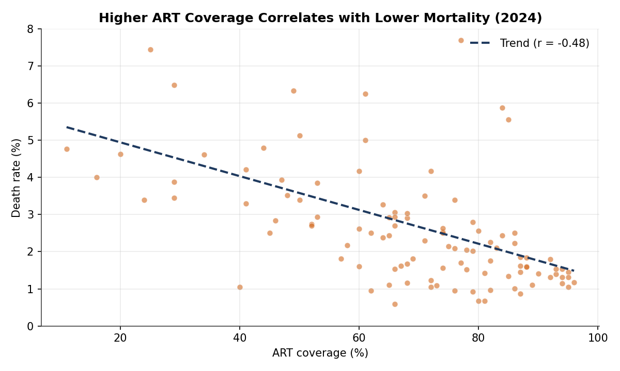
Does treatment reduce mortality?
Across 108 countries, higher ART coverage is clearly associated with lower death rates.
r ≈
−0.48
negative correlation
This is the core evidence that treatment programmes save lives. The link is moderate, not perfect, because outcomes also depend on early diagnosis, adherence, and health-system quality — but the direction is unmistakable.

Slide 6
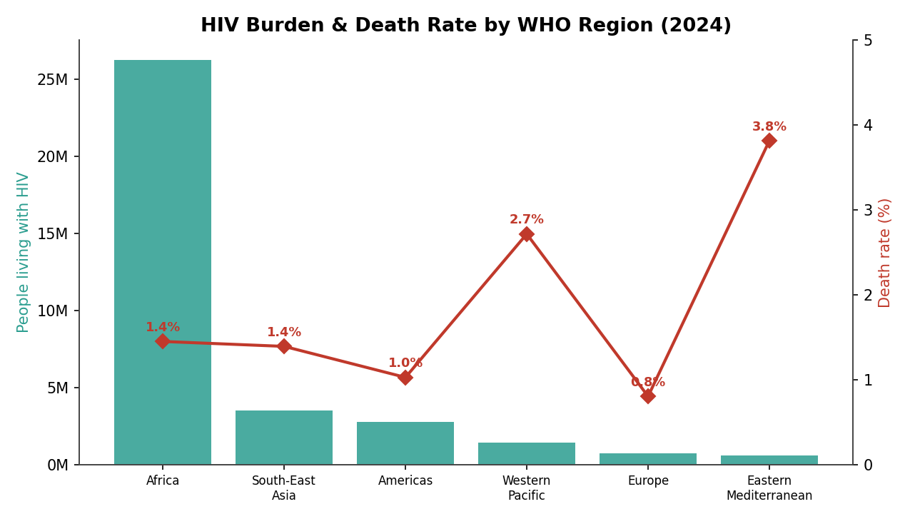
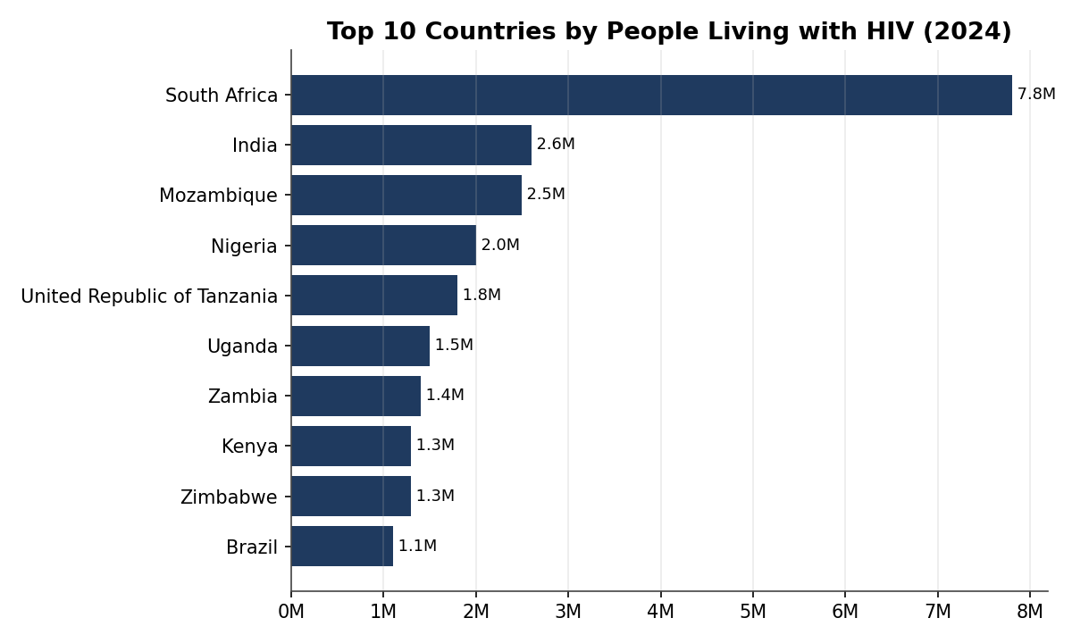
The geography of the epidemic
Africa carries ~75% of the global burden — but the highest death rates sit elsewhere.
Burden ≠ death rate. Africa leads on absolute burden (26.3M living with HIV, led by South Africa at 7.8M). Yet the Eastern Mediterranean (3.81%) and Western Pacific (2.71%) post the highest death rates — regions where treatment access lags the size of the epidemic.

Slide 7
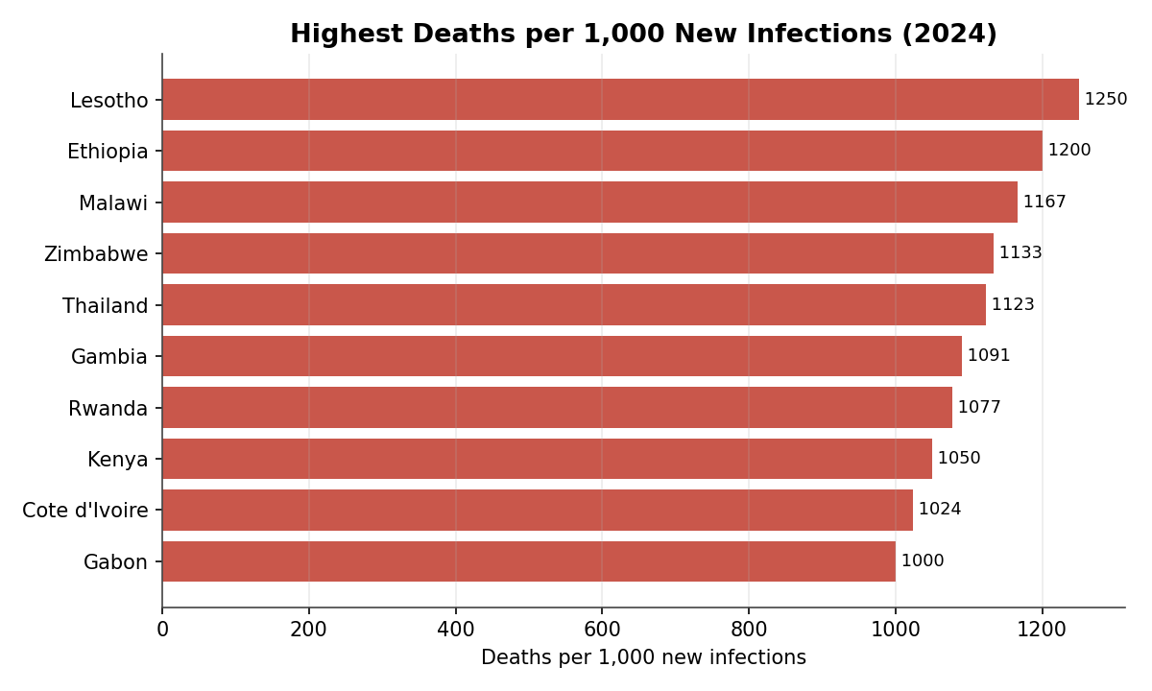
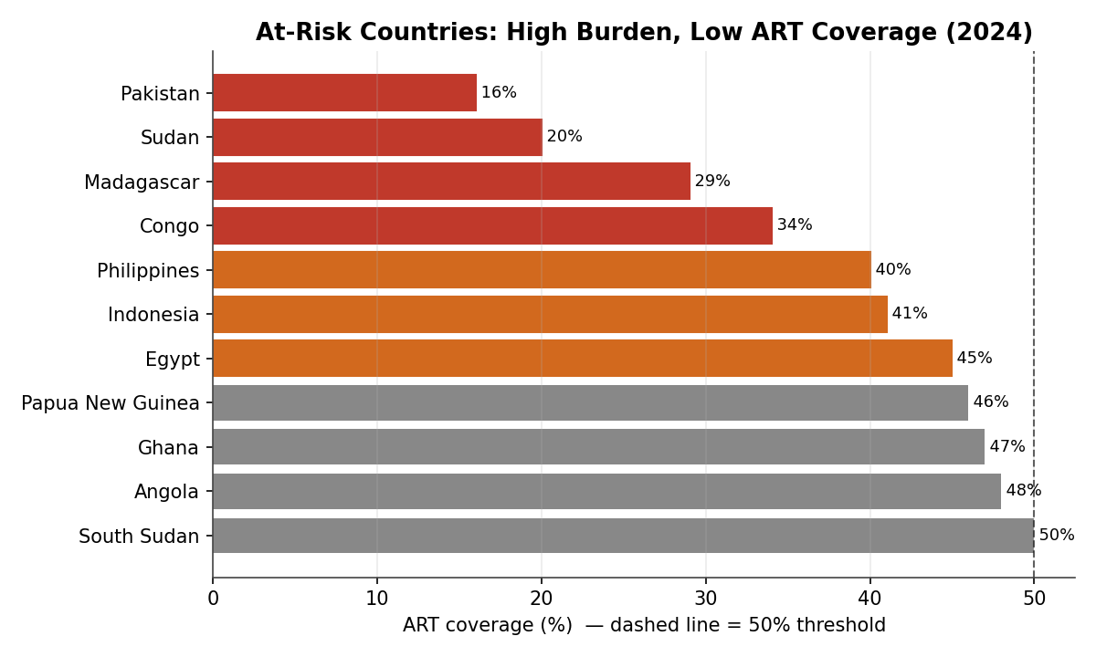
Where intervention is most urgent
Two lenses on risk: where deaths outnumber new infections, and where coverage is dangerously low.
Priority list. Lesotho, Ethiopia, Malawi and Zimbabwe record more deaths than new infections (>1,000 per 1,000) — a retention-in-care problem. Meanwhile Pakistan (16%), Sudan (20%), Madagascar (29%) and Indonesia (41%) pair large burdens with sub-50% ART coverage — the clearest targets for urgent scale-up.

Slide 8
Recommendations
Close the coverage gaps
Channel funding to low-ART, high-burden countries — Pakistan, Indonesia, Madagascar, Congo, Sudan. Largest available mortality win.
1
Re-energise prevention
With infections plateauing, renew PrEP, testing and education — focused on Africa and rising-infection settings like the Philippines.
2
Fund the growing care pool
Lock in sustainable, long-term financing for lifelong ART so the mortality gains are never reversed.
3
Target retention hotspots
In Lesotho, Ethiopia, Malawi and Zimbabwe, prioritise early diagnosis, adherence and viral suppression.
4
Modernise data reporting
Move five-yearly indicators to annual reporting everywhere for timelier monitoring and faster course-correction.
5

Slide 9
The bottom line
A public-health success in motion — with unfinished business.
Infections down 59%, deaths down 70% from peak, treatment up ten-fold. Sustained, targeted, data-driven investment — guided by the model and dashboard built here — is what keeps the curve falling.
Built with Power BI • Data: World Health Organization

