Slide 1
WORLD HEALTH ORGANIZATION • CAPSTONE PROJECT
Global HIV Trends & Treatment Effectiveness Analysis
A holistic, data-driven view of the global HIV landscape, 2000–2024
Specialization: Healthcare | Business Focus: Public Health Analysis | Tool: Power BI
Data source: WHO • 150 countries • 6 WHO regions

Slide 2
Project Overview
Over three decades, the WHO and partners have transformed HIV from a fatal disease into a manageable chronic condition through prevention programmes, awareness campaigns and the rollout of Antiretroviral Therapy (ART).
This project evaluates:
1
Whether HIV infections are truly declining
Despite this progress, HIV remains a major public-health concern — especially where healthcare infrastructure is limited — and questions persist about the true effectiveness and sustainability of current interventions.
2
Whether increased treatment access is reducing mortality
3
How the overall burden of HIV is evolving globally
1

Slide 3
Problem Statement & Objectives
The Problem
The Objectives
Despite available HIV data, stakeholders lack a unified analytical framework to:
Disease monitoring
Track the global spread of HIV over time
• Evaluate the effectiveness of treatment programmes
Evaluate treatment impact
• Understand the link between infections, deaths and treatment
Assess how ART coverage affects mortality
• Identify regions requiring urgent intervention
Support strategic decisions
This limits strategic planning and resource allocation.
Help policymakers target high-risk regions
2

Slide 4
The Data
9,763 annual records • WHO • 150 countries • 2000–2024
New Infections
HIV Deaths
Newly reported HIV cases — measures disease spread (incidence)
Deaths caused by HIV — measures severity & mortality
People Living with HIV
ART Coverage (%)
Total individuals living with HIV — measures burden (prevalence)
Share of HIV-positive people on treatment — measures access
Two data nuances handled in modelling. ART coverage is a percentage (averaged, never summed); and new infections & ART coverage are reported every five years until 2020, then annually — so trends use comparable years rather than treating gaps as zeros.
3

Slide 5
Methodology & Data Model
A clean star schema: 1 fact table + 3 dimensions
Data Collection
▶
Data Modelling
▶
Analysis & Visualisation
▶
Recommendations
Dim_Date (25)
DateKey (PK) • Year
Decade • ART_Era
Dim_Geography (150)
Fact_HIV (9,763)
Dim_Indicator (4)
CountryKey (PK)
Country
RegionCode
WHO_Region
IndicatorKey (FK)
CountryKey (FK)
DateKey (FK)
Value
IndicatorKey (PK)
Indicator
Measure_Type
Unit
KPIs (DAX): Death Rate = Deaths ÷ PLHIV • Survival Rate = 1 − Death Rate • Deaths per 1,000 Infections • ART Coverage (PLHIV-weighted) • YoY Growth
4

Slide 6
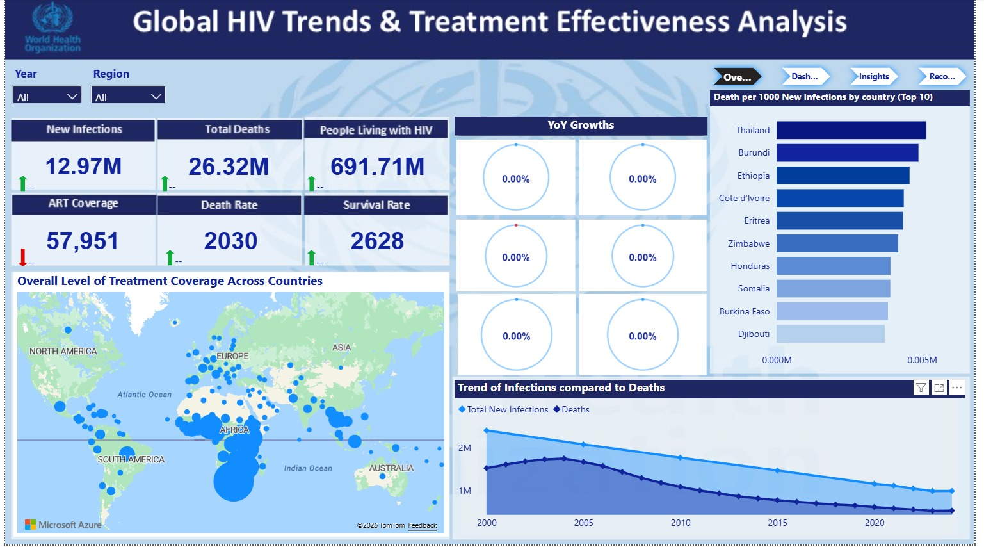
The Power BI Dashboard — Page 1: Overview
KPIs • global trend • treatment map • deaths per 1,000
5

Slide 7
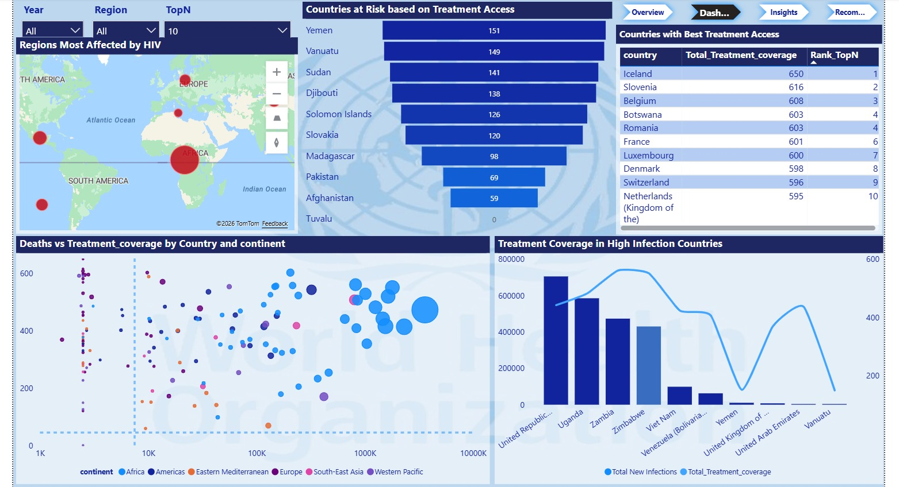
The Power BI Dashboard — Page 2: Deep Dive
regions • at-risk • best access • coverage vs deaths
6

Slide 8
Executive Snapshot
HIV has shifted from a fatal disease to a managed chronic condition — but the job is unfinished.
984K
523K
35.2M
79%
1.49%
NEW INFECTIONS
HIV DEATHS
LIVING WITH HIV
ART COVERAGE
DEATH RATE
↓59% vs 2000
↓70% from peak
rising prevalence
PLHIV-weighted
deaths ÷ PLHIV
1
2
3
Infections down, but stalling
Treatment is working
Burden keeps growing
Down 59% since 2000 — yet essentially flat from 2023 to 2024 (+0.25%).
ART coverage and death rate move in opposite directions (r ≈ −0.48).
More people live with HIV each year, so the care burden expands.
Figures reflect the most recent reporting year (2024); the dashboard's cumulative card sums prevalence across all years.
7

Slide 9
Business Questions Answered
Every question in the project brief, addressed by the dashboard.
1
How many new infections over time?
7
Infections vs deaths trend?
Fell 59% — 2.40M (2000) → 0.98M (2024); now plateauing.
Both falling; deaths have fallen faster than infections.
2
Total HIV-related deaths globally?
8
Most affected regions?
~523K in 2024; down ~70% from the 2004 peak.
Africa (~75% of burden); top death rates in E. Mediterranean & W. Pacific.
3
How many people living with HIV?
9
Best treatment access?
~35.2M in the latest year and rising (chronic-condition effect).
Rwanda, Botswana, Namibia, Zimbabwe, Eswatini, Zambia (90%+).
4
Overall treatment coverage?
10
Do high-infection countries have cover?
~66% average / ~79% PLHIV-weighted ART coverage (2024).
Mostly yes (S. Africa, Nigeria 80%+) — but Indonesia 41%, Philippines 40% lag.
5
Mortality & survival rate?
11
ART coverage vs mortality?
Death rate ≈ 1.49%; survival rate ≈ 98.51%.
Negative correlation (r ≈ −0.48): more coverage, lower mortality.
6
Highest deaths per 1,000 infections?
12
Most at-risk countries?
Lesotho, Ethiopia, Malawi, Zimbabwe, Thailand.
Pakistan 16%, Sudan 20%, Madagascar 29%, Congo 34%, Indonesia 41%.
8

Slide 10
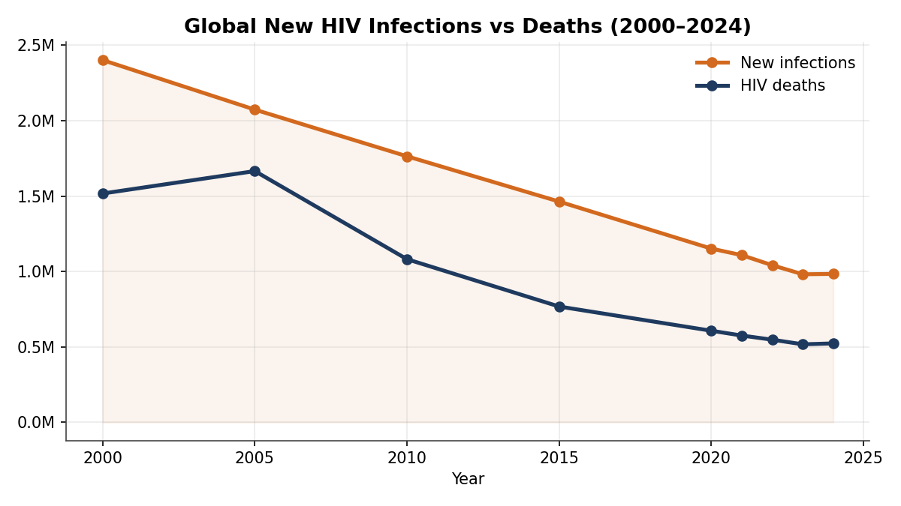
Are infections truly declining?
Both new infections and deaths have fallen sharply — but the decline is flattening.
What the data says
2.40M → 0.98M new infections
a 59% drop since 2000.
Deaths down ~70% from the 2004 peak.
BUT 2023→2024 was almost flat (+0.25%).
Prevention gains are plateauing — renewed effort is needed to keep the curve falling.
9

Slide 11
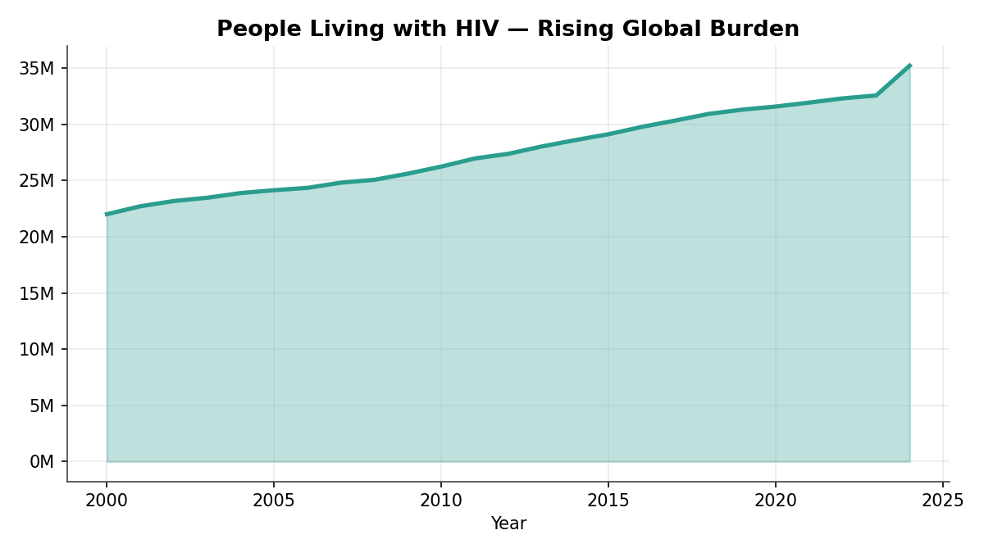
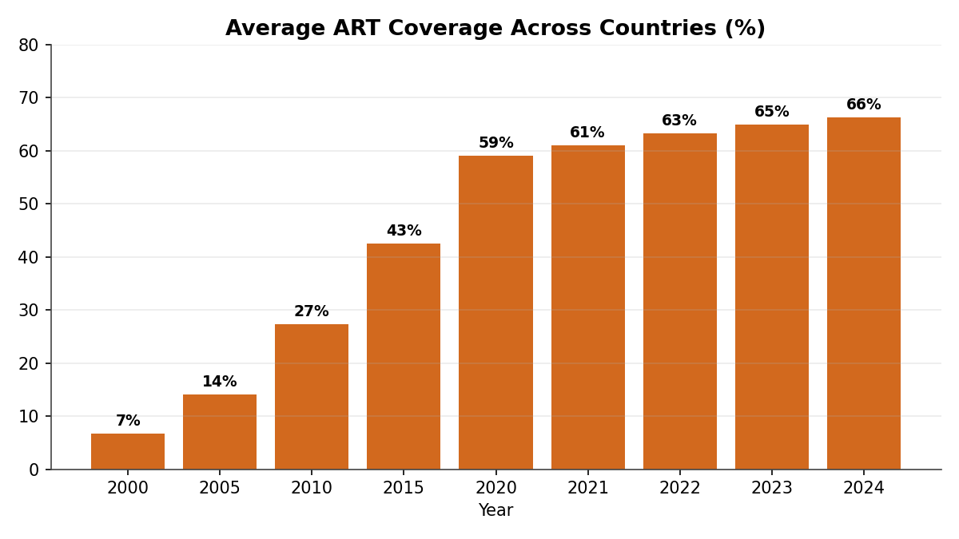
A success that creates a new challenge
As deaths fall, more people live with HIV — driven by a ten-fold rise in treatment access.
The chronic-condition signature. People living with HIV climbed from 22M (2000) to 35.2M (2024) because ART now keeps people alive — average coverage rose from 7% to 66%. The mortality win is real, but it locks in a permanent, growing need for lifelong treatment and financing.
10

Slide 12
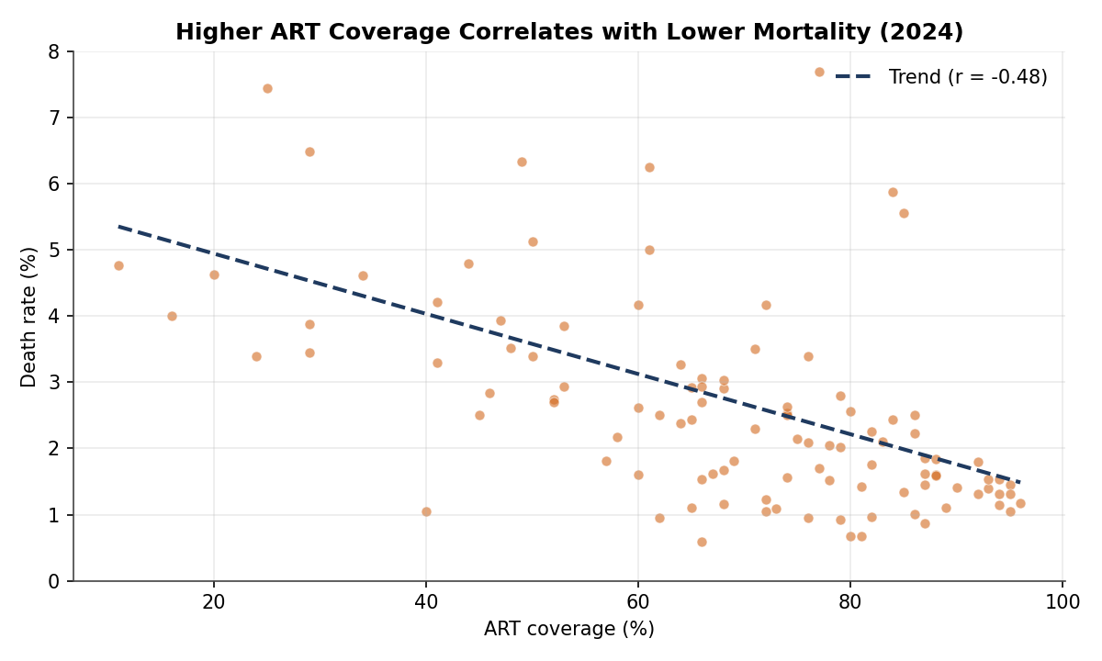
Does treatment reduce mortality?
Across 108 countries, higher ART coverage is associated with lower death rates.
r ≈
−0.48
negative correlation
This is the core evidence that treatment programmes save lives. The link is moderate — outcomes also depend on early diagnosis, adherence and health-system quality — but the direction is unmistakable.
11

Slide 13
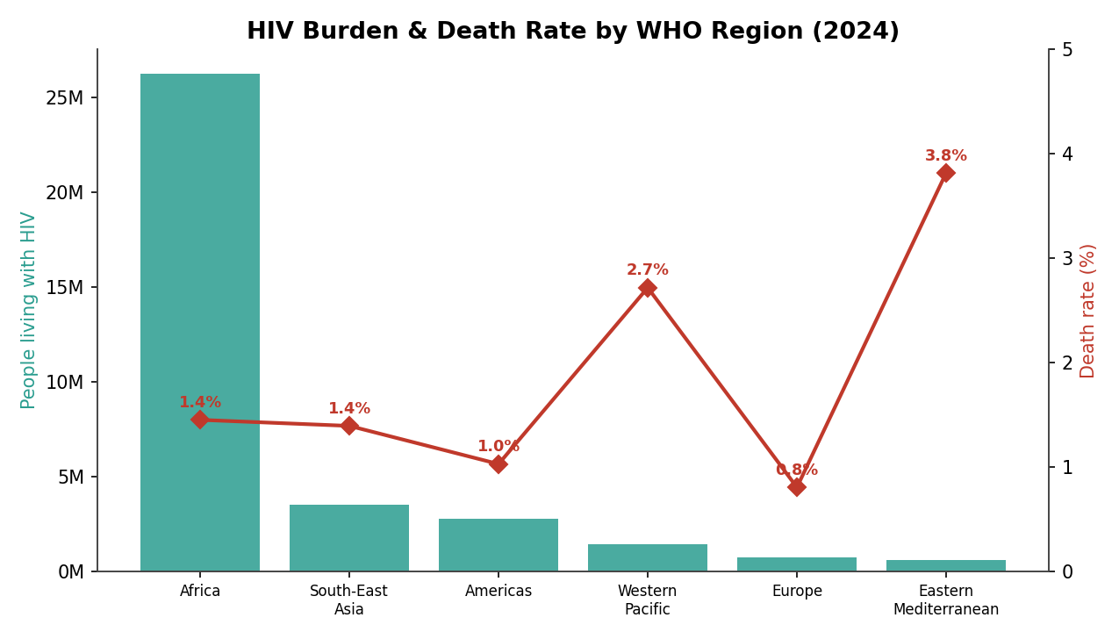
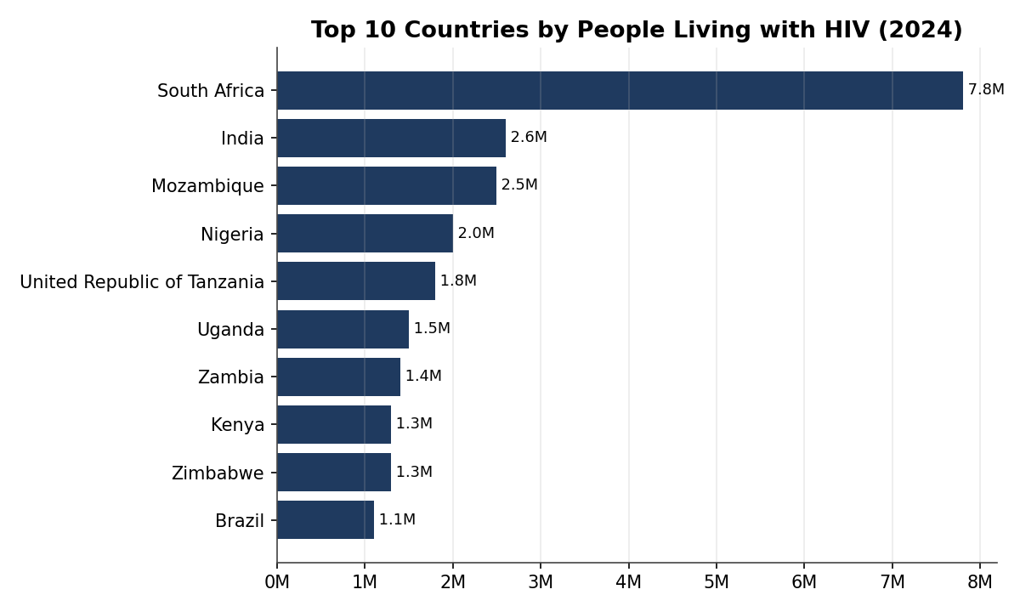
The geography of the epidemic
Africa carries ~75% of the burden — but the highest death rates sit elsewhere.
Burden ≠ death rate. Africa leads on absolute burden (26.3M living with HIV, led by South Africa at 7.8M). Yet the Eastern Mediterranean (3.81%) and Western Pacific (2.71%) post the highest death rates — regions where treatment access lags the size of the epidemic.
12

Slide 14
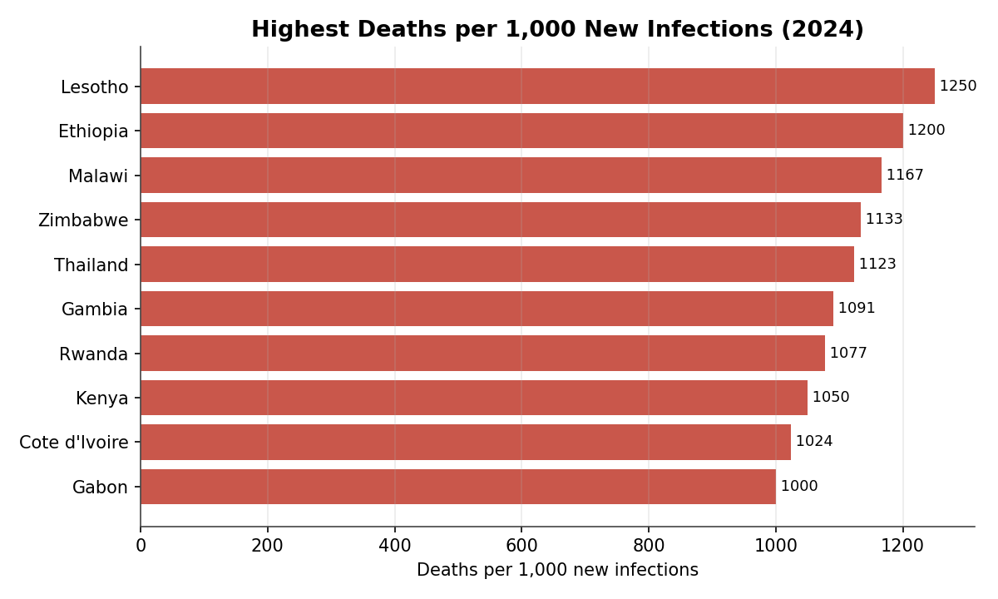
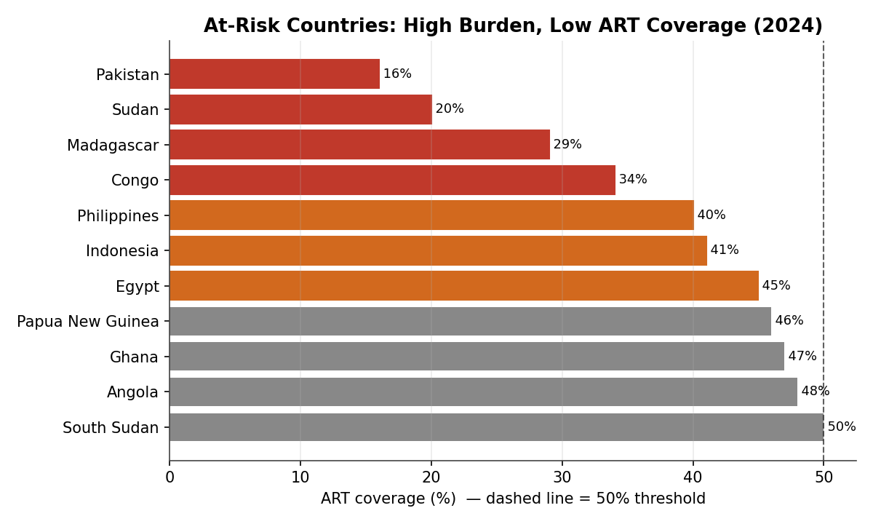
Where intervention is most urgent
Two lenses: where deaths outnumber new infections, and where coverage is dangerously low.
The priority list. Lesotho, Ethiopia, Malawi and Zimbabwe record more deaths than new infections (>1,000 per 1,000) — a retention-in-care problem. Pakistan (16%), Sudan (20%), Madagascar (29%) and Indonesia (41%) pair large burdens with sub-50% ART coverage — the clearest targets for urgent scale-up.
13

Slide 15
Dashboard Insights
What the analysis tells us about burden, treatment and implementation.
Dashboard Insight
Dashboard Insight
▶
Across 2000–2024 the dashboard counts 690M+ people living with HIV. Rising prevalence isn't worsening infections — better ART keeps patients alive, so HIV is increasingly a manageable chronic condition. Higher prevalence can reflect healthcare success.
▶
Countries with stronger ART coverage generally show lower mortality, better survival and improved long-term disease management. As treatment access improves, mortality tends to fall.
▶
African countries carry the highest HIV burden — high infection rates, large numbers living with HIV and significant mortality — reflecting how healthcare inequality, poverty and limited treatment access affect outcomes across the region.
▶
Yet some countries record high “Deaths per 1,000 New Infections” even where coverage looks moderate or high — pointing to weak healthcare delivery, late diagnosis, poor follow-up, medication interruptions or data-reporting gaps.
▶
In many countries death rates are falling faster than infection rates — evidence that healthcare systems and HIV interventions are improving survival through better access to medication and long-term care.
▶
Treatment availability alone is not enough if implementation systems are weak — strong delivery, monitoring and reporting are just as critical as access.
14

Slide 16
Recommendations
✓
Expand access, prevention & early diagnosis
Reducing the global HIV burden requires early diagnosis, improved treatment access, stronger healthcare systems and effective prevention. Governments and health organizations should expand community testing, awareness campaigns and mobile screening to encourage early detection and reduce transmission. Increasing access to affordable ART — particularly in high-burden regions such as Sub-Saharan Africa — is essential to lowering HIV-related deaths and improving quality of life.
✓
Strengthen systems, monitoring & data
Healthcare systems must strengthen patient monitoring, treatment distribution and data-reporting to ensure consistent care and informed decisions. Preventive education, condom distribution and youth-awareness initiatives remain critical to reducing new infections. Tools such as Microsoft Power BI help monitor trends, identify high-risk populations and support evidence-based policymaking. Sustainable progress depends on integrating prevention, treatment, accurate reporting and data-driven strategies.
15

Slide 17
Priority Actions
Five data-driven moves, ranked by impact.
1
Close the coverage gaps
Fund low-ART, high-burden countries — Pakistan, Indonesia, Madagascar, Congo, Sudan.
2
Re-energise prevention
Renew PrEP, testing & education as new infections plateau — focus on Africa & the Philippines.
3
Fund the growing care pool
Sustainable, long-term financing for lifelong ART so mortality gains aren't reversed.
4
Target retention hotspots
Lesotho, Ethiopia, Malawi, Zimbabwe — early diagnosis, adherence & viral suppression.
5
Modernise data reporting
Move five-yearly indicators to annual reporting for timelier course-correction.
16

Slide 18
The bottom line
A public-health success in motion — with unfinished business.
Infections down 59%, deaths down 70% from peak, treatment up ten-fold. Sustained, targeted, data-driven investment — guided by the dashboard and model built in this project — is what keeps the curve falling.
Built with Power BI • Data: World Health Organization • 2000–2024

