Slide 1
Longitudinal clustering for cardiorenal data
Audrey Yeo RN, Vartan Kurtcuoglu , Diane de Zélicourt
University of Zurich Institute of Physiology The Interface Group
audrey.yeo@uzh.ch
Project funded by Junior Grant and WP
NCCR Retreat 2021
Zürich, 15. January 2021

Slide 2
Outline Slide
1
2
3
4
5
Objective
Method
Results
Discussion and Conclusion
Outlook

Slide 3
Objective
1
5
A proof of concept for a longitudinal clustering method
Manipulated the data into clusters based on GFR values (outcome variable) and checked for performance of a purpose built R package/ facility based on outcome variable values
The method validation is a use case for future studies with real patient data

Slide 4
Method
Data from Moss et al (2012)¹’s virtual population of Guyton’s model of whole-body circulatory regulation model was sampled
The sample of virtual patients was taken from a virtual population on the basis of exhibiting conditions similar to those of a real-world patient
Out of 96 parameters and 276 output variables :
32 cardiac, 21 renal, 16 autoregulation, 16 hormonal, 11 local circulation, and 4 thirst-related.
This validation study used GFR, Extracellular K⁺, MAP, HR over four unequispaced time points: 1 hour, 1 day, 1 week and 1 month
Moss R, Grosse T, Marchant I, Lassau N, Gueyffier F, et al. (2012) Virtual Patients and Sensitivity Analysis of the Guyton Model of Blood Pressure Regulation: Towards Individualized Models of Whole-Body Physiology. PLoS Comput Biol 8(6): e1002571. doi:10.1371/journal.pcbi.1002571

Slide 5
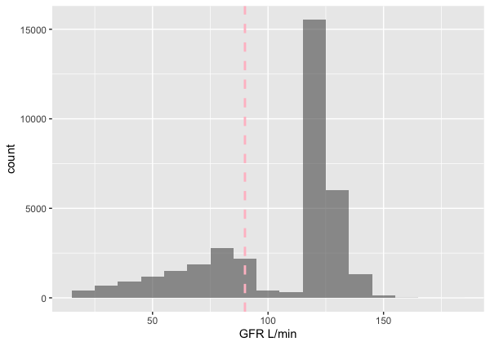
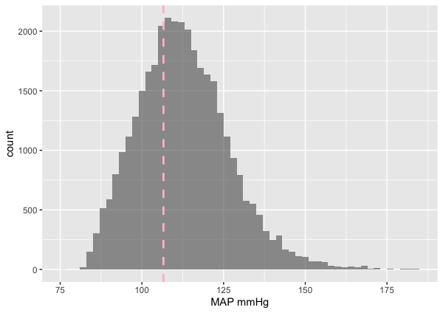
Results 1
The distribution of GFR as outcome variable (90 L/min threshold) and MAP (110 mmHg thresdhold) as covariate
Fig A : Distribution of GFR as outcome variable (90 L/min threshold)
Fig B : Distribution of MAP (110 L/min threshold) as covariate

Slide 6
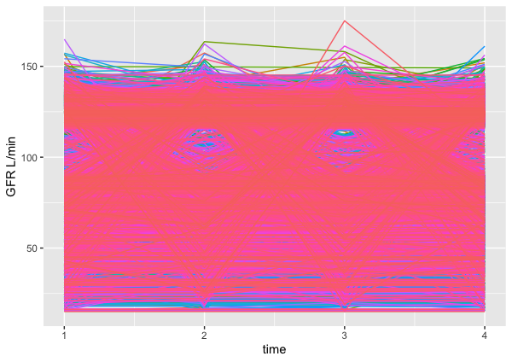
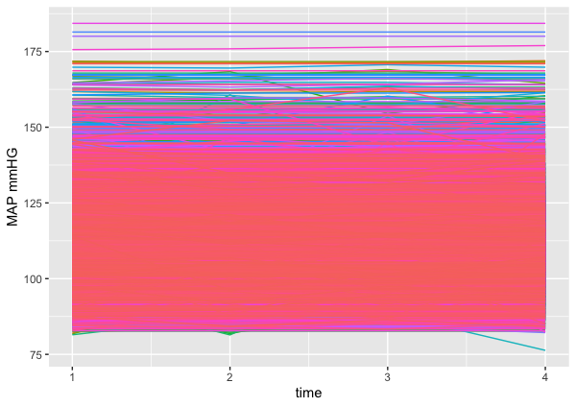
Results 2
Raw trajectories of GFR and MAP
Fig A : Raw trajectories of time (1: 1 hour, 2: 1 day, 3: 1 week, 4: 1 month)
for GFR in L/min in Figure A.
Fig B : Raw trajectories of time (1: 1 hour, 2: 1 day, 3: 1 week, 4: 1 month)
for MAP in mmHg in Figure B.

Slide 7
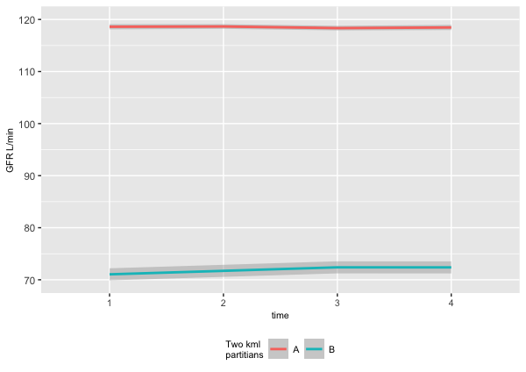
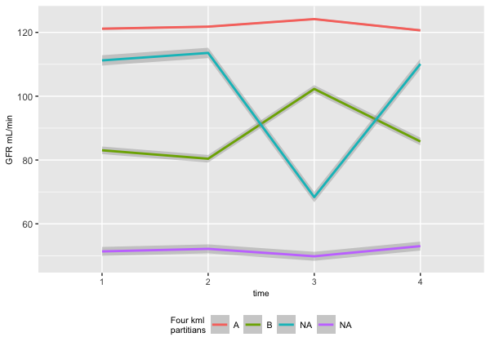
Results 3
Clustering GFR values into two and four partitians validation

Slide 8
Discussion and Conclusion
Results of supervised clustering vs splitting data based on clinical thresholds
Clustering R package kml by Genolini et al (2017)¹ show distinct trajectories for virtual population
The clustered data may show that covariates are associated with dependant variable through further modelling techniques
Genolini, Alacoque, Sentenac, Arnaud, 2017 kml and kml3d: R Packages to Cluster Longitudinal Data kml and kml3d: R Packages to Cluster Longitudinal Data

Slide 9
Outlook
This validation study used GFR, Extracellular K⁺, MAP, HR. This could be further improved and guided by clinical knowledge
Ideal number of clusters could be validated

Slide 10
Picture Slide with Comment and Text
Comment
Text

Slide 11
Large Picture Slide

Slide 12
Black Content Slide
Text
Text
Text
Text

Slide 13
Black Picture Slide

Slide 14
Black Picture Slide with Comment
Comment

Slide 15
Large Black Picture Slide

