Slide 1
Longitudinal clustering for cardiorenal data
Audrey Yeo RN, Vartan Kurtcuoglu , Diane de Zélicourt
University of Zurich Institute of Physiology The Interface Group
audrey.yeo@uzh.ch
Event Name
Zürich, DD. Month YYYY

Slide 2
Outline Slide
1
2
3
4
5
Objective
Method
Results
Discussion and Conclusion
Outlook

Slide 3
Objective
1
5
To validate a longitudinal clustering method (proof of concept)
Manipulated the data into clusters based on GFR values (outcome variable) and checked for performance of a purpose built R package/ facility based on outcome variable values
The method validation is a use case for future studies with real patient data

Slide 4
Method
Moss et al (2012)’s virtual population of Guyton’s model of whole-body circulatory regulation model was sampled
The sample of virtual patients was taken from a virtual population on the basis of exhibiting conditions similar to those of a real-world patient
Out of 96 parameters and 276 output variables :
32 cardiac, 21 renal, 16 autoregulation, 16 hormonal, 11 local circulation, and 4 thirst-related.
This validation study used GFR, Extracellular K⁺, MAP, HR,

Slide 5
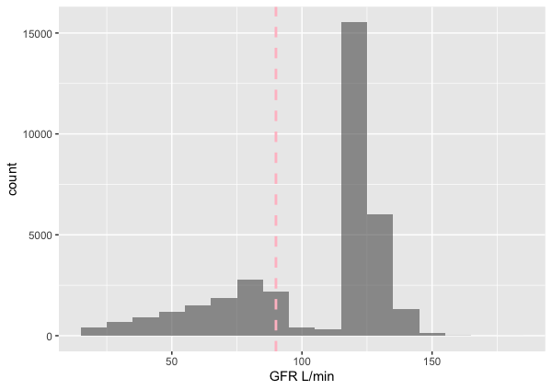
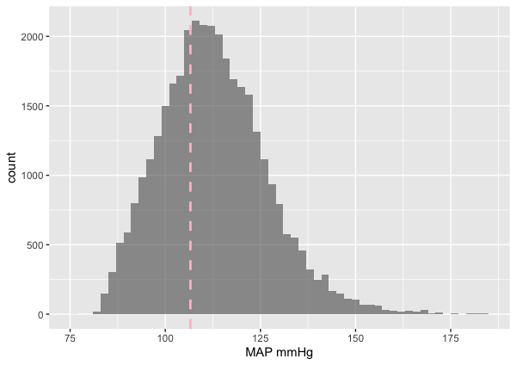
Results 1
The distribution of GFR as outcome variable (90 L/min threshold) and MAP (110 mmHg thresdhold) as covariate

Slide 6
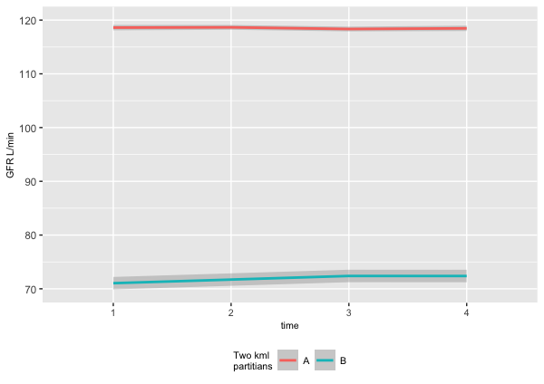
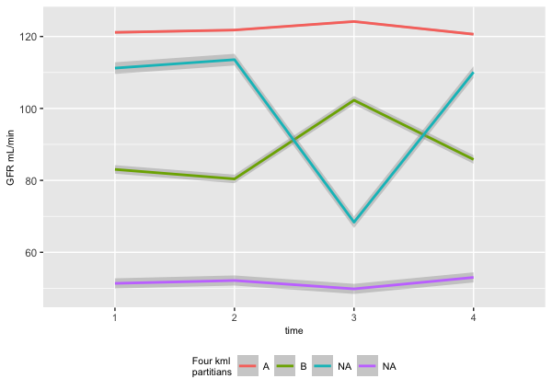
Results 2
Clustering into two and four partitians validation

Slide 7
Discussion and Conclusion
Clustering R package show distinct trajectories for virtual population
The clustered data may show that covariates are associated with dependant variable through further modelling techniques

Slide 8
Outlook
This validation study used GFR, Extracellular K⁺, MAP, HR. This could be further improved and guided by clinical knowledge
Ideal number of clusters could be validated
Direction or pattern of trajectory could also be validated

Slide 9
Picture Slide with Comment and Text
Comment
Text

Slide 10
Large Picture Slide

Slide 11
Black Content Slide
Text
Text
Text
Text

Slide 12
Black Picture Slide

Slide 13
Black Picture Slide with Comment
Comment

Slide 14
Large Black Picture Slide

