Slide 1
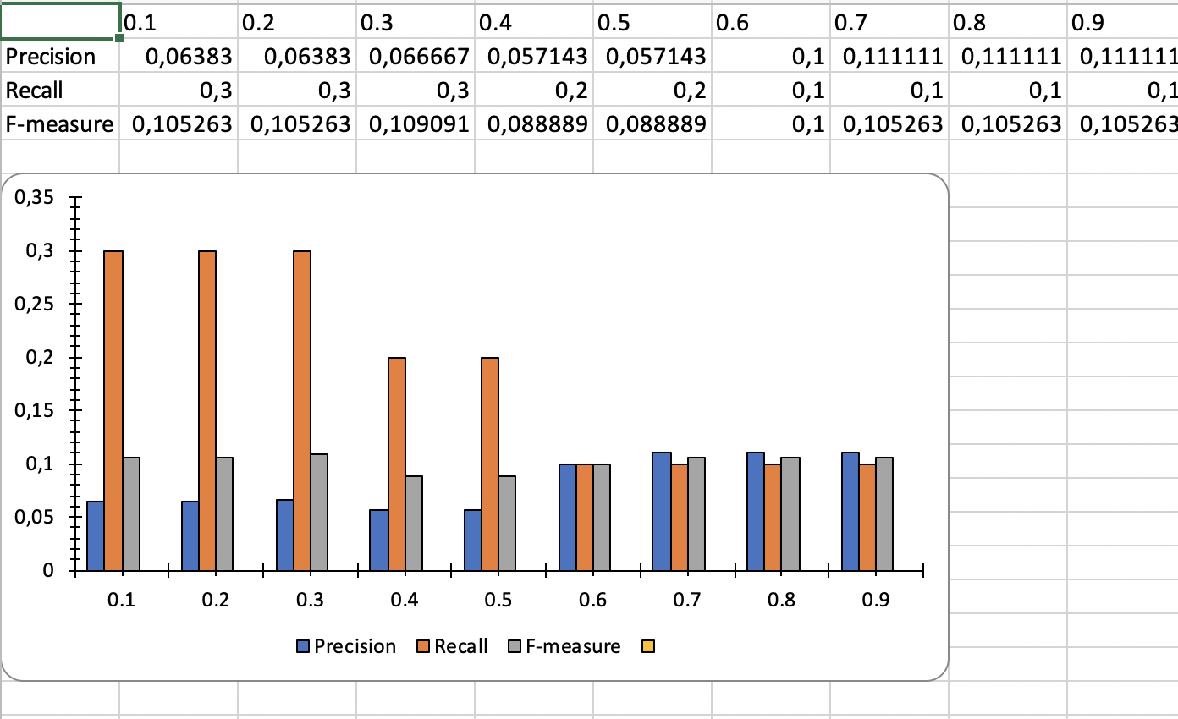
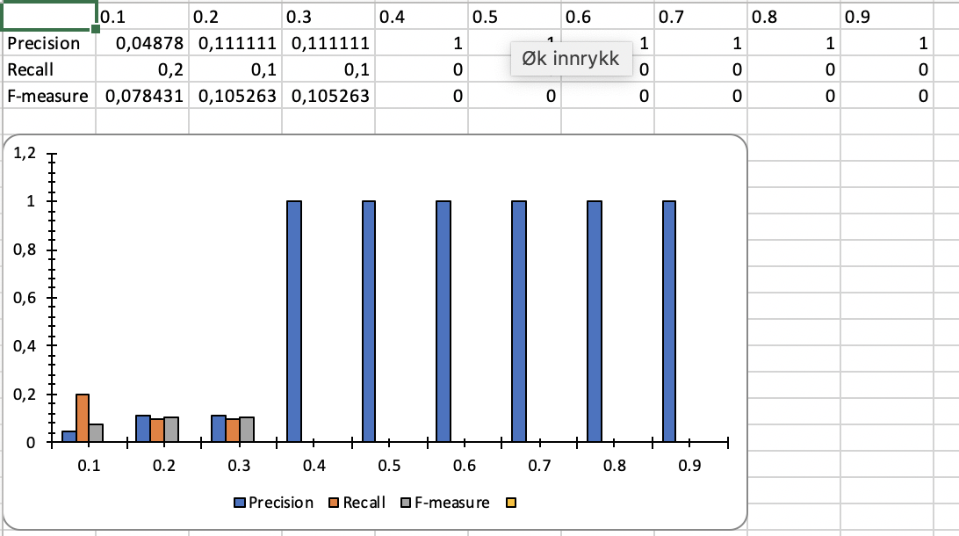
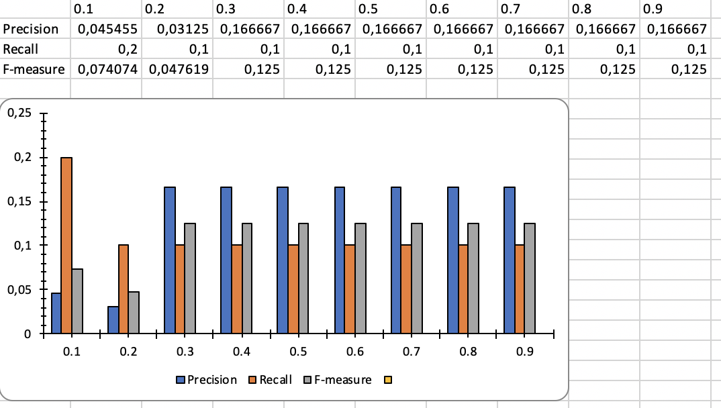
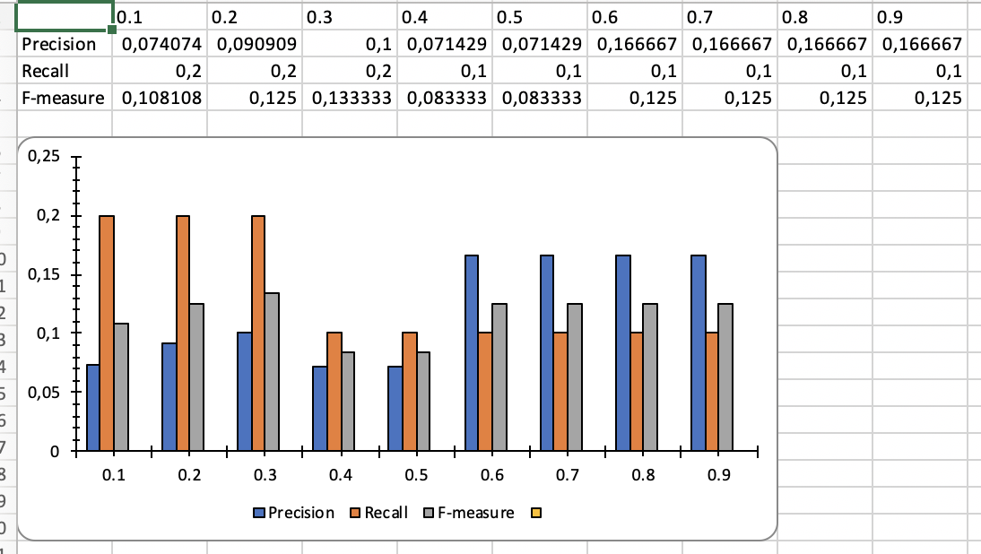
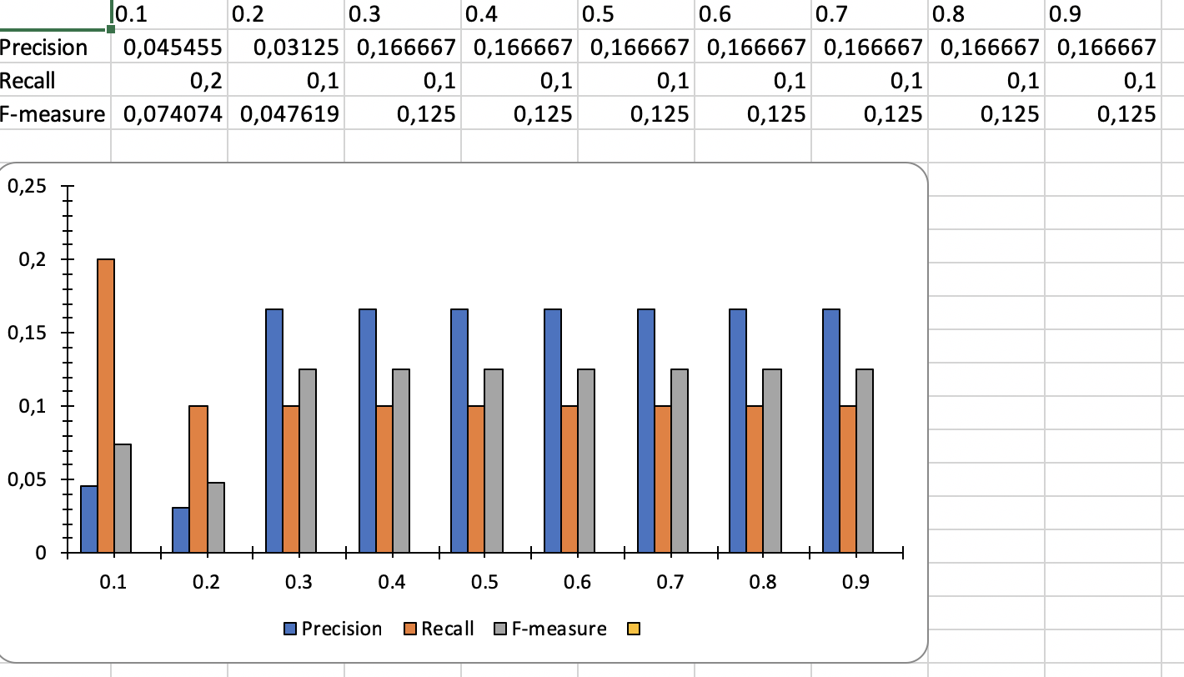
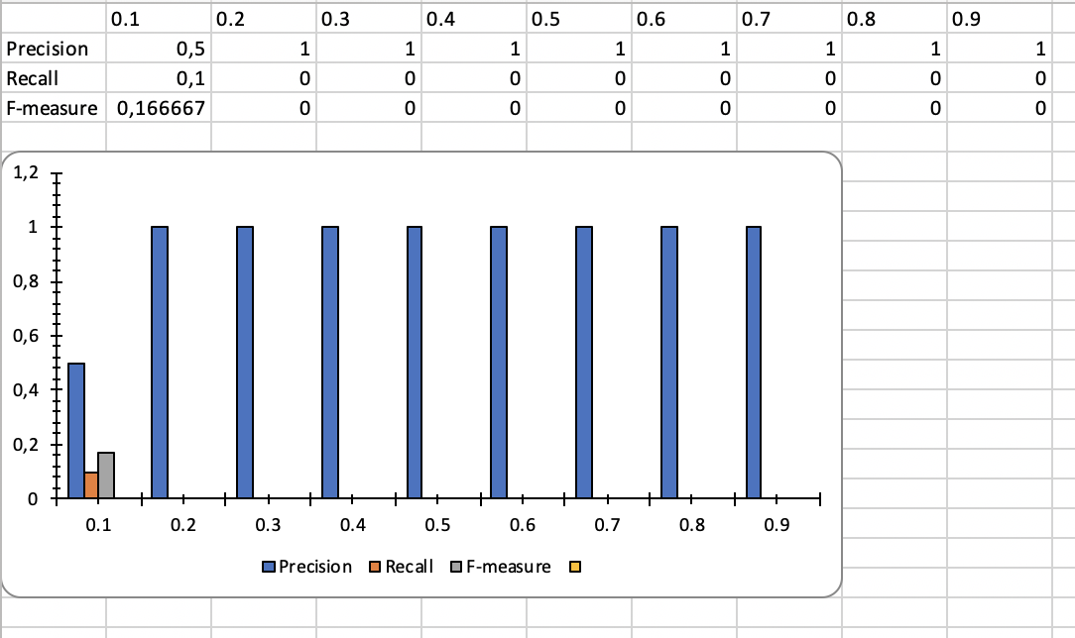
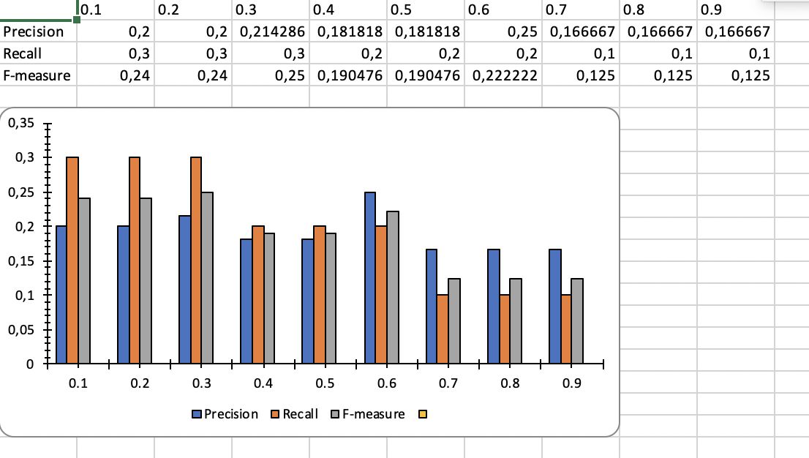
Nouns
Nouns, verbs, adjectives
Nouns and verbs (Jaccard)
Nouns and verbs, Jaccard and ISub
Nouns and verbs, lemmatized
Nouns and verbs, Jaccard
Nouns and verbs, Jaccard and Isub (0.7)

Slide 2
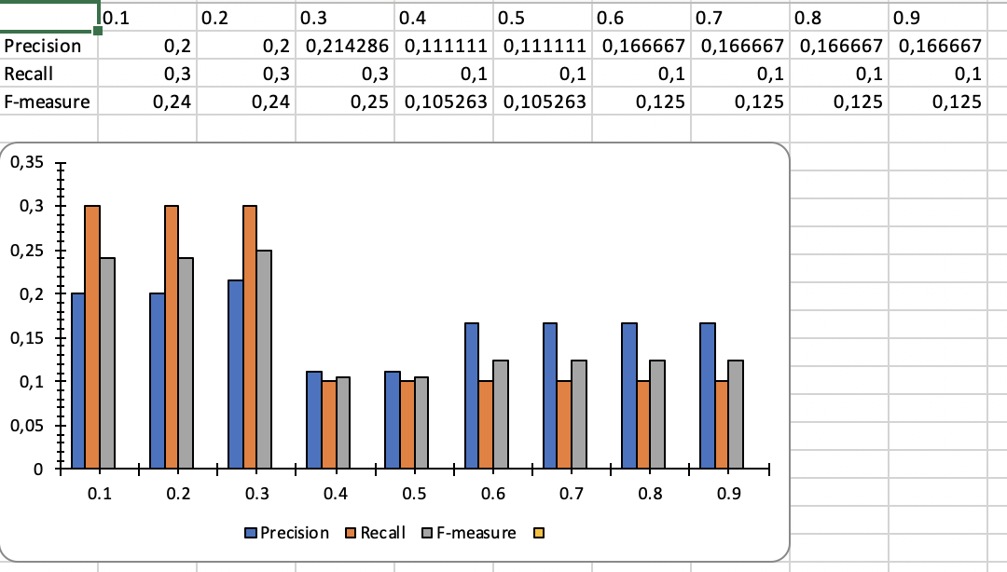
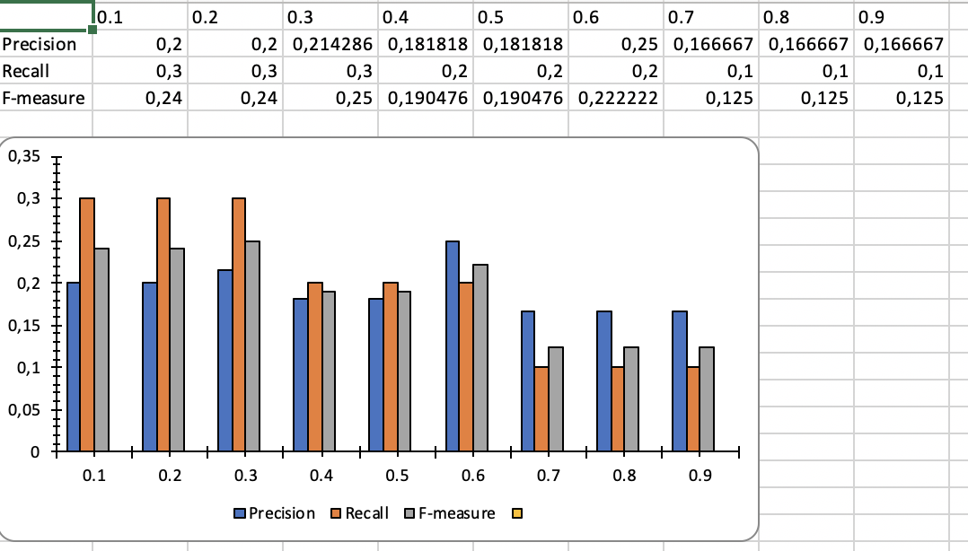
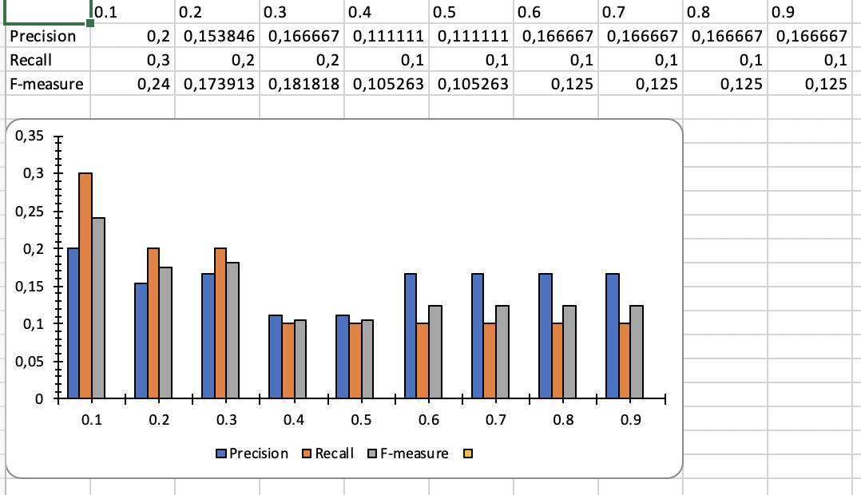
Nouns and verbs, Jaccard and Isub (0.7)
Nouns and verbs, Jaccard and Isub (0.8)
Nouns and verbs, Jaccard and Isub (0.9)

