Slide 1
Cryptography
Secure Communication

Slide 2
Useful Tips
Learn to script out algorithms
(Language not important but you don’t want to do everything by hand)
Use google to assist in decoding or decrypting
https://gchq.github.io/CyberChef/ is great if you do not know what you are dealing with
Learn to love math

Slide 3
Encryption
Encoding
Vs
Hashing
Obfuscation

Slide 4
Encoding
Primary purpose is to change the form the data is in so that the data can be more easily processed by a different system
Easily be able to go between encoded and decoded
Encoding is not Encryption
Does not require any form of key
The way in which the data is transformed is public so that it can be reverse

Slide 5
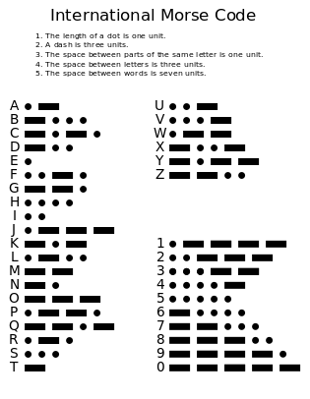
Encoding Examples
Morse Code - Main purpose is to translate alphanumeric characters into something that can be sent via signals
Decoded - “Morse Code”
Encoded - “-- --- .-. … . -.-. --- -.. .”

Slide 6
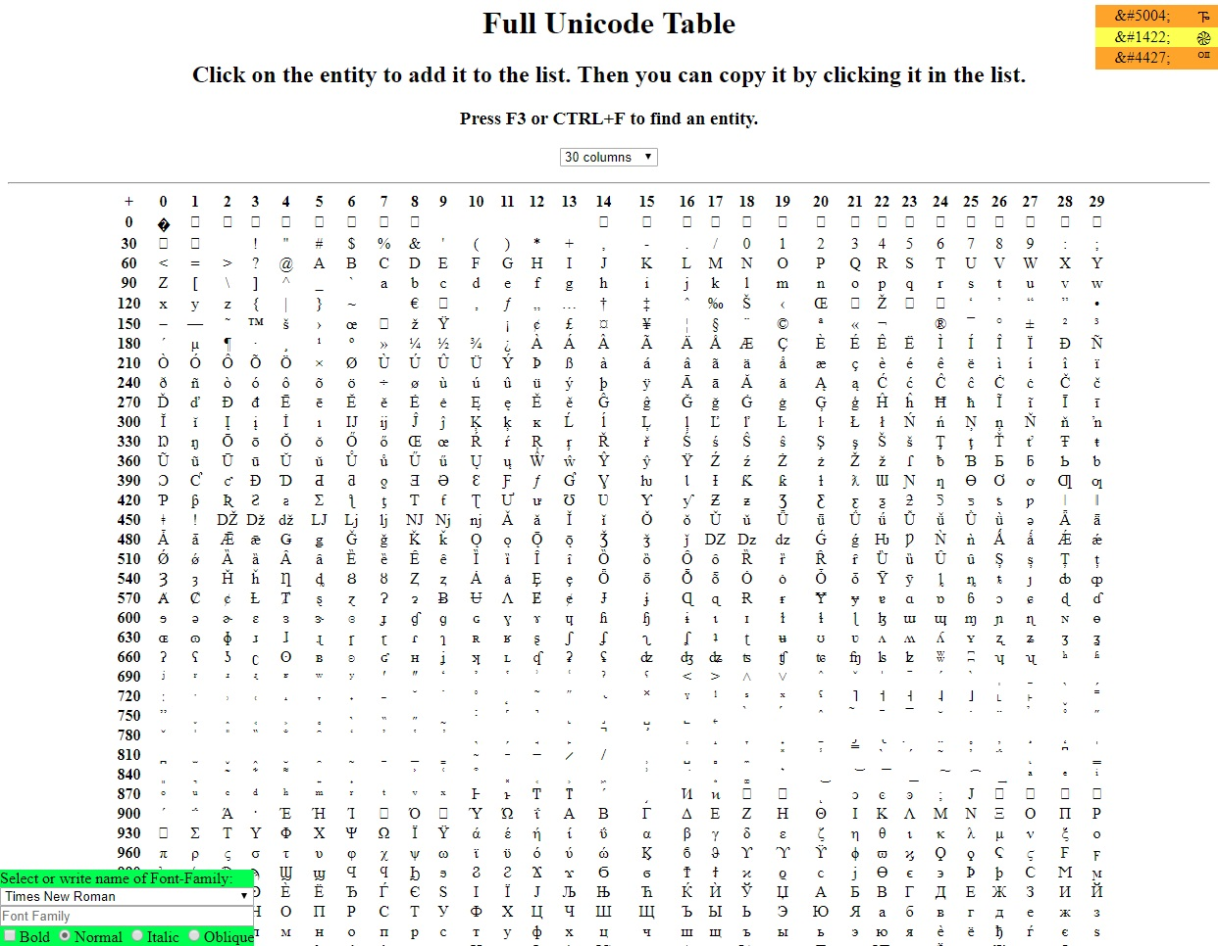
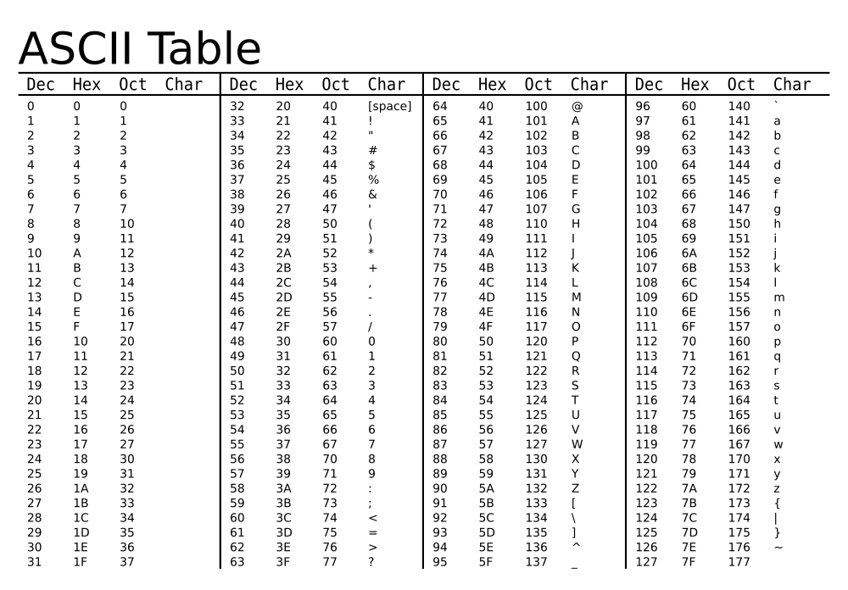
Encoding Examples
ASCII and Unicode - both are used for character encoding for electronic communication
ASCII is American whereas Unicode is international

Slide 7
Encoding Examples
The Bases - Some of the most popular encoding techniques are using number of base(x^2)
Decoded message = abc
Use = sign as padding
Binary(Base 2)
ASCII - “97 98 99”
Encoded - “01100001 01100010 01100011”
Hex(Base 16)
01100001 01100010 01100011
Encoded - “61 62 63”
Base 32
01100001 01100010 011000110*
Encoded - “MFRGG===”
Base64
01100001 01100010 01100011
Encoded - “YWJj”

Slide 8
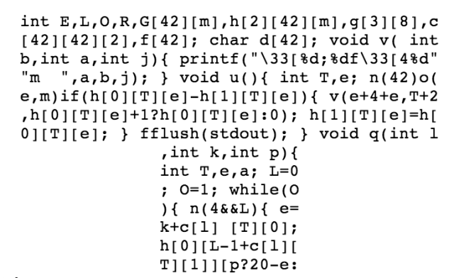
Obfuscation
The main purpose for obfuscation is to make something more difficult to understand
It is possible to deobfuscate something but it will likely take time as obfuscation techniques vary widely
Obfuscation is mainly used in source code
Some reasons why you might use obfuscation
Makes it more difficult to copy
Harder to attack before deobfuscating

Slide 9
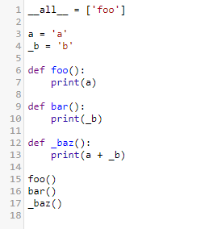
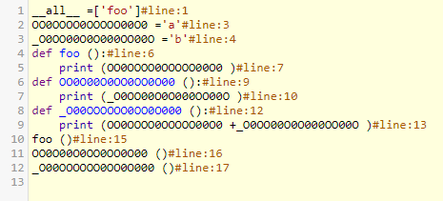
Obfuscation - Python Example
https://pyob.oxyry.com/
Deobfuscated Obfuscated

Slide 10
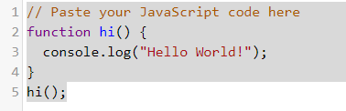
Obfuscation - Javascript Example
https://obfuscator.io/
Deobfuscated
Obfuscated

Slide 11
Hashing
A hashing algorithm can be thought of as a machine that takes a plain-text input and outputs a computed combination of hexadecimal numbers (called a hash)
Using the same input will result in receiving the same output
Altering even one character of an input will completely change the output
Can not be reversed
i.e. can not go backwards from hash to plain-text input

Slide 12
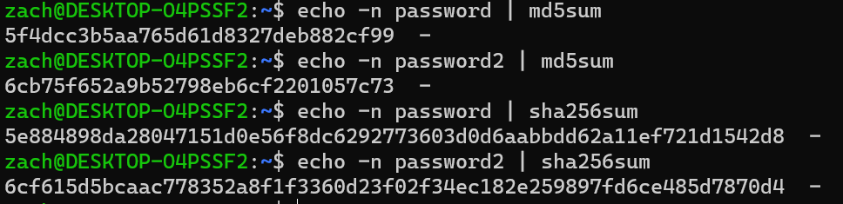
Hash Examples

Slide 13
Types of Hashes
Message-Digest Algorithm (MD2, MD4, MD5, MD6)
MD5 hash is commonly used in CTF challenges
Secure Hash Algorithm (SHA-1, SHA-224, SHA-256, …)
Different versions output hashes of different lengths
Ex. SHA-1 → 40 hexadecimal digits, SHA-256 → 64 hexadecimal digits
And many, many more

Slide 14
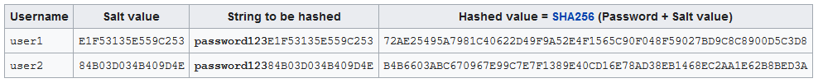
Salting
A salt is a piece of random data that is used as an additional input for a hashing algorithm
Each user has their own salt

Slide 15
Encryption
Taking data or messages and making it hard to read
Concealing the actual message so that an eavesdropper can not (easily) read it
How do we encrypt something?
Using Algorithms known as Ciphers
Using secret keys
Decryption:
Taking an encrypted message that is unreadable and transforming it back into the original message
Notes:
Ethan

Slide 16
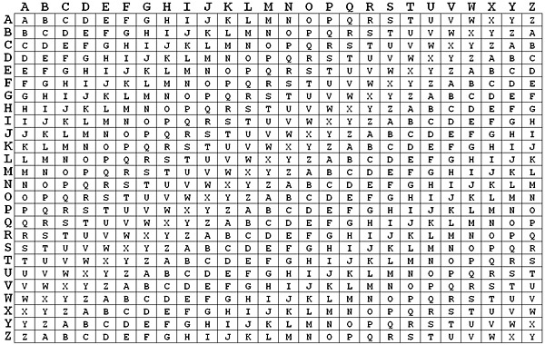
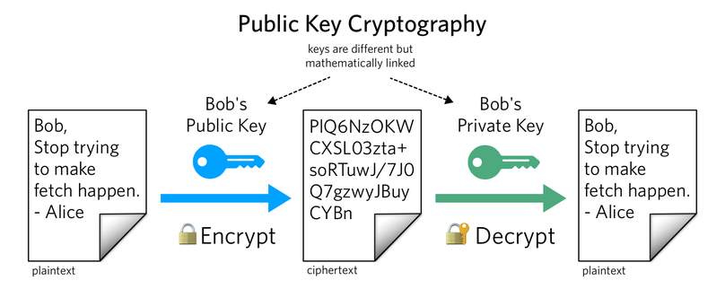
Different Types of Encryption
Symmetric - Use the same key for encryption and decryption (ex: Vigenere Cipher)
The key is shared between the sender and receiver
Asymmetric - Uses two keys where one is for encryption and the other is for decryption.
The encryption key, public key, is not secret
The decryption key, private key, is secret
Anyone can use the public key to encrypt a message but only the user with the private key can decrypt the message
Notes:
Ethan

Slide 17
Vigenere Cipher - Symmetric Key
Encryption
Plaintext - hacker
Key - auehc
Encrypted - hugrgr
Decryption
Encrypted - hugrgr
Key - auehc
Plaintext - hacker

Slide 18


RSA - Asymmetric Key
Encryption -
Decryption -
Prime Numbers - p, q
Plaintext - m
p * q = n
Carmichael’s Totient of n or λ(n) = (p-1)*(q-1) **KEPT SECRET**
Choose an integer e such that 1 < e < λ(n) and GCD(e, λ(n)) = 1
Find d which is the modular multiplicative inverse of e mod( λ(n)) or e^-1 mod( λ(n))
https://planetcalc.com/3311/

Slide 19
RSA Example
n = p * q
λ(n) = (p-1)*(q-1)
e = 1 < e < λ(n) and GCD(e, λ(n)) = 1
d = e^-1 mod( λ(n))
If p = 11, q = 13, what does n =
143
If n = 143 then what does λ(n) =
120
If e = 7 then what does d =
103
Solve using these values:
m = 9
e = 7
n = 143
d = 103

Slide 20
Secure Communication through AES
Some background info:
DES preceded AES
AES was introduced and has been one leading encryption algorithms since 2001
AES is subset of the block cipher known as Rijndael
AES has key lengths of 128 bits, 192 bits and 256 bits making it realistically impossible to bruteforce
AES is a symmetric encryption algorithm
How do we transfer the key between users securely?

Slide 21
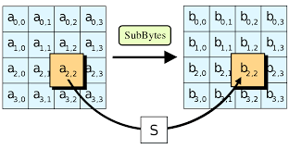
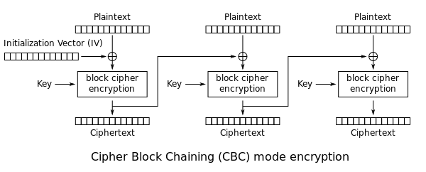
High Level Explanation - AES CBC
Plaintext and first key is loaded into blocks
Round keys are generated from the AES key schedule
XOR plaintext with key
Byte Substitution
Shift Rows
Mix Columns
Repeat x number of times

Slide 22
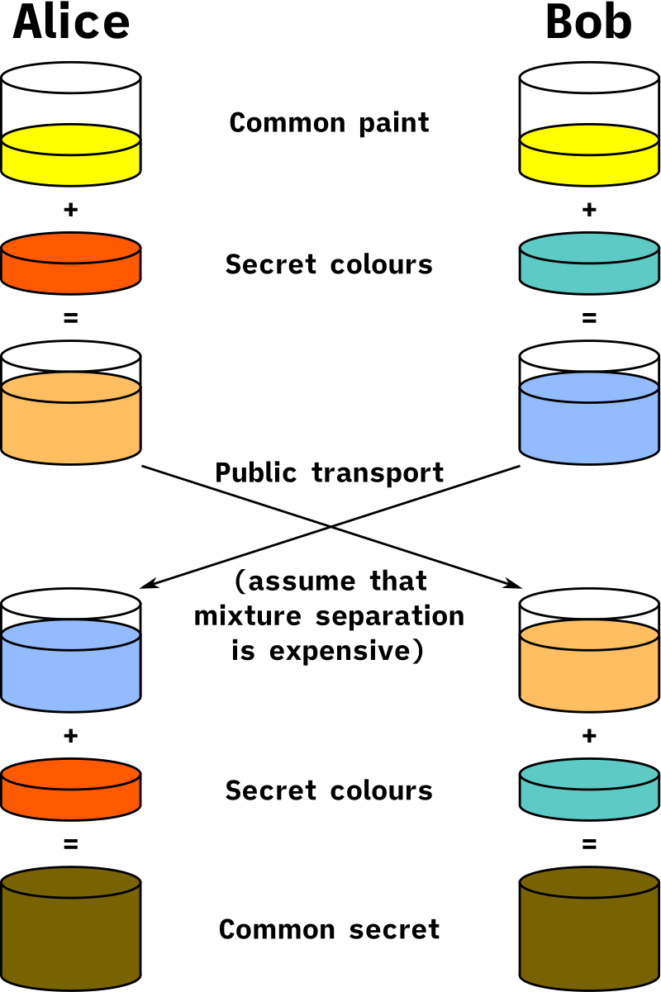
Diffie Hellman Key Exchange
Uses the discrete logarithm problem to help establish a shared (symmetric) key for faster encryption times.
Diffie hellman key exchange makes it where key swapping can occur over public communication
This allows for algorithms like AES to be secure as the exchanging of keys is secure

Slide 23
Diffie Hellman Key Exchange
Alice and Bob agree on a public modulus of 17
Alice and Bob agree on a public base of 4
Alice chooses a secret number 3
Alice computes 4^3 mod 17 = 13
Alice sends Bob her value of 13
Alice then computes with Bob’s value
Alice computes 16^3 mod 17 = 16 <- shared key
Alice and Bob agree on a public modulus of 17
Alice and Bob agree on a public base of 4
Bob chooses a secret number 6
Bob computes 4^6 mod 17 = 16
Bob sends Alice his value of 16
Bob the computes with Alice’s value
Bob computes 13^6 mod 17 = 16 <- shared key

Slide 24
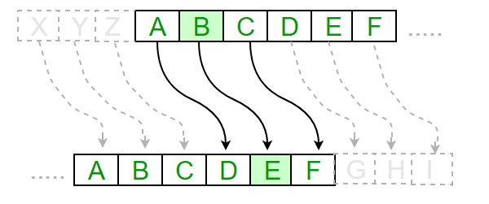
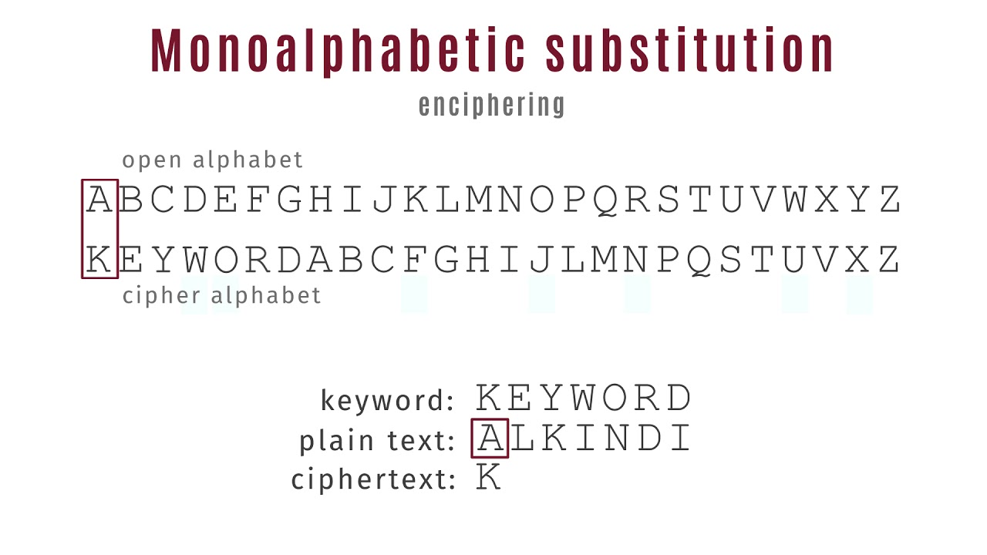
Additional Ciphers - Substitution
Substitution Ciphers
Can make your own or use popular cipher alphabets

Slide 25
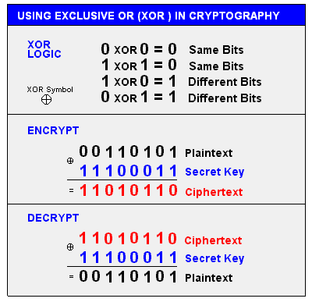
Additional Ciphers - XOR
XOR - symmetric encryption
The message is XOR’ed with a key in order to get the cipher text
Very popular in other ciphers

Slide 26
Additional Ciphers - Matrix Ciphers
Columnar Transposition
Message - “thisisoursecret1”
Ciphertext - “tirrhsseioetsuc1”
t | h | i | s
i | s | o | u
r | s | e | c
r | e | t | 1

Slide 27
Cryptography in Review
Encoding - easy to go back and forth, no key is needed, not secure as encode and decode solutions are public
Obfuscation - used to make reading/understanding more difficult but can be deobfuscated, can make your own obfuscation technique
Hashing - easy to get a hash but should be impossible to go from hash to original message, hash algorithms should have no collisions and hash should completely change after any change to the message
Encryption - uses a key in order to encrypt and a key is needed to decrypt (if an asymmetric cipher is used a private key will be needed)

