Slide 1
Memory Forensics

Slide 2
Order of Volatility
RFC 3227 specifies that data collection should be conducted on the most volatile storage elements first
CPU Cache and Registers
Routing Tables / ARP Cache / Process Tables / Kernel Statistic / RAM
Temporary File Systems / Swap Space
Disk
Remote Logging / System Monitoring Data
Physical Configuration / Network Topology
Archival Media

Slide 3
Locard’s Exchange Principle
Locard’s Exchange Principle “holds that the perpetrator of a crime will bring something into the crime scene and leave with something from it, and that both can be used as forensic evidence.”
The concept that “every contact leaves a trace” holds both in physical and electronic forensics
This means we are likely to see some trace of malicious activity such as a malicious process or recently opened files

Slide 4
Why analyze memory?
Provides a lot of relevant data in one file
Network connections
Processes
Registry
File listings
Opened files
Commands used
Disk imaging takes time
As per order of volatility, some information is exclusive to live memory and will not appear on disk

Slide 5
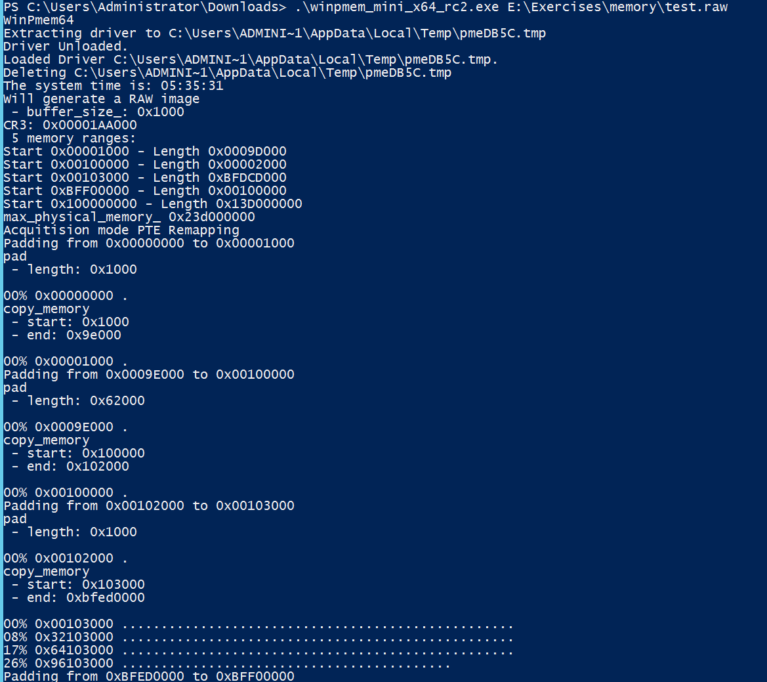
Acquiring Memory
Winpmem
Used to capture memory dump
Free
Comes in a standalone variant
Also apart of the rekall suite
Surge Collect
Used to capture memory dump
Not free
May see surge-collect.exe in command history of some memory dumps

Slide 6
Volatility
Open source memory forensics tool
Supports a variety of plugins
Plugins add additional functionality
Plugins installed in my version:
Prefetch
Autoruns
Can automate many memory analysis tasks
Can be downloaded here
https://www.volatilityfoundation.org/releases
Easier to use if you define a function in power shell
function vol { C:\Python27\python E:/Tools/volatility/vol.py --plugins=E:/Tools/vol_plugins/ -f E:/Evidence/PC1/data.lime --profile=Win7SP1x64 $args }
Can then be called using vol
vol imagelist

Slide 7
imageinfo
Provides information about the image:
Date and time of the machine when image was taken
Kernel build identifier
Recommended profile to use
Need to use imageinfo first to identify the profile to use with Volatility plugins
Default profile = WinXPSP2x86

Slide 8
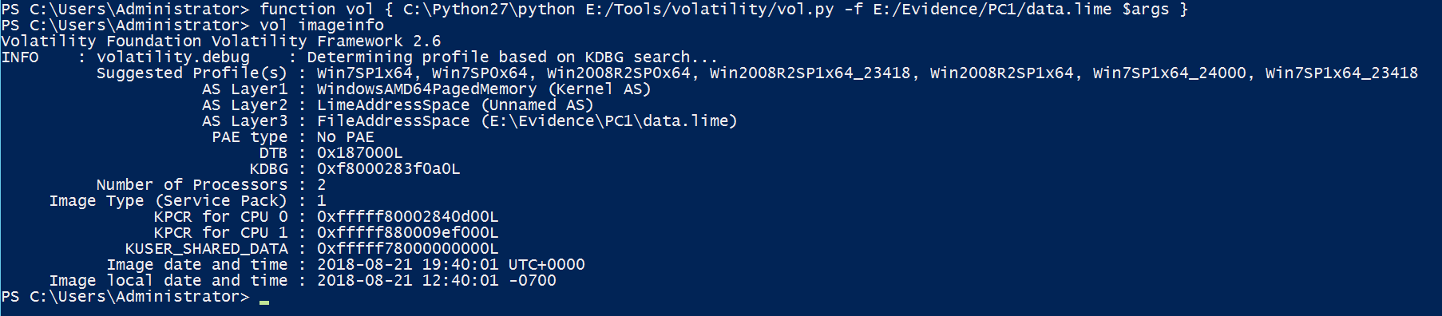
imageinfo

Slide 9
Process Tree
Hierarchy of standard processes
Each process has a process ID
Parent process:
process that has created one or more child processes
Child process:
process created by another process (the parent process)

Slide 10
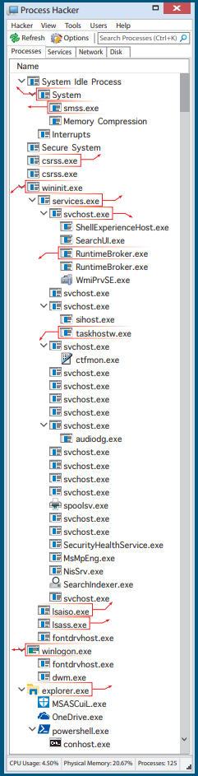
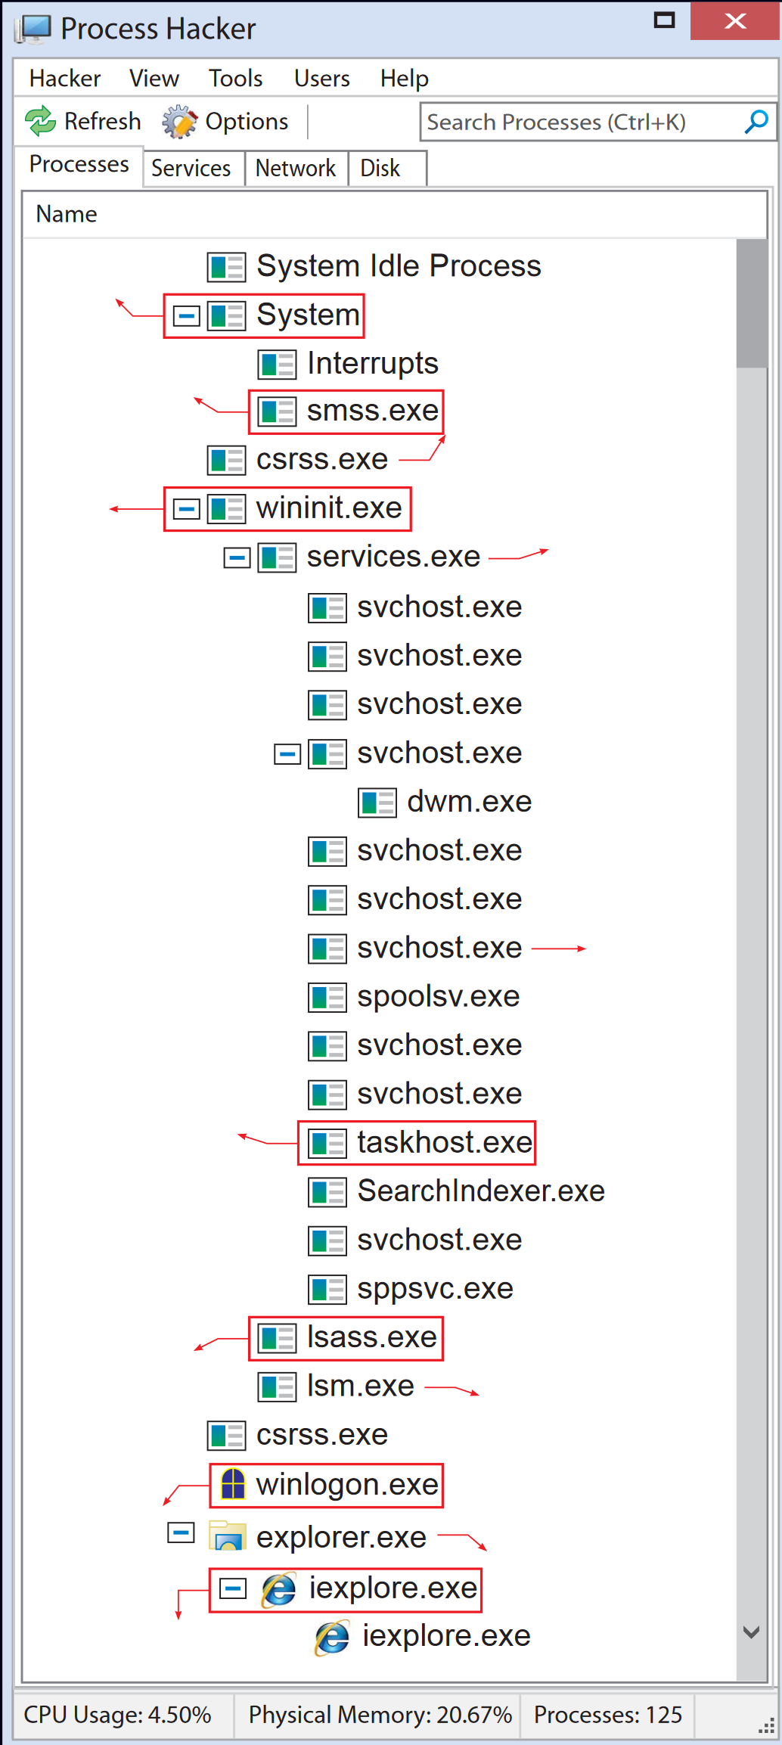
Process Tree

Slide 11
Critical System Processes
Csrss.exe
client/server runtime subsystem
Creates and deletes processes and threads
One csrss.exe per session
Watch for naming convention copying (csrsss.exe, cssrs.exe)
Services.exe
Windows service control manager (SCM)
List of windows services in private memory space
Should be the parent of any svchost.exe, spoolsv.exe, and searchindexer.exe
One copy of services.exe running from system32.exe

Slide 12
Critical System Processes
Svchost.exe
Multiple shared host services processing on a system
Container for DLL’s associated with a service
Should be in system32
Look out for scvhost.exe and svch0st.exe
Lsass.exe
Local security authority subsystem process
Enforces security policy, password verification, and creating process tokens
Target for injection
Clear text password hashes stored here
There should only be one lsass.exe, parents should be winlogon.exe and wininit.exe

Slide 13
Critical System Processes
Winlogon.exe
Interactive logon prompt
Initiates screen saver, loads user profiles, responds to secure attention sequence
Monitors files and directories for Windows File Protection (WFP)
Explorer.exe
One explorer.exe for each logged on user
Handles GUI folder navigation, start menu
Access to documents you have open and FTP credentials mapped through Windows Explorer
Smss.exe
Session manager for user-mode processes that start during boot sequence
Responsible for creating sessions that isolate OS services from users via console or RDP

Slide 14
Other Common Processes
Mail client
Web browsers
Office
Adobe
Memory Collection Tools
Other applications

Slide 15
Pslist, pstree, psxview
Pslist
Flat list of running processes at the time of the memory dump
Good place to start
Obvious malicious processes would show up here
Pstree
List of processes and their parent/child relationships
Similar to viewing a process tree with the Process Explorer
Psxview
Similar function to pslist, plus shows all of the areas in the memory image where the process is listed
Helps to identify hidden processes

Slide 16
psscan
Searches a memory image for (_POOL_HEADER) in order to find artifacts of processes, similar to file carving
Can find previously terminated processes
Can find processes that were hidden by a rootkit
Takes longer to run than pslist as it is scanning through the entire memory image
Offers more thorough results, but can lead to false positives

Slide 17
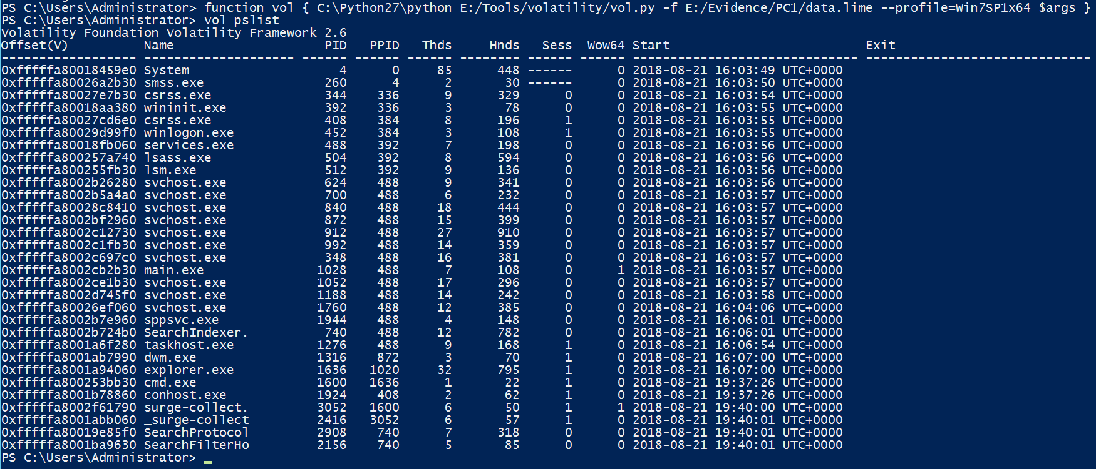
pslist

Slide 18
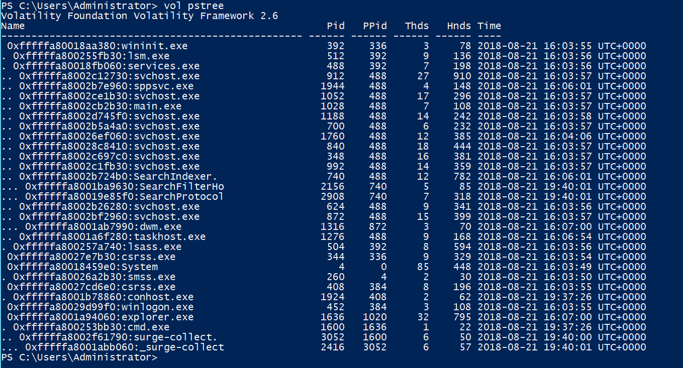
pstree

Slide 19
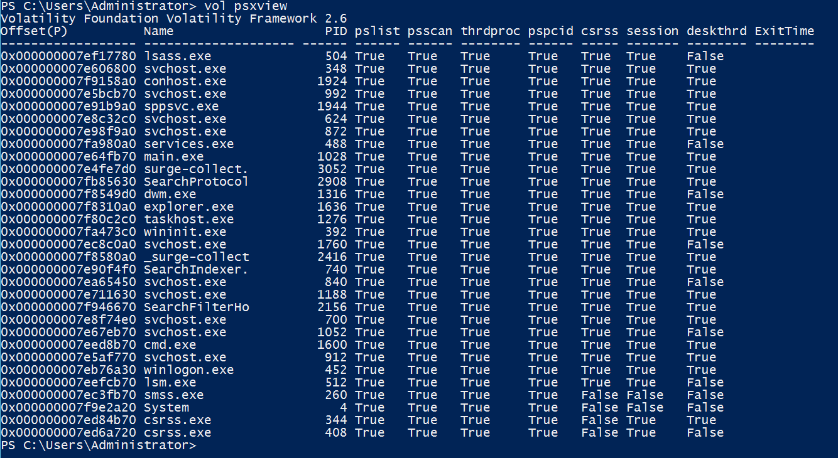
psxview

Slide 20
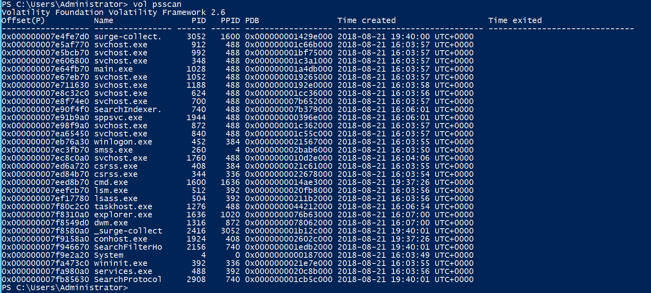
psscan

Slide 21
handles
Reference to open instance of a kernel object
Files
Registry Keys
Mutexes (mutants)
Named pipes
Processes
Threads
Normally you would look at the handles of a particular process

Slide 22
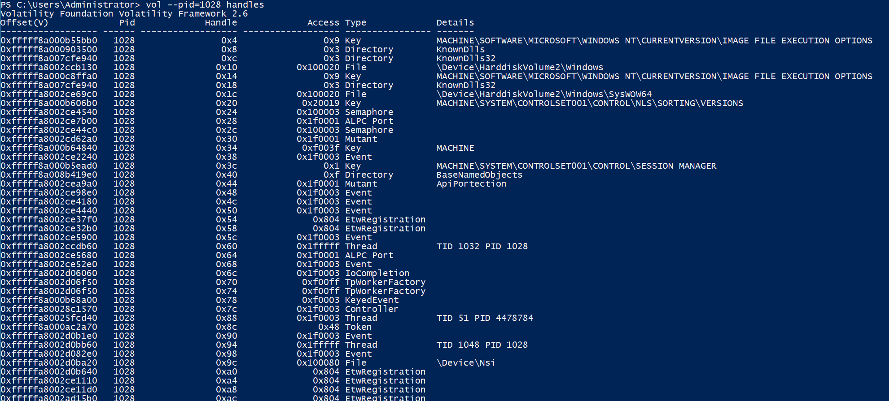
handles

Slide 23
Command Lines
Analyze command history using
cmdscan
consoles

Slide 24
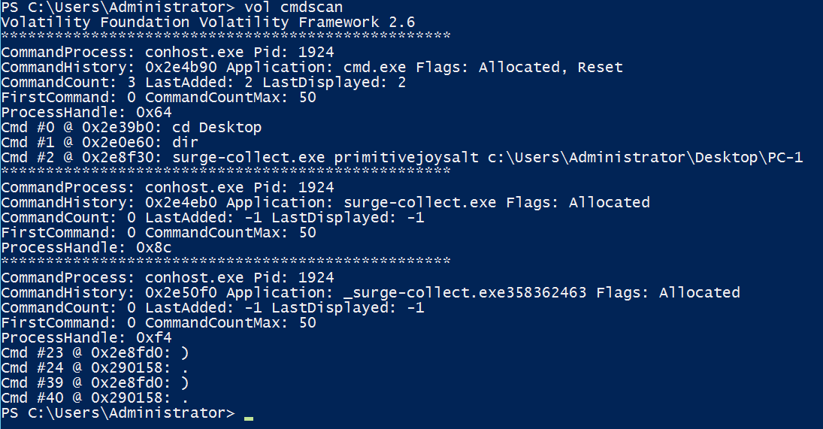
cmdscan

Slide 25
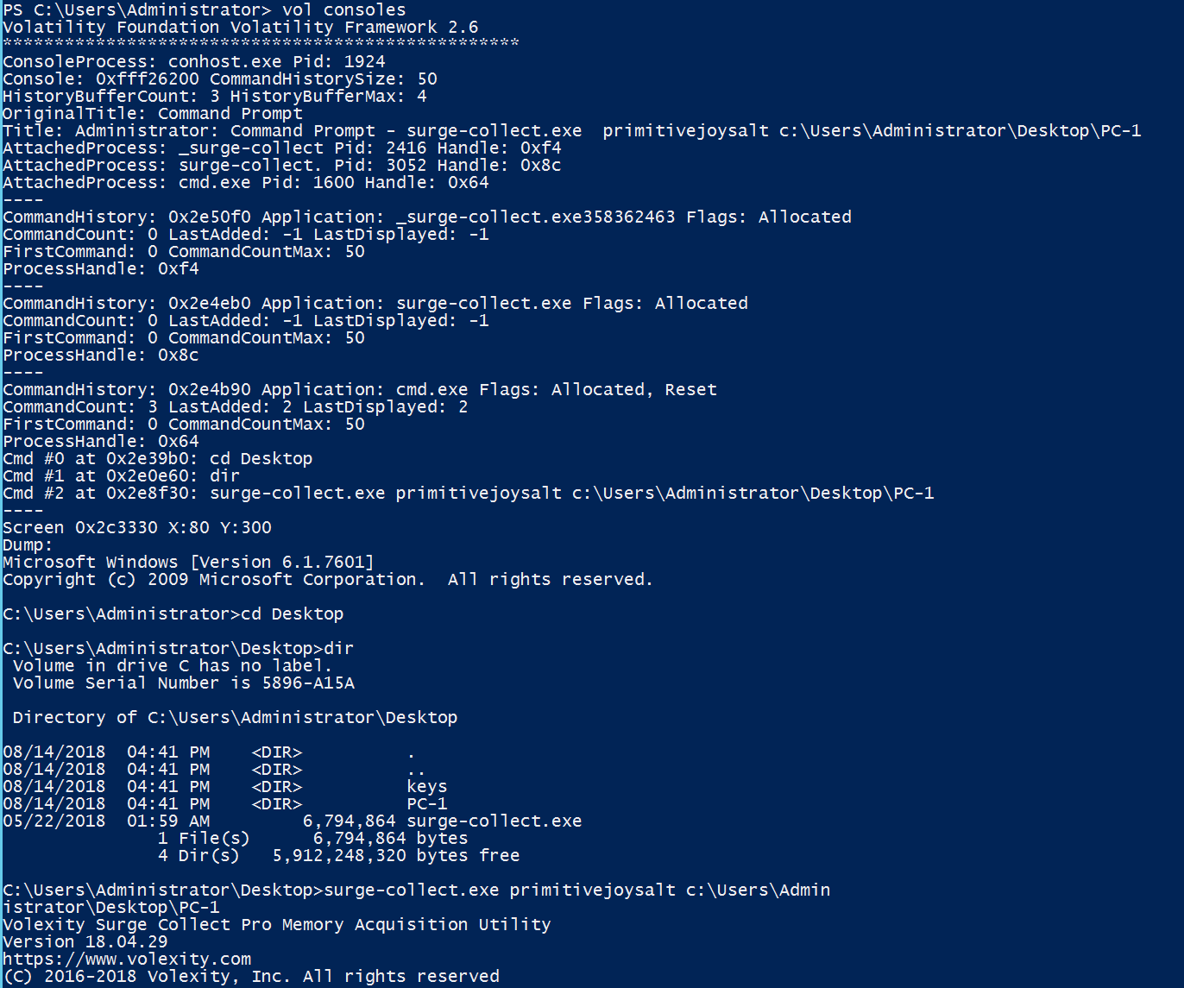
consoles

Slide 26
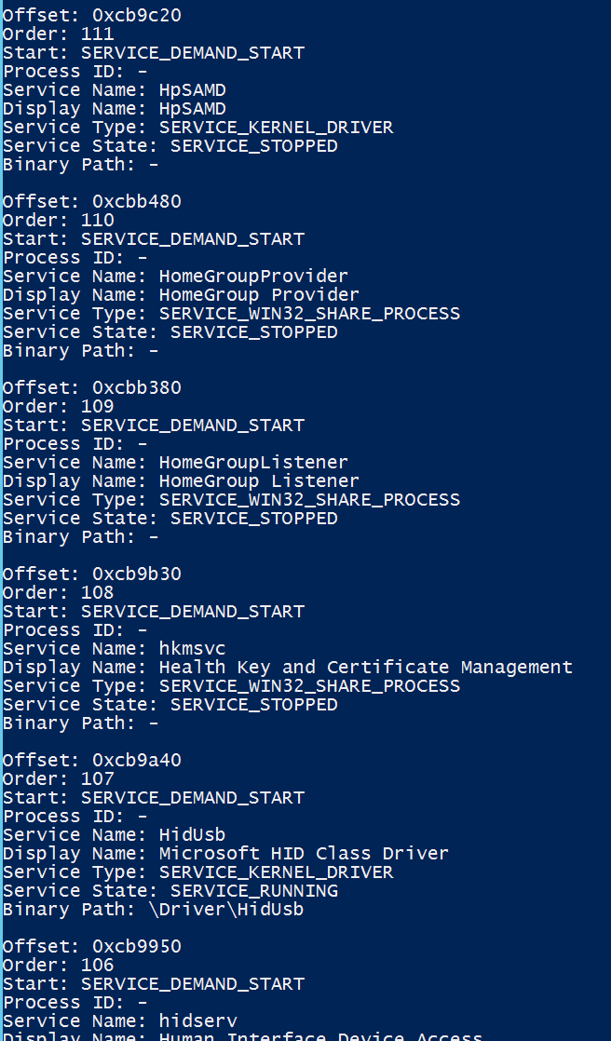
svcscan
List all running services using svcscan

Slide 27
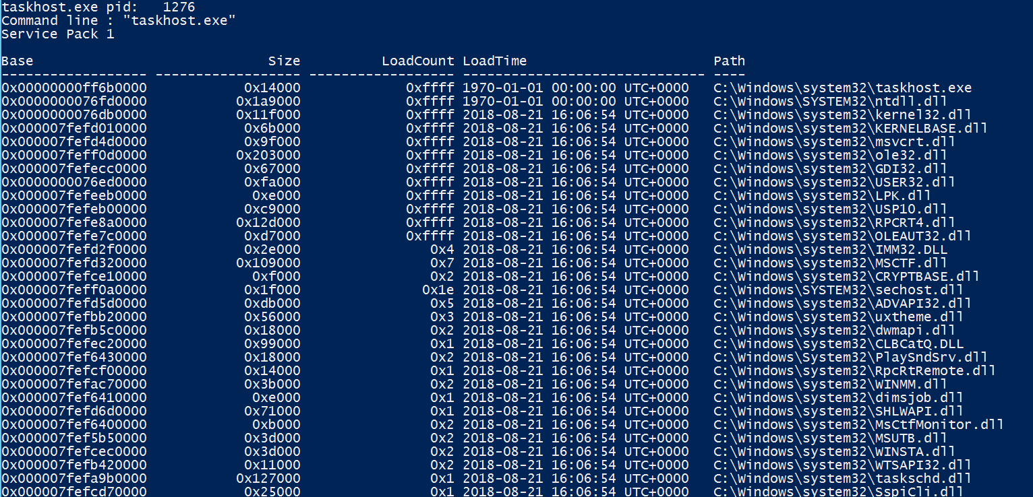
DLLs
Dynamic Link Library - Libraries loaded into memory along with a process
Useful to see if someone has injected a malicious DLL into the process
DLLList - List of loaded dlls by process

Slide 28
Sockets and Connections
Can view network connections using netscan
There are a few other network related commands that only work on older versions of windows (pre-Windows 7)
Sockets
Connections
connscan

Slide 29
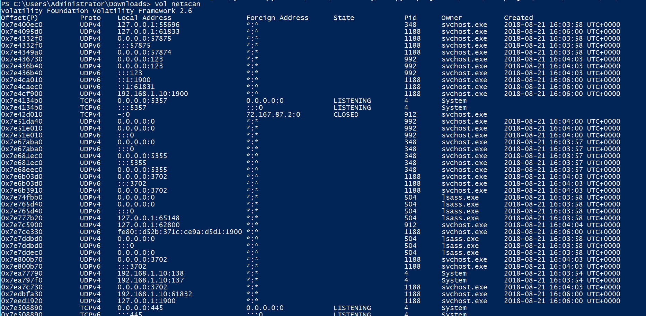
netscan

Slide 30
Dumping Files
Several ways to dump files
Moddump - module files
Dumpfiles - all files
Procdump - files relative to a process
Dlldump - dumps DLL files
Can use --regex and --pid options to narrow down dumped files
Can use --dump-dir to specify where dumped files should be placed

Slide 31
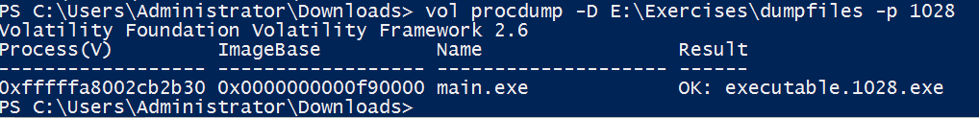
procdump/dumpfiles

Slide 32
Registry
The Windows registry is a “central hierarchical database used to store information that is necessary to configure the system for one or more users, applications, and hardware devices.”
Registry analysis is a whole other topic
Volatility has several ways to analyze the registry
Autoruns
Userassist
shellbags

Slide 33
Links
DFIR “Memory Forensics” Poster
https://digital-forensics.sans.org/media/DFPS_FOR526_v2.5_4-19.pdf
DFIR Hunt Evil Poster
https://digital-forensics.sans.org/media/DFPS_FOR508_v4.6_4-19.pdf
DFIR Find Evil Poster
https://www.sans.org/security-resources/posters/dfir-find-evil/35/download
Volatility Download
https://www.volatilityfoundation.org/releases
Volatility Profiles
https://raw.githubusercontent.com/volatilityfoundation/volatility/master/README.txt
Winpmem
https://github.com/Velocidex/WinPmem/releases/tag/v4.0.rc1

