Slide 1
Threat Intelligence
And
Network Analysis

Slide 2
Threat Intelligence

Slide 3

A Good Place to Start
https://attack.mitre.org/
The Mitre Framework is almost like a wiki of all the real world applications of Cyber Threats
Split into Tactics, Matrices, Techniques, Mitigations, Groups, Software, and Resources

Slide 4
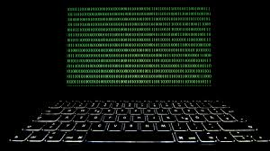
What is an Advanced Persistent Threat
APT for short
This term stands for when a group exploits, gains access, and maintains access for an extended period of time
The threat actor will avoid suspicion and discovery from blue teams
It is assumed these groups have a large amount of funding
They aren’t your typical Script Kiddie

Slide 5
Mitre Framework Methodology
Initial Access - finding a vulnerability
Persistence - Service Manipulation
Privilege Escalation - su to root
Defense Evasion - bypassing uac
Credential Access - dumping hashes
Discovery - enumeration
Lateral Movement - pivot to other machines
Collection - find data
C2 - Command and Control
Exfiltration - take data
Impact - larger implications
https://attack.mitre.org/techniques/enterprise/

Slide 6
Mitre Att&ck Framework Groups
This is where you can see some of the techniques and tactics associated with certain APTs
Exploiting a system is a little bit like a handwriting signature
Everyone has a different way of doing it
The signature can be correlated to other attacks
With a good enough sampling it can be inferred who the possible group was that committed the attack

Slide 7
Current Events
Drovorub
Malware discovery recently released to the public
Alleged nation state APT software toolkit
https://media.defense.gov/2020/Aug/13/2002476465/-1/-1/0/CSA_DROVORUB_RUSSIAN_GRU_MALWARE_AUG_2020.PDF
You can see the groups that use this are associated with some of the groups on Mitre’s Website!
The term Drovorub stands for woodcutter

Slide 8
Current Events
Election Security
Tyler Technologies Indicator Of Compromise
Government Contractor
Produces software for displaying voting results from elections
Produces guides on how to prevent ransomware attacks
https://krebsonsecurity.com/2020/09/govt-services-firm-tyler-technologies-hit-in-apparent-ransomware-attack/

Slide 9
Network Analysis

Slide 10
What is network analysis?
Process of intercepting, recording, and analyzing network traffic in order to detect and respond to security threats
Goals:
Identify anomalous behavior
Add context to an incident (incident response)
Identify potential weak spots in the network

Slide 11
SIEM - Security Information and Event Management
Focused on aggregating data to a central location
Network data
Threat intelligence data
Endpoint data
Machine status
Once the data is collected and put into the centralized database a wide variety of things can be done with the data
Analysis of the data to detect attacks
Correlation of data across different data sources
Machine learning to detect anomalous behavior
Useful in performing forensics in the event of an attack

Slide 12
Network IDS/IPS
Intrusion Detection System (IDS)
Monitors your network for possible dangerous activity, including malicious acts and violations of security protocols
May alert an administrator, but doesn’t necessarily take any action
Signature Based:
Relies on a preprogrammed list of known attack behaviors, which trigger the alert
Anomaly Based:
Uses a model of normal behavior on the network to alert an admin anytime it detects any deviation from that model
Intrusion Prevention System (IPS)
Takes action based on Intrusion Detection
Reject data packets, give commands to a firewall, sever a connection

Slide 13
Honeypot
A trap for hackers or other bad guys
Mimics a vulnerable target and uses intrusion attempts to gain information
Can monitor network activity in particular
Examples:
Decoy Database
Full of bogus info
If someone queries that database, you’ve been compromised
Malware Honeypot
Mimics a vulnerable application or computer
Analyze the network traffic from this to make new signatures for the IDS/IPS

Slide 14
Network Protocols
A protocol provides a mechanism by which systems can communicate by establishing a set of rules and common message format
Allows connected devices to communicate with each other, regardless of differences in internal processes, structure, or design
Different protocols are used to communicate through the various network layers

Slide 15
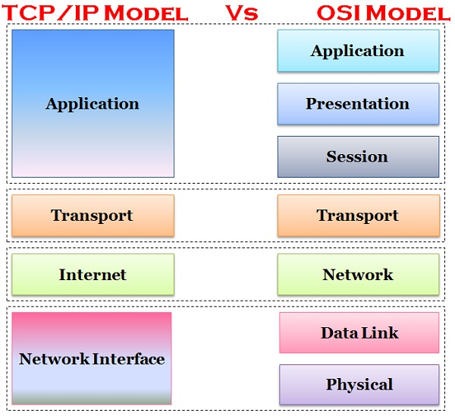
Network Models
Lower layer services provides services to higher layers
Higher layer services use services of lower layers

Slide 16
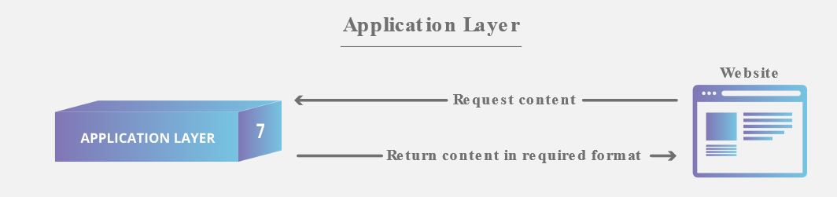
Application Layer
Provides services for application programs
Directly interacts with data from user
Top layer - relies on all the layers below it to complete its process
Protocols:
HTTP, HTTPS, FTP, SSH, DNS

Slide 17
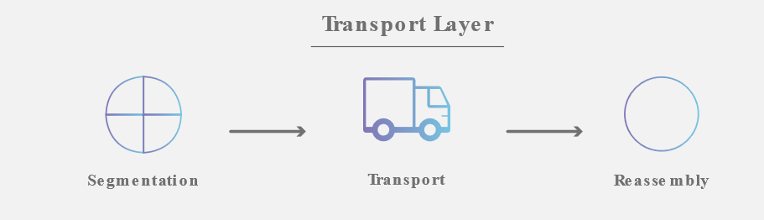
Transport Layer
Responsible for end-to-end communications between two devices
Protocols:
TCP
Connection Oriented: Three Way Handshake
Divides messages into segments
Provides reliable data transfer at the cost of additional delay and overhead
UDP
Connectionless
Best effort process

Slide 18
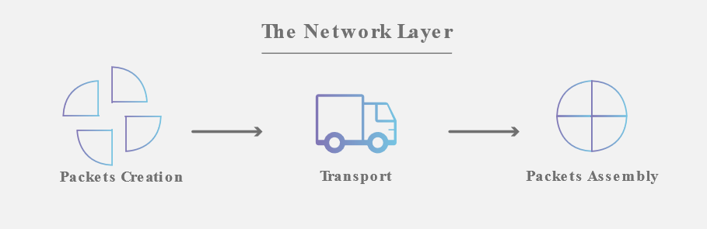
Network Layer
Facilitates data transfer between two different networks
Data is transferred in the form of packets via network paths
Protocols:
IP - Internet Protocol
ICMP - Internet Control Message Protocol

Slide 19

Data Link Layer
Handles moving of data into and out of a physical link in a network
Protocols:
ARP: Address Resolution Protocol
IP to MAC Address
RARP: Reverse Address Resolution Protocol
MAC to IP Address

Slide 20
Packet Sniffing
Practice of gathering, collecting, and logging some or all packets that pass through a computer network, regardless of how the packet is addressed
Two Types:
Hardware
Designed to be plugged into a network and to examine it
Software
Changes configuration so that the network interface passes all network traffic up the stack, which is known as promiscuous mode.
Logs all software packets that pass the interface, regardless of their destination addresses.

Slide 21

Wireshark
Free, open source packet analyzer
Allows us to do live packet captures and examine packet contents
https://www.wireshark.org/download.html

Slide 22
Wireshark Demo

Slide 23
Malware Traffic Analysis
Identify unusual network behavior
Determine what computers are infected
Determine source of malware
Where to practice:
https://www.malware-traffic-analysis.net/

Slide 24
Where to practice
ctf.cs.umass.edu
forensics09 - forensics13
ctf.auburn.edu
Animal Crossing, Fahrenheit 451
picoctf.com
Shark on Wire challenges
www.malware-traffic-analysis.net

