Slide 1
Web App Tools
死神

Slide 2
Discovery

Slide 3

Gobuster
Syntax
gobuster dir -u http://10.10.31.210 -w /usr/share/wordlists/dirbuster/directory-list-2.3-medium.txt
Gobuster is faster than dirbuster and in the CLI
This is a directory traversal tool
HTTP Responses
100s - Informational Responses
200s - Successful responses
300s - Redirects
400s - Client errors
500s - server side errors

Slide 4
Wordlists on Kali
Each Kali workstation comes pre-packed with plenty of wordlists to use for web app testing
Change directories to /usr/share/wordlists
Here you can check some of them out
The dirb/dirbuster wordlists typically have the best for web app fuzzing
https://tools.kali.org/password-attacks/wordlists

Slide 5
Nikto
Web Scanner
Can find SQL and XSS vulnerabilities fairly easily
Won’t exploit for you
Logs to metasploit
Syntax
nikto -h fireinthehole.com
https://tools.kali.org/information-gathering/nikto

Slide 6
CMS (Content Management System) and Automation Servers
Where a web administrator or network engineer can create and modify web/system content
Examples
Wordpress
Joomla
Drupal
Jenkins

Slide 7
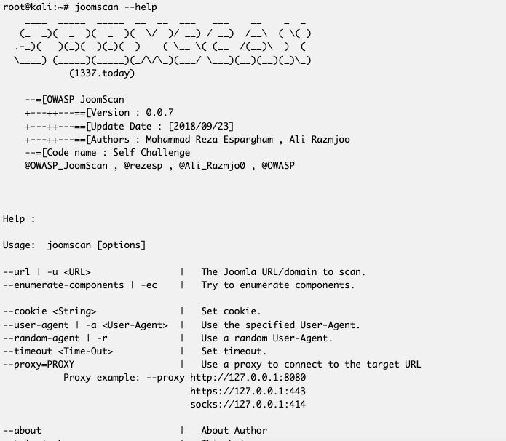
JoomScan
https://tools.kali.org/web-applications/joomscan

Slide 8
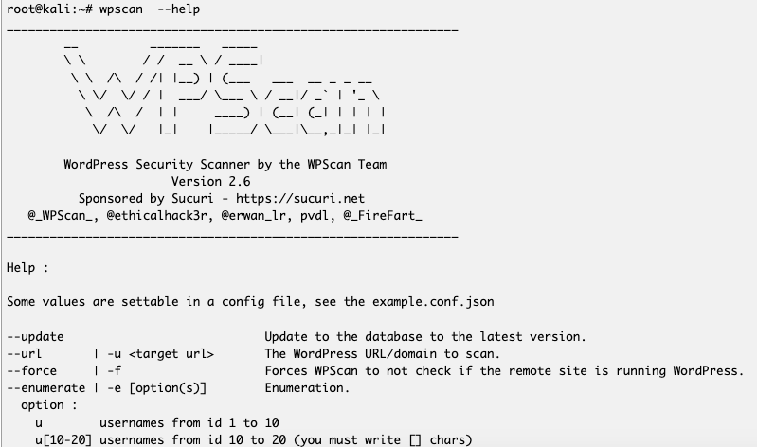
wpscan

Slide 9
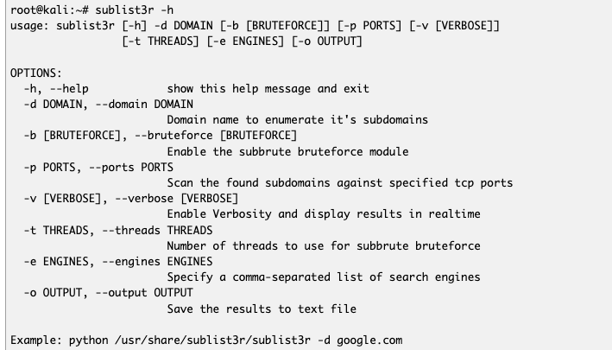
Sublist3r
A good substitute for gobuster

Slide 10
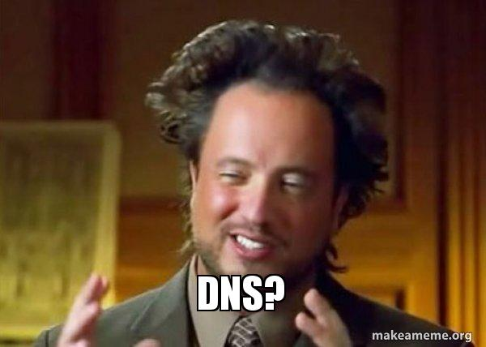

Slide 11
DNS What is it?
Domain Name System Port 53 TCP/UDP
It’s a phone address book for the internet!
It takes an IP like 172.16.31.200 and gives it a URL
Went over it in OSINT a bit however it directly factors into our current lesson
Example: 8.8.8.8 is the primary DNS Server for google
Good for debugging

Slide 12
DNS Tools
dnsrecon
Can perform zone transfers
dnsenum
Enumerates DNS
dnsmap
Searching subdomains /usr/share/wordlists
WRITE YOUR OWN
Bash script for discovering nameservers!
for ip in $(seq 50 100); do host <random ip>; done | grep -v “not found”

Slide 13
Exploitation

Slide 14
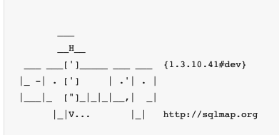
SQLmap
Syntax
python sqlmap.py -u ‘http://mysite.com/page.php?id=5’
SQLmap is extremely powerful tool designed to perform sql injections on target urls.

Slide 15
Manual things
Always try username/password combos
admin:admin
tomcat:tomcat
Use inspect element
Check various parameters
Check use of special characters in login forms

Slide 16
Multi-Faceted Tools

Slide 17
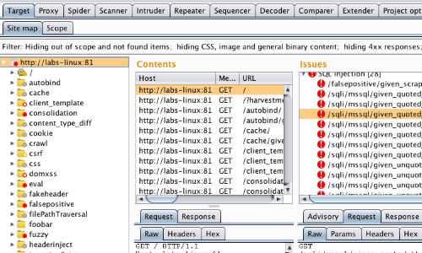
Burpsuite
Made by PortSwigger
Do tryhackme’s burp room (must pay for subscription) if you want a great tutorial
Look into FoxyProxy too

Slide 18
DEMO & Lab’s
Look into:
Hackthissite
Tryhackme

