Slide 1
Back to Basics
Kali Linux / Ubuntu
Easily the most complete systems for CTFs and security in general
Installation through a Virtual Machine(VM) or bootable from a flash drive/CD.
VMs are run using Virtual Machine software
VMWare Player and Virtual Box are the best ones
Only downside is when you're doing wireless security
ISOs on respective websites, VMs on offensivesec

Slide 2
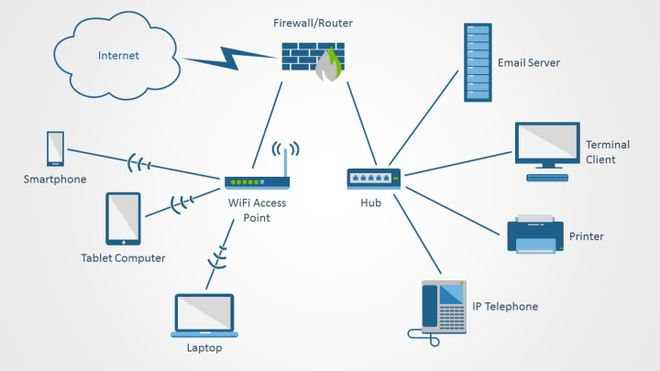
Networks
A bunch of things connected to a single thing
They all have IP addresses and ports
Talk to one another by sending packets

Slide 3

Now what…?
Nmap - “Network Mapper”
Open source tool
Network exploration and security auditing
Designed to rapidly scan large networks
Can find info including:
Hosts
Services and operating systems
Packet filtering and firewalls
Etc etc etc etc

Slide 4
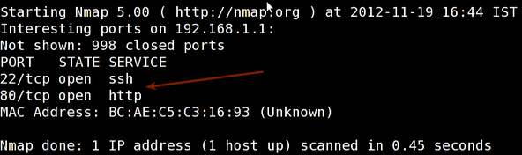
nmap: Scanning a host
Scan a single host with IP Address (IPv4)
nmap 192.168.1.1
nmap server.example.com
nmap -v server.example.com

Slide 5
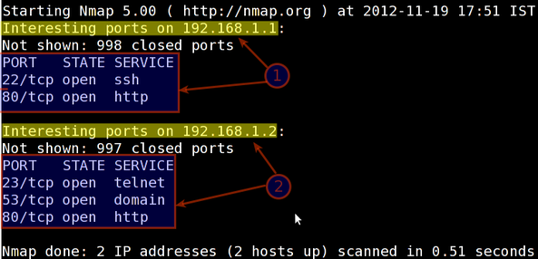
nmap: Scanning more things
Scanning a block or subnet
nmap 192.168.1.1 192.168.1.2 192.168.1.3
nmap 192.168.1.1-20
nmap 192.168.1.*
nmap 192.168.1.0/24
nmap 192.168.1.0/24 –exclude 192.168.1.5

Slide 6
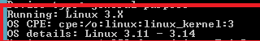
nmap: Getting some info
OS / Version Detection
nmap -A 192.168.1.254
nmap -v -A 192.168.1.1
nmap -O 192.168.1.1
Firewall protection
nmap -sA 192.168.1.254
nmap -PN 192.168.1.1

Slide 7
nmap: Specifying ports
Specific Ports
nmap -p 80 192.168.1.1
nmap -p T:80 192.168.1.1
nmap --top-ports 5 192.168.1.1
Detecting Services
nmap -sV 192.168.1.1

Slide 8
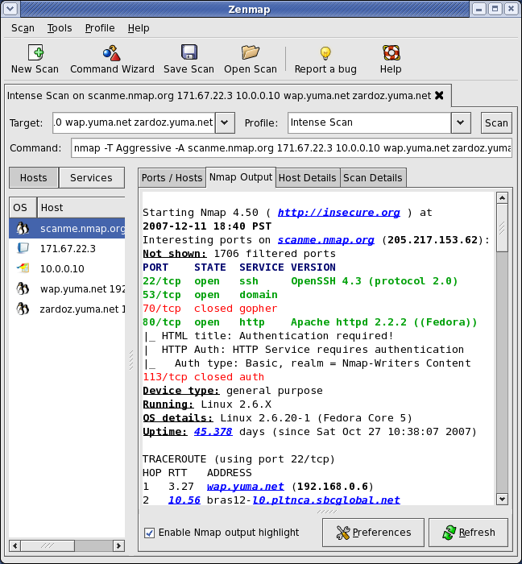
GUI
Zenmap
sudo apt-get install zenmap

Slide 9
Memory Forensics with Volatility
What is memory forensics?
Imagine taking a snapshot of a computer, grabbing its processes, files, policies, users, settings, etc.
Shove all of those things into a .img or .mem file
Extract the information from it without messing with the actual computer
Use case: FBI man finds a laptop that was used to commit a crime, he wants to do an investigation without tampering with the actual laptop

Slide 10
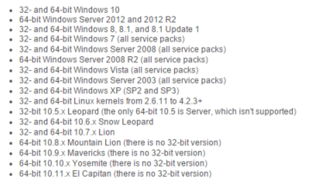
Volatility
Python based tool for memory and disk forensics
Most widely used memory forensics application
Used to find processes, files, information on the operating system and everything in between

Slide 11
Volatility
Basic information about the file
Imageinfo
Operating system being used
Some hardware information
Dates and times
Process information
Psscan / pslist
Gives process names, PIDs, Start times, etc

Slide 12
Volatility
Clipboard information
Connection / Networking Information
connections
Malware Detection
malfind
Crash / Hibernation Reports
crashfind / hibfind

Slide 13
Volatility
Registry Searching
Hivelist
Dumps the hives in current memory locations
Printkey
Prints the key and subhives associated with a given hive
Hivedump / hashdump
Dumps hives and hashes at certain memory addresses
Especially useful for getting password hashes

Slide 14
Volatility
Getting WindowsXP Service Pack 2 NTLM hashes
Volatility imageinfo –f memfile
Volatility hivelist –profile=WinXPSP2x86 -f memfile
Volatility hashdump -f memfile –profile WinXPSP2x86 -y 0xe10181f0 -s 0xe1271ae0 > hashs.txt

