Slide 1
Commonly used CTF Tools

Slide 2


Kali Linux
Based on BackTrack Linux
Collection of tools for pen-testing/forensics.
Comes pre-installed with most of the tools used in CTFs
VMWare/Virtual Box images available on Offensive-Security

Slide 3
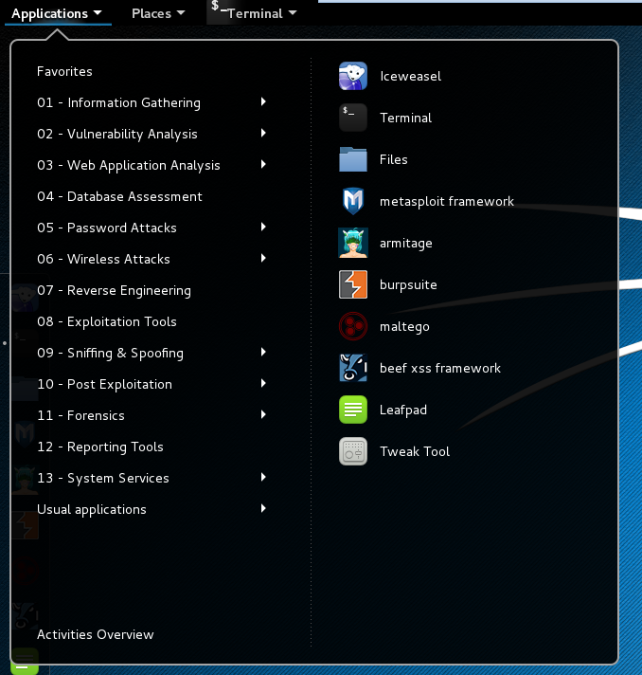
Tools
Web Application
Password Attacks
Reverse Engineering
Forensics
Other

Slide 4



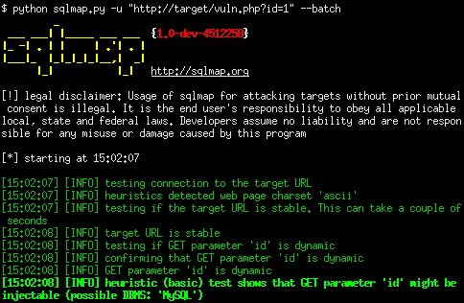
Web Applications
BurpSuite
OWASP-zap
HTTrack
SQLmap

Slide 5


Password Attacks
Hashcat
Medusa
RainbowCrack
John/Johnny
ophcrack

Slide 6




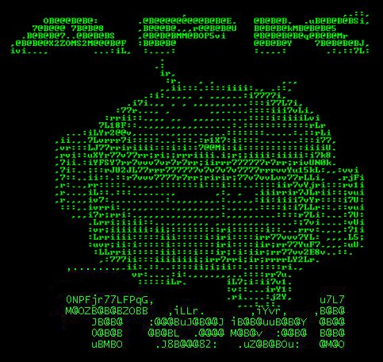
Reverse Engineering
OllyDbg
IDA Pro
Dex2Jar
Radare2
APK Tool

Slide 7
Forensics
Binwalk
Foremost
Scalpel
Magicrescue
Googling “Steg tools” and trying every option that starts with Steg
DFF
Volatility

Slide 8



Other
Wireshark
Aircrack-ng
nmap

