Slide 1
Enumeration
The First Step

Slide 2
Agenda
Clerical Stuff
Pentest / Scope?
The HackLab
Networking Basics
Basic Host Discovery
Nmap
Moving Forward

Slide 3

What's a pentest?
White hat
Paid to hack people
Black box vs White (clear) box
Scope?
The "things" you're supposed to test
In our case: the game, and definitely not AU_WiFi

Slide 4
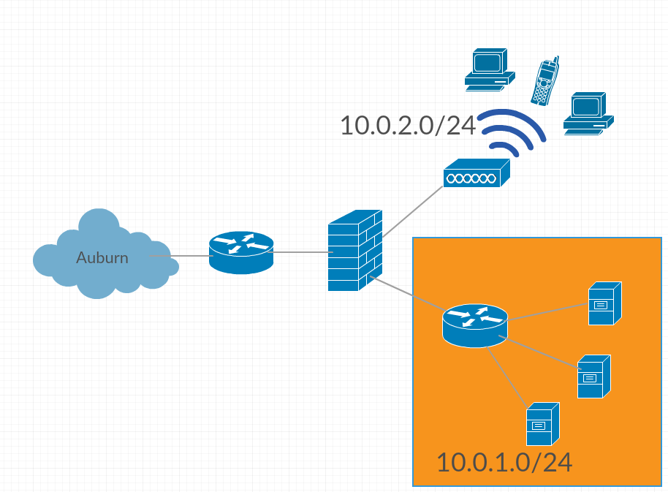
Hack-Lab
auctf / auctf_5ghz
!!auctf2016
VPN: Next Week

Slide 5
Points of Interest
10.0.2.0/24 - The Player Network
10.0.2.3 - File Server
10.0.2.4 - Overseer
10.0.1.0/24 - The Scope
10.0.1.4 - 10.0.1.254
Important boxes get reset every 24 hours so don't bother

Slide 6


Networking Basics
IP: 192.168.1.124
Netmask: 255.255.255.0
Gateway: 192.168.1.1
Subnet
IP Address
Packet
Ports
Router

Slide 7
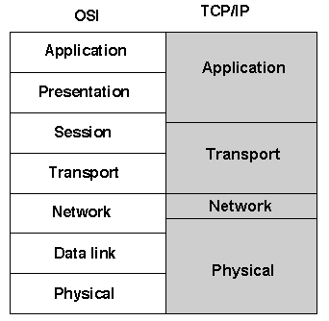

Networks == Onions
Telnet
TCP / UDP
Ping
ARP
MAC

Slide 8

Ping
ICMP – Layer 3
Most basic host discovery option
ping –c 4 10.0.2.2

Slide 9

Tracert
Traces routes
Good for information gathering / troubleshooting
traceroute 10.0.1.15
tracert google.com

Slide 10

ARP
Address Resolution Protocol
Sits between layer 2 and layer 3
Hardware Addresses <=> Internet Addresses
arp -a

Slide 11
Host Discovery With ARP
Arp-scan / netdiscover
Limited to subnet, so we can only scan 10.0.2.0/24
sudo arp-scan 10.0.2.0/24 -I wlan0
sudo netdiscover -r 10.0.2.0/24 -i wlan0

Slide 12

Port Scanning
Probing ports and analyzing responses
Open vs Closed vs Filtered
Looking for attack vectors

Slide 13
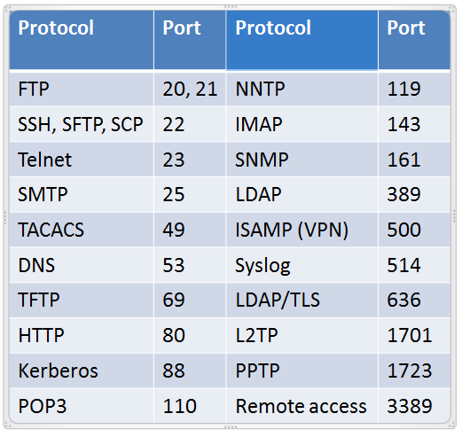
Common Ports
Secure vs Insecure
SSH vs Telnet
SFTP vs FTP vs TFTP

Slide 14

nmap
The Go-To port scanning / host discovery utility
nmap 10.0.1.16
nmap 10.0.1.0/24 --exclude 10.0.1.1-2
nmap –p 80 10.0.1.0/24
nmap –sV 10.0.1.16

Slide 15

OS Detection
Can be used to determine more info
nmap –v –A 10.0.1.0/24
xprobe2 10.0.1.xx
Sometimes totally breaks

Slide 16

GUI Alternatives
Gives you an easier to look at overview
Not possible to do when sshing into our network
Zenmap
Sparta

Slide 17
Other Scanning Stuff
Mass-Scan
Shodan.io
Snmpwalk / finger enumeration / etc
Nessus Scanning

Slide 18
Next Steps
Can't do much without knowing where you're going
Nmap scanning is integral to metasploit / armitage
Once you know services and ports you can move towards exploitation

Slide 19
Contacts, Website, Mailing List, etc...
V@auburn.edu | mr@auburn.edu | jss0040@auburn.edu
Auctf.github.io
#auctf on auburnacm.slack.com
Goo.gl/HjJW7u - Mailing List

