Slide 1
Ethical Hacking Club Kickoff
January 2021

Slide 2
WELCOME!

Slide 3
Current Leadership
President - Charles Harper
Vice President - Ethan Johnson
Treasurer - TBD
Secretary - Jonathan Aldridge
Public Relations - Vicki McLendon
Web Manager - TBD
Technical Leads - Jordan Sosnowski, Zachary Leggett
Group Lead - Tripp Isbell
Faculty Advisor - Dr. Tauritz

Slide 4
Needed Positions
Treasurer - is responsible for managing sponsor relationships and creating new sponsor relationships, as well as, handling interactions with the university on how and when money can be spent. Experience interacting with companies/sponsors and interacting with university financial officials may be useful but is not required.
Web Manager - is responsible for posting the weekly write ups, event updates, and also general club information to the website. They would also be actively working to improve the appearance and functionality of the website as they and the other club officers see fit. Experience in using jekyll/web development would be useful but is not required.
Contact - ethan.johnson@auburn.edu or charles.harper@auburn.edu

Slide 5
T-Shirt Competition Update
Have not received many applications
Pushing back a month
Keeping sending in your submissions

Slide 6
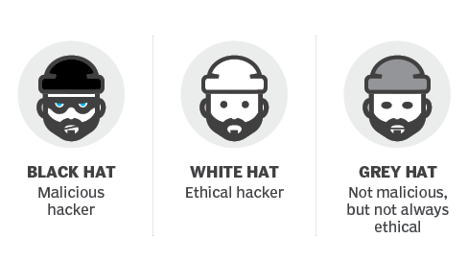
Hacker Spectrum

Slide 7
Warning
For this club, DO NOT hack, probe, prod, or analyze any system unless given explicit (preferably written) permission by the owner of the system.

Slide 8
Why Choose Cybersecurity
Worldwide spending on cybersecurity is forecasted to reach $170.4 billion in 2022.
Only 5% of companies’ folders are properly protected, on average.
Security breaches have increased by 11% since 2018 and 67% since 2014.
Damage related to cybercrime is projected to hit $6 trillion annually by 2021.
By 2021, it’s projected that there will be 3.5 million unfilled cybersecurity jobs globally.
The cybersecurity unemployment rate is 0% and is projected to remain there through the end of 2021.
Most jobs can be done remotely
https://www.varonis.com/blog/cybersecurity-statistics/

Slide 9
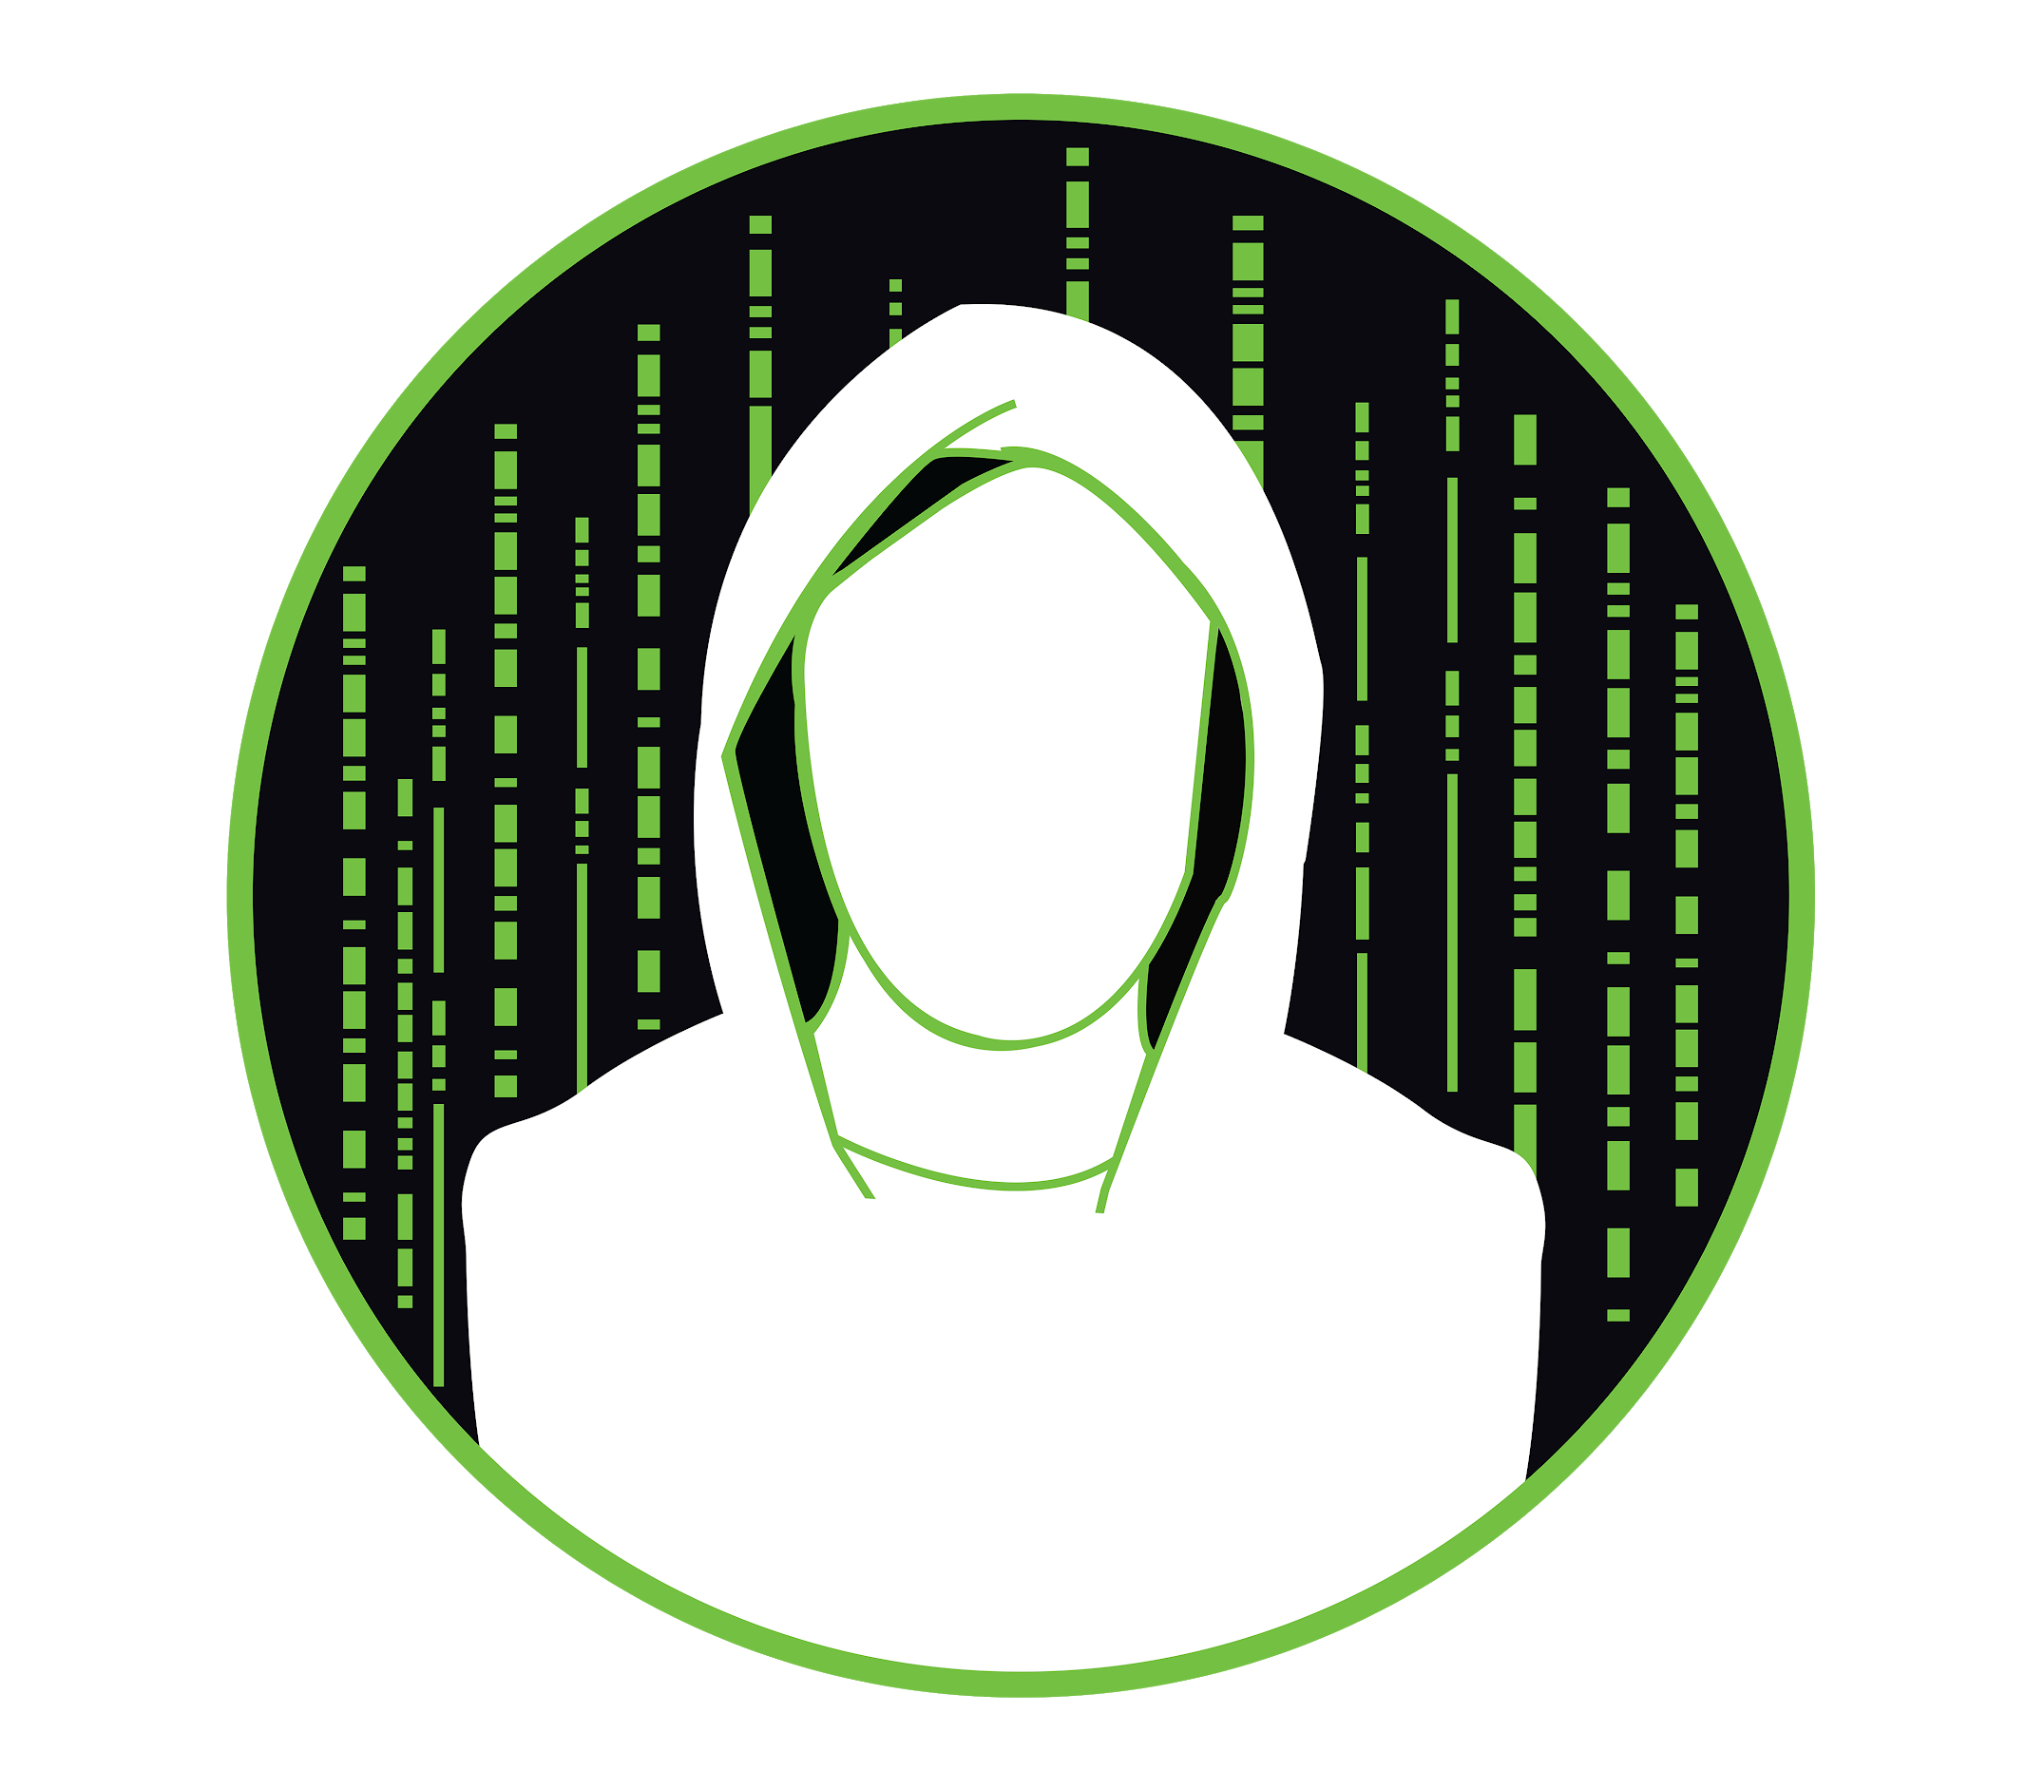


What We Do
Weekly Meetings on Cybersecurity Topics
Weekly Talks from Members
Cyber security Focused Projects
“Capture the Flag” and other Cyber Security Focused Events
AUCTF 2021, Auburn’s own CTF Event
Trip to DEFCON in Las Vegas, NV

Slide 10
What if I Cannot Make the Meeting
Our slide deck for each meeting will be posted in the discord
Write ups for each meeting will be posted to the website
Meetings will not be recorded at this time
https://ehc.auburn.edu/

Slide 11

Offensive Security vs Defensive Security
Privilege Escalation
Scanning
Penetration Testing
Web Application Hacking
PWN
Video Game Hacking
Digital Forensics
Memory Forensics
Network Forensics
Reverse Engineering
Code Analysis
Malware Analysis

Slide 12
Tentative Plans for Spring 2021
Forensics
Disk, Memory, Network
Reverse Engineering
Static / Dynamic Analysis, Ghidra, Assembly Crash Course,
Video Game Hacking
Binary Exploitation
Buffer Overflows, Format String Vulnerabilities, ASLR, ROP

Slide 13
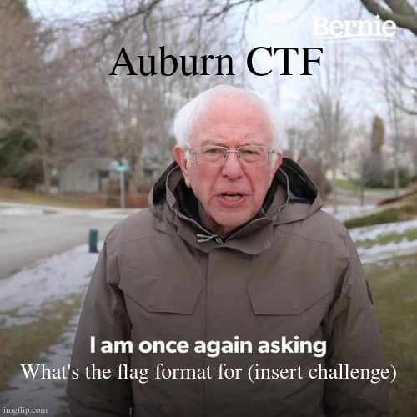
AUCTF 2021
Scheduled for the beginning of May
Prizes
TBD
Club participation will help prepare you for the challenges
Categories include but not limited to:
Web
Bash
Forensics
Reversing

Slide 14
Other Plans for Spring 2021
Member talks - can be about anything cyber / computer related, reach out to an admin to schedule a time/meeting
Club Projects - the attack defense project is actively being worked on, any other projects that members show interest in
Cybersecurity Events - if you have a CTF you would like to participate in as a club reach out to an admin and we will try to organize a club team

Slide 15

Survey
https://aub.ie/ehc-spring2021

Slide 16
Questions?
?

Slide 17
Tools for Next Week
Required
Active Disk Editor
A hex editor of choice
HxD
Visual Studio Code - Hex Editor Extension
010 Editor (Not Free)
Optional (but useful)
SANS Forensics VM

