Slide 1
Rogue Access Points attacks
EVIL TWIN

Slide 2
What is a rogue access point (AP)
A rogue access point is a wireless access point that has been installed on a secure network without explicit authorization from a local network administrator, whether added by a well-meaning employee or by a malicious attacker.
Think setting up a router in your dorm room

Slide 3
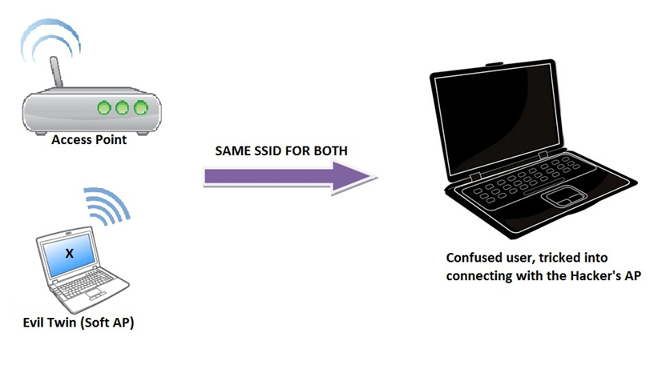
Evil Twin

Slide 4


“Starbucks Wifi” Channel 6
Rogue Access Point
“Starbucks WiFi”, Channel 6

Slide 5
“Starbucks Wifi” Channel 6
Rogue Access Point
“Starbucks WiFi”, Channel 6

Slide 6
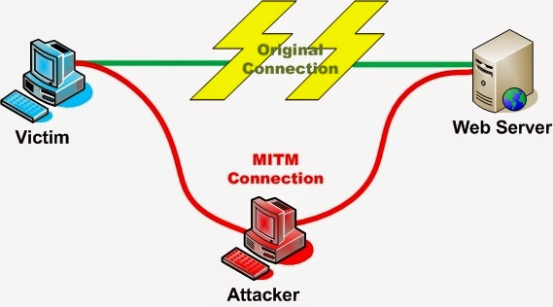
Man in the Middle

Slide 7
Advantages of Evil Twin Attacks
Relatively easy to perform
Hard to Detect
Targeted attack
Doesn’t pwn everything in the area

Slide 8
Disadvantages of Evil Twin
Doesn’t work against protected network out of the box
Workaround
Listen for probe requests
Identify ESSID and Channel of network that client have in common
Spin up twin with ESSID and Channel
Deauthorize secure network

Slide 9
Detecting Evil Twins with Whitelisting
Whitelist all legitimate access points by bssid and mac address
Sniff continuously for probe responses
If probe response of essid, and the bssid is not in the whitelist, then it’s a rogue AP
Deauth rogue AP

Slide 10
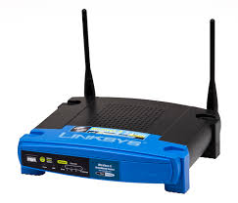
“I have ESSID ‘Starbucks’”
IDS
Whitelist:
00:11:8A:B7:9F
22:33:44:55:66
99:99:99:99:66
Is 11:22:33:44:00 Allowed?
IDS
IDS
No
Whitelist:
00:11:8A:B7:9F
22:33:44:55:66
99:99:99:99:66
Deauth
IDS
Find a sys admin

Slide 11
Can spoof BSSID/mac
Rouge AP can be set up with same BSSID and MAC.
For all intents and purposes looks exactly like legitimate AP

Slide 12
Other methods?
Detect using varying signal strength.
Establish baseline and check if it varies much.
Note if the hacker figures out the signal strength you can modify it on a wireless card
“iwconfig wlan0 txpower 30”

Slide 13
Karma Attack
Seeks out WiFi requests from nearby devices
Responds that it is the droid wireless signal they are looking for
Pwns all nearby networks

Slide 14
Evil Twin DEMO

Slide 15

Wireshark
Packet Sniffing
Uses PCAP files to see everything on the network
“Just look at it”™
Reason 1 for not doing anything important on insecure WIFI

Slide 16
Wireshark Demo

