Slide 1
Open Source Intelligence
September 2020

Slide 2
Open Source Intelligence (OSINT)
Many of you may be more familiar with OSINT than you think you are. Have you gone down a rabbit hole and tried figuring out where a random picture you saw online was taken? Have you ever done some investigating in trying to find out who wrote that song on the radio was?
If you used publicly available information, like the internet, to find your answers then you did OSINT.
In this lecture we will discuss a few techniques that can help you find information effectively. Some of the techniques you may have seen before, but others may be completely new.

Slide 3
Excellent Resources
The OSINT Framework: https://osintframework.com/
Michael Bazzell’s Open Source Intelligence Techniques: https://www.amazon.com/dp/169903530X/ref=cm_sw_em_r_mt_dp_aURxFbR23BSKC
A lot of the material from this lecture is pulled from this book. Go check it out!
Quiztime Riddles: https://twitter.com/quiztime?lang=en
Tracelabs: https://www.tracelabs.org/

Slide 4
Google
Google and other search engines are arguably the most powerful tools in your tool belt. Learning how to effectively search is essential.
Google Dorking is a way of refining google searches using advanced operators.
Notes:
Inspired by content from Open Source Intelligence Techniques by Michael Bazzell

Slide 5
Google Dorking
Specific string: “<query>”
“Jordan Sosnowski” - would return only results containing Jordan Sosnowski
Specific domain: site:<domain>
site:linkedin.com Auburn University Ethical Hacking Club - search for Auburn University Ethical Hacking Club and restrict the results to linkedin.com
Specific File Types: filetype:<file_extension>
filetype:txt "passwd"
In URL: inurl:<query>
inurl:config filetype:txt

Slide 6

Google Dorking
Excluding content from results: -
site:auburn.edu
site:auburn.edu -football
Or operation: OR
“Auburn Ethical Hacking Club” OR “AUEHC”

Slide 7
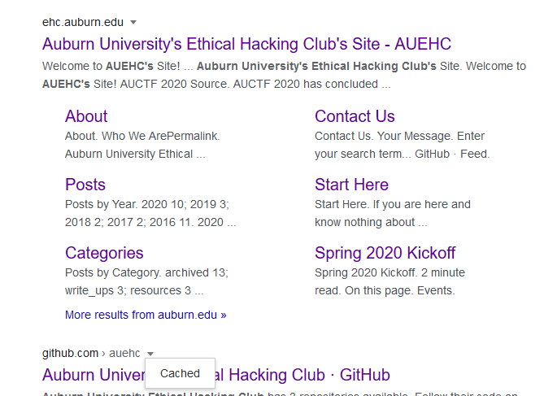
Old Web Pages
You can find information about websites by looking at the cached versions within search engines
Google, Bing, Yandex, Baidu Caches:
Load older versions of the website that google has cached

Slide 8
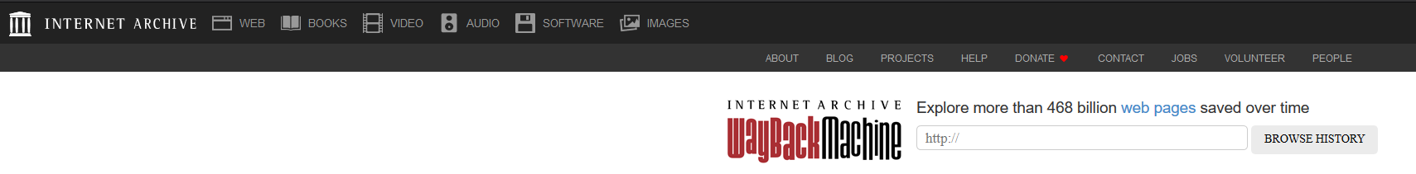
Old Web Pages
Search for archived web pages
The Wayback Machine
https://archive.org/web/

Slide 9
Domain Names
Domain Names are a simple way of resolving IP addresses so we don’t have to remember 4 octets of an IP address.
Tools
Dnsrecon
Dnserum
Host command
Shodan hostname: parameter
SSL Server Test
Rapid7 Open DNS records

Slide 10
Domain Names: Domain Registration
You can get additional information about who made the website, what servers they are running on, their IP address ranges, etc. Several websites are available to get this information, but there are also build in command line tools that are more effective.
Through whois lookups, you can easily get information about admins running the site:
viewdns.info/whois

Slide 11
Domain Names: past IP history
You can check the past IPs of a domain. This may be helpful in determining IPs that might have be involved in a previous crime, or servers under control by the target:
viewdns.info/iphistory

Slide 12
Domain Names: Finding Subdomains
Websites can have what are called subdomains which may be used to partition the functionality of a given website. These subdomains sometimes can be used for testing purposes, or to provide functionality to a specific group, perhaps the employees might want access to the ftp server.
Sometimes, these are hidden or made so that they are not crawled by web spiders (robots.txt).
Subdomains can be really juicy targets

Slide 13
Domain Names: Finding subdomains
A few websites are available for finding subdomains, one is Find Subdomains:
https://findsubdomains.com
Additionally there are MANY tools specifically made for this task, as a few are:
Sublist3r
SubBrute
DNSRecon

Slide 14
IP Addresses
It is public knowledge where an IP address is coming from and how exactly it may be hosted. For example, Auburn University may have a group of public facing IP addresses that utilize a specific Internet Service Provider like Spectrum or Comcast
Tools
Whois
Arin.net

Slide 15
Documents
Three categories of interest when dealing with documents:
Documents that contain information about the target
Documents that were created by the target
Documents with metadata that may indicate more about their origin

Slide 16
Documents
Finding Documents:
Use google and the points from ‘Google Dorking’ to find relevant files:
Xls, xlsx
Doc, docx
Pdf
Txt

Slide 17
Documents: places to look
It may be worth checking google/microsoft docs to see if permissions were messed up:
site:docs.google.com “document name”
Amazon web services, google Cloud:
site:amazonaws.com …
site:storage.googleapis.com …
Iterating over and looking through AWS buckets:
https://buckets.grayhatwarfare.com

Slide 18
Documents: metadata
Metadata can be found on documents and can be valuable for investigations. Metadata includes information like:
The name of the computer that made the document
The username associated with the creation of the document
Software versions used
And more

Slide 19
Documents: metadata
There are many sites that can pull the metadata from documents:
Extract Metadata: Extractmetadata.com
Jeffrey’s Viewer: exif.regex.info/exif.cgi
That being said, it’s often easier and safer to use a tool locally:
Exiftool: sno.phy.queensu.ca/~phil/exiftool -Windows/Linux
FOCA: www.elevenpaths.com/labstools/foca - Windows solution
Metagoofil - Linux solution

Slide 20
Images
Images can help you identify location, contacts, interests, and more.
There are several tools that can help find all of this information

Slide 21
Images: Reverse Image Lookups
You can use one of several search engines to run reverse image lookups on a provided images.
https://images.google.com
https://bing.com/images
https://images.yandex.com
https://graph.baidu.com
It is recommended to use more than one search engine when doing reverse image lookups.
Sometimes it helps to crop out irrelevant portions of an image to refine the search.

Slide 22
Images: Exif Data
Photos taken with digital cameras have metadata known as ‘exif data’. There are several tools available for viewing this information.
This information can be useful for sorting images, determining location for geotagging, etc. But it can also be useful to us.
You can scrub exif data from images fairly easily, and most social media websites do this for you on upload.
Tools: Jeffrey’s Exif Viewer: exif.regex.info/exif.cgi
Exiftool: sno.phy.queensu.ca/~phil/exiftool

Slide 23
Images: Exif Data - Locating Cameras
Some cameras leave a serial number in the exif data.
We can use the information from a photograph to get the serial number and then search for images posted to the internet using that same serial number to help locate the camera:
Tool: cameratrace.com/trace

Slide 24
Videos
Running reverse video searches is also entirely possible by dissecting the video into several still frames using something like amnesty (for youtube), or by hand
citizenevidence.amnestyusa.org
You MAY also be able to retrieve deleted videos from youtube using the wayback machine

Slide 25
Social Networks
Social Networks are a treasure trove of information for a threat actor. Common places to look would be linkedin, twitter, facebook, and instagram.
Tools
Social-searcher
Twofi
linkedin2username

Slide 26
People Searching
Finding People, or a collection of information based on a known name can be useful if you know other information about them (such as approximate age, where they live, etc). Several website are available for this kind of searching:
https://thatsthem.com/
https://truepeoplesearch.com
Pipl
Maltego
whitepages

Slide 27
Telephone Numbers
Finding carriers may help during an investigation (one can contact the provider) afterwards:
https://freecarrierlookup.com/
https://carrierlookup.com
Caller ID databases can help identify names (as well as other information) associated with a number:
twilio.com/lookup (requires account)
Opencnam.com (requires account)
Everyone API (requires account)
Whitepages

Slide 28
Telephone Numbers
Contact Exploitation:
Add the phone number to your contacts and then open a social media application and use ‘find my friends’.

Slide 29
Usernames
Checking if a username has been used for other services to see if you can find any more information about the user.
Websites:
Knowem.com
Checkusernames.com
CLI:
Sherlock
Theharvester - discovers emails which are commonly used as usernames too

Slide 30
In the Dumps
Data breaches and dumps can be valuable resources for information on a target. Has the email address they typically use been involved in a data breach? Check haveibeenpwned.
https://haveibeenpwned.com
Additional information can be found from data breaches, and a popular website that shares that information is dehashed. Dehashed also allows you to search by password, which you may be able to use to find private email addresses of a target
https://dehashed.com
https://intelx.io

Slide 31
Maps
Snapchat Maps: map.snapchat.com
Wikimapia, combines yahoo, bing, google maps into one: wikimapia.org
Mapillary, Street views: mapillary.com

Slide 32
Tools worth mentioning and learning
Recon-ng
Spiderfoot

Slide 33
Things not mentioned
LOTS of websites were not mentioned here. There are plenty of tools available for each of these different tasks. Many of them require accounts or money to use.
LOTS of tools were not mentioned here. There are plenty of tools that can do similar things to each of the websites mentioned.
Government and State public records. These are highly dependent on the target’s location (country, state, county, etc.) There are plenty of websites (free and paid) that allow you to look through public records to find out more on a target.
HTML parsing. Don’t be afraid to look into the HTML of a website to see if a developer might have left something behind.

Slide 34
Michael Bazzell
A lot of this material was inspired by or pulled from Macheal Bazzell’s book Open Source Intelligence Techniques. If you’re interested in learning more I would highly recommend it.
Thank you Mr. Bazzell!

Slide 35
What now
Beginning: https://www.sourcing.games/
Harder: https://hackthebox.eu/
Hardest: https://twitter.com/quiztime?lang=en
Our CTF Challenges

Slide 36
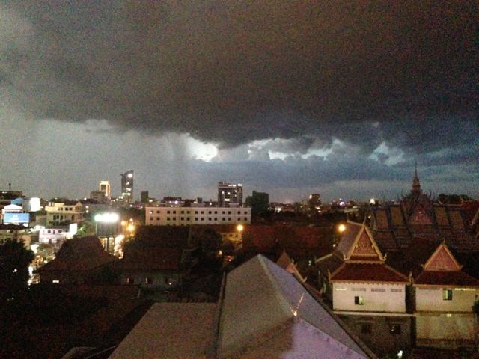
Quiztime Riddle
What is the name of the city?
Bonus: Can you pinpoint the exact location?
Quiztime on twitter:
https://twitter.com/bayer_julia/status/1292933118748434432?s=20

