Slide 1


SP2 Presentation
Using Emotion Word Intensities for Multi-label Emotion Detection of Text
Andrei Francis U. Enrique | Maria Art Antonette D. Clariño
21 May 2024

Slide 2

Sentiment & Emotion Analysis
Emotions
Background of the Study
Emotions are an active part of daily life, and can influence human perceptions, opinions, and decision making.
A wealth of textual data is present on the internet in many different forms. Sentiment analysis has been developed in large part to extract valuable insight from this freely accessible data.
Emotion Detection
Approaches
Meant to expand upon the usual tasks of sentiment analysis such as determining polarity and subjectivity, emotion detection is concerned with associating a body of text with a range of emotions.
Machine learning, and particularly deep learning-based approaches are currently the most accurate approaches to emotion detection. The use of lexicons and keyword lists are still popular for analysis of text.

Slide 3

Objectives
Use emotion word intensities to identify the emotions expressed by a body of text.
Specific Objective 1
Specific Objective 2
Specific Objective 3
Identify the relationship between the presence of emotion words in a body of text and the emotions expressed within said body of text
Determine the importance of emotion word intensities in relation to other features used to identify emotions in text.
Evaluate the performance of a machine learning model that uses emotion word intensities in classifying multi-labeled emotion data.

Slide 4
Dataset
Text | Labels
Well, I really put my foot in my mouth this time but, I don't know, I like you two. | 8, 3, 5
XED Dataset
Movie Subtitles
Annotated according to text’s association with emotions
Multilabeled and Multilingual
Emotion Values | Emotion Values | Emotion Values | Emotion Values
anger | 0 | joy | 1
anticipation | 0 | sadness | 0
disgust | 1 | surprise | 0
fear | 0 | trust | 1

Slide 5
Emotion Word Intensities
Derived from NRC Emotion Intensity Lexicon
Words scored according to their degree of association with one or more distinct emotion labels
Higher value indicates a stronger association
Word | Emotion | Score
elated | joy | 0.894
pleased | joy | 0.725
sweet | joy | 0.625
calm | joy | 0.394
silence | joy | 0.127

Slide 6






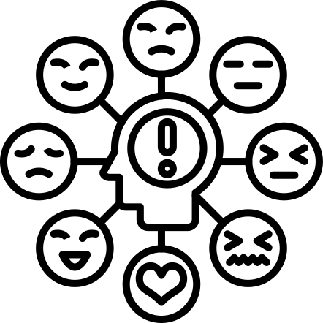
Training Dataset
Model Training
Text Preprocessing
Emotion Intensity Value & N-gram Extraction
Emotion Intensity Lexicon
Linear SVM
Model
Model Evaluation
& Comparison
Test Dataset
Methodology

Slide 7

Classification Model
Linear SVM
One-vs-rest strategy
Unigrams, bigrams, trigrams as baseline features
90:10 stratified train-test split
Image Source: https://www.analyticsvidhya.com/blog/2021/10/support-vector-machinessvm-a-complete-guide-for-beginners/

Slide 8
['we', 'must', 'protect', 'these', 'investments', 'so', 'the', 'area', 'can', 'continue', 'to', 'prosper', 'and', 'grow']
Feature Extraction
Emotion Word Intensities
continue | continue
anticipation | 0.414
trust | 0.422
prosper | prosper
anticipation | 0.578
joy | 0.562
grow | grow
anticipation | 0.555
joy | 0.242
trust | 0.492
text total | text total | text total | text total
anger | 0 | joy | 0.804
anticipation | 1.547 | sadness | 0
disgust | 0 | surprise | 0
fear | 0 | trust | 0.914

Slide 9
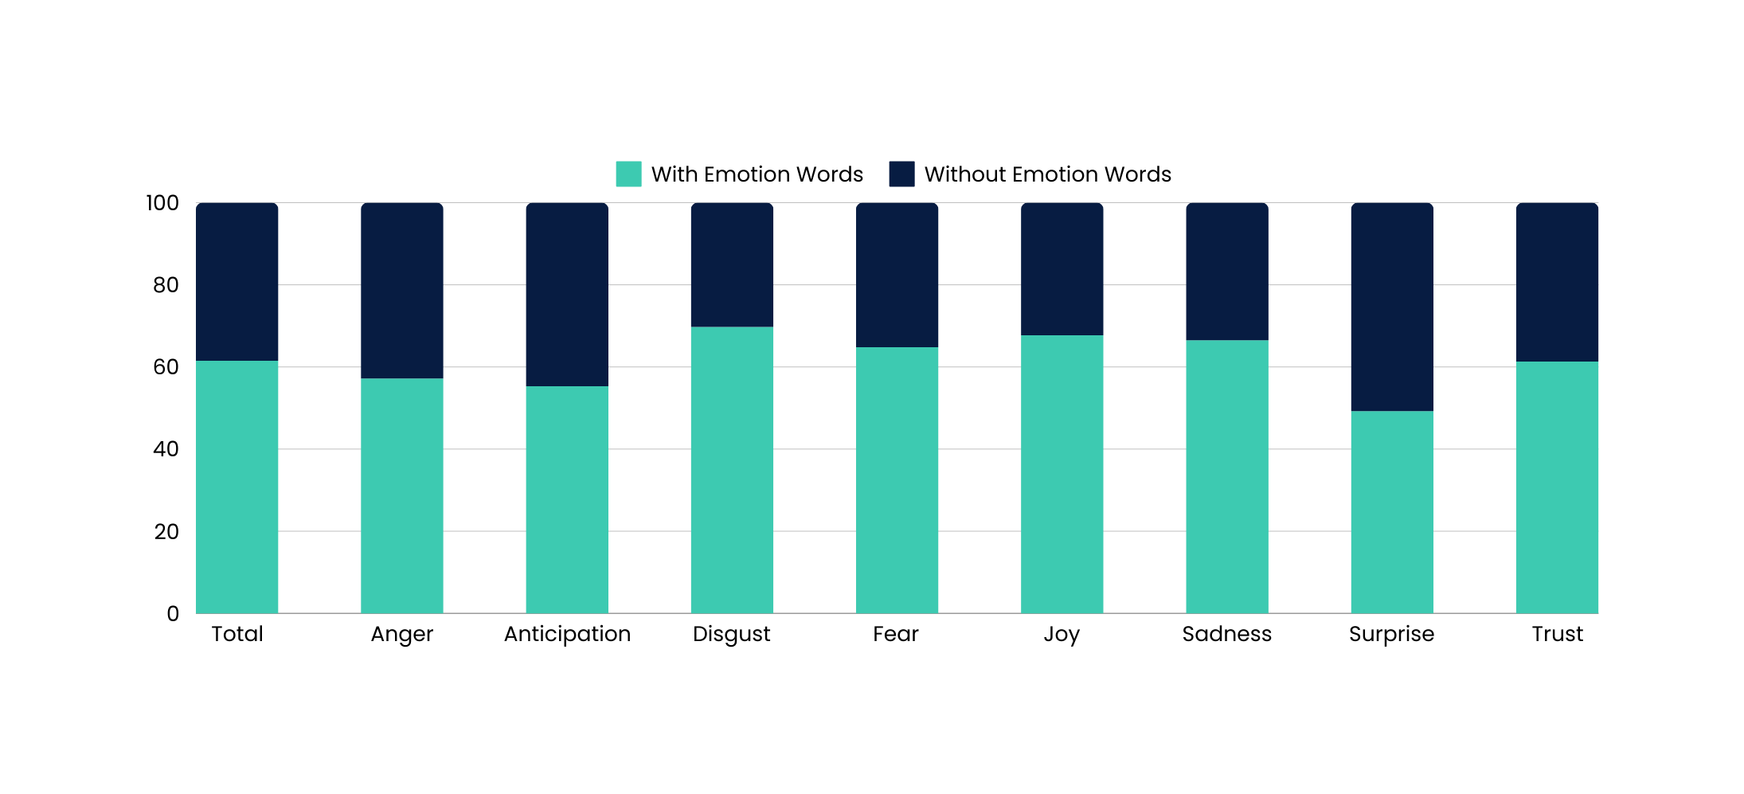
Percentage of Sentences with Emotion Words

Slide 10
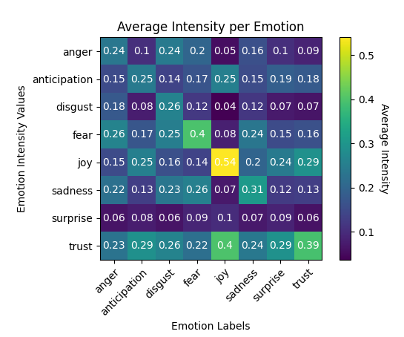
Average Emotion Intensity Values
Intensity values for Joy and Trust appear frequently across all labels
Intensity values for surprise are rarer
Intensity values generally appear most frequently in their respective emotion label

Slide 11
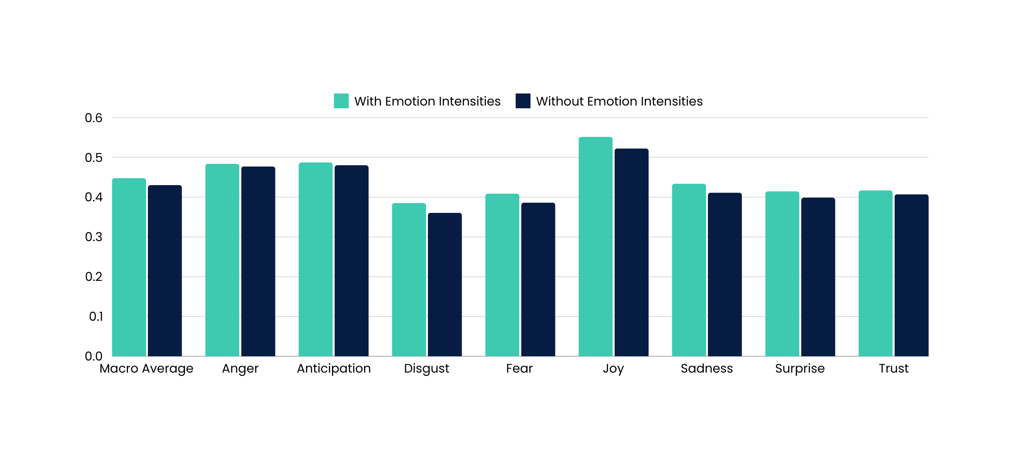
F1 Scores

Slide 12
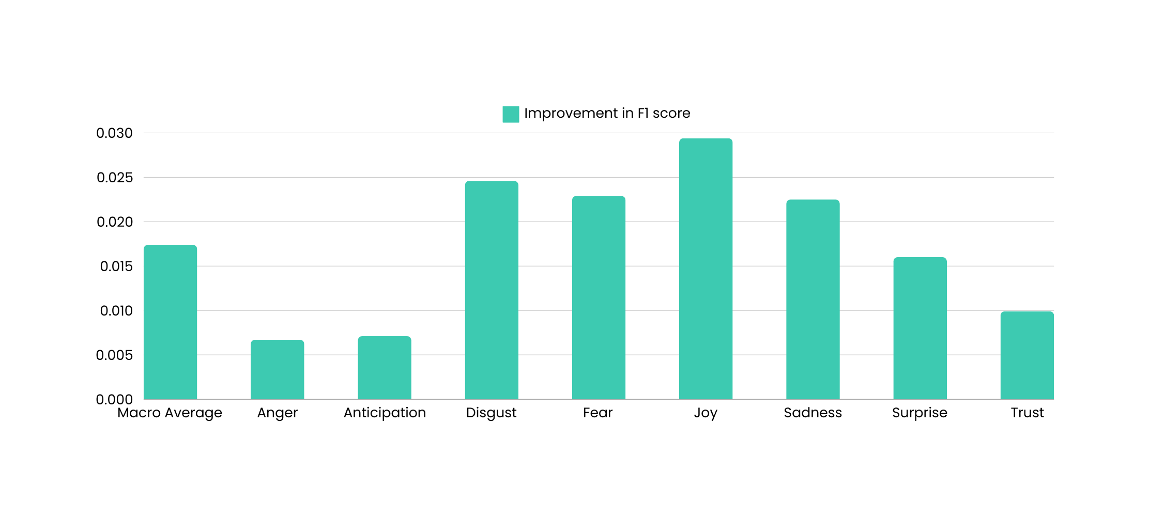
Score Improvement per Class

Slide 13
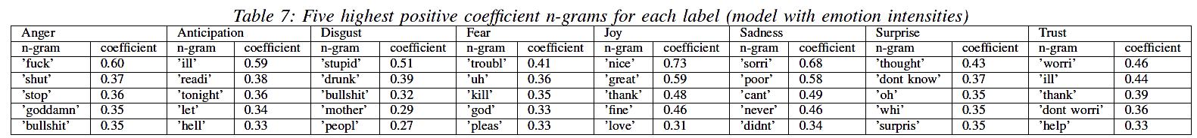
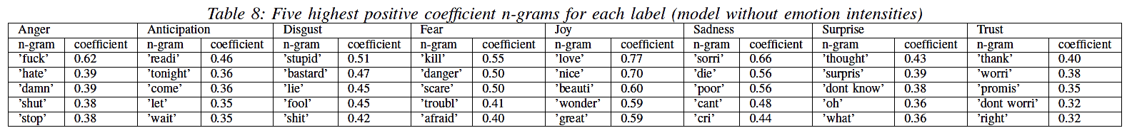
Feature Importance
N-grams

Slide 14
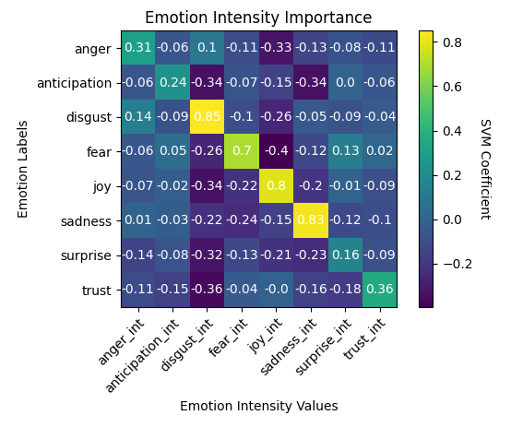
Feature Importance
Emotion Intensities

Slide 15
Statistical Significance
Class | T-statistic | p-value
Macro F1 | 6.7505 | 8.3601e−5
Anger | 1.9331 | 0.0852
Anticipation | 2.6758 | 0.0254
Disgust | 4.1034 | 0.0027
Fear | 3.0154 | 0.0146
Joy | 4.1379 | 0.0025
Sadness | 4.0615 | 0.0028
Surprise | 2.7542 | 0.0223
Trust | 2.2045 | 0.0549
Ten-fold stratified t-test
t-value - 2.262
p-value - 0.05
Statistically significant classes are highlighted in bold

Slide 16
Emotion Word Intensities
The addition of emotion word intensities was able to significantly improve the performance of the classification model.
Feature Importance
Intensity values for disgust, joy, sadness, and fear displayed very high correlation with their respective classes.
Classification Model
Conclusions
The Linear SVM classifier performed well at identifying sentences with joy; more work can be done in improving the identification of other classes.

Slide 17
Emotion Intensity Lexicon
An expanded emotion intensity lexicon can improve the performance of the classifcation model.
Grammar-based modifiers for Emotion Intensities
Derived emotion intensity values may be further influenced by positive adjectives or negative words.
Other Features of Interest
Recommendations
Emojis
Special characters
Figures of Speech

Slide 18
References
Alzoubi, H. M., & Aziz, R. (2021). Does emotional intelligence contribute to quality of strategic decisions? The mediating role of open innovation. Journal of Open Innovation: Technology, Market, and Complexity, 7(2), 130.
Kusal, S., Patil, S., Choudrie, J., Kotecha, K., Vora, D., & Pappas, I. (2022). A Review on Text-Based Emotion Detection--Techniques, Applications, Datasets, and Future Directions. arXiv preprint arXiv:2205.03235.
Hartmann, J., Huppertz, J., Schamp, C., & Heitmann, M. (2019). Comparing automated text classification methods. International Journal of Research in Marketing, 36(1), 20-38
Mohammad, S. M. (2017). Word affect intensities. arXiv preprint arXiv:1704.08798.
Öhman, E., Pàmies, M., Kajava, K., & Tiedemann, J. (2020). Xed: A multilingual dataset for sentiment analysis and emotion detection. arXiv preprint arXiv:2011.01612.

Slide 19
SP2 Presentation
Thank you for Listening
Andrei Francis Enrique
21 May 2024

