Slide 1
An Introduction to Computing and Problem Solving
Chapter 1
© 2016 Pearson Education, Ltd. All rights reserved.

Slide 2
Questions and Answers
1.1 An Introduction to Computing and Python
How do we communicate with the computer?
  Programming languages
How do we get computers to perform complicated tasks?
  Tasks are broken down into a sequence of instructions
Why Python?
  Powerful, easy to download, write and read
© 2016 Pearson Education, Ltd. All rights reserved.

Slide 3
Questions and Answers
How did the language Python get its name?
  Named for the British comedy group Monty Python (really!)
Book uses the editor IDLE to create programs. How did IDLE get its name?
  Stands for Integrated DeveLopment Environment
What is an interpreted language?
  Uses an interpreter, translates high-level language one statement at a time into machine language and then runs
© 2016 Pearson Education, Ltd. All rights reserved.

Slide 4
Questions and Answers
What are the meanings of the terms “programmer” and “user”?
  Programmer: a person who solves problems by writing programs on a computer
  User: any person who runs a program
What is the meaning of the term “code”?
  Python statements that the programmer writes
© 2016 Pearson Education, Ltd. All rights reserved.

Slide 5
Questions and Answers
Are there certain characteristics that all programs have in common?
  Input, processing, output
What are the meanings of the terms “hardware” and “software”?
  Hardware: physical components of the computer
  Software: the programs
© 2016 Pearson Education, Ltd. All rights reserved.

Slide 6
Questions and Answers
How are problems solved with a program?
  Step-by-step procedure devised to process given data and produce requested output.
What is a zero-based numbering system?
  Numbering begins with zero instead of one
Prerequisites to learning Python?
  Be familiar with how folders and files are managed
© 2016 Pearson Education, Ltd. All rights reserved.

Slide 7
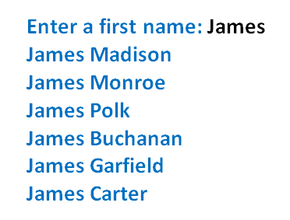
Questions and Answers
What is an example of a program developed in this textbook?
FIGURE 1.1 A possible output for a program in Chapter 3.
© 2016 Pearson Education, Ltd. All rights reserved.

Slide 8
Questions and Answers
How does the programmer create such a program?
  About ten lines of code that search a text file named USpres.txt and extract the requested names.
© 2016 Pearson Education, Ltd. All rights reserved.

Slide 9
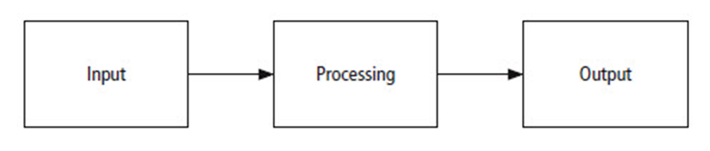
1.2 Program Development Cycle
FIGURE 1.2 The problem solving process.
© 2016 Pearson Education, Ltd. All rights reserved.

Slide 10
Program Planning
Analyze: Define the problem.
Design: Plan the solution to the problem.
Code: Translate the algorithm into a programming language.
Test and correct: Locate and remove any errors in the program.
Complete the documentation: Organize all the material that describes the program.
© 2016 Pearson Education, Ltd. All rights reserved.

Slide 11
1.3 Programming Tools
Algorithms
Flowcharts
Pseudocode
Hierarchy charts
© 2016 Pearson Education, Ltd. All rights reserved.

Slide 12
Algorithm Development
Algorithm to determine number of stamps for a letter
Rule of thumb: 1 stamp for every 5 sheets of paper
  Request sheets of paper
  Divide by 5
  Round quotient up to next whole number
  Reply with number of stamps
© 2016 Pearson Education, Ltd. All rights reserved.

Slide 13
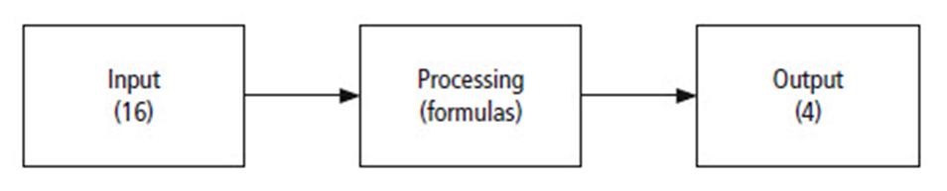
Problem Solving for Stamps
FIGURE 1.3 The problem solving process
for the stamp problem.
© 2016 Pearson Education, Ltd. All rights reserved.

Slide 14
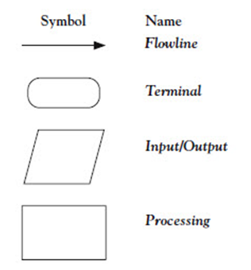
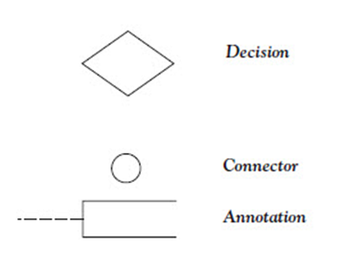
Flowcharts
© 2016 Pearson Education, Ltd. All rights reserved.

Slide 15
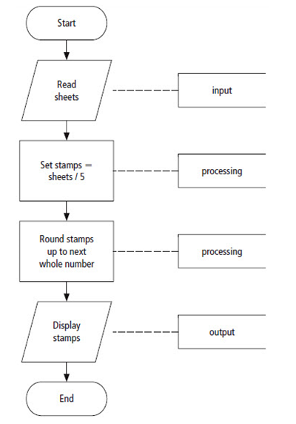
Example Flowchart
FIGURE 1.4 Flowchart for the postage-stamp problem.
© 2016 Pearson Education, Ltd. All rights reserved.

Slide 16
Pseudocode
Abbreviated plain English version of actual computer code
Symbols used in flowcharts replaced by English-like statements
Allows programmer to focus on steps required to solve problem
© 2016 Pearson Education, Ltd. All rights reserved.

Slide 17
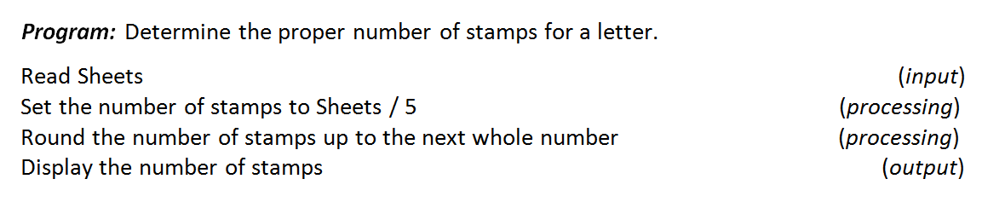
Example Pseudocode
import math
a = float(input('Sheets number = '))
b = a/5
r_b = math.ceil(b)
print('The number of stamps is ',r_b)
a = float(input('Sheets number = '))
b = a/5
r_b = round(b)
print('The number of stamps is ',r_b)
FIGURE 1.5 Pseudocode for the postage stamp problem.
© 2016 Pearson Education, Ltd. All rights reserved.

Slide 18
Hierarchy Chart
Shows the overall program structure
Depict organization of program, omit specific processing logic
Describe what each part, or module, of the program does
Each module subdivided into a succession of submodules
© 2016 Pearson Education, Ltd. All rights reserved.

Slide 19
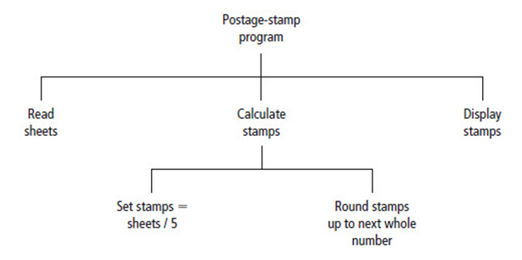
Example Hierarchy Chart
FIGURE 1.6 Hierarchy chart for the postage-stamp problem.
© 2016 Pearson Education, Ltd. All rights reserved.

Slide 20
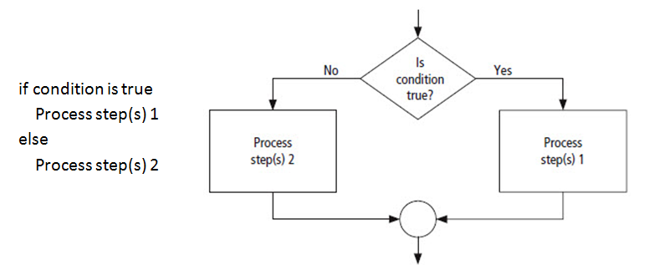
Decision Structure
FIGURE 1.7 Pseudocode and flowchart for a decision structure.
© 2016 Pearson Education, Ltd. All rights reserved.

Slide 21
Direction of Numbered
NYC Streets Algorithm
Problem: Given street number of one-way street in New York City, decide direction of street, either eastbound or westbound.
Discussion: There is a simple rule to tell the direction of a one-way street in New York City: Even-numbered streets run eastbound.
© 2016 Pearson Education, Ltd. All rights reserved.

Slide 22
Direction of Numbered
NYC Streets Algorithm
Input: Street number.
Processing: Decide if the street number is divisible by 2.
Output: “Eastbound” or “Westbound”.
© 2016 Pearson Education, Ltd. All rights reserved.

Slide 23
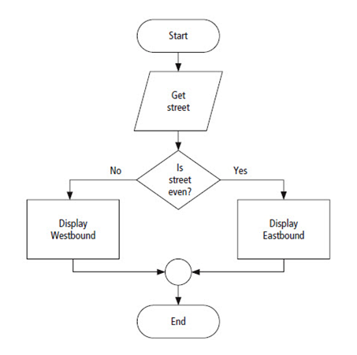
Direction of Streets Algorithm
FIGURE 1.8 Flowchart for the numbered
New York City streets problem.
© 2016 Pearson Education, Ltd. All rights reserved.

Slide 24
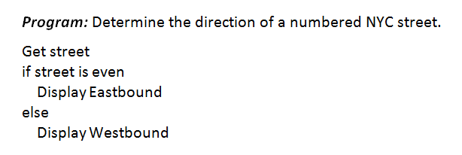
Direction of Streets Algorithm
s = float(input('Street number = '))
r = s % 2
if r != 0:
print('Westbound')
else:
print('Eastbound')
FIGURE 1.9 Pseudocode for the numbered
New York City streets problem.
© 2016 Pearson Education, Ltd. All rights reserved.

Slide 25
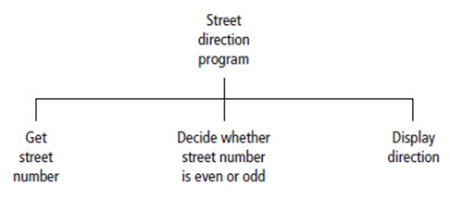
Direction of Streets Algorithm
FIGURE 1.10 Hierarchy chart for the numbered
New York City streets problem.
© 2016 Pearson Education, Ltd. All rights reserved.

Slide 26
Repetition Structure
A programming structure that executes instructions many times
  Repetition structure
  Looping structure
Need a test (or condition) to tell when the loop should end
  Check condition before each pass through loop
© 2016 Pearson Education, Ltd. All rights reserved.

Slide 27
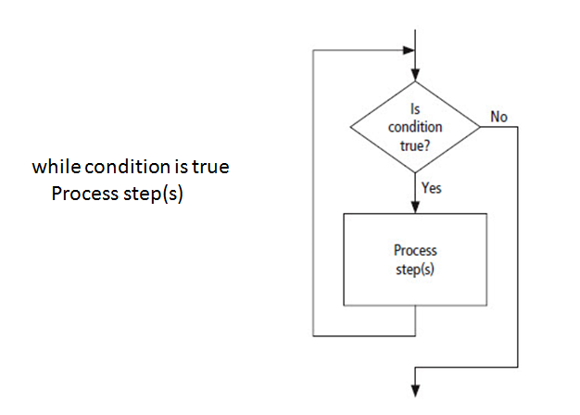
Direction of Streets Algorithm
FIGURE 1.11 Pseudocode and flowchart for a loop.
© 2016 Pearson Education, Ltd. All rights reserved.

Slide 28
Class Average Algorithm
Problem: Calculate and report the average grade for a class.
Discussion: Average grade equals sum of all grades divided by number of students.
  Need loop to read and then add (accumulate) grades for each student in class.
  Inside the loop, we also need to total (count) number of students in class.
© 2016 Pearson Education, Ltd. All rights reserved.

Slide 29
Class Average Algorithm
Input: Student grades.
Processing: Find the sum of the grades; count the number of students; calculate average grade = sum of grades / number of students.
Output: Average grade
© 2016 Pearson Education, Ltd. All rights reserved.

Slide 30
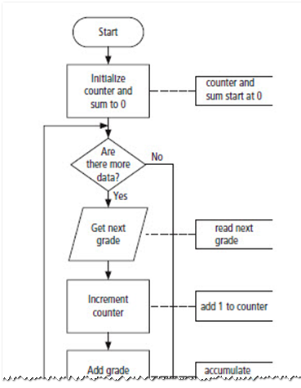
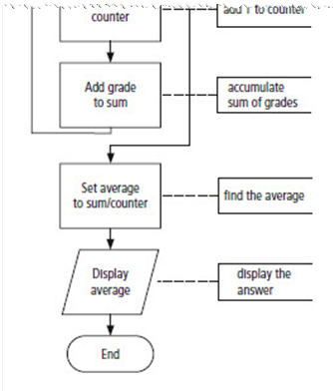
Class Average Algorithm
FIGURE 1.12 Flowchart for the class average problem.
© 2016 Pearson Education, Ltd. All rights reserved.

Slide 31
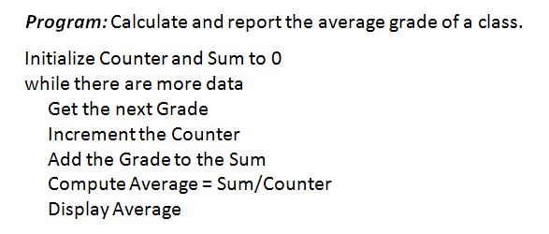
Class Average Algorithm
FIGURE 1.13 Pseudocode for the class average problem.
© 2016 Pearson Education, Ltd. All rights reserved.

Slide 32
#Enter 5 Grades
Grade1 = int(input('Enter score 1: '))
Grade2 = int(input('Enter score 2: '))
Grade3 = int(input('Enter score 3: '))
Grade4 = int(input('Enter score 4: '))
Grade5 = int(input('Enter score 5: '))
total =(Grade1 + Grade2 + Grade3 + Grade4 + Grade5)
Average = total/5
print("The average grade is: ", Average)
© 2016 Pearson Education, Ltd. All rights reserved.

Slide 33
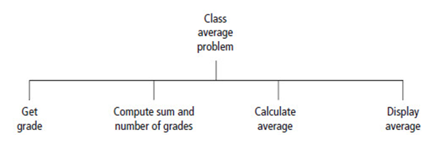
Class Average Algorithm
FIGURE 1.14 Hierarchy chart for the class average problem.
© 2016 Pearson Education, Ltd. All rights reserved.

Slide 34
End
Sections 1 - 3
Chapter 1
© 2016 Pearson Education, Ltd. All rights reserved.

