Slide 1
Strings
Section 2
Chapter 2
© 2016 Pearson Education, Ltd. All rights reserved.

Slide 2
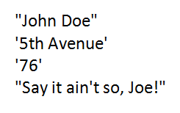
String Literals
Sequence of characters that is treated as a single item
Written as a sequence of characters surrounded by either single quotes (') or double quotes (").
Opening and closing quotation marks must be the same type- either both double quotes or both single quotes
© 2016 Pearson Education, Ltd. All rights reserved.

Slide 3
String Variables
Variables also can be assigned string values
Created (come into existence) the first time they appear in assignment statements
When an argument of a print statement
  Quotation marks not included in display
© 2016 Pearson Education, Ltd. All rights reserved.

Slide 4
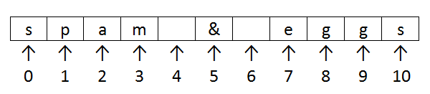
Indices and Slices
Position or index of a character in a string
  Identified with one of the numbers 0, 1, 2, 3, . . . .
FIGURE 2.4 Indices of the characters of
the string "spam & eggs".
© 2016 Pearson Education, Ltd. All rights reserved.

Slide 5
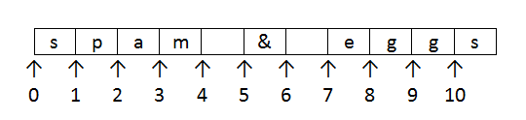
Indices and Slices
If str1 is a string, then str1[m:n] is the substring beginning at position m and ending at position n - 1
  Example “spam & eggs”[2:7]
FIGURE 2.5 Aid to visualizing slices.
© 2016 Pearson Education, Ltd. All rights reserved.

Slide 6
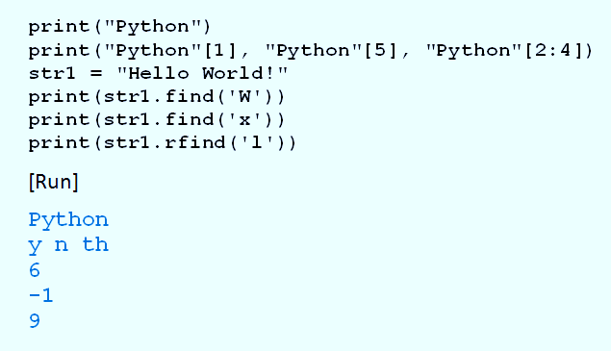
Indices and Slices
Example 1: Program shows use of indices
The rfind is the positive index of the first appearance from the right side.
© 2016 Pearson Education, Ltd. All rights reserved.

Slide 7
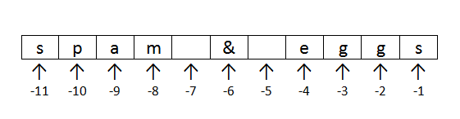
Negative Indices
Python allows strings to be indexed by their position with regards to the right
  Use negative numbers for indices.
FIGURE 2.6 Negative indices of the characters of
the string "spam & eggs".
© 2016 Pearson Education, Ltd. All rights reserved.

Slide 8
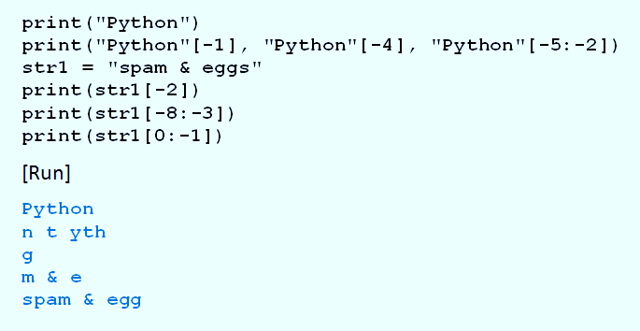
Negative Indices
Example 2: Program illustrates negative indices.
© 2016 Pearson Education, Ltd. All rights reserved.

Slide 9
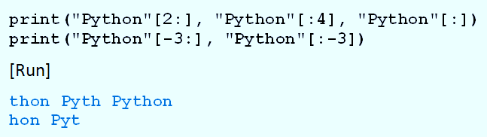
Default Bounds for Slices
Example 3: Program illustrates default bounds
© 2016 Pearson Education, Ltd. All rights reserved.

Slide 10
String Concatenation
Two strings can be combined to form a new string
  Consisting of the strings joined together
  Represented by a plus sign
Combination of strings, plus signs, functions, and methods can be evaluated
  Called a string expression
© 2016 Pearson Education, Ltd. All rights reserved.

Slide 11
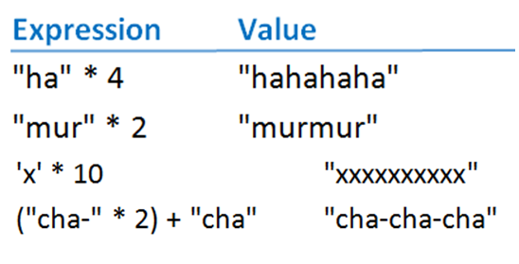
String Repetition
Asterisk operator can be used with strings to repeatedly concatenate a string with itself
© 2016 Pearson Education, Ltd. All rights reserved.

Slide 12
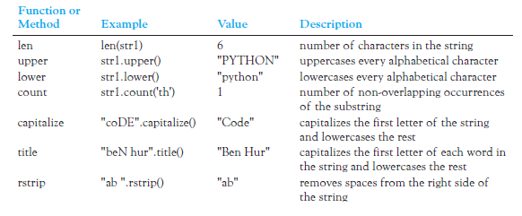
String Functions and Methods
Table 2.3 String Operations (str1 = "Python")
© 2016 Pearson Education, Ltd. All rights reserved.

Slide 13

Chained Methods
Lines can be combined into a single line said to chain the two methods
  Executed from left to right
© 2016 Pearson Education, Ltd. All rights reserved.

Slide 14
The input Function
Prompts the user to enter data
  User types response, presses ENTER key
  Entry assigned to variable on left
© 2016 Pearson Education, Ltd. All rights reserved.

Slide 15
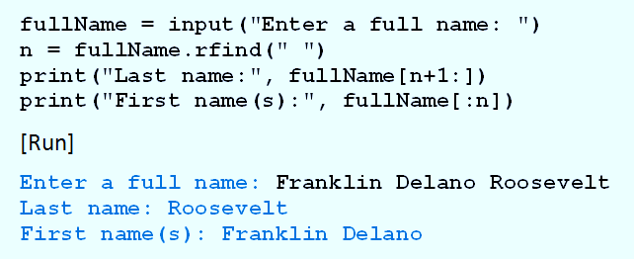
The input Function
Example 4: Program parses a name
© 2016 Pearson Education, Ltd. All rights reserved.

Slide 16
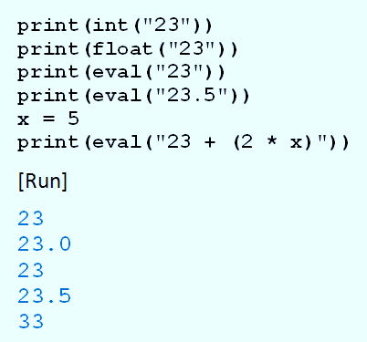
More String Functions
Example 5:
Program
shows use
of int, float,
and eval
functions
© 2016 Pearson Education, Ltd. All rights reserved.

Slide 17
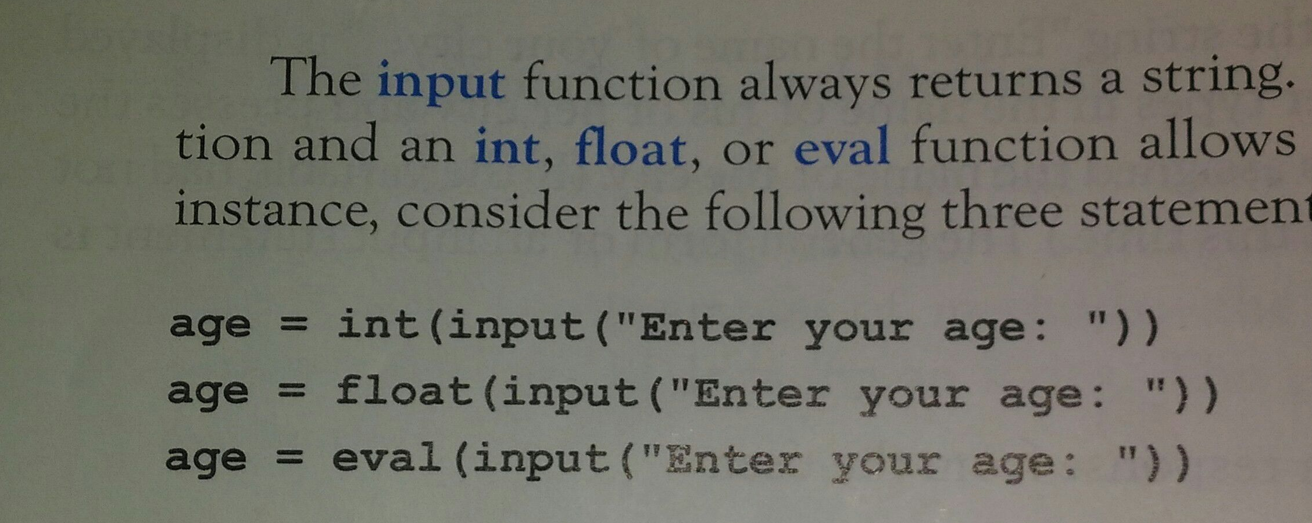
Please see page 56
© 2016 Pearson Education, Ltd. All rights reserved.

Slide 18
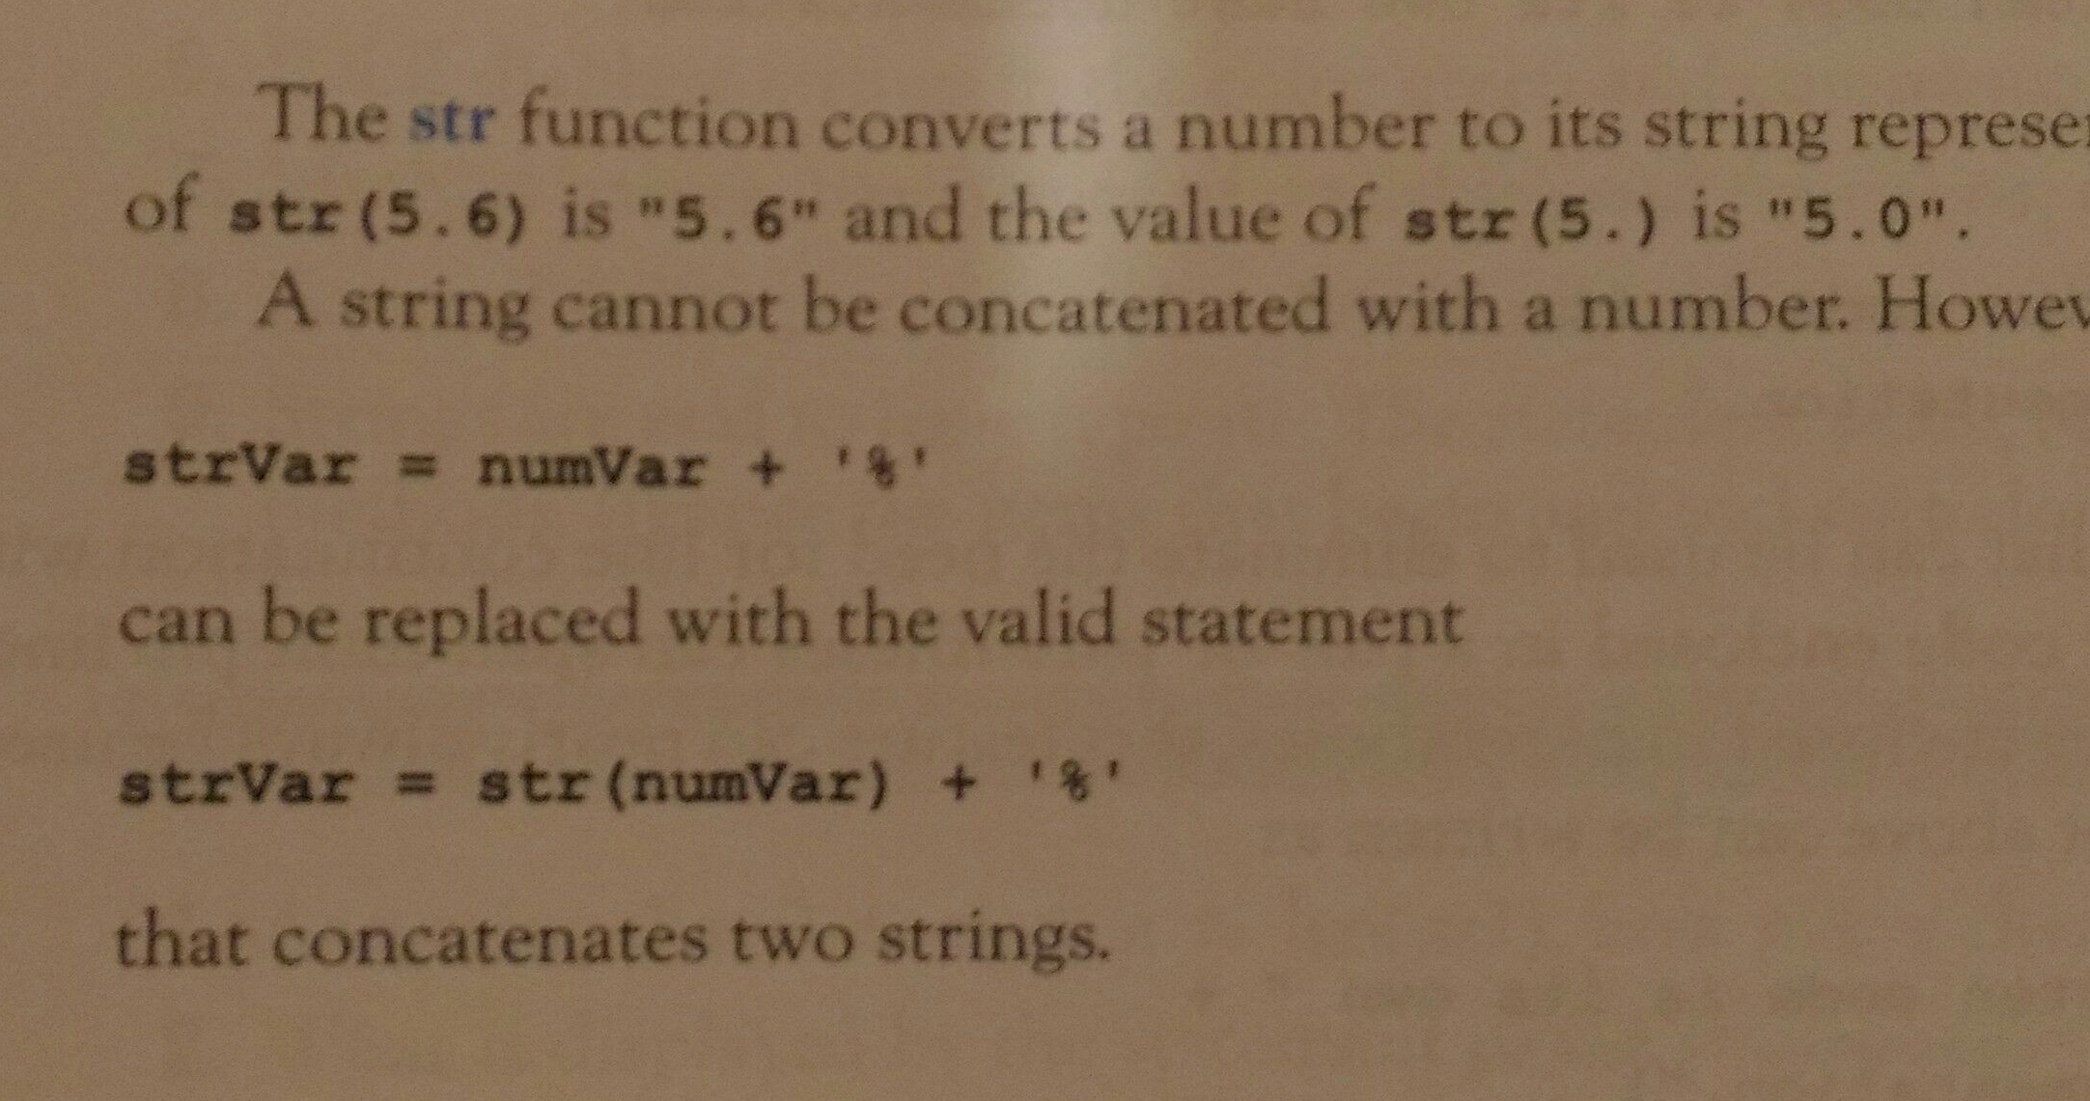
String Functions with Numbers
The str function converts a number to its string representation
© 2016 Pearson Education, Ltd. All rights reserved.

Slide 19
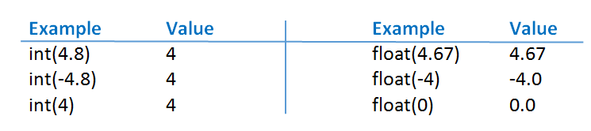
Int and float work with Numbers
-
© 2016 Pearson Education, Ltd. All rights reserved.

Slide 20
Internal Documentation
Benefits of documentation
Other people easily understand program.
You can better understand program when you read it later.
Long programs are easier to read
  Purposes of individual pieces can be determined at a glance.
© 2016 Pearson Education, Ltd. All rights reserved.

Slide 21
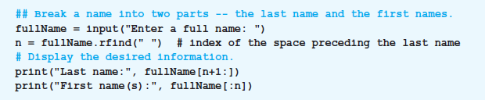
Internal Documentation
Example 6: Program shows use of documentation.
© 2016 Pearson Education, Ltd. All rights reserved.

Slide 22

Line Continuation
A long statement can be split across two or more lines
e.g., quotation = “Well written code is its own best documentation.”
  End each line with backslash character ( \ )
e.g., quotation = “Well written code is its own” + \
“ best documentation.”
Alternatively any code enclosed in a pair of parentheses can span multiple lines.
  This is preferred style for most Python programmers
© 2016 Pearson Education, Ltd. All rights reserved.

Slide 23
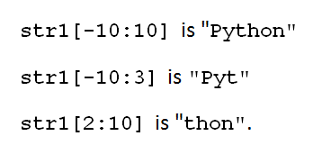
Indexing and Slicing Out of Bounds
Python does not allow out of bounds indexing for individual characters of strings
  Does allow out of bounds indices for slices
Given: str1 = “Python”
  Then print(str1[7]) print(str1[-7])
  These are OK
© 2016 Pearson Education, Ltd. All rights reserved.

Slide 24
Section 2.2
Practice and Homework at Pages 62~65)
Practice: No. 94, 98, 100, 101, and 102
Homework: No. 104, 105, 106, 108, and 112
© 2016 Pearson Education, Ltd. All rights reserved.

Slide 25
End
Section 2
Chapter 2
© 2016 Pearson Education, Ltd. All rights reserved.

